Slide 1
Unit Testing with JUnit
(being revised)

Slide 2
Many Levels of Software Testing
Software testing is critical!
Testing the specification
Unit Testing - test one class
Integration Testing - test components and application
Acceptance Testing
Usability Testing
...

Slide 3
Why Test?
1. Saves time!
  Testing is faster than fixing "bugs".
2. Testing finds more errors than debugging.
3. Prevent re-introduction of old errors (regression errors).
  Programmers often recreate an error (that was already fixed) when they modify code.
4. Validate software: does it match the specification?

Slide 4
Psychological Advantage
Makes you focus on current tasks.
  Test-driven development:
  write tests first ... what the code should do.
  Then write code that passes the tests
Increase satisfaction.
Confidence to make changes.

Slide 5
Testing is part of development
Agile Development philosophy
Test early.
Test continually!
Design
Test
Code
Test
Code
Test
Design
Test
Code
When To Test?
- Test while you are writing the source code
- Retest whenever you modify the source code

Slide 6
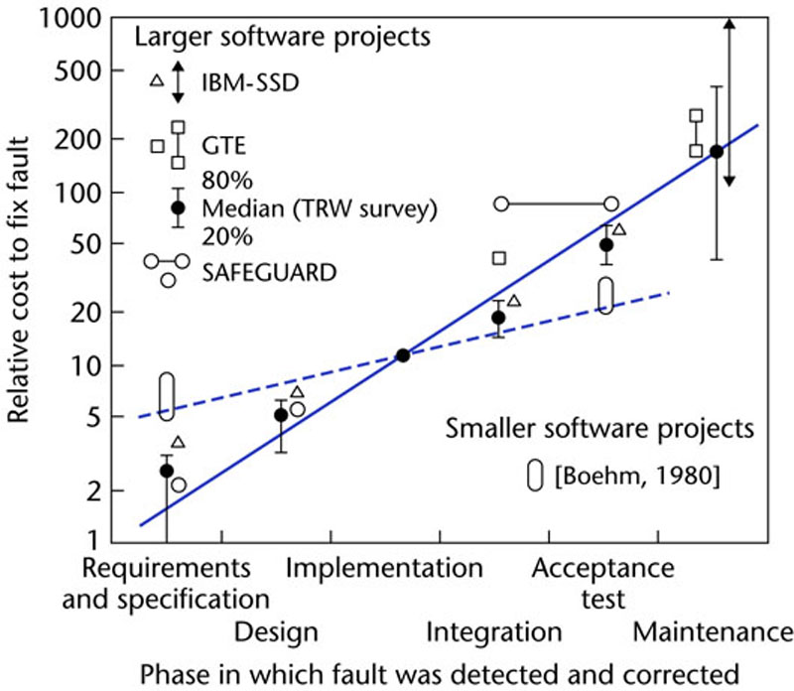
The Cost of Fixing Defects
Discover & fix a defect early is much cheaper (100X) than to fix it after code is integrated.
Figure 1.5

Slide 7
An Example
A Coin Purse holds coins.
It has a capacity that is fixed when the purse is created.
  capacity is the number of coins (any type) that purse can hold
You can insert and withdraw coins within capacity.
Purse
+ Purse( capacity )
+ getCapacity( ) : int
+ getBalance( ) : int
+ isFull( ) : boolean
+ insert( Coin ) : boolean
+ withdraw( amount ) : Coin[*]
+ count( ) : int
insert returns true if coin is inserted.

Slide 8
Writing Test Code from Scratch
Purse purse = new Purse(2); // can hold 2 coins
// test insert and isFull methods
boolean result = purse.insert( new Coin( 10 ) );
if ( ! result ) out.println("ERROR: insert failed");
if ( purse.isFull() )
out.println("ERROR: full");
balance = purse.getBalance( );
if ( balance != 10 )
out.println("ERROR: balance is wrong" );
if ( purse.withdraw(5) != null )
out.println("ERROR: withdraw is wrong");
if ( purse.withdraw(10) == null )
out.println("ERROR: couldn't withdraw 10 Baht");

Slide 9
Too Much Coding!
A lot of code for a simple test.
Would you write these tests for a real application?
No way.

Slide 10
Insight: Factor out Common Code
The test code is mostly redundant "boiler plate" code.
Automate the redundant code.
Create a tool to perform tests and manage output.

Slide 11
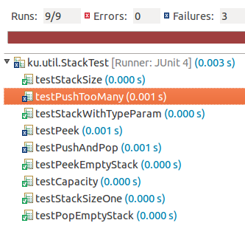
JUnit does it!
public class StackTest {
@Test
public void testStackSize( ) {
...
}
@Test
public void testPeek() {
...
}
@Test
public void testPushAndPop() {
...
}

Slide 12
Some Simple Tests
import org.junit.Test;
import org.junit.Assert;
public class SimpleTest {
@Test
public void testAddition( ) {
Assert.assertEquals( 2, 1+1 );
}
@Test
public void testSqrt() {
Assert.assertEquals(5.0, Math.sqrt(25),1.0E-12);
}
@Test
public void testPi() {
Assert.assertTrue( Math.PI < 3.15 );
}

Slide 13
Structure of a Test Class
Class in Your Project Test Class
public class Purse {
/** create coin purse */
public Purse(int capacity) {
...
}
/** insert coins */
public boolean insert(
int tens, int fives, int ones){
...
}
/** get value of purse */
public int getBalance( ) {
...
}
public class PurseTest {
@Test
public void testPurse( ) {
// test the constructor
}
@Test
public void testInsert() {
// test insert method
}
@Test
public void testGetBalance( ) {
// test balance method
}

Slide 14
Example: test the Math class
import org.junit.*;
public MathTest {
@Test // @Test identifies a test method
public void testMax( ) { // any public void method name
Assert.assertEquals( 7, Math.max(3, 7) );
Assert.assertEquals( 14, Math.max(14, -15) );
}
JUnit test methods are in the Assert class.
assertEquals(expected, actual )
assertTrue( expression )
assertSame( obja, objb )
actual
result
expected
result

Slide 15
Example: test the Purse constructor
import org.junit.*;
public PurseTest {
/** test the constructor */
@Test
public void testPurseConstructor( ) {
Purse p = new Purse( 10 ); // capacity 10
Assert.assertEquals("Purse should be empty", 0, p.count() );
Assert.assertEquals("Capacity should be 10", 10, p.getCapacity() );
Assert.assertFalse( p.isFull() );
}

Slide 16
What can you Assert ?
JUnit Assert class provides many assert methods
Assert.assertTrue( 2*2 == 4 );
Assert.assertFalse( "Stupid Slogan", 1+1 == 3 );
Assert.assertEquals( new Double(2), new Double(2));
Assert.assertNotEquals( 1, 2 );
Assert.assertSame( "Yes", "Yes" ); // same object
Assert.assertNotSame("Yes", new String("Yes") );
double[] a = { 1, 2, 3 };
double[] b = Arrays.copyOf( a, 3 );
Assert.assertArrayEquals( a, b );
Assert.assertThat( patternMatcher, actualValue );

Slide 17
Floating Point Tests have a tolerance
static final double TOL = 1.0E-8; // tolerance
@Test
public void testMath( ) {
Assert.assertEquals(
1.414213562, Math.sqrt(2), TOL );
}
tolerance for floating point comparison
Comparison of floating point values should include a tolerance for comparison. Test passes if
| expected - actual | <= tolerance

Slide 18
Use import static Assert.*
Tests almost always use static Assert methods:
@Test
public void testInsert( ) {
Assert.assertTrue( 1+1 == 2 );
Use "import static" to reduce typing:
import static org.junit.Assert.*;
public class StupidTest {
@Test
public void testInsert( ) {
assertTrue( 1+1 == 2 );

Slide 19
Test Methods are Overloaded
Assert.assertEquals is overloaded (many param. types)
assertEquals( expected, actual );
assertEquals( "Error message", expected, actual );
can be any primitive data type or String or Object
assertEquals can compare any values. It uses the class's equals( ) method.
assertEquals( 10, 2*5 );
assertEquals( "YES", "yes".toUpperCase() );
assertArrayEquals( int[]{1,2,3}, array );

Slide 20
assertEquals and assertSame
assertSame tests if two values refer to the same object. Like writing a == b in Java.
Object x = "test";
list.add( x );
assertSame( x, list.get(list.size()-1) );

Slide 21
test insertCoin method
import org.junit.*;
import static org.junit.Assert.* ;
public PurseTest {
@Test
public void insertCoins() {
Purse purse = new Purse( 2 );
assertTrue("Couldn't add coin!", p.insertCoin( new Coin( 2 ) );
assertEquals( 2, purse.getBalance( ) );
assertFalse( purse.isFull( ) );
assertTrue("Couldn't add note!", p.insertCoin(new BankNote(50) );
assertEquals( 52, purse.getBalance( ) );
assertTrue( purse.isFull( ) );
Import all static methods from the Assert class.

Slide 22
Running JUnit 4
1. Use Eclipse, Netbeans, or BlueJ (easiest)
Eclipse, Netbeans, and BlueJ include JUnit.
2. Run JUnit from command line.
CLASSPATH=c:/lib/junit4.1/junit-4.1.jar;.
java org.junit.runner.JUnitCore PurseTest
3. Use Ant (automatic build and test tool)

Slide 23
JUnit 4 uses Annotations
JUnit 4 uses annotations to identify methods
@Test a test method
@Before a method to run before each test
@After a method to run after each test
@BeforeClass method to run one time before testing starts

Slide 24
Before and After methods
@Before indicates a method to run before each test
@After indicates a method to run after each test
public PurseTest {
private Purse purse;
@Before
public void runBeforeTest( ) { purse = new Purse( 10 ); }
@After
public void runAfterTest( ) { purse = null; }
@Test public void testPurse( ) {
Assert.assertEquals( 0, purse.count() );
Assert.assertEquals( 10, purse.capacity() );
}
Create Test fixture
before each test.

Slide 25
@Before (setUp) and @After (tearDown)
@Before - method that is run before every test case.
  setUp( ) is the traditional name.
@After - method that is run after every test case.
  tearDown( ) is the traditional name.
setUp( )
setUp( )
testFun1( )
one test case
testFun2( )
another test
tearDown( )
tearDown( )

Slide 26
Why use @Before and @After ?
You want a clean test environment for each test.
This is called a test fixture. Use @Before to initialize a test fixture. Use @After to clean up.
private File file; // fixture for tests writing a local file
@Before
public void setUp( ) {
file = new File( "/tmp/tempfile" );
}
@After
public void tearDown( ) {
if ( file.exists() ) file.delete();
}

Slide 27
Testing for an Exception
you can indicate that a test should throw an exception.
List should throw IndexOutOfBoundsException if you go beyond the end of the list.
// this test should throw an Exception
@Test( expected=IndexOutOfBoundsException.class )
public void testIndexTooLarge() {
List list = new ArrayList();
list.add( "foo" );
list.get( 1 ); // no such element!
}

Slide 28
Valid Arguments
If an argument is invalid, Coin throws IllegalArgument Exception
// this test should throw an Exception
@Test( expected=IllegalArgumentException.class )
public void testRejectBadCoins() {
Coin coin = new Coin(-1);
}

Slide 29
Limit the Execution Time
specify a time limit (milliseconds) for a test
this test fails if it takes more than 500 milliseconds
// this test must finish in less than 500 millisec
@Test( timeout=500 )
public void testWithdraw() {
// test fixture already created using @Before
// method, and inserted coins, too
double balance = purse.getBalance();
assertNotNull( purse.withdraw( balance-1 ) );
}

Slide 30
fail!
Signal that a test has failed:
@Test
public void testWithdrawStrategy() {
//TODO write this test
fail( "Test not implemented yet" );
}

Slide 31
What to Test?
Test BEHAVIOR not just methods.
May have MANY TESTS for one method.
One test may involve several methods.

Slide 32
Designing Tests
"edge" cases:
  a Purse with capacity 0 or 1
  if capacity is 2, can you insert 1, 2, or 3 coins?
typical cases:
  some withdraw that should succeed: 1 Baht
  can you withdraw exactly the amount in the purse?
  some withdraws that should fail.

Slide 33
Designing Tests
impossible cases:
  can you withdraw negative amount?
  can you withdraw balance+1 ?
  can you withdraw Double.INFINITY ?

Slide 34
Organize Your Test Code
Create a separate source tree named "test" for tests
  avoid mixing application classes and test classes
coinpurse/
src/purse/
Purse.java
Coin.java
test/purse/
PurseTest.java
CoinTest.java

Slide 35
Designing Tests
typical cases
  Purse capacity 5. Insert many different coins.
  When you withdraw, do coins match what you inserted?

Slide 36
Example: Purse
Test behavior ... not just methods
  "can I insert same coin twice?"
  "can I withdraw all the money?"
  "does withdraw always exactly match what I requested?"

Slide 37
Questions about JUnit 4
Why use:
import static org.junit.Assert.*;
How do you test if Math.sin(Math.PI/2) is 1 ???
assertEquals( 1.0, Math.sin(Math.PI/2), 1.0E-14 );
How do you test if a String named str is null ???
String str;
assertNotNull( str ); or assertTrue( str == null );

Slide 38
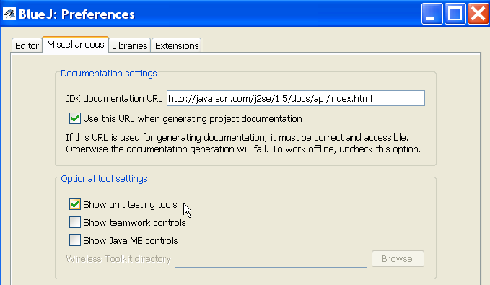
Using JUnit in BlueJ
1. From "Tools" menu select "Preferences..."
2. Select "Miscellaneous" tab.
3. Select "Show unit testing tools".

Slide 39
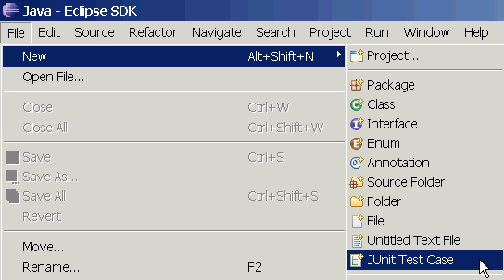
Using JUnit in Eclipse
Eclipse includes JUnit 3.8 and 4.x libraries
  you should use Junit 4 on your projects
eclipse will manage running of tests.
  but, you can write your own test running in the main method
Select a source file to test and then...

Slide 40
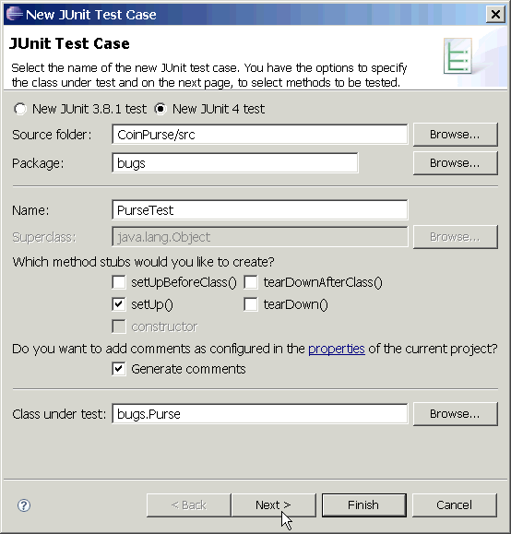
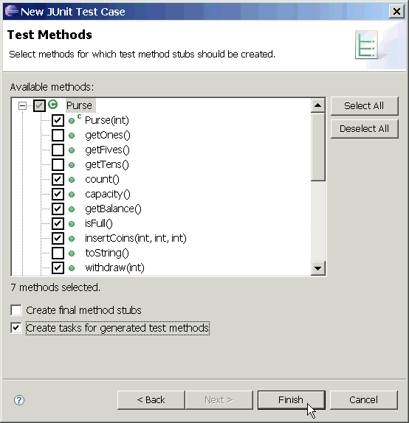
Using JUnit in Eclipse (2)
Select test options and methods to test.

Slide 41
Using JUnit in Eclipse (3)
/** Test of the Purse class
* @author James Brucker
*/
public class PurseTest {
private Purse purse;
private static final int CAPACITY = 10;
/** create a new purse before each test */
@Before
public void setUp() throws Exception {
purse = new Purse( CAPACITY );
}
@Test
public void testCapacity() {
assertEquals("capacity wrong",
CAPACITY, purse.capacity());
}
Write your test cases.
Eclipse can't help much with this.

Slide 42
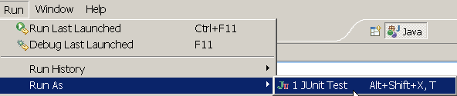
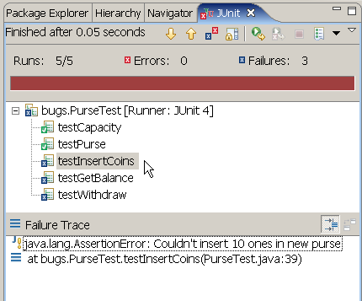
Run JUnit in Eclipse (4)
Select the JUnit test case file and choose
Run => Run As => JUnit Test
Results appear in a new JUnit tab.
Click on any result for details and to go to the source code.

Slide 43
References
JUnit Home
http://www.junit.org
JUnit Software & documentation
http://www.sf.net/projects/junit
  Eclipse & Netbeans include Junit, but you still need to install JUnit to get documentation

Slide 44
Quick Starts
JUnit 4 in 60 Seconds
  http://www.cavdar.net/2008/07/21/junit-4-in-60-seconds/
JUnit Tutorial by Lars Vogel
  includes how to use JUnit in Eclipse.
  http://www.vogella.de/articles/JUnit/article.html
JUnit 4 in 10 Minutes
  on JUnit web site

Slide 45
Other Software for Testing
TestNG - a better JUnit
http://www.testng.org
NUnit - Unit testing for .Net Applications
http://www.nunit.org

Slide 46
JUnit 3.x
JUnit 3.x is obsolete
But existing software still uses JUnit 3.x, so it is useful to know how to read JUnit 3 tests.
For new code, use the current version of JUnit.

Slide 47
Structure of a JUnit 4 Test Class
import org.junit.*; // package org.junit
import static org.junit.Assert.*;
public PurseTest { // don't extend TestCase
Purse purse;
/**test insert coins */
@Test // use @Test annotation for tests
public void testInsertCoins() { // any method name is OK
Purse p = new Purse( 1 );
boolean result = p.insertCoin( new Coin( 5 ) );
assertTrue("Couldn't insert coins!", result );
assertFalse( p.insertCoin( new Coin(1) ); // should be full
assertEquals( 5.0, p.getBalance( ), 0.001 );
}
@Before
public void initialize( ) { // any method name is OK
purse = new Purse( 10 ); // capacity 10
}

Slide 48
Structure of a JUnit 3 Test Class
import junit.framework.*; // package junit.framework
import static junit.framework.Assert.*;
public PurseTest extends TestCase { // must extend TestCase
Purse purse;
// No annotations
public void testInsertCoins() { // names must begin with "test"
Purse p = new Purse( 1 );
boolean result = p.insertCoin( new Coin( 5 ) );
assertTrue("Couldn't insert coins!", result );
assertFalse( p.insertCoin( new Coin(1) );
assertEquals( 5.0, p.getBalance(), 0.001 );
}
// no @Before annotation
protected void setUp( ) { // setUp method must use this name
purse = new Purse( 10 ); // capacity 10
}

Slide 49
Key Points in Using JUnit 3.x
Test class "extends TestCase"
JUnit package is junit.framework
import junit.framework.*;
Import static methods:
import static junit.framework.Assert.*;
Must use the naming convention:
public void testGetBalance( ) { ... }
protected void setUp( ) { ... }
protected void tearDown( ) { ... }
no annotations (@Before, @After, @Test ...)

Slide 50
JUnit 3 Test Suite
For JUnit 3.x your need a method & a constructor:
  PurseTest( string ) constructor calls super( string )
  suite( ) creates a test suite
import junit.framework.*;
public PurseTest extends TestCase {
public PurseTest( String testmethod ) {
super( testmethod );
}
/** create a test suite automatically */
public static Test suite( ) {
TestSuite suite = new TestSuite( PurseTest.class );
return suite;
}
}
This is standard form of the constructor; just copy it

Slide 51
Compiling and Running Tests
You invoke a JUnit TestRunner to run your test suite.
JUnit 3.8 provides 3 test runners:
  junit.textui.TestRunner - console test runner
  junit.awtui.TestRunner - graphical using AWT
  junit.swingui.TestRunnger - graphical using Swing
> set CLASSPATH = /java/junit3.8.2/junit.jar;.
> javac PurseTest.java
> java junit.swingui.TestRunner PurseTest
Name of your test class as arg.

Slide 52
Another Way to Run Tests
Call test runner from your class's main method
  don't need to invoke junit.*.TestRunner on cmd line
public PurseTest extends TestCase {
...
public static void main( String [] args ) {
junit.swingui.TestRunner.run( PurseTest.class );
}
> set CLASSPATH = /java/junit3.8.2/junit.jar;.
> javac PurseTest.java
> java PurseTest
Name of your test class as arg.

Slide 53
Selecting Tests to Run: TestSuite
In the example we created a TestSuite using:
public static Test suite( ) {
TestSuite suite = new TestSuite( PurseTest.class );
return suite;
}
JUnit uses reflection to locate all methods named "test*".
or can specify only the tests you want to run
only run these test methods
/** create a custom test suite */
public static Test suite( ) {
TestSuite suite = new TestSuite( );
suite.addTest( new PurseTest( "testPurse" ) ); // test the constructor
suite.addTest( new PurseTest( "testInsertCoins") ); // insert coins
return suite;
}

Slide 54
JUnit 3 Adaptor for JUnit 4 test class
You can run JUnit 3 test cases using JUnit 4 ...
import org.junit.Test;
import static org.junit.Assert.*;
// import adaptor for JUnit 3
import junit.framework.JUnit4TestAdaptor;
public PurseTest { // don't extend TestCase
/* JUnit 3 calls suite( ) to get a test suite */
public static junit.framework.Test suite( ) {
return new JUnit4TestAdaptor( PurseTest.class );
}
@Test
... rest of the JUnit 4 tests ...

Slide 55
Questions about JUnit 3
What are the 2 forms of every assert( )?
Why use:
import static junit.framework.Assert.*;
What is the name of ...
  the test class for "class LineItem" ?
  your test class extends what other class?
  the test method for the LineItem constructor?
  the test method for the getItemID() method?

