Slide 1
Week 15 Meeting
Online Slides
https://docs.google.com/presentation/d/1WZcFmH_kz3o0v-sT4bQBAEbQNNOlD0_tKj2UZiF7oEI/edit

Slide 2
Topics
TA Meeting this Week
English
Java in VS Code
PA4 - Only 11 Proposals
Assignment: Video Settings
Exercises & Review

Slide 3
TA Meeting
Schedule another online meeting with T.A. or instructor.
Between now & Final exam.
Purpose is to discuss work on your PA4 project.
Don't ask "what's on the exam?" -- TA's don't know.

Slide 4
English
Mass Noun
A noun describing something that cannot be counted, e.g. a substance.
Examples
sand
"There is sand at the beach"
not "There are sands at the beach"
water, coffee, ...
"A glass of water" not "a glass of waters"

Slide 5
Refers to a Collection, not one item
alphabet
"Learn the alphabet" not "learn the alphabets"
unless you are learning several alphabets
staff
"the department staff" not "the staffs"
CPE and IUP web sites contain this mistake

Slide 6
Punctuation You Should Know
1. Always leave a space after , . ? ! ) : ;
Unless they occur together (like this).
2. Never leave a space before , . ? ! ) : ;
Enter your name : wrong
Observer , Strategy ,and Singleton - 3 mistakes
I like Java.And Python ,too. - no excuse for this

Slide 7
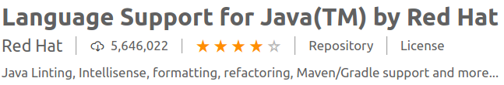
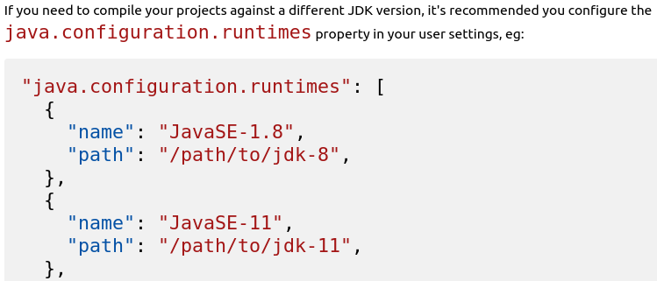
Know Your Tools
If you use VS Code, open the Extensions and READ the description for installed extensions. It has important info!

Slide 8
How to Change Java Compiler
Setting the JDK
The path to the Java Development Kit is searched in the following order:
the java.home setting in VS Code settings (workspace then user settings)
the JDK_HOME environment variable
the JAVA_HOME environment variable
on the current system path
Eclipse & IntelliJ users:
You should know how to select JDK for a project, too.

Slide 9
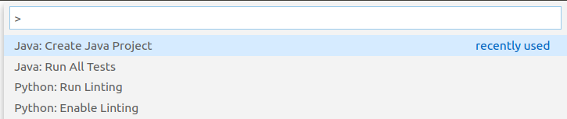
VS Code Commands & Settings
1. What keys do you press so you can enter a VS Code command? _______________________
Note: if no one can answer this, then we end the class meeting here. A "meeting" requires participation.

Slide 10
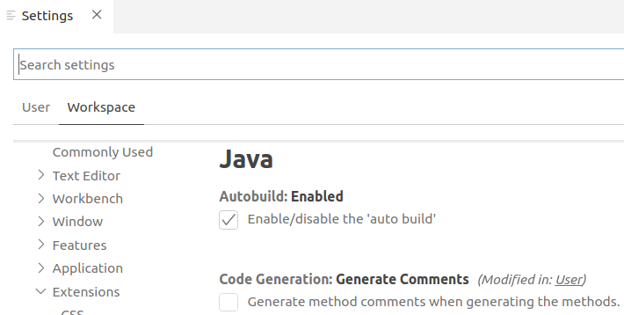
VS Code Settings
2. How do you display the project settings page?

Slide 11
Using Java I/O
Want to read Strings, numbers, and more
Want to read Strings
Want to read characters
Want to read bytes
InputStream

Slide 12
Using I/O Hierarchy
Want to read Strings, numbers, and more
Want to read Strings
Want to read characterss
Want to read bytes
Reader
InputStream

Slide 13
Using More Hierarchy
Want to read Strings, numbers, and more
Want to read Strings
Want to read characterss
Want to read bytes
BufferedReader
Reader
InputStream

Slide 14
Many ways to tokenize
String
Tokenizer
(*)
Want to read Strings, numbers, and more
Want to read Strings
Want to read characterss
Want to read bytes
Scanner
BufferedReader
Reader
InputStream
* or string.split(regex)

Slide 15
Final Exam
May cover anything from the course.
Written & programming parts.
Divided in 60-90 minute sessions, with break.
Most time will be for coding.
Need to reduce bandwidth for proctoring.

Slide 16
Need to Reduce Video Size & BW
Kittitouch 10MB (too low-res)
Chanathip 9MB (too low-res)
Suchon 523MB
Nuttapol 1,101MB (1GB)
Thornthep Upload Failed (too large)
Saruj 1,720MB
Setthanat 714MB

Slide 17
Didn't Follow Instructions
"6210545602" - Wrong name for share, Sorawichaya
stream - 58MB but incorrect content

Slide 18
What Size is Possible?
Videos I made for this course: 2-3 MB/minute
Student video: 500 MB/45min = 11 MB/minute
Student video: 900 MB/45min = 20 MB/minute

Slide 19
Assignment: Video Settings
Assignment: learn & document how OBS video settings effect the video size & quality. Recommend settings for creating a usable video of a coding screencast, with the smallest file size.
Benefit:
learn basic params of digital video & what they do
Goal: document OBS settings that result in the least bandwidth while producing a usable screencast video.
Submit:
Google Doc on Google Classroom
Due: 10:00 AM Sunday Morning
Bonus:
Best paper gets double points for assignment.
If a (near) tie, the paper submitted earliest gets the bonus.
Fame: Best settings will be posted and entire class will use them.

Slide 20
Assignment: details
1. Learn & experiment with video parameters in OBS that result in the smallest video subject to the requirement that the screen and clock are readable.
2. Document what the settings do and indicate which settings have the greatest effect on video size & quality for a screencast of coding (not much motion occurring).
3. Include some results for specific settings. Good if you have more than one set of results for comparison.
OBS Settings used Stream rate/min Video size/min
4. Submit to Google Classroom as a Google Doc.

Slide 21
Quiz on Recursion?
Involves a list.
May require use of a helper method.
About same difficulty as codingbat problems.

Slide 22
Exercise: Improve this Code
// Read lines & skip empty lines
while(scanner.hasNext()) {
if (! scanner.hasNextLine() ) break;
String line = scanner.nextLine();
if (!line.isEmpty() && !line.isBlank())
{
// process the line
System.out.println(line);
}
}

Slide 23
Exercise: Improve this Code
SBufferedReader reader = null;
boolean fileOk = true;
try {
reader = new BufferedReader( new InputStreamReader(
new FileInputStream( "data.csv" ) ));
fileOk = true;
}
catch (FileNotFoundException ex1) {
System.out.println("Could not read file "+filename);
fileOk = false;
}
catch (IOException ex2) {
System.out.println("Count not read file "+filename);
fileOk = false;
}
if (! fileOk) System.exit(1);

Slide 24
Topics this Week
1. Threads
2. Worker Threads - threads for background tasks

Slide 25
Process? Thread?
Demo: show running processes
What is a process?
What is a thread?
The Chrome browser uses a separate process for each tab's web content.
In Firefox, tabs use separate threads in same process, while UI runs in a separate process
https://developer.mozilla.org/en-US/docs/Mozilla/Firefox/Multiprocess_Firefox
What's the difference? How does it matter?

Slide 26
Coming Soon
Material you won't be tested on
1. How to use FXML in JavaFX (part 1 showing now :-)
2. ORM & ORMlite (and why you should not use MySQL)
3. Properties for reading settings from a file
4. As per your request.

Slide 27
Show Processes
Linus/MacOS
  ps ax
  ps -el and many more options
  top
  System Monitor (GUI)
Windows
Task Manager (Ctrl + Shift + Esc) or right click on My Computer or right click on Menu Bar
tasklist

