Slide 1
Working with component styles One way : external file
Open file – app.component.css – how you can use this file ?
Write :
h3{
color:darkblue;
}
See the result

Slide 2
Another way : Inline
Open file – app.component.ts –
@Component({
selector: 'app-root',
templateUrl: './app.component.html',
// styleUrls: ['./app.component.css']
styles: [`
h3{
color:yellow;
}
`]
})
See the result
Comment the reference from
where it considering color:blue
Sign – for multiline

Slide 3
Fully Understanding the Component Selector

Slide 4
1. Selector as attribute
Open file – semesters.component.ts
@Component({
selector:'[semesters]',
template:`<h2>{{ title }}</h2>
<ul>
<li *ngFor="let semester of semesters">
{{ semester }}
</li>
</ul>
`
})
Open File – app.component.html
<!-- <semesters></semesters> -->
<div semesters></div>
Write selector in [ ]
Bcz this will not work

Slide 5
2. Selector as class
Open file – semesters.component.ts
selector: '.semesters',
Open File – app.component.html
<div class="semesters"></div>

Slide 6
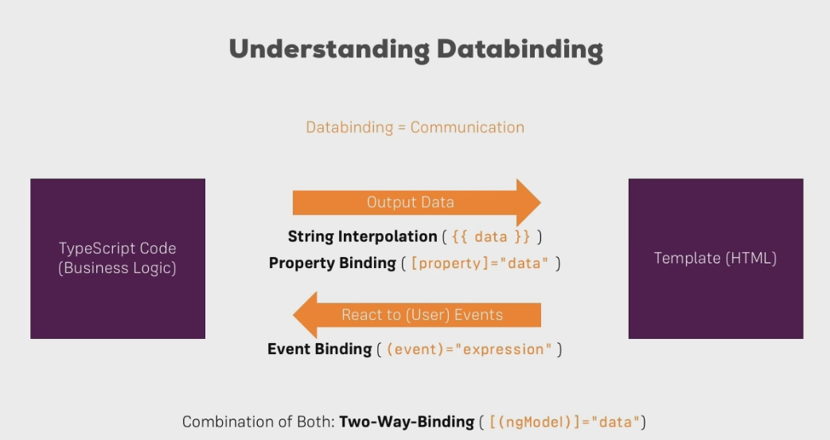
What is Databinding?

Slide 7
String Interpolation – {{ }}
{{ }} – syntax for interpolation
You can use only that value which at the end convert into string or return string
You can’t write multiline in this and you can’t write block in this
E.g you can not add if or for structure
You can user ternary expression

Slide 8
First make one server component
That print – The Server Component

Slide 9
First make one server component
That print – The Server Component
Now open – server.component.ts – write:
export class ServerComponent
{
serverID: number = 10;
serverStatus: string = 'offline';
}
Open file – server.component.html – write:
<p>{{'Server'}} with ID {{ serverID }} is {{ serverStatus }}</p>
Now see the result
Type is not necessary

Slide 10
In same code if you want to show server status by return method…?

Slide 11
app.component.ts
export class ServerComponent
{
serverID: number = 10;
serverStatus: string = 'offline';
getServerStatus(){
return this.serverStatus;
}
}
----------------------------------------------
app.component.html
<p>{{'Server'}} with ID {{ serverID }} is {{ getServerStatus() }}</p>

Slide 12
Property Binding
Open file – semesters.component.html –
Add one button :
<button class=“btn btn-primary”>Add Semester</button>
Now add disable property :
<button disabled>

Slide 13
Open file – semesters.component.ts –
export class SemesterComponent implements OnInit {
allowNewSemester=false;
constructor() {
setTimeout(()=>{
this.allowNewSemester=true;
},2000);
}

Slide 14
For this to work we have to add in .html file:
<button [disabled]="!allowNewSemester">Add Semester</button>
[] – used for dynamic property binding

Slide 15
Property Binding vs String Interpolation
Open file - semesters.component.html –write
<p>{{ allowNewSemester }}</p>
Now see the result : run the app.
OR
<p [innerText]="allowNewSemester"></p>
String Interpolation
Property Binding
You can not use both together

Slide 16
Event Binding
On button click :
Open semester.component.html file:
Comment line:
<!--<p [innerText]="allowNewSemester"></p>-->
Open semester.component.ts file: write:
export class SemesterComponent implements OnInit {
allowNewSemester=false;
semesterCreationStatus='No Semester was Created!';
You can use this property in html as output:
Write: <p>{{ semesterCreationStatus }}</p>
You can see result

Slide 17
Open semester.component.ts – Write:
onCreateSemester(){
this.semesterCreationStatus='Semester was created!';
}
Open semester.component.html – write:
<button
class="btn btn-primary"
[disabled]="!allowNewSemester"
(click)="onCreateSemester()">Add Semester</button>

Slide 18
Passing and Using Data with Event Binding
Open file – semester.component.html: write
<label>Semester Name</label>
<input type="text" class="form-control">
Added input box: after that
<input
type="text"
class="form-control"
(input)="onUpdateSemesterName($event)">
So add this method to .ts file: create first property:
semesterName='';
Create Method:
onUpdateSemesterName(event:any){
this.semesterName=(<HTMLInputElement>event.target).value;
}

Slide 19
Now we can see the value by: String interpolation
<p>{{ semesterName }}</p>

Slide 20
Two-way-Databinding (Property and event)
Open – semester.component.html –write: comment previous input tag
<input
type="text"
class="form-control"
[(ngModel)]="semesterName">

Slide 21
Combining all Forms of Databinding
Now from click button you want to add semester:
<input
type="text"
class="form-control"
[(ngModel)]="semesterName">
<!-- <p>{{ semesterName }}</p> -->
In .ts File:
onCreateSemester(){
this.semesterCreationStatus='Semester was created! Name is '+this.semesterName;
}

Slide 22
Binding Example
Create : ng g c bindingExmple

Slide 23
Understanding Directives

Slide 24
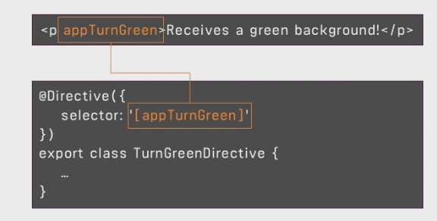
What are Directives?
Instructions in the DOM
Instructing angular that add our component in this place
Types
User defined
Built-in

Slide 25
Using ngIf to Output Data Conditionally
Comment line - <!--<p>{{ semesterCreationStatus }}</p>-->
And add line -
<p>Semester was created, server name is {{ semesterName }}</p>
See the result

Slide 26
Directive
ngIf – conditionally add or remove an element from the DOM

Slide 27
Make variable:
semesterCreationStatus='No Semester was Created!';
semesterName='';
semesterCreated=false;
Change function also
onCreateSemester(){
this.semesterCreated=true;
this.semesterCreationStatus='Semester was created! Name is '+this.semesterName;
}

Slide 28
Change that statement to html:
<p *ngIf="semesterCreated">Semester was created, server name is {{ semesterName }}</p>
Paragraph created at runtime

Slide 29
HTML:
<button (click)="getHobby()">Hobby</button>
<ul class="list-group" *ngIf="showList">
<li class="list-group-item" *ngFor="let i of listHobby">{{i}}</li>
</ul>
TS:
getHobby()
{
this.showList=true;
}

Slide 30
Enhancing ngIf with an Else Condition
showList:boolean=false;
getHobby()
{
this.showList=true;
}
-------------------------------------------------
<button (click)="getHobby()">Hobby</button>
<ul class="list-group" *ngIf="showList; else noList">
<li class="list-group-item" *ngFor="let i of listHobby">{{i}}</li>
</ul>
<ng-template #noList><p>No list</p></ng-template>

Slide 31
Styling Elements Dynamically with ngStyle
----------------------------
<div [ngStyle]="{'background':'red','font-size':'50px'}">Change the background color</div>
------------------------------
isValid:boolean=true;
<div [ngStyle]="{'background': isValid? 'blue':'yellow'}">Change according to condition</div>
------------------------------
isStatus:boolean=false;
constructor() {
this.isStatus=Math.random() > 0.5 ? 'StatusOn' : 'StatusOff';
}
getColor()
{
return this.isStatus== 'StatusOn' ? 'green' : 'pink';
}
<div [ngStyle]="{background:getColor()}">Change according to function: {{isStatus}}</div>

Slide 32
All Directives: ngIf, ngFor, ngClass, ngStyle, ngSwitch

Slide 33
For Unit 2 and Unit 3 refer class Demo

