Slide 1
PathBinder Hackathon
Attack of the retreating invisible cows!

Slide 2
What can we offer?
Mike
SaaS
+
= ?
For-Profit
Ryan

Slide 3
Introducing…
Payment Gateway
Serverless Application
Centralized payment connector
Secure
Event-driven (not yet)

Slide 4
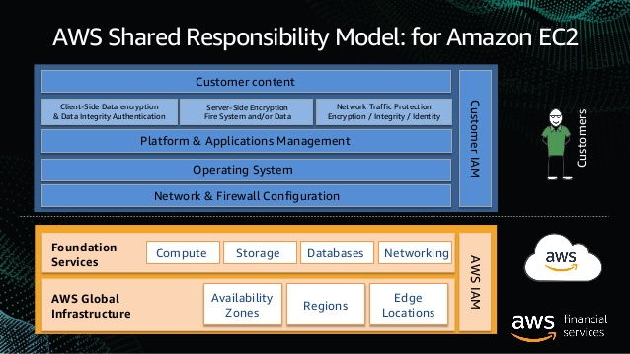
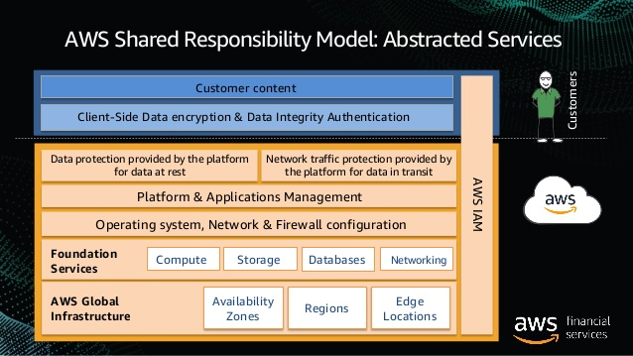
Serverless - Security

Slide 5
Serverless - Payment Model
Pay per request
If no one is using it, you don’t pay!
AWS API Gateway
1st year, 1,000,000 requests per month are free
$0.0000035 per request thereafter ($3.50/1M)
AWS Lambda
1,000,000 requests per month are free forever

Slide 6
Payment Processor - Stripe
Very comparable to Paypal and Square
2.9% + $0.30 per transaction
Offers built-in recurring subscription charges

Slide 7
Demo
Quick overview of Stripe’s dashboard
Create a product / plan
Deploy Payment Gateway
Call API
Show API Key auth failure
Create API Key
Try again!

