Slide 1

t
11. – 14.12.2017
Frankfurt am Main
Sigrid Keydana
Practical Deep Learning
#ittage

Slide 2
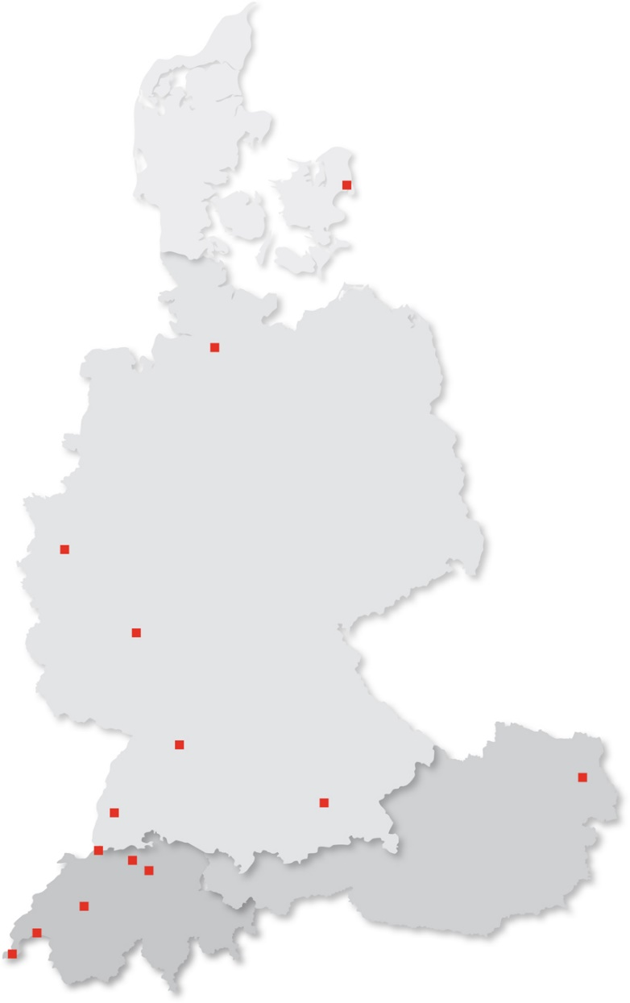
With over 600 specialists and IT experts in your region.
COPENHAGEN
14 Trivadis branches and more than 600 employees
200 Service Level Agreements
Over 4,000 training participants
Research and development budget: CHF 5.0 million
Financially self-supporting and sustainably profitable
Experience from more than 1,900 projects per year at over 800 customers
HAMBURG
DÜSSELDORF
FRANKFURT
STUTTGART
FREIBURG
MUNICH
VIENNA
BRUGG
BASEL
ZURICH
BERN
GENEVA
LAUSANNE
2
2017/13/12
Practical Deep Learning
Notes:
“We are a non-affiliated and profitable company with over 600 employees. Regional proximity to our customers is one of our key considerations. We achieve this by operating 14 branch operations in Switzerland, Germany, Austria and Danmark. We successfully completed more than 1900 customer projects during the last business year. Additionally, we also support our customers with over 200 Service Level Agreements. The basis for this sustained technological excellence is reflected in our research and development budget. Every year we invest around 5 million Swiss franks in analyzing and evaluating new technologies and developing our methods and products.”
2

Slide 3
About me
My background
from psychology/statistics via software development and database engineering to data science/ML/DL
My passion
machine learning and deep learning
data science and (Bayesian) statistics
explanation/understanding over prediction accuracy
Where to find me
blog: http://recurrentnull.wordpress.com
twitter: @zkajdan
3
2017/13/12
Practical Deep Learning

Slide 4
INFOBOX – Read and delete
In the chapter divider, the chapter text is written centered in the text field
Please keep chapter names as short as possible, less text and punchy titles are better!
Why deep learning?

Slide 5
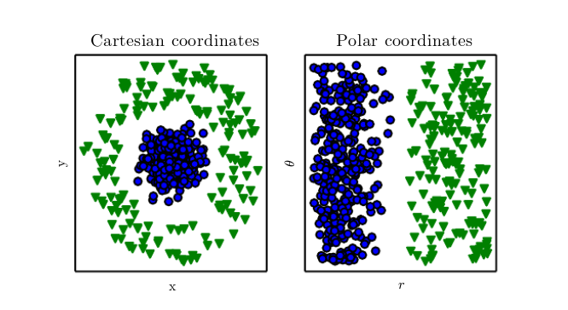
Task: Separate the green triangles from the blue circles
Source: Goodfellow et al., Deep Learning, 2016

Slide 6
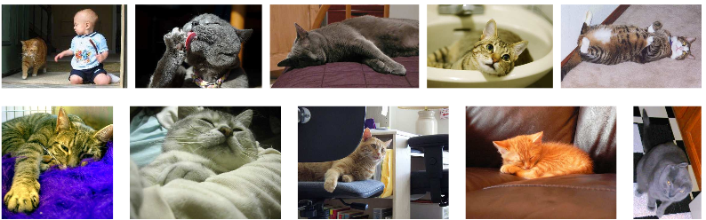
Features matter…
… so, can’t we just hard code them?
-
Source: Parkhi et al. , The Truth about Cats and Dogs

Slide 7
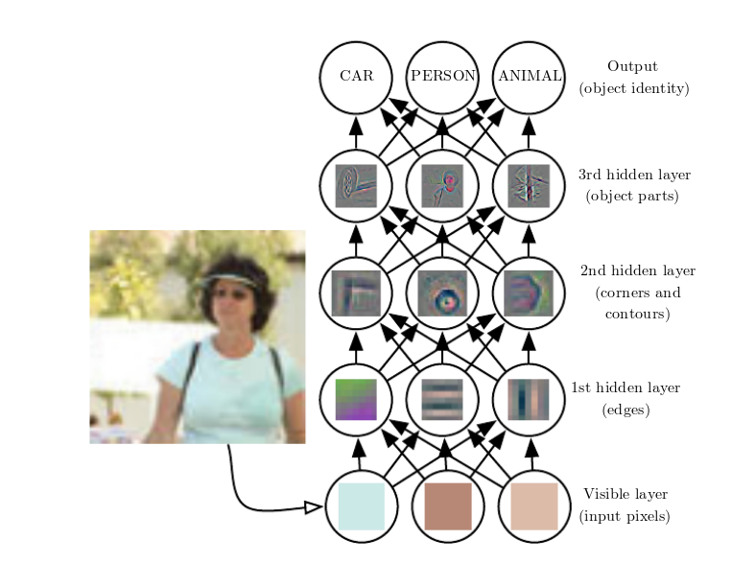
Example: Learning features for object classification
Source: Goodfellow et al., Deep Learning, 2016

Slide 8
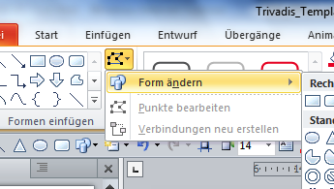
Deep learning vs. machine learning
INFOBOX – Read and delete
Use this box for design pages with text boxes. You can change the bullet automatically here and objects can be grouped (important for even spacing 1)
You can permanently change the shape of all objects at any time via Format → Add shapes → Change shapes (2)
Pre-ML programs
Machine Learning (ML)
Deep Learning (DL)
in: data
in: rules
out: conclusion
in: data
learn: mappings/functions
out: conclusion
in: data
learn: features
learn: mappings/functions
out: conclusion
1
2

Slide 9
INFOBOX – Read and delete
In the chapter divider, the chapter text is written centered in the text field
Please keep chapter names as short as possible, less text and punchy titles are better!
How does a deep neural network learn?

Slide 10
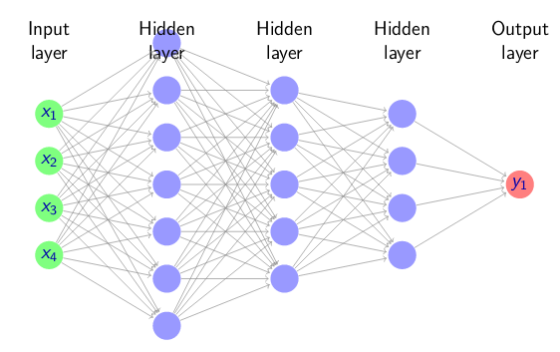
A deep neural network
Source: Stergiou & Siganos, Artificial Neurons

Slide 11
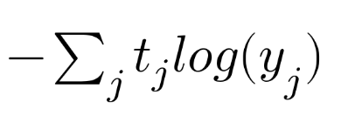
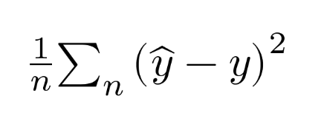
First, we need a loss function
… that is, a way to quantify our current error.
You said 98% probability it was a cat… but it’s a dog!
You said sales were gonna to up by 5%... but really they went down by 0.7%!

Slide 12
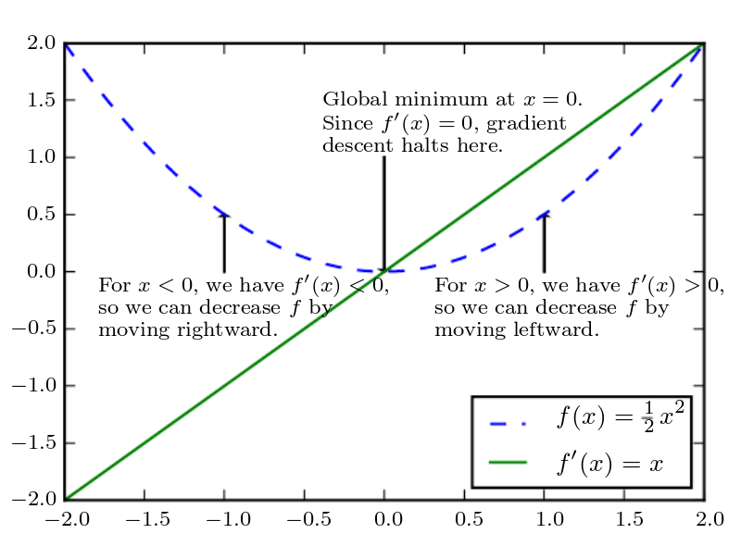
Second, we need to reduce that error
… that is, a way to quantify our current error.
Source: Goodfellow et al., Deep Learning, 2016

Slide 13
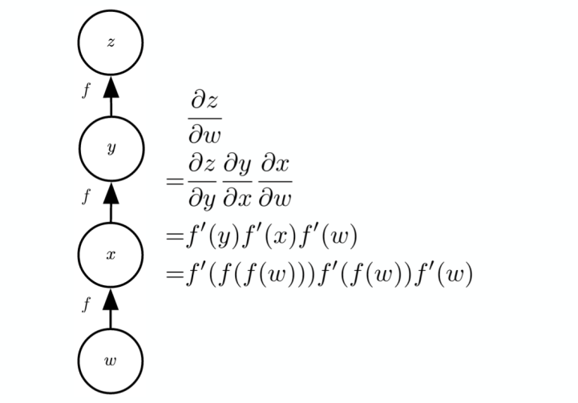
Third, we need to propagate back that error
… all through the network.
Source: Goodfellow et al., Deep Learning, 2016

Slide 14
INFOBOX – Read and delete
In the chapter divider, the chapter text is written centered in the text field
Please keep chapter names as short as possible, less text and punchy titles are better!
So how can we do that ourselves?

Slide 15





Deep Learning frameworks

Slide 16
Keras: User friendliness and fast experimentation
“Being able to go from idea to result with the least possible delay is key to doing good research. “
High level library running on top of TensorFlow, CNTK, or Theano
Extensive documentation and lots of sample code
Includes layers for all standard architectures (different kinds of CNNs and RNNs)
model = Sequential()
model.add(Dense(units=64, activation='relu', input_dim=100))
model.add(Dense(units=10, activation='softmax'))
model.compile(loss='categorical_crossentropy', optimizer='sgd', metrics=['accuracy'])
model.fit(x_train, y_train, epochs=50)
classes = model.predict(x_test)

Slide 17
TensorFlow: Google Glamour included
Probably the best-known deep learning framework outside the DL community
Originally developed by the Google Brain team
Super-fast release cycle
Core framework not the easiest to use, but comes with several higher-level APIs on top
W = tf.Variable([.3], dtype=tf.float32) b = tf.Variable([-.3], dtype=tf.float32) x = tf.placeholder(tf.float32) linear_model = W*x + b
y = tf.placeholder(tf.float32) squared_deltas = tf.square(linear_model - y) loss = tf.reduce_sum(squared_deltas)
init = tf.global_variables_initializer() sess = tf.Session() sess.run(init)
print(sess.run(loss, {x: [1, 2, 3, 4], y: [0, -1, -2, -3]}))

Slide 18
PyTorch: Dynamical neural networks with Python
Torch (Lua) ported to Python
Developed at and open-sourced by Facebook
Fast on-GPU tensor computations (alternative to numpy)
Dynamical computation graphs
Rapidly gaining popularity
model = Linear(input_dim, output_dim)
loss_fn = torch.nn.MSELoss()
optimizer = torch.optim.Adam(model.parameters(), lr=learning_rate)
for epoch in range(num_epochs):
y_pred = model(X_train)
loss_var = loss_fn(y_pred, y_train)
optimizer.zero_grad()
loss_var.backward()
optimizer.step()

Slide 19
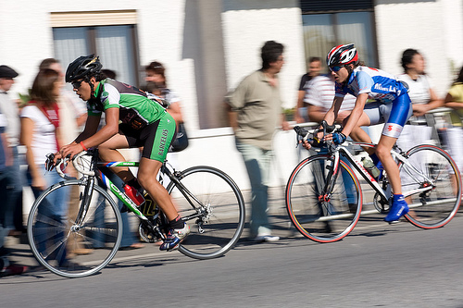
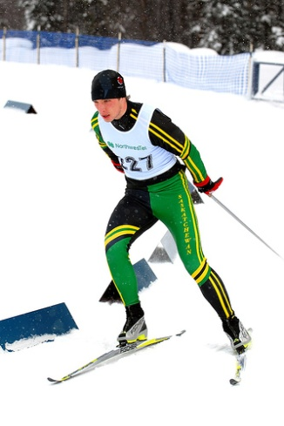
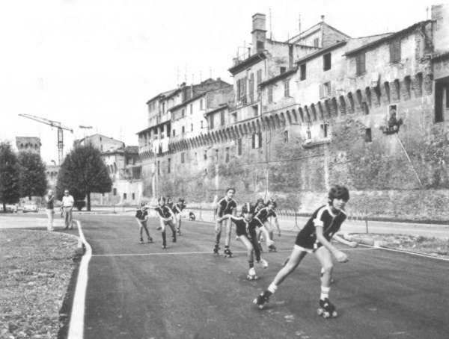
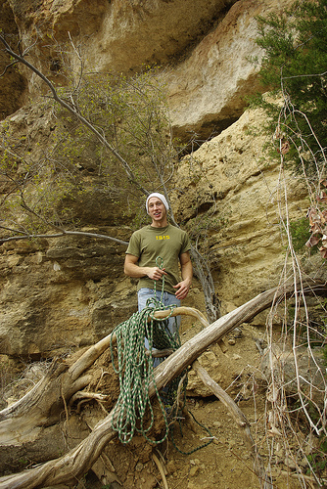
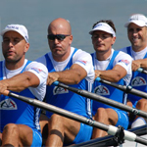
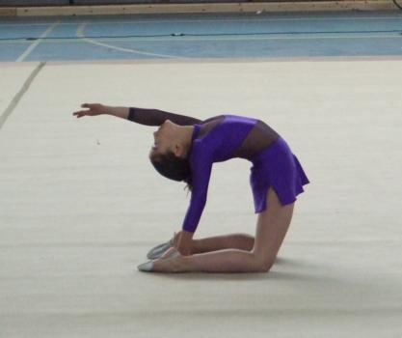
Case study: Distinguishing sports
6 classes, ~ 8000 images in training set, ~1800 in test set
4-block CNN in Keras, (raw) TensorFlow and PyTorch

Slide 20
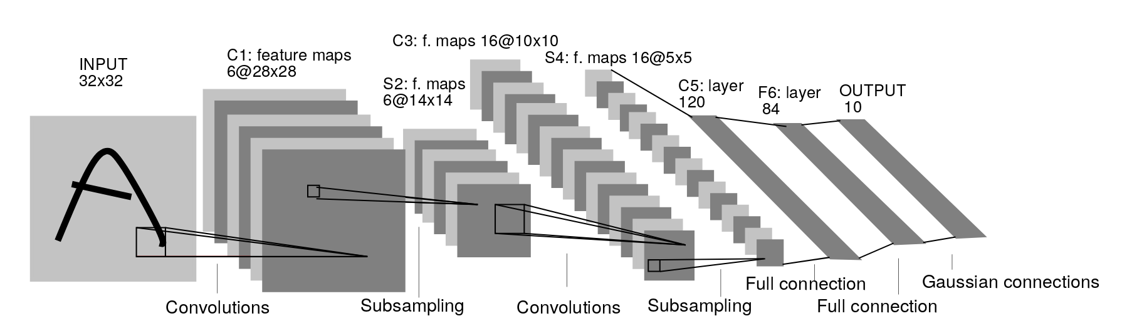
Example CNN architecture (LeNet)

Slide 21
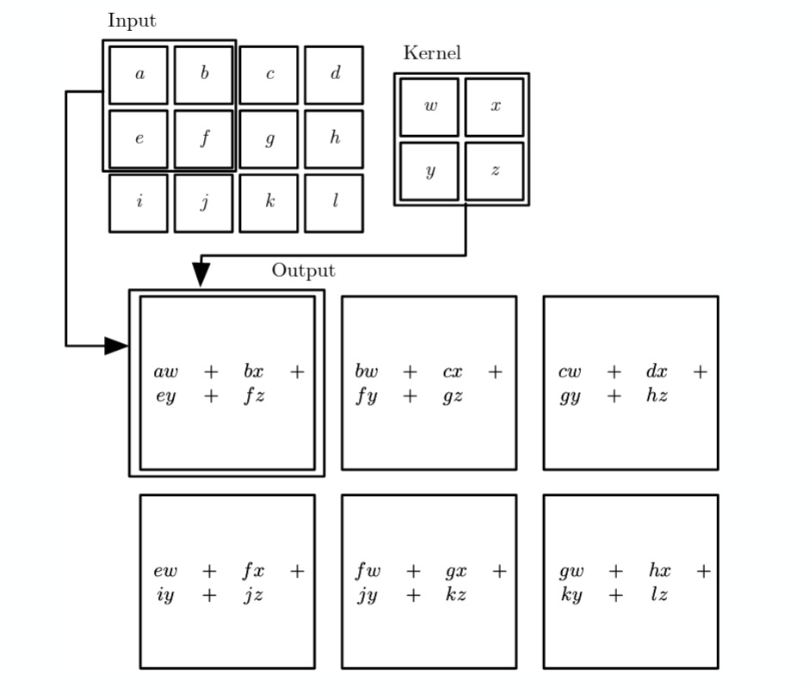
The Convolution Operation
Source: Goodfellow et al., Deep Learning, 2016

Slide 22
Demo time!
Notebooks:
https://github.com/skeydan/deeplearning_keras_tf_pytorch/blob/master/cnn_keras.ipynb
https://github.com/skeydan/deeplearning_keras_tf_pytorch/blob/master/cnn_tensorflow.ipynb
https://github.com/skeydan/deeplearning_keras_tf_pytorch/blob/master/cnn_pytorch.ipynb

Slide 23
Questions? Thank you!
INFOBOX – Read and delete
There are two versions of the last slide available, one for the contact details of a speaker, and one for two or more speakers.
Name, title and location always underneath one another in one row (Shift+Return)
This idea is that this is the last slide (also for questions and answers) and is on the screen for a long time at the end of the presentation, so the viewers have the chance to write down the contact data ☺

