Slide 1
Deep Learning in Action
With DL4J!
Sigrid Keydana

Slide 2
INFOBOX – Read and delete
In the chapter divider, the chapter text is written centered in the text field
Please keep chapter names as short as possible, less text and punchy titles are better!
Deep Learning in 3 W’s

Slide 3
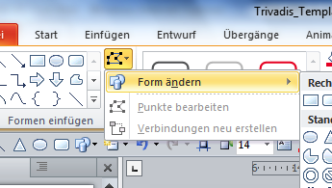
What?
INFOBOX – Read and delete
Use this box for design pages with text boxes. You can change the bullet automatically here and objects can be grouped (important for even spacing 1)
You can permanently change the shape of all objects at any time via Format → Add shapes → Change shapes (2)
Pre-ML programs
Machine Learning (ML)
Deep Learning (DL)
in: data
in: rules
out: conclusion
in: data
learn: mappings/functions
out: conclusion
in: data
learn: features
learn: mappings/functions
out: conclusion
1
2

Slide 4
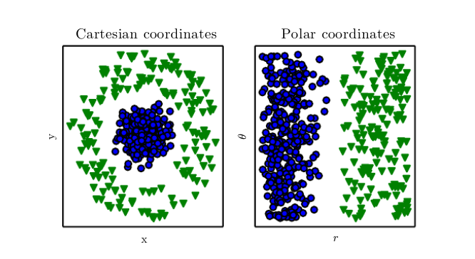
Why features matter
Source: Goodfellow et al., Deep Learning, 2016

Slide 5
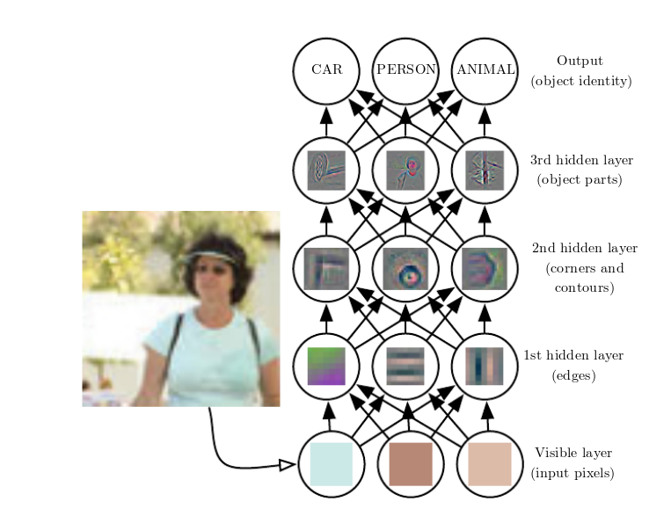
Example: Features for object classification
Source: Goodfellow et al., Deep Learning, 2016

Slide 6
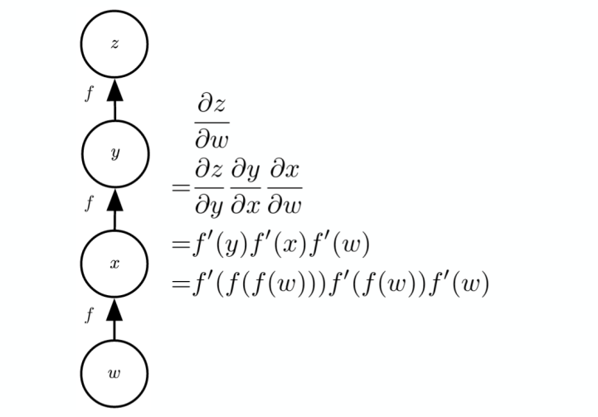
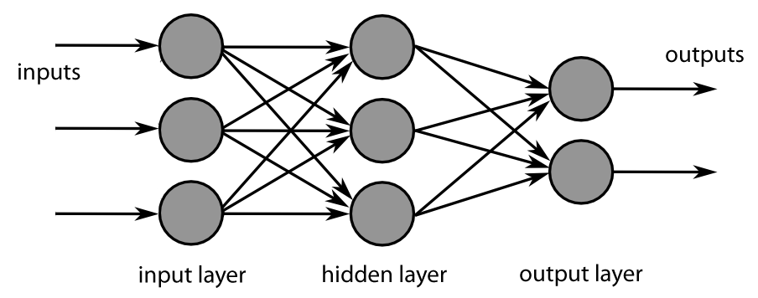
hoW?
Learning from errors in a deep network
Source: Wikipedia
Source: Goodfellow et al., Deep Learning, 2016

Slide 7
Why?
$$$
Applications in industry
Applications in science
Finance
Physics
Cosmology
Pharmacology
Medicine
Meteorology
Biology
Engineering
Autonomous driving
Machine translation
Image recognition
Manfacturing
Robotics
Healthcare
Music, text, image generation
Chatbots
Google
Microsoft
Facebook
Baidu
. . .
. . .
. . .
Apple
Intel
IBM
Nvidia

Slide 8
INFOBOX – Read and delete
In the chapter divider, the chapter text is written centered in the text field
Please keep chapter names as short as possible, less text and punchy titles are better!
So is this just for the big guys?

Slide 9
No.
Just need
Reasonable amount of data
Adequate hardware – or run in the cloud!
Deep learning software – and people who know to code and run it
Let’s zoom in on the software.

Slide 10
Deep Learning frameworks
Python (possibly C/C++)
Keras
PyTorch
Theano
TensorFlow
MXNet

Slide 11
What if my whole environment is Java/JVM-based?
And/or I need to run on a (Spark/Hadoop) cluster?
And/or I need to optimize performance?
Enter…

Slide 12
INFOBOX – Read and delete
In the chapter divider, the chapter text is written centered in the text field
Please keep chapter names as short as possible, less text and punchy titles are better!
DL4J

Slide 13
DL4J in a nutshell
Open-source DL framework for the JVM ecosystem (maintained by Skymind)
Distributed – runs on Spark and Hadoop
Fast (with adequate JVM settings)
Lots of nicely commented example code
Helpful developers! (Github / Gitter chat)

Slide 14
So if the focus is on production …
… what does the developer’s experience look like?
Developer 1 (normally uses Keras for quick experiments): “I miss playing around in the notebook… What’s actually going on in that code?”
Developer 2 (too impatient for fiddling around with parameters): “Is that endless training time really necessary? Can’t I just use something out-of-the-box?”
Developer 3 (could be me): “I want to apply this method from that paper and don’t have the time… perhaps it’s already implemented in …?”

Slide 15
But first… let’s just see some code!
How does linear regression look like in DL4J?
MultiLayerNetwork net = new MultiLayerNetwork(new NeuralNetConfiguration.Builder()
.iterations(numEpochs)
.optimizationAlgo(OptimizationAlgorithm.CONJUGATE_GRADIENT)
.updater(Updater.SGD)
.list()
.layer(0, new DenseLayer.Builder().nIn(numFeatures).nOut(hiddenDim)
.activation(Activation.RELU)
.build())
.layer(1, new OutputLayer.Builder(LossFunctions.LossFunction.MSE)
.activation(Activation.IDENTITY)
.nIn(hiddenDim).nOut(outputDim).build())
.build());
net.init();
net.fit(X, Y);

Slide 16
INFOBOX – Read and delete
In the chapter divider, the chapter text is written centered in the text field
Please keep chapter names as short as possible, less text and punchy titles are better!
Spot on … agile development

Slide 17
Keras model import
Can experiment in Keras and then import models
Let’s see this in action!
MultiLayerNetwork network = KerasModelImport.importKerasSequentialModelAndWeights(modelPath);

Slide 18
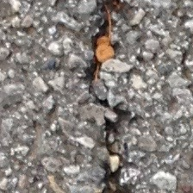

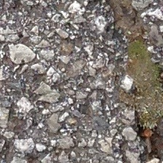
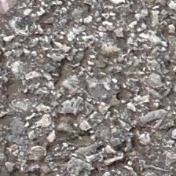
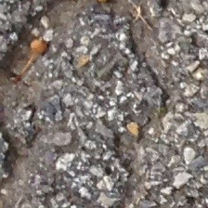
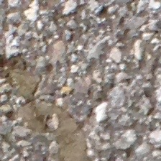


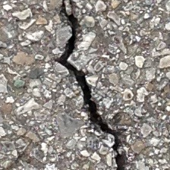

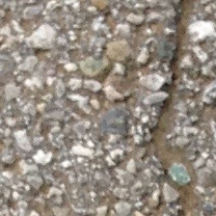

Keras model import demo: Crack? No crack?

Slide 19
INFOBOX – Read and delete
In the chapter divider, the chapter text is written centered in the text field
Please keep chapter names as short as possible, less text and punchy titles are better!
Spot on … pretrained models

Slide 20
Model zoo
Can use e.g. VGG16, VGG19, ResNet, GoogleNet… with weights mostly trained on ImageNet
Examples available for different forms of usage (adaptation to own classes, fine tuning)
Let’s try this out!
ZooModel vgg16 = new VGG16(); ComputationGraph pretrainedNet = (ComputationGraph) vgg16.initPretrained(PretrainedType.IMAGENET);

Slide 21
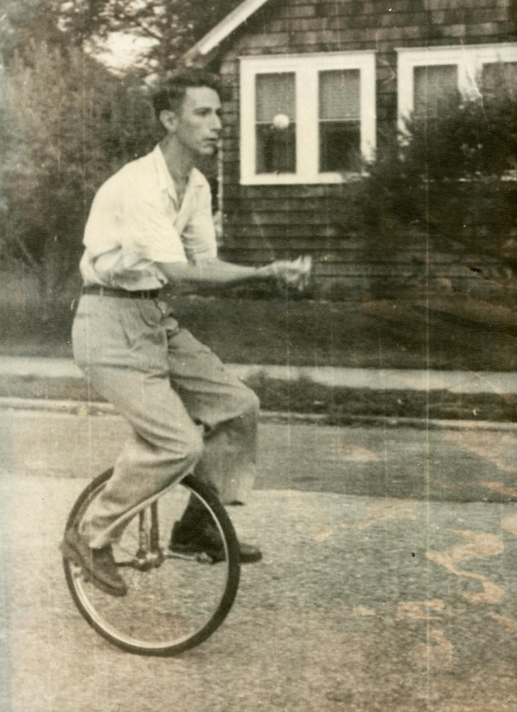
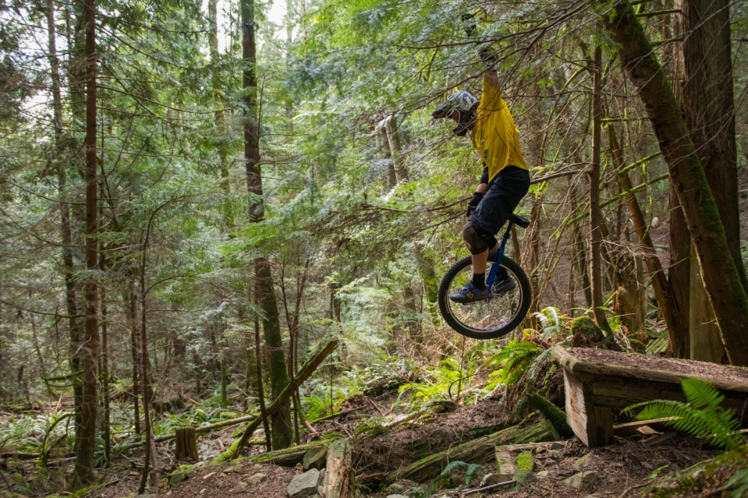
VGG 16 demo: What’s this?
Source: http://krisholm.com/en/blog/Introducing-the-KH-27.5
Source: https://www.juggle.org/claude-shannon-mathematician-engineer-genius-juggler/

Slide 22
INFOBOX – Read and delete
In the chapter divider, the chapter text is written centered in the text field
Please keep chapter names as short as possible, less text and punchy titles are better!
Spot on … available algorithms

Slide 23
Example: Anomaly detection
One state-of-the-art approach: Variational Autoencoder with reconstruction probability
Implemented in DL4J as a specific variational layer
MultiLayerConfiguration conf = new NeuralNetConfiguration.Builder() .//…
.layer(0, new VariationalAutoencoder.Builder() .activation(Activation.LEAKYRELU) .encoderLayerSizes(encoderSizes) .decoderLayerSizes(decoderSizes) .pzxActivationFunction(latentActivation) .reconstructionDistribution(new BernoulliReconstructionDistribution(Activation.SIGMOID)) .nIn(inputSize) .nOut(latentSize) .build()) .pretrain(true).backprop(false).build();

Slide 24
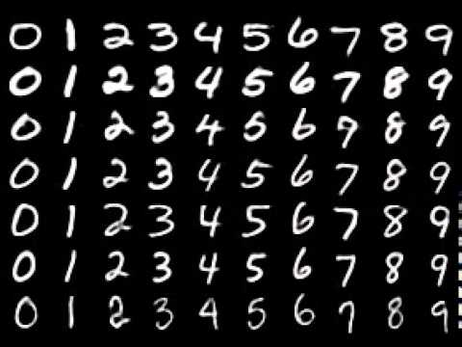
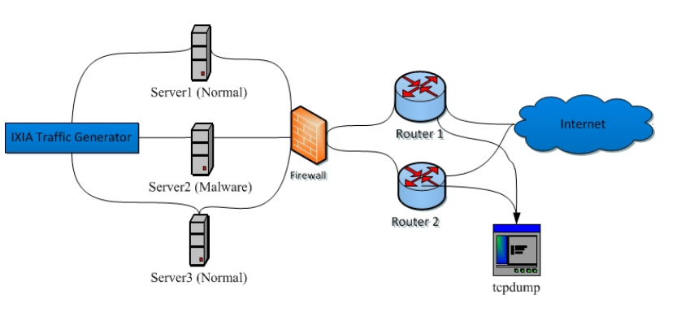
Variational autoencoder demos
MNIST handwritten digits
UNSW-NB15 intrusion detection

Slide 25

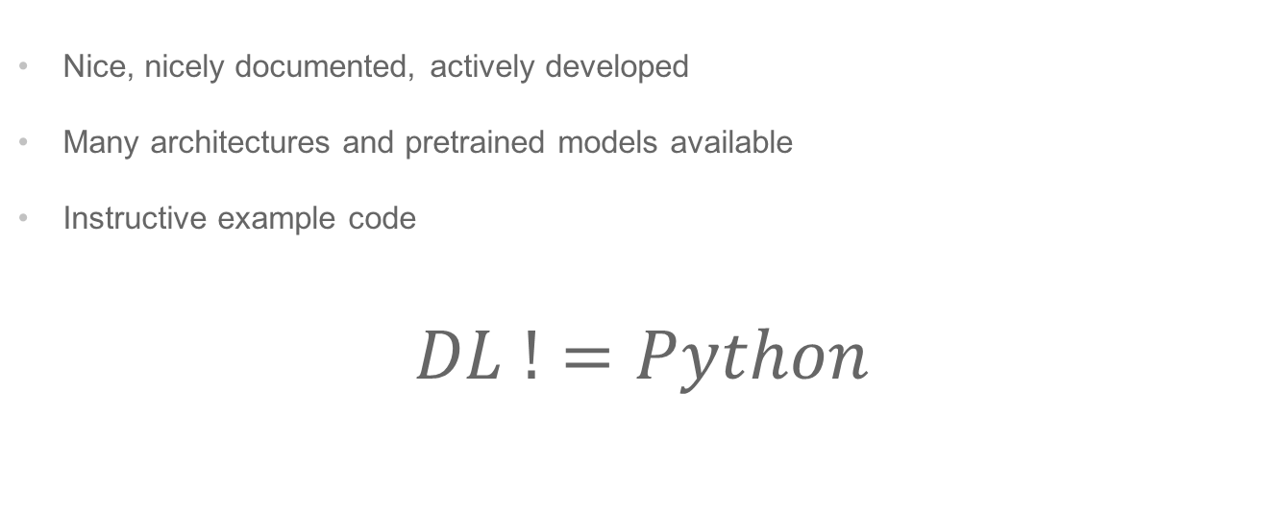
Conclusion: DL4J
Nice, nicely documented, actively developed
Many architectures and pretrained models available
Instructive example code
$$DL !=Python$$

Slide 26
Questions? Thank you!
INFOBOX – Read and delete
There are two versions of the last slide available, one for the contact details of a speaker, and one for two or more speakers.
Name, title and location always underneath one another in one row (Shift+Return)
This idea is that this is the last slide (also for questions and answers) and is on the screen for a long time at the end of the presentation, so the viewers have the chance to write down the contact data ☺

