Slide 1
Analytical propeller performance
Gabriel Rodrigues Felix
Aerospace Engineer – UFMG
Master of Science in Aerodynamics – ITA
Applied Aerodynamics Engineer - Embraer

Slide 2
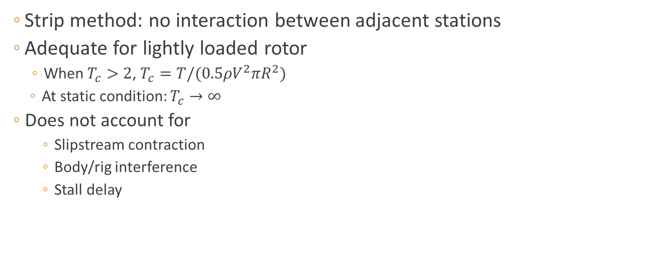
Blade Element Momentum Theory
Strip method: no interaction between adjacent stations
Adequate for lightly loaded rotor
When $T_{c}>2$, $T_{c}=T/(0.5ρV^{2}πR^{2})$
At static condition: $T_{c}→∞$
Does not account for
Slipstream contraction
Body/rig interference
Stall delay

Slide 3
Validação

Slide 4
Validação

Slide 5
Prop1

Slide 6
Prop2

Slide 7
Prop3

Slide 8
Prop4

