Slide 1
Used-Goods Market for SKKU students.
2017313233, Changyeon Seo

Slide 2
Project Objective
Providing online market service for used-goods.
-User can register there own used-goods and sell it
-User can search some products from the list of uploaded goods
-User can buy some goods from another user
-In this process, user(as a buyer) can communicate with seller(as a seller)

Slide 3
Functions
User Register
- Sign up : 회원가입
- Sign in & out : 로그인, 로그아웃
Sell product : 판매 게시글 작성
Search product : 상품 검색
Add comments
- attach comment : 판매 게시글에 댓글 작성
- send buy signal to seller : 판매자에게 구매 신호 발송
Check User’s own Information : 사용자 정보 확인
Send/Receive message between Seller and Buyer : 판매자/구매자 간 쪽지

Slide 4
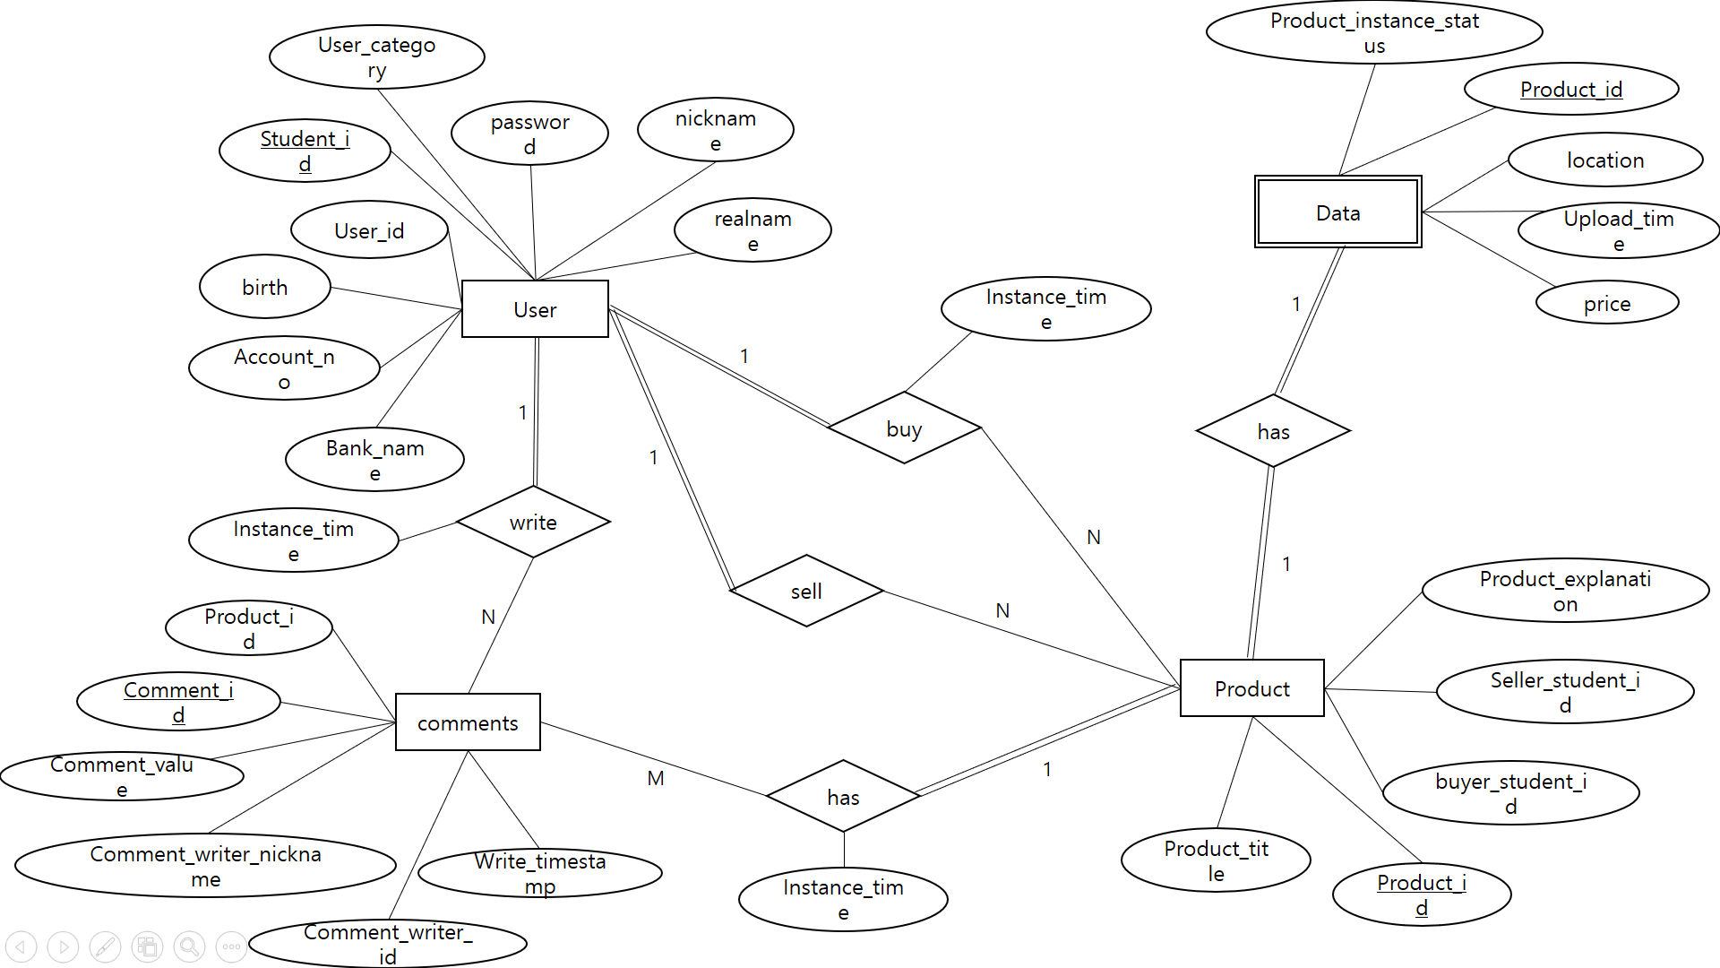
DB Design
ER diagram

Slide 5
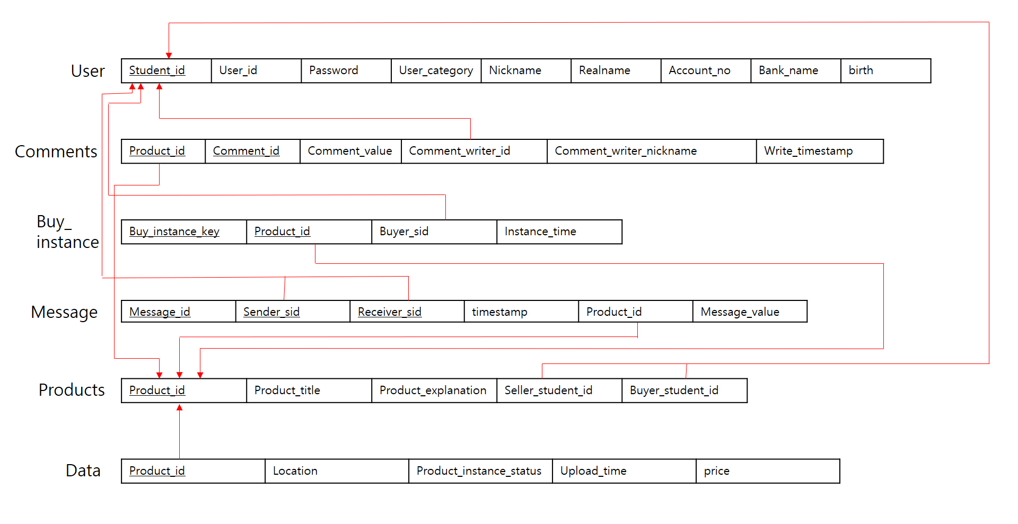
DB Design
Relational model

Slide 6
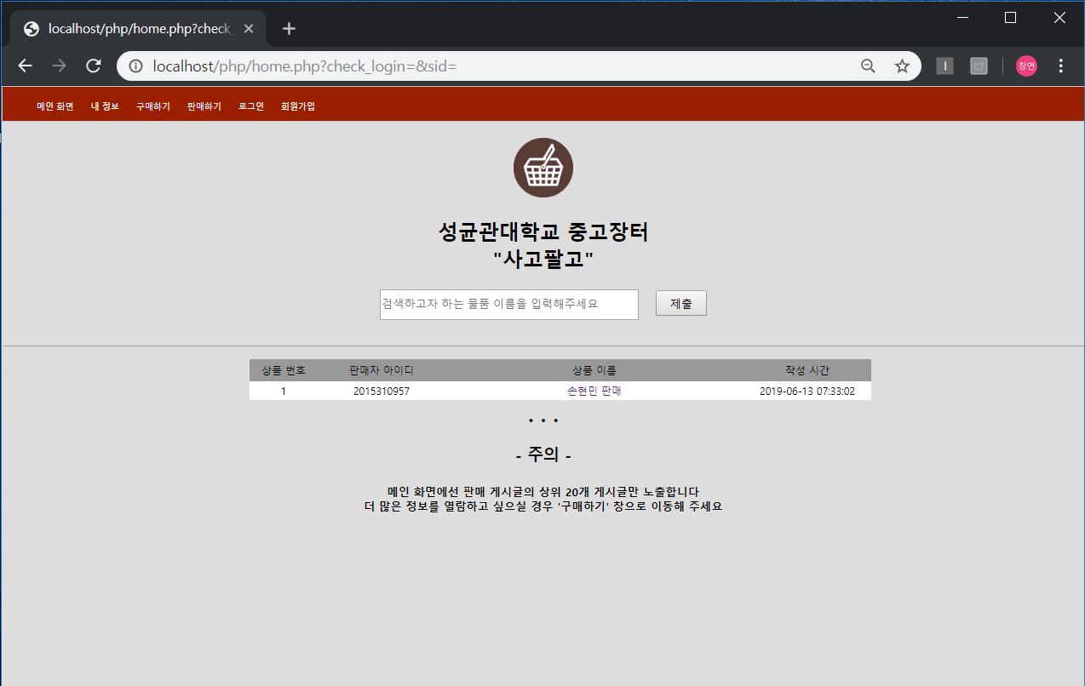
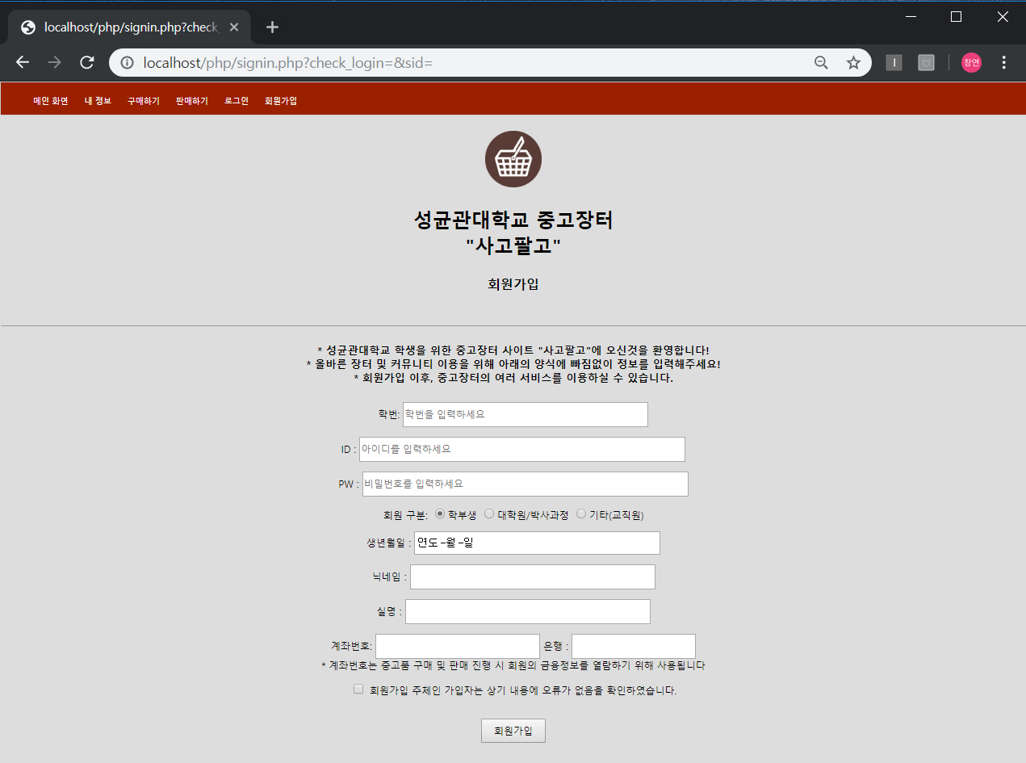
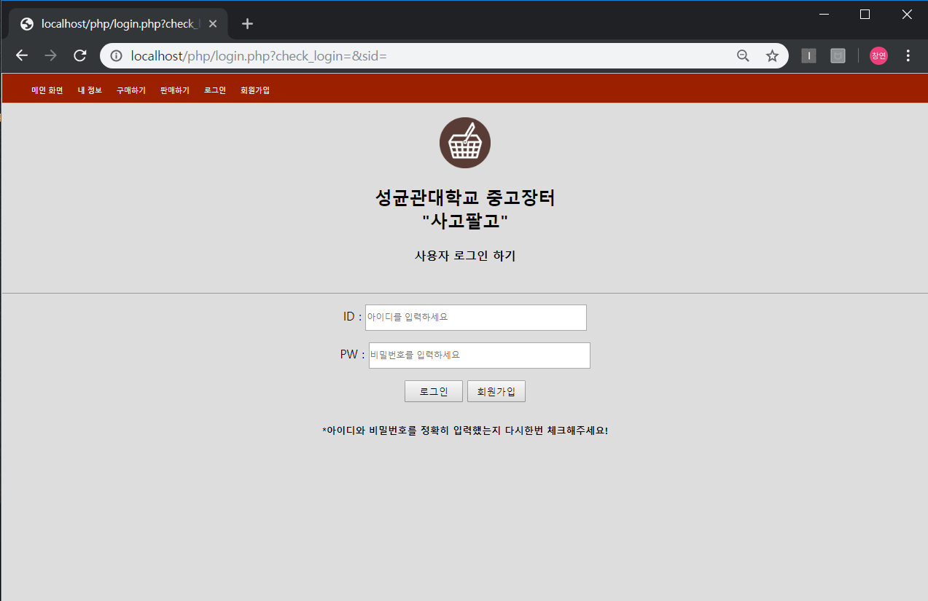
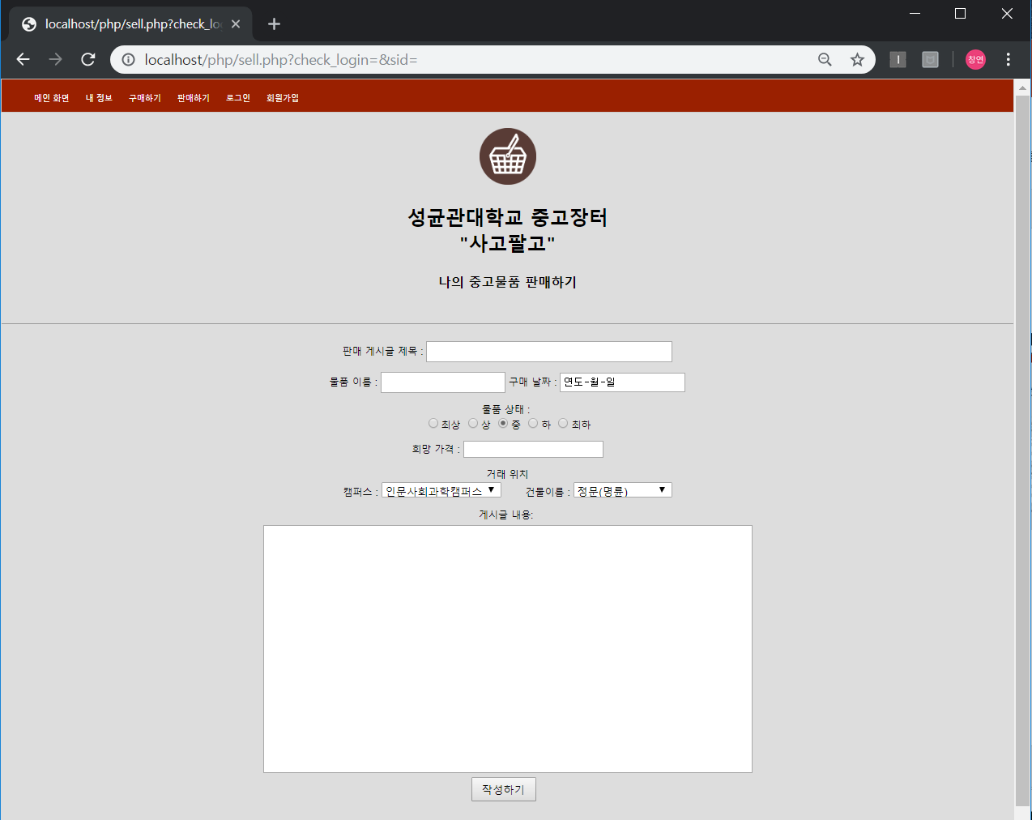
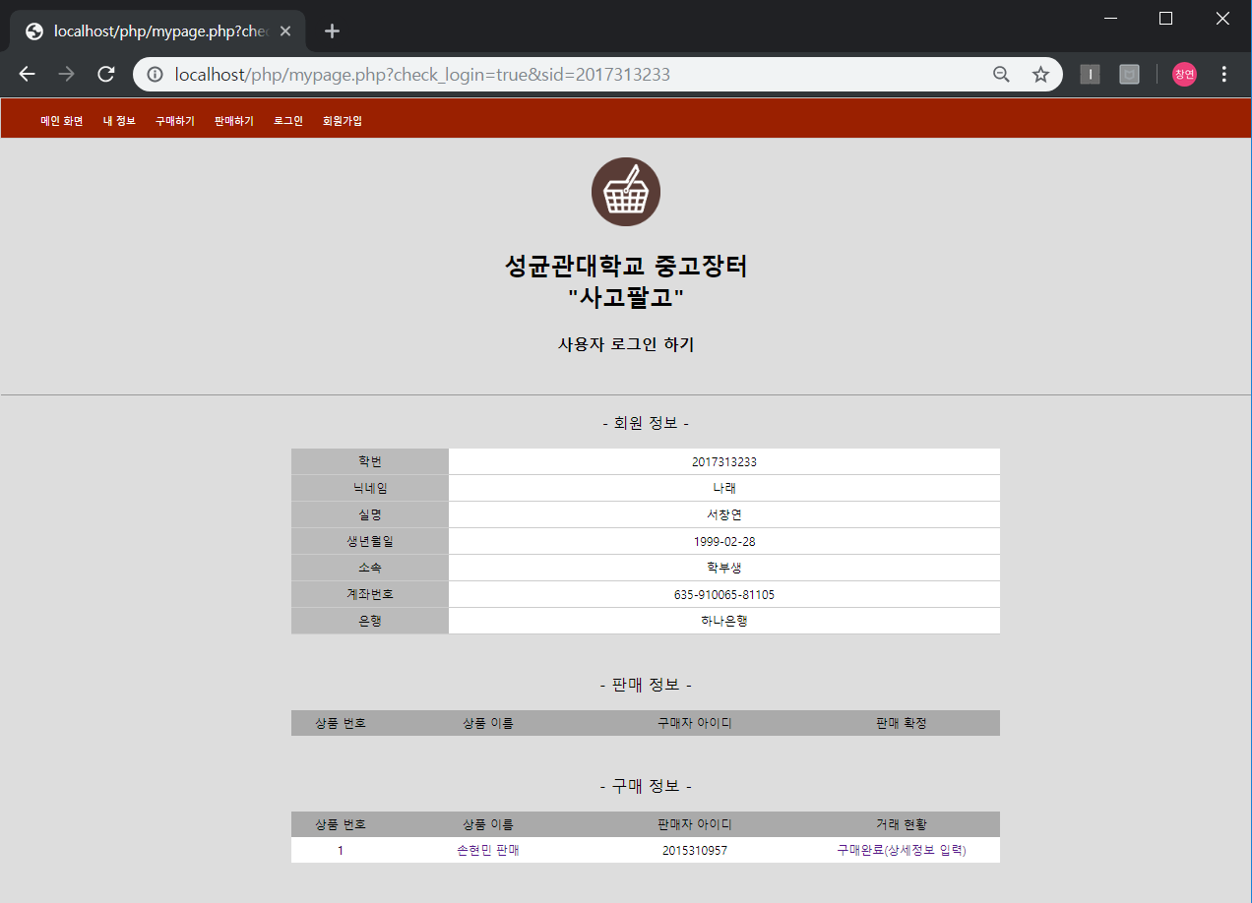
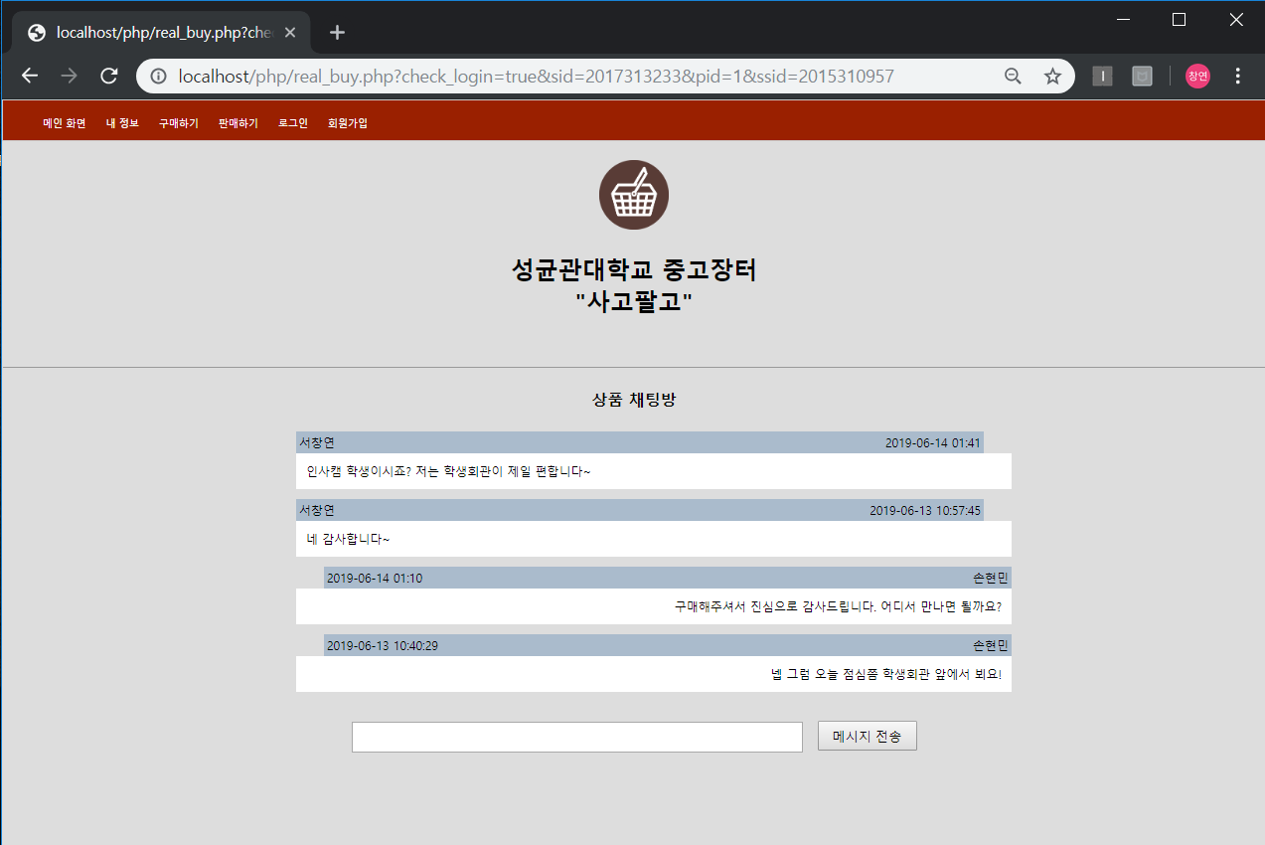
Demonstration

Slide 7
Product_instance_status
User_category
Product_id
password
nickname
Student_id
location
realname
Data
User_id
Upload_time
birth
User
Instance_time
1
price
Account_no
1
1
buy
has
Bank_name
1
write
Instance_time
N
sell
1
Product_explanation
Product_id
N
N
Comment_id
Product
Seller_student_id
comments
Comment_value
M
has
1
buyer_student_id
Comment_writer_nickname
Product_title
Write_timestamp
Instance_time
Product_id
Comment_writer_id

Slide 8
User
Student_id | User_id | Password | User_category | Nickname | Realname | Account_no | Bank_name | birth
Comments
Product_id | Comment_id | Comment_value | Comment_writer_id | Comment_writer_nickname | Write_timestamp
Buy_
instance
Buy_instance_key | Product_id | Buyer_sid | Instance_time
Message
Message_id | Sender_sid | Receiver_sid | timestamp | Product_id | Message_value
Products
Product_id | Product_title | Product_explanation | Seller_student_id | Buyer_student_id
Data
Product_id | Location | Product_instance_status | Upload_time | price

