Slide 1
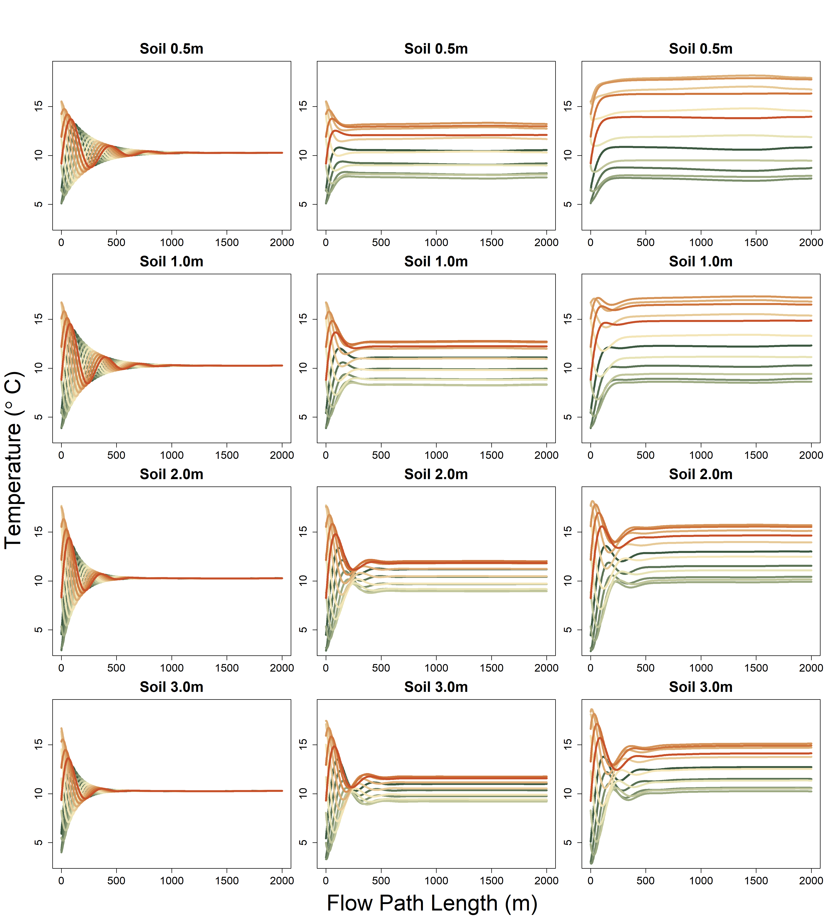
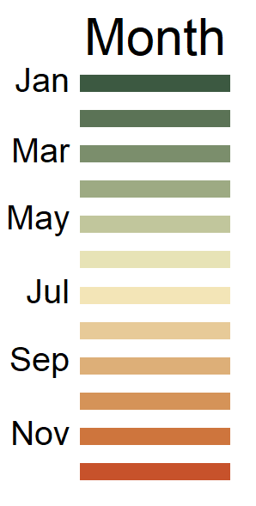
River Only
Shady
Sunny

Slide 2
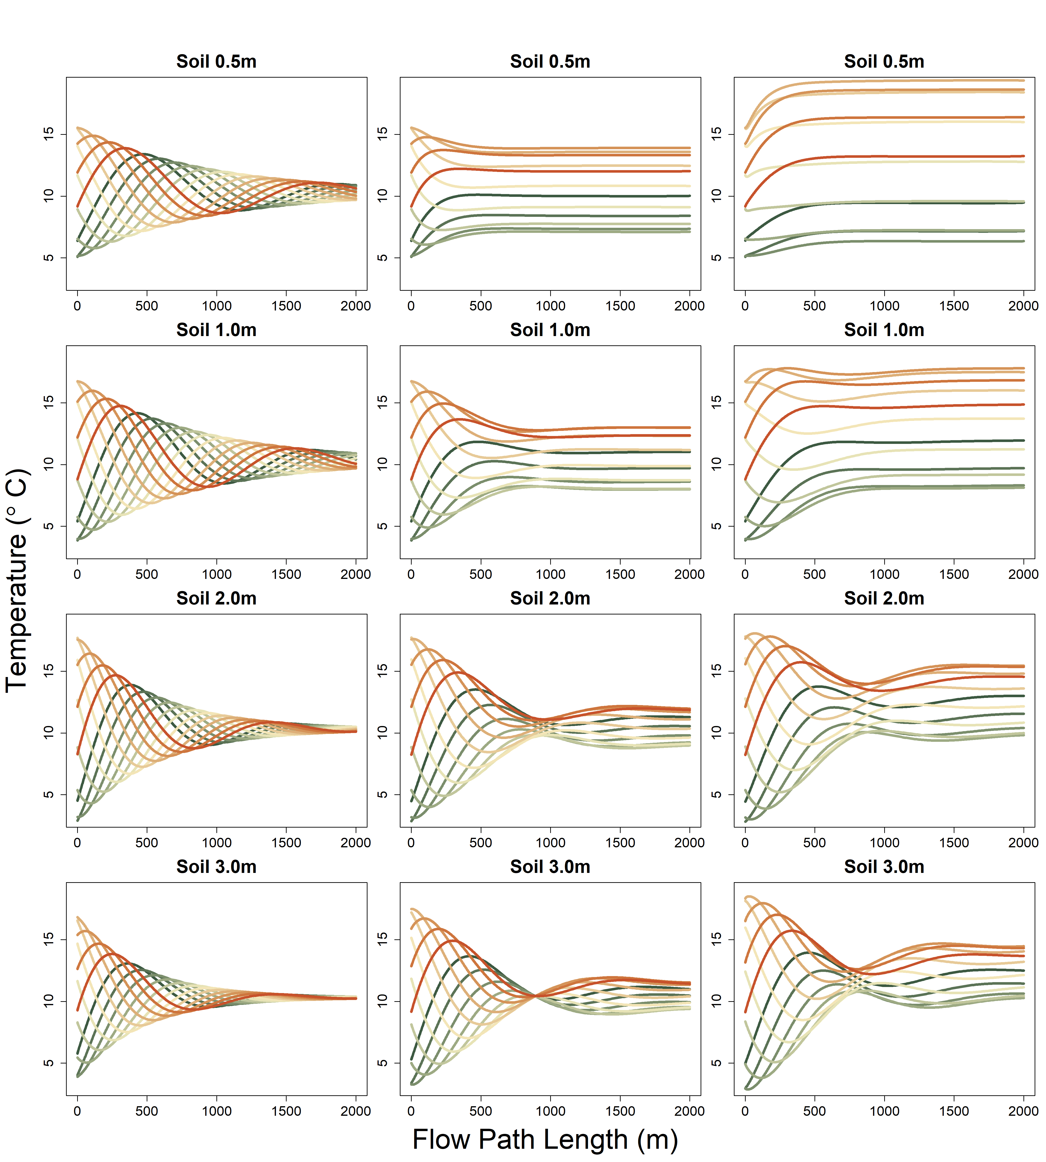
River Only
Shady
Sunny
K= 400 m day-1
Model run with max x = 2000

Slide 3
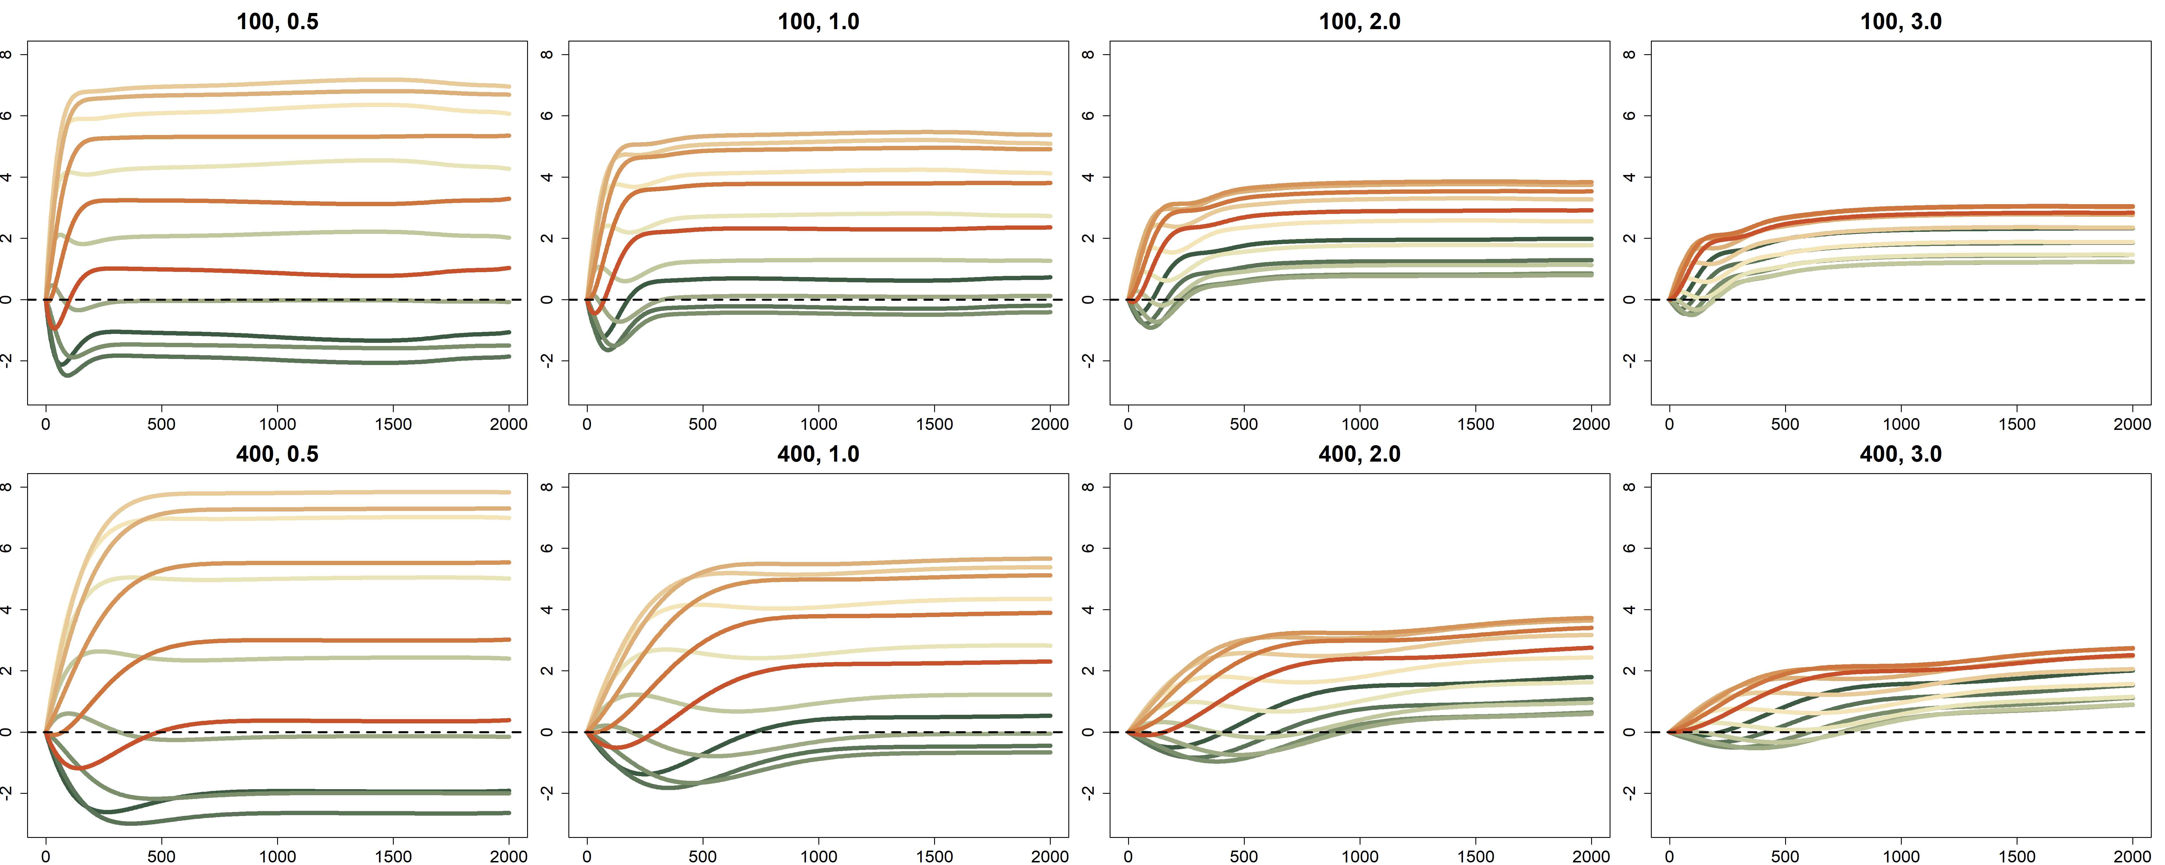
A
Soil 0.5m
Soil 1.0m
Soil 2.0m
Soil 3.0m
Temperature Difference (°C)
B
Soil 0.5m
Soil 1.0m
Soil 2.0m
Soil 3.0m
Temperature Difference (°C)
Flow Path Length (m)

Slide 4
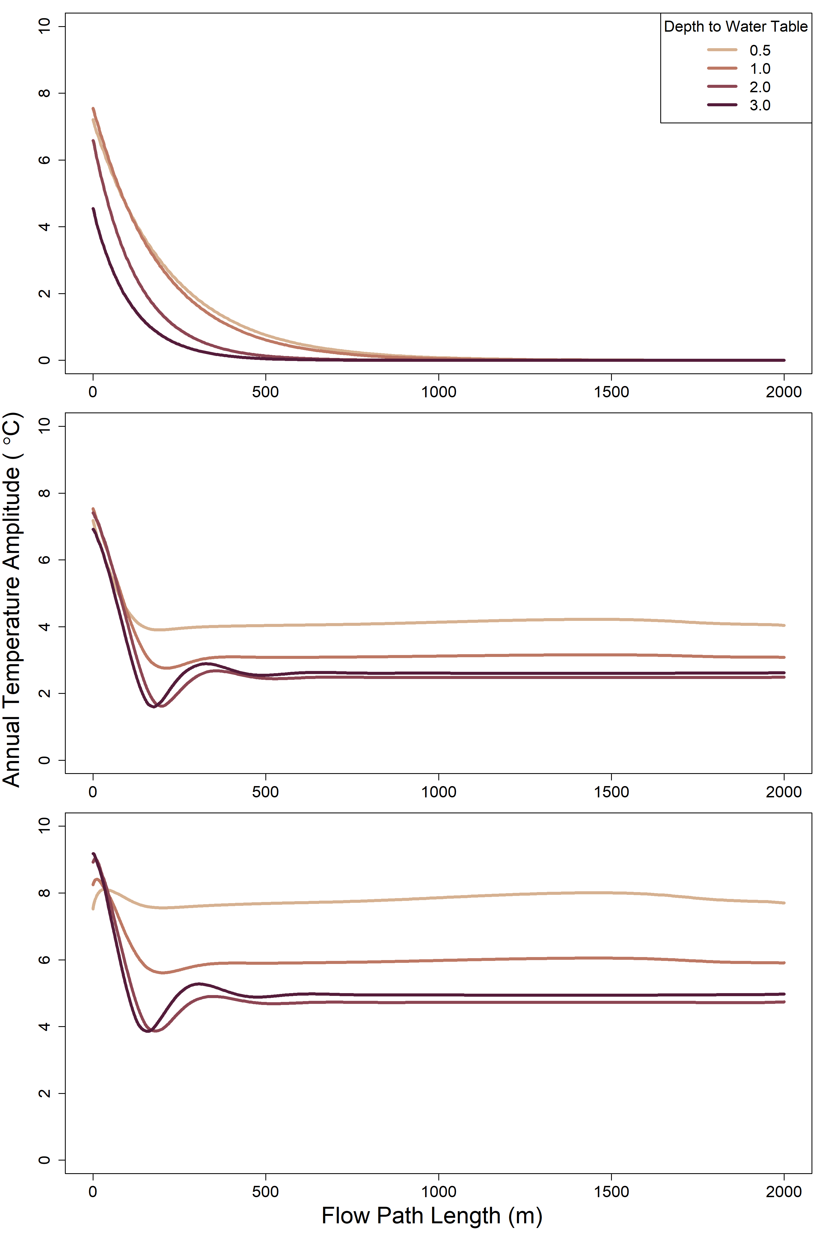
A
B
C

Slide 5
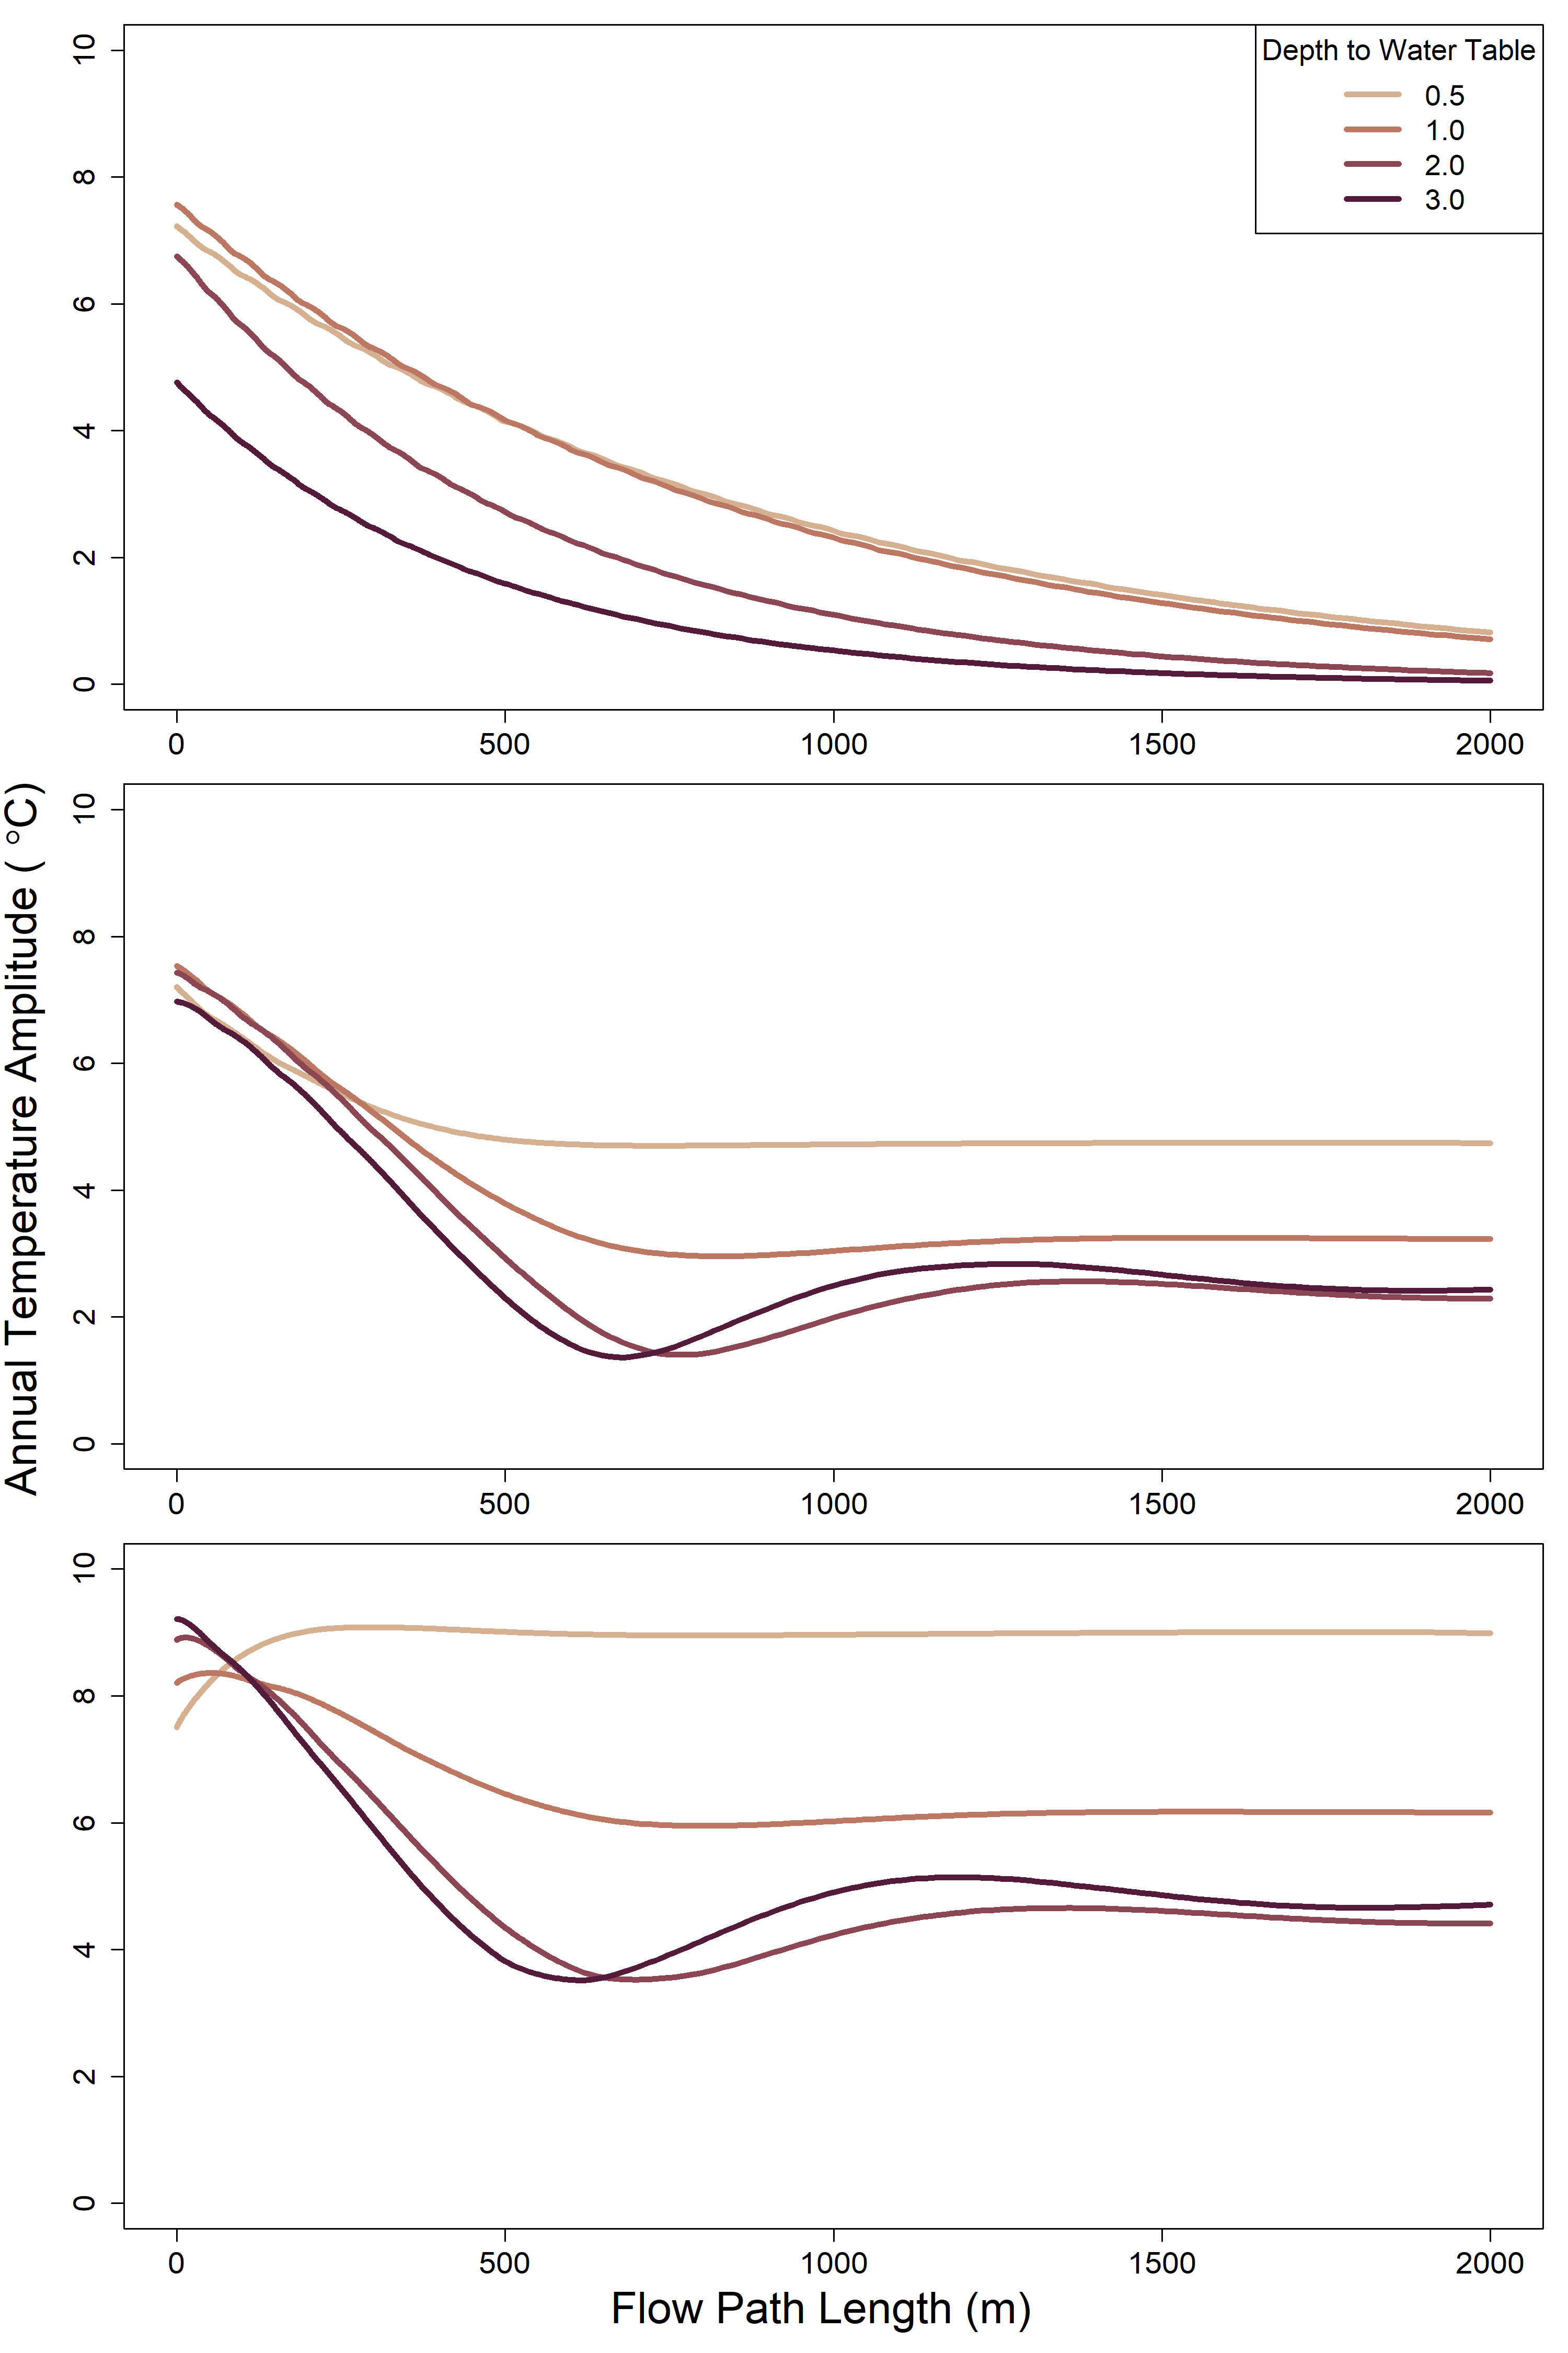
A
B
C

