Slide 1
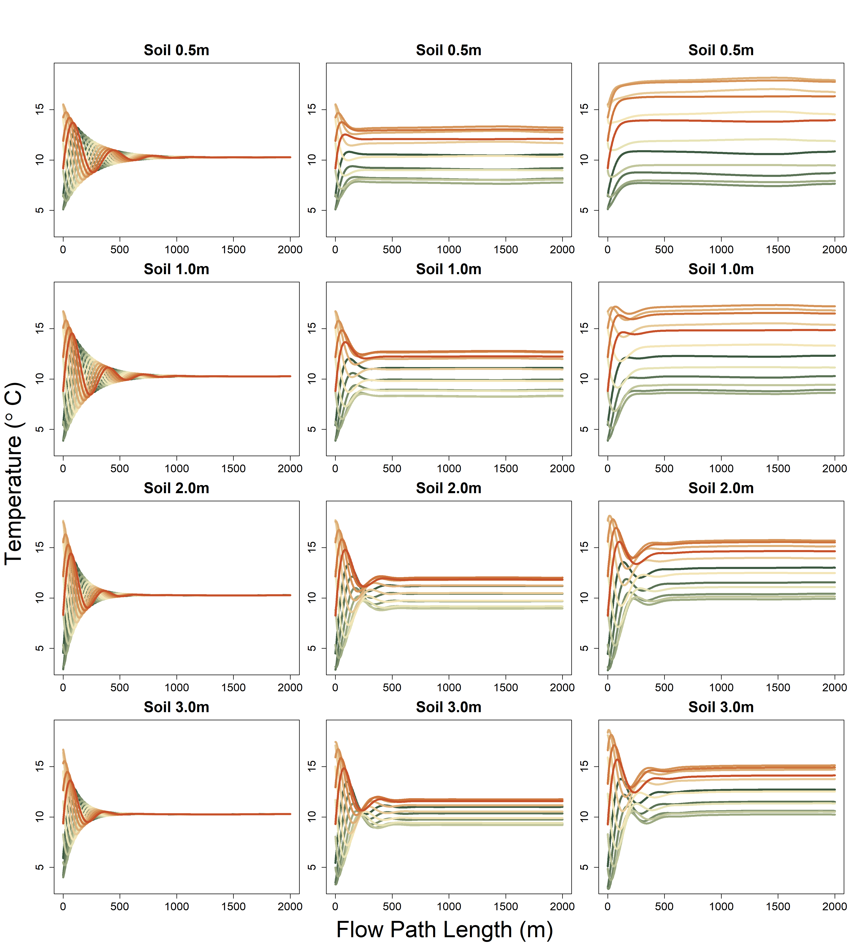
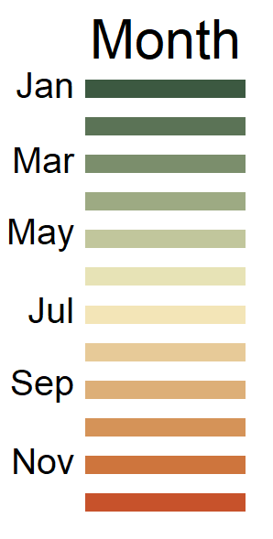
River Only
Shady
Sunny

Slide 2
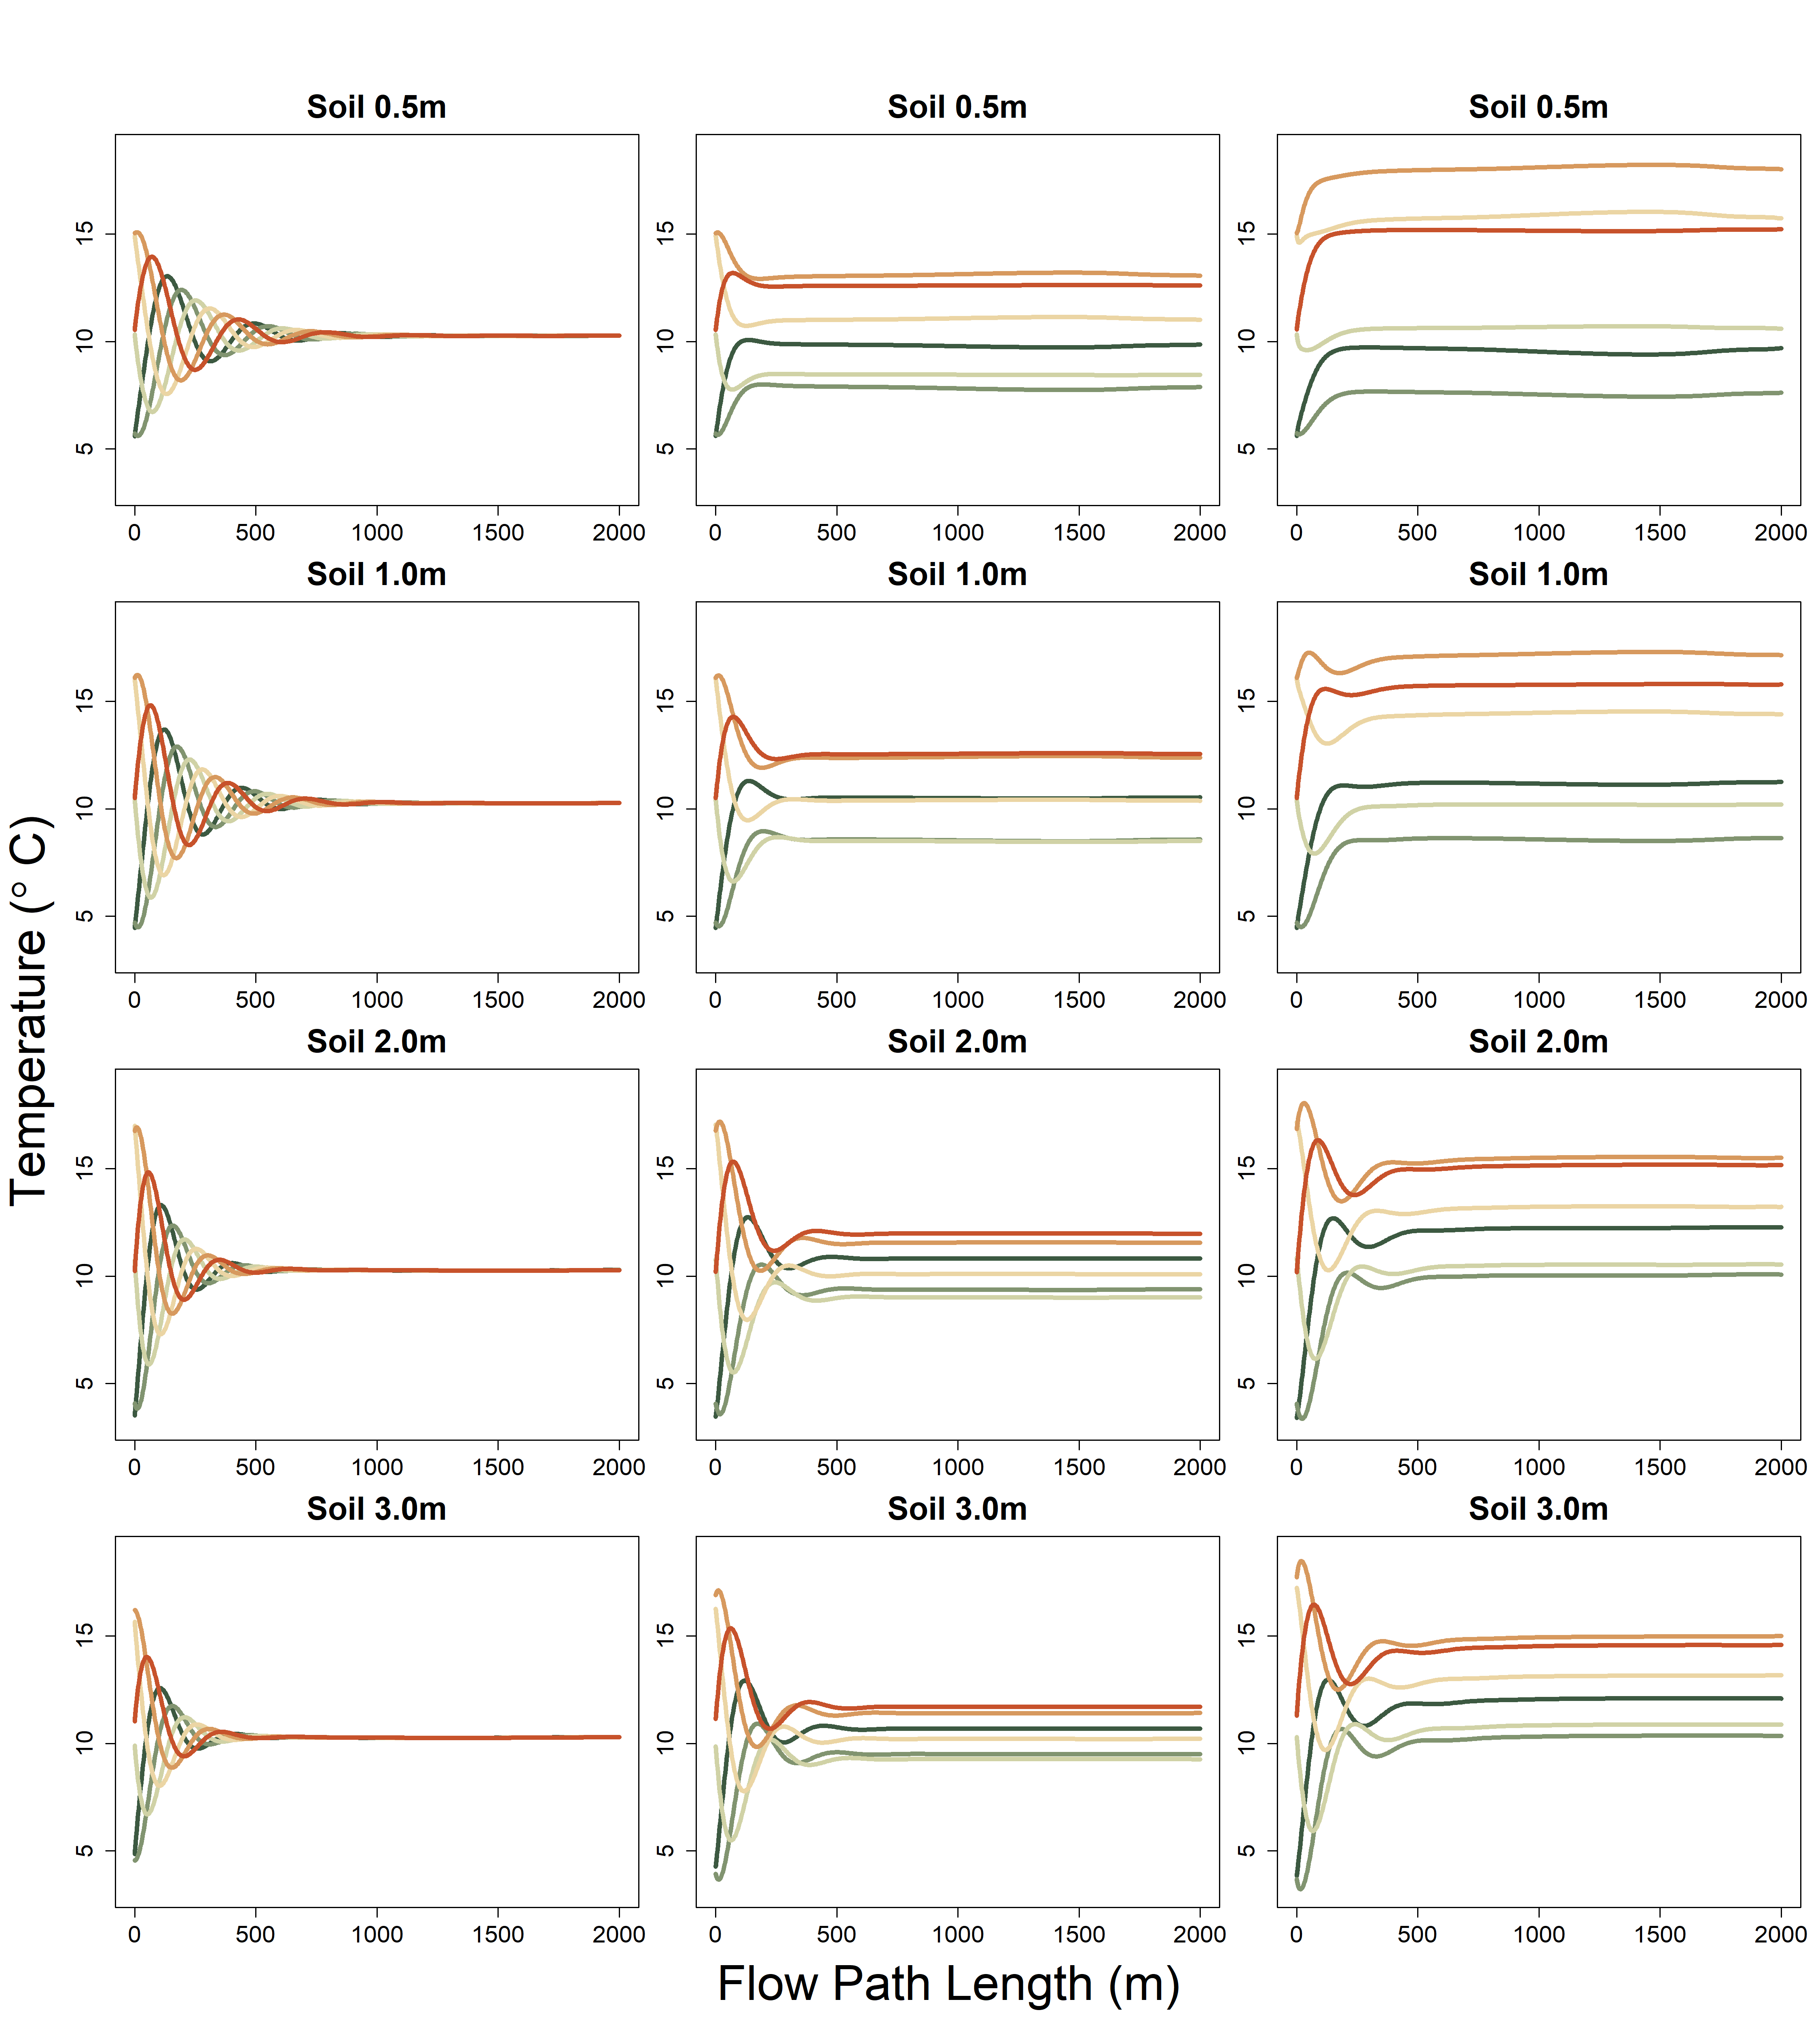
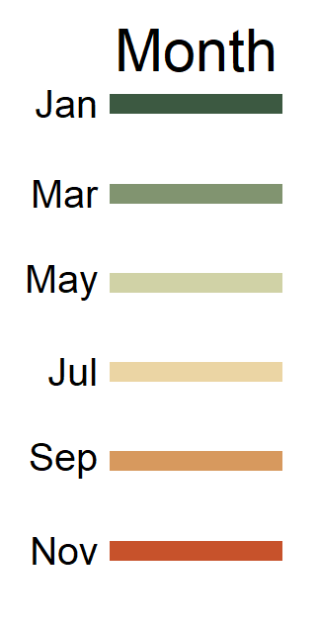
River Only
Shady
Sunny

Slide 3
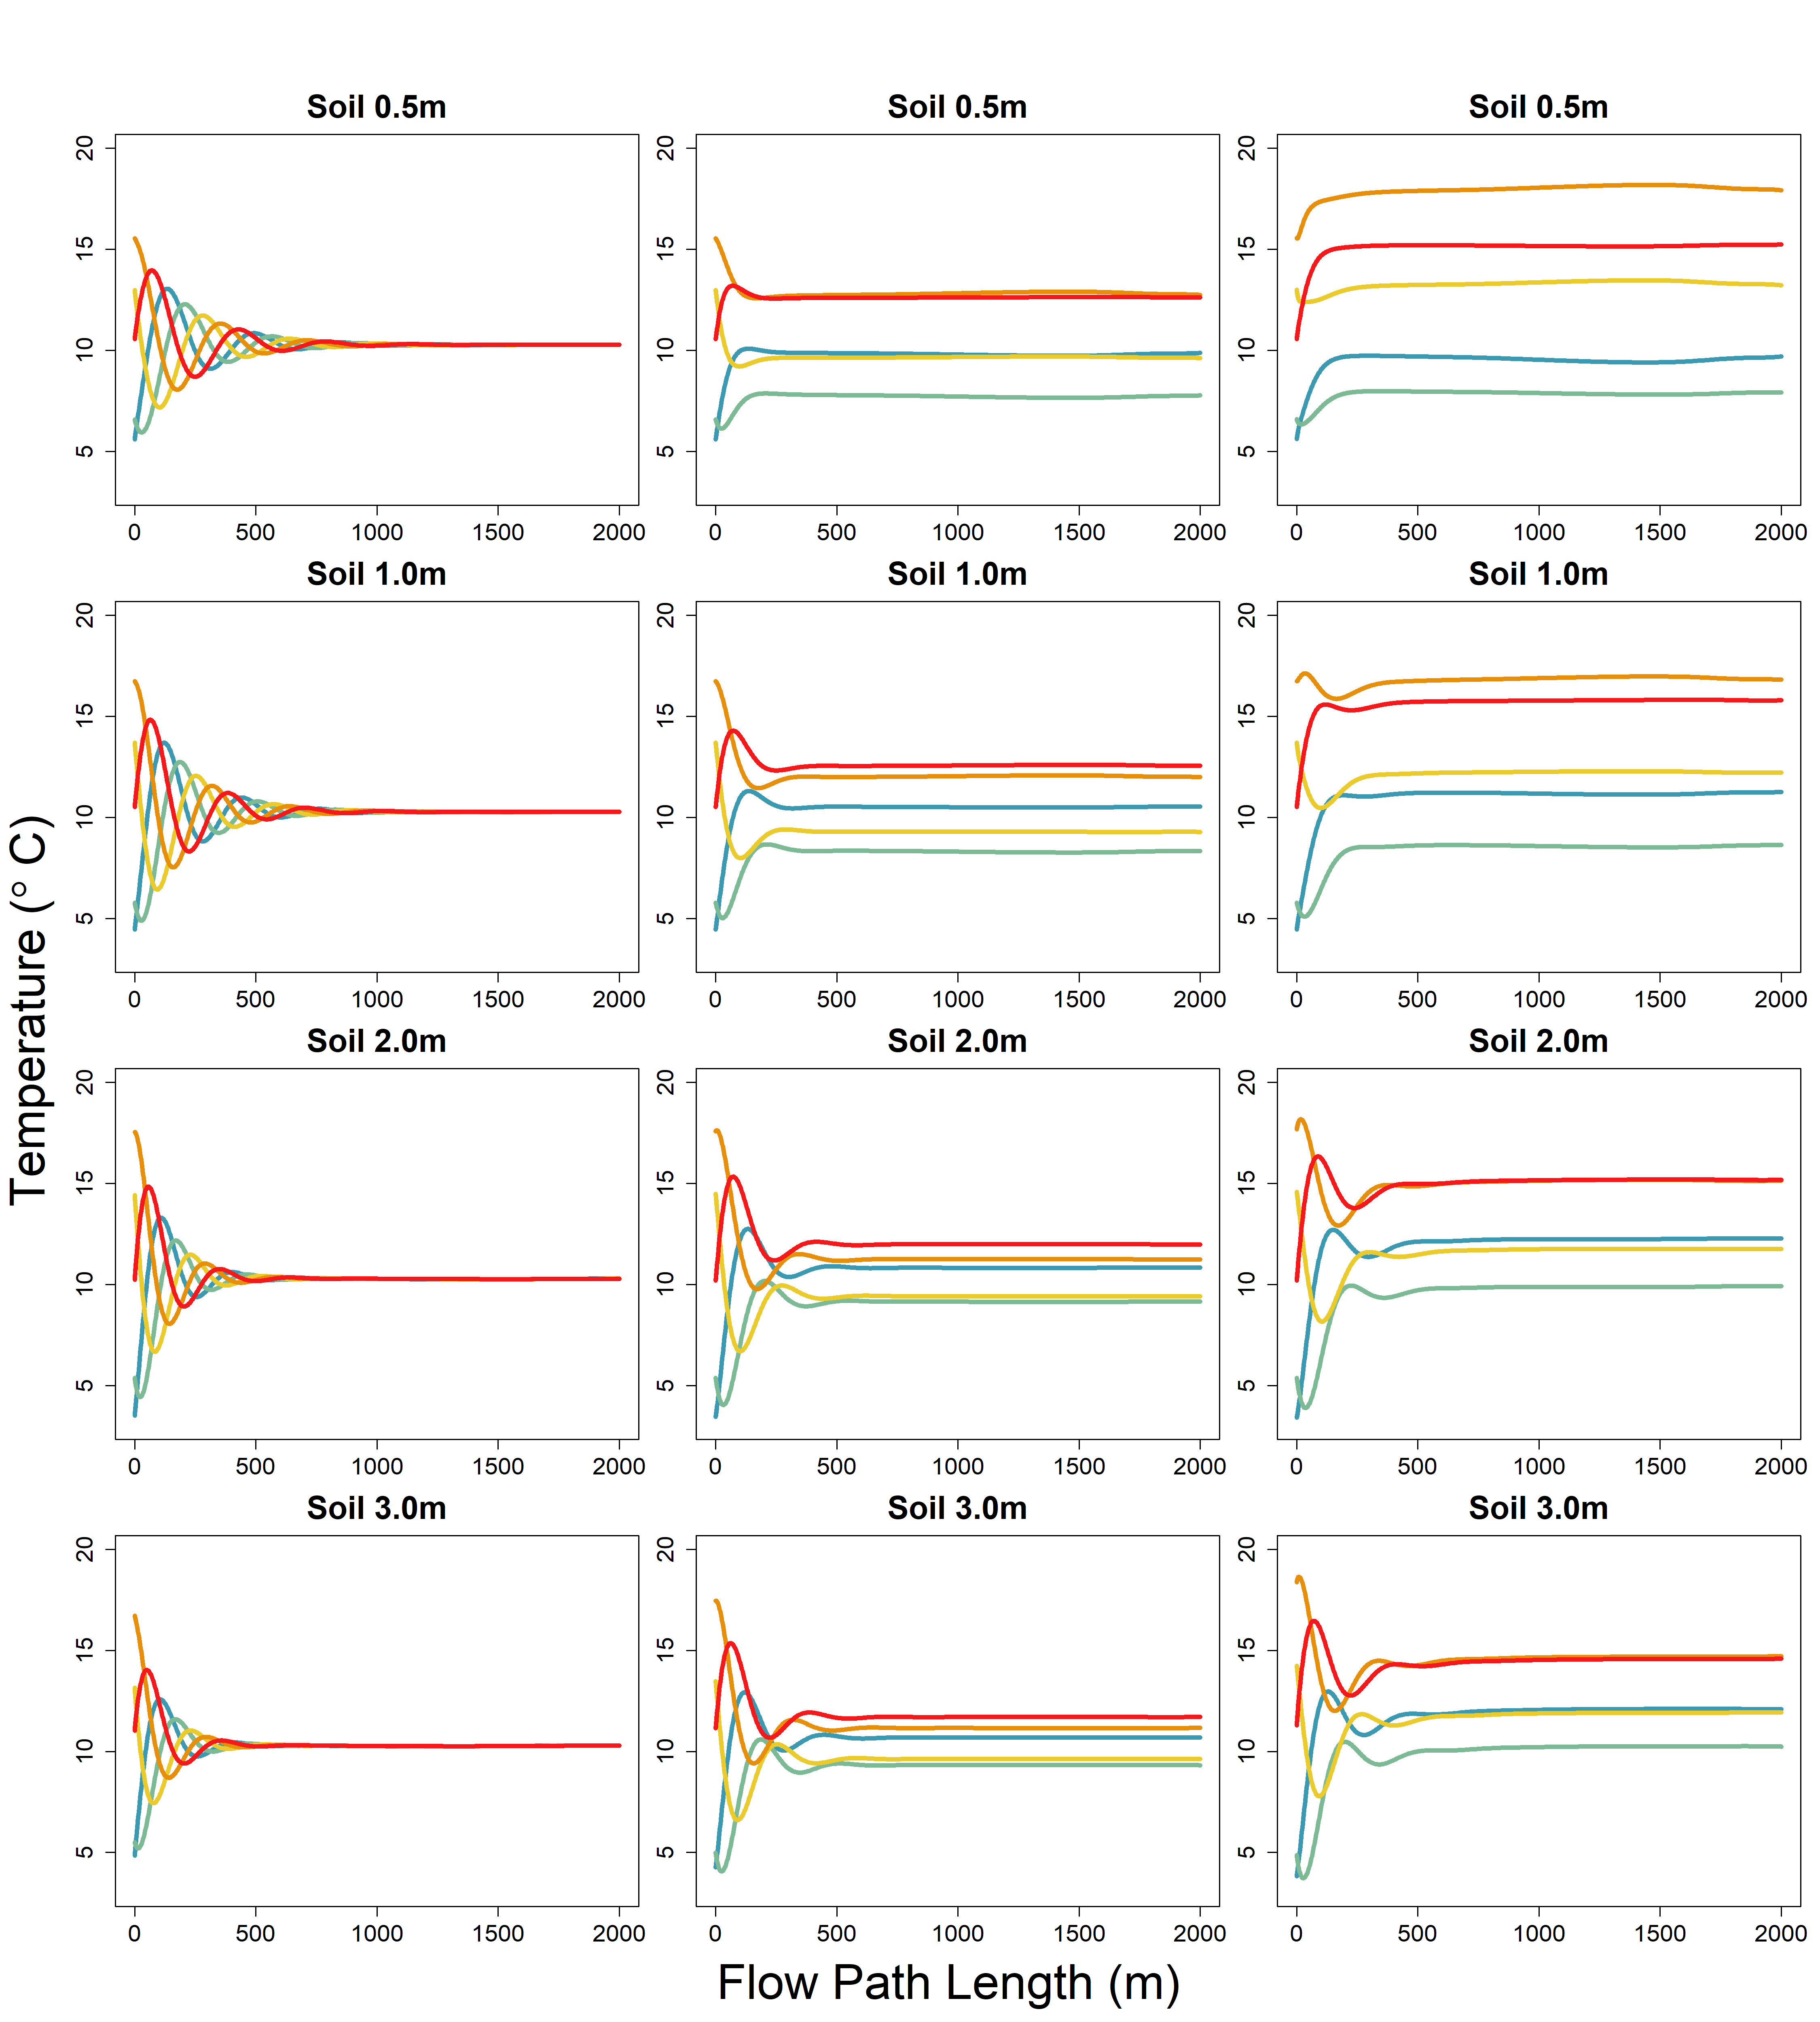
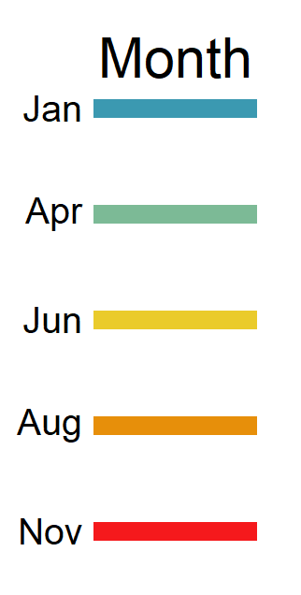
River Only
Shady
Sunny

Slide 4
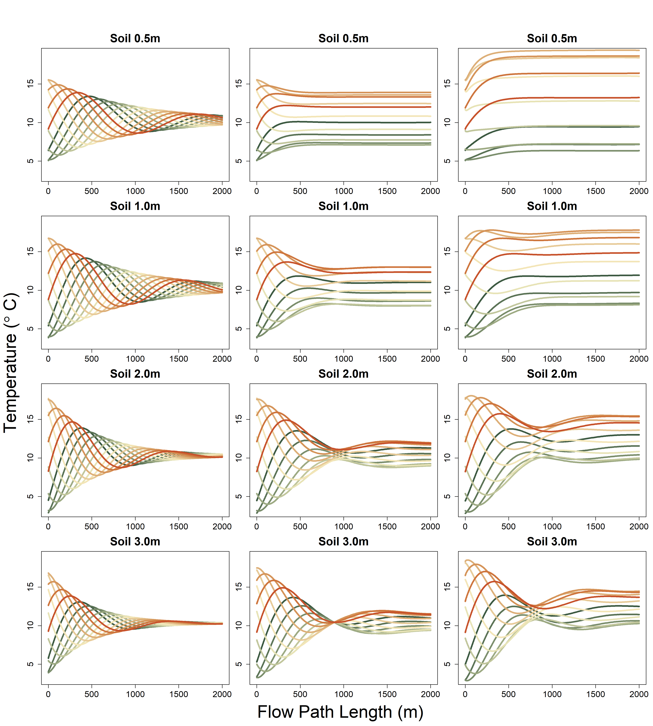
River Only
Shady
Sunny
K= 400 m day-1
Model run with max x = 2000

Slide 5
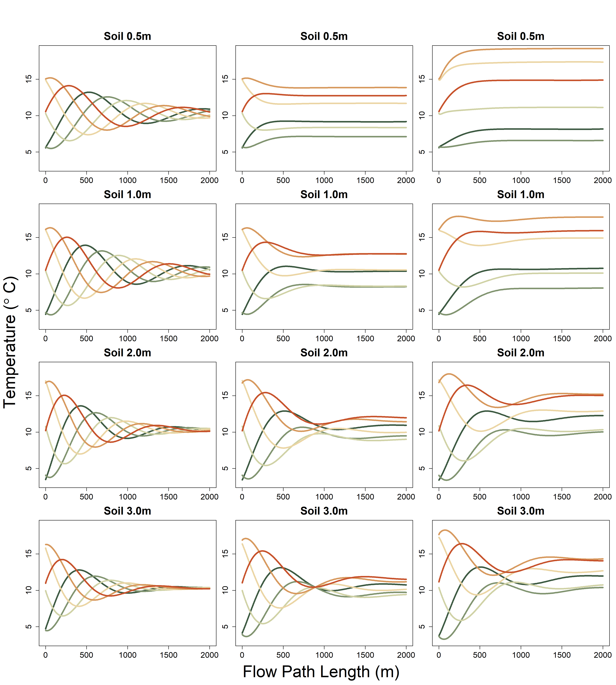
River Only
Shady
Sunny

Slide 6
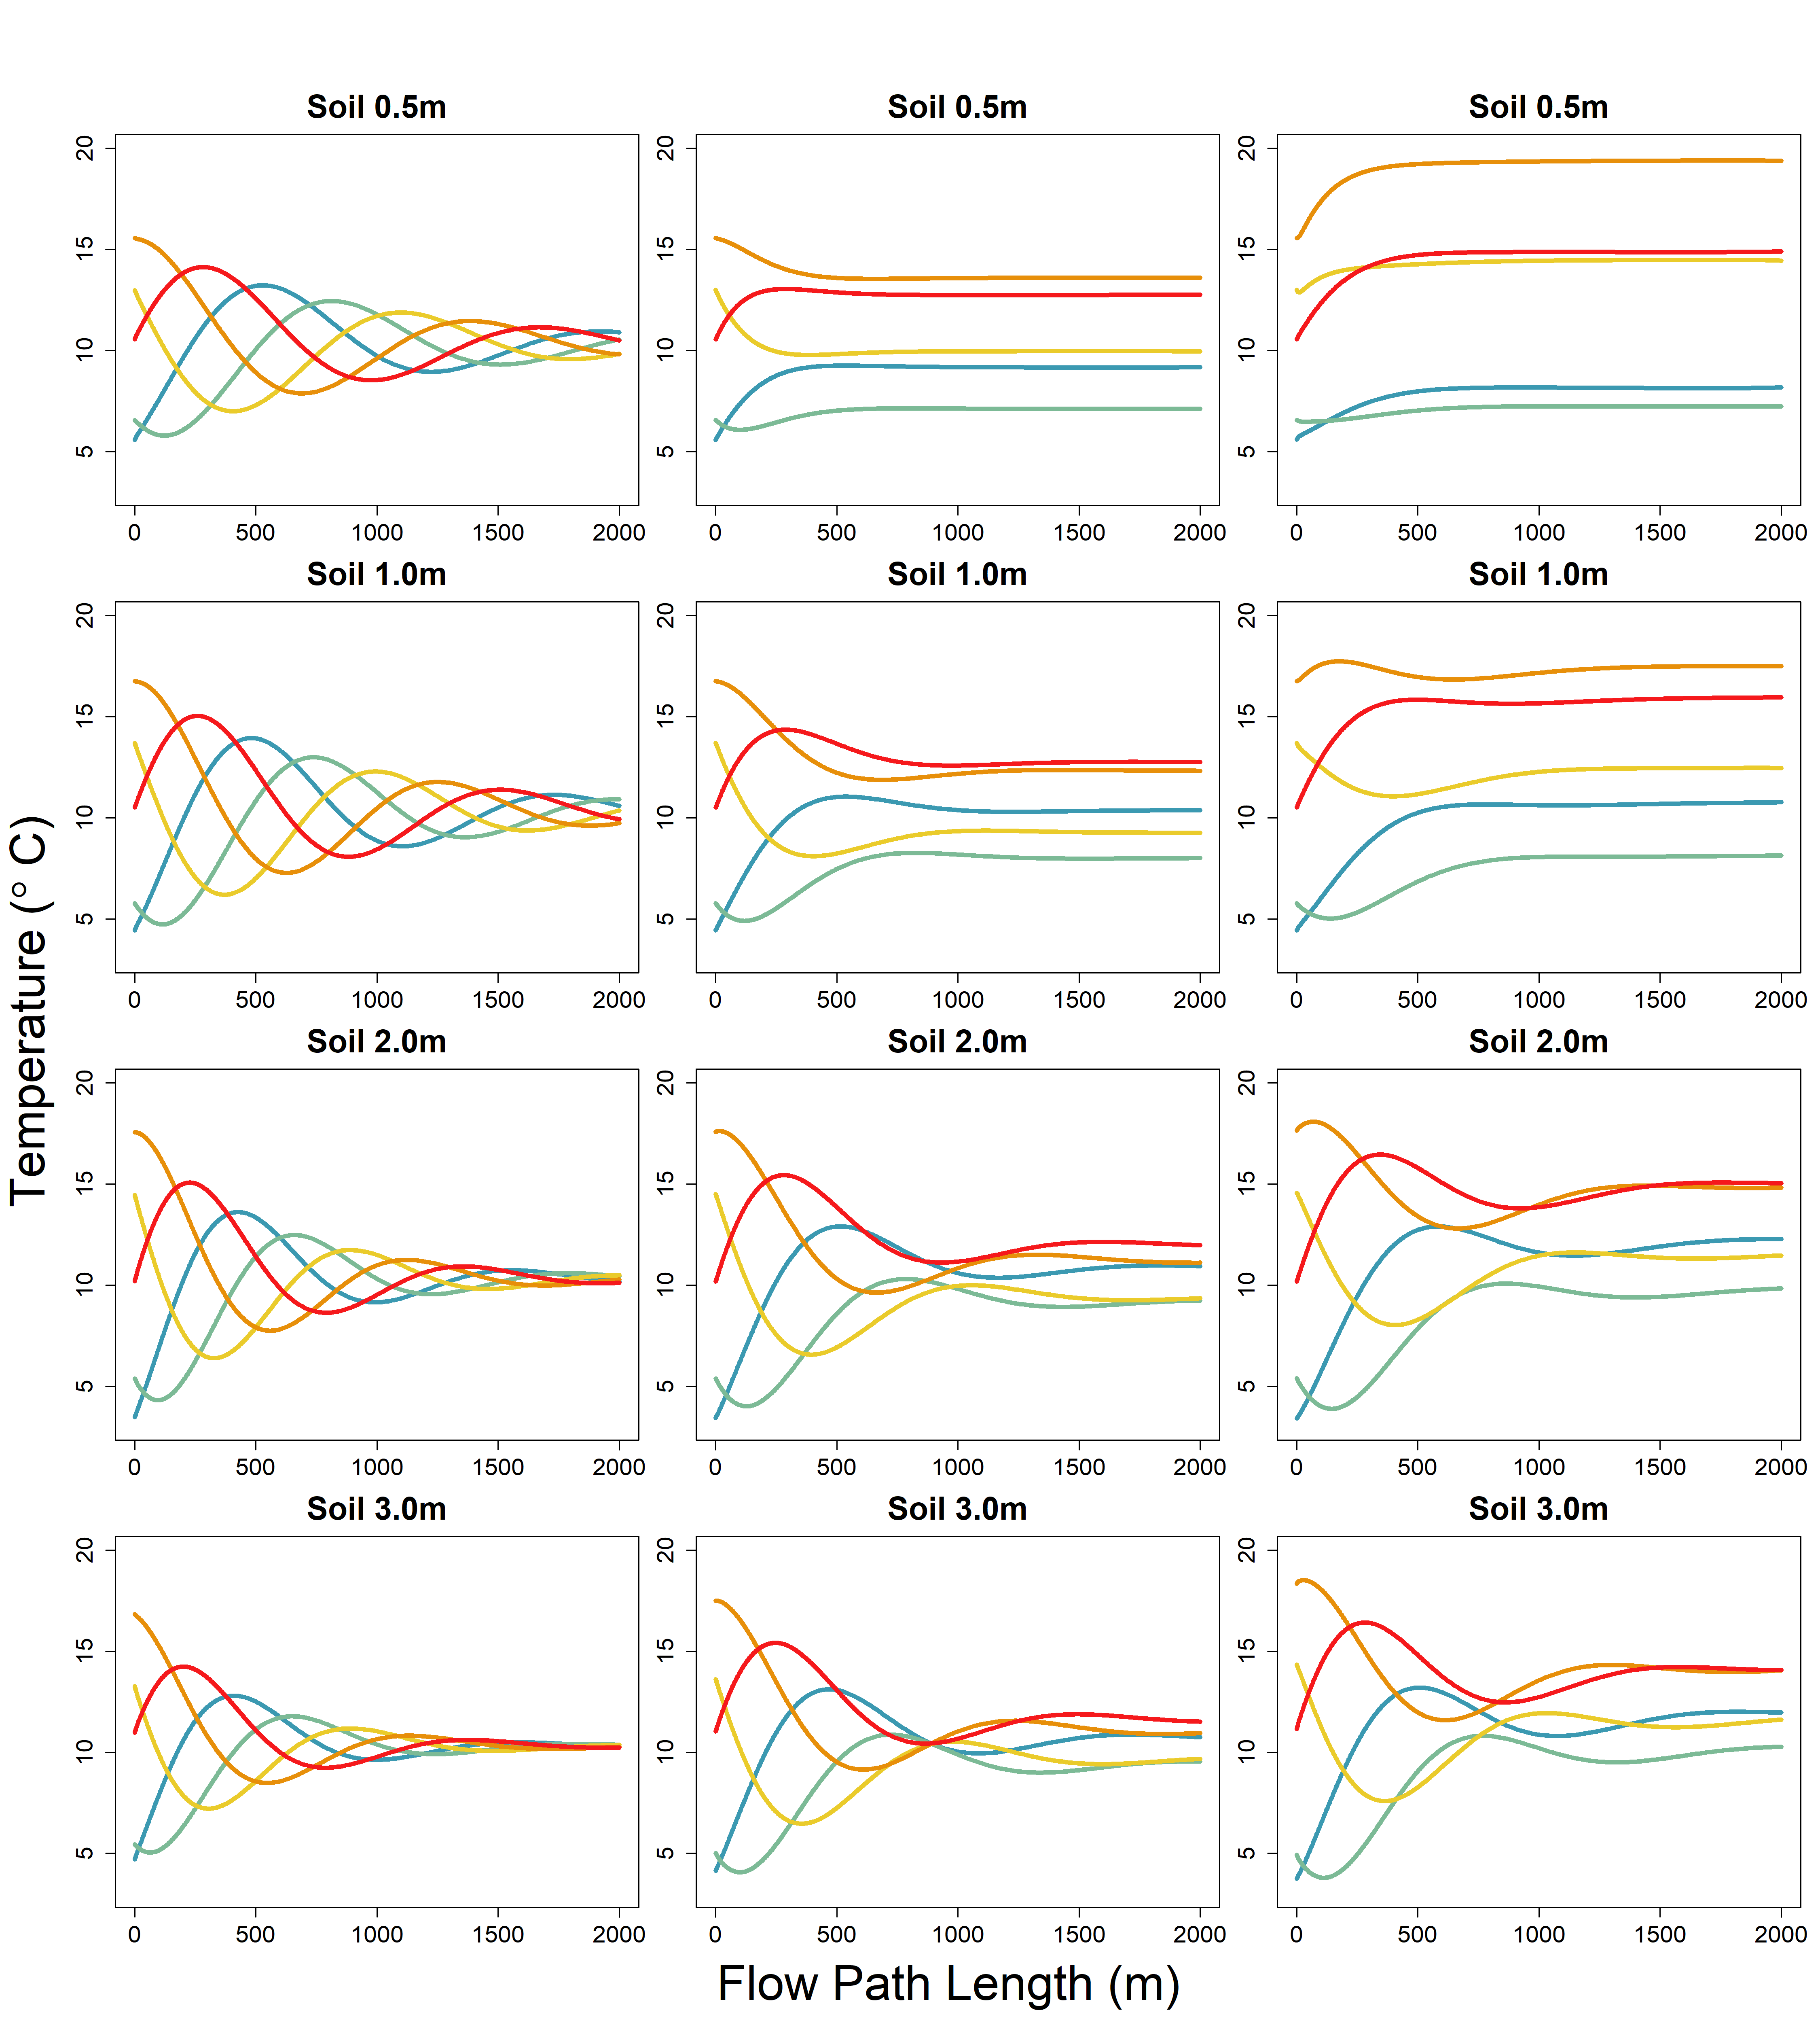
River Only
Shady
Sunny

Slide 7
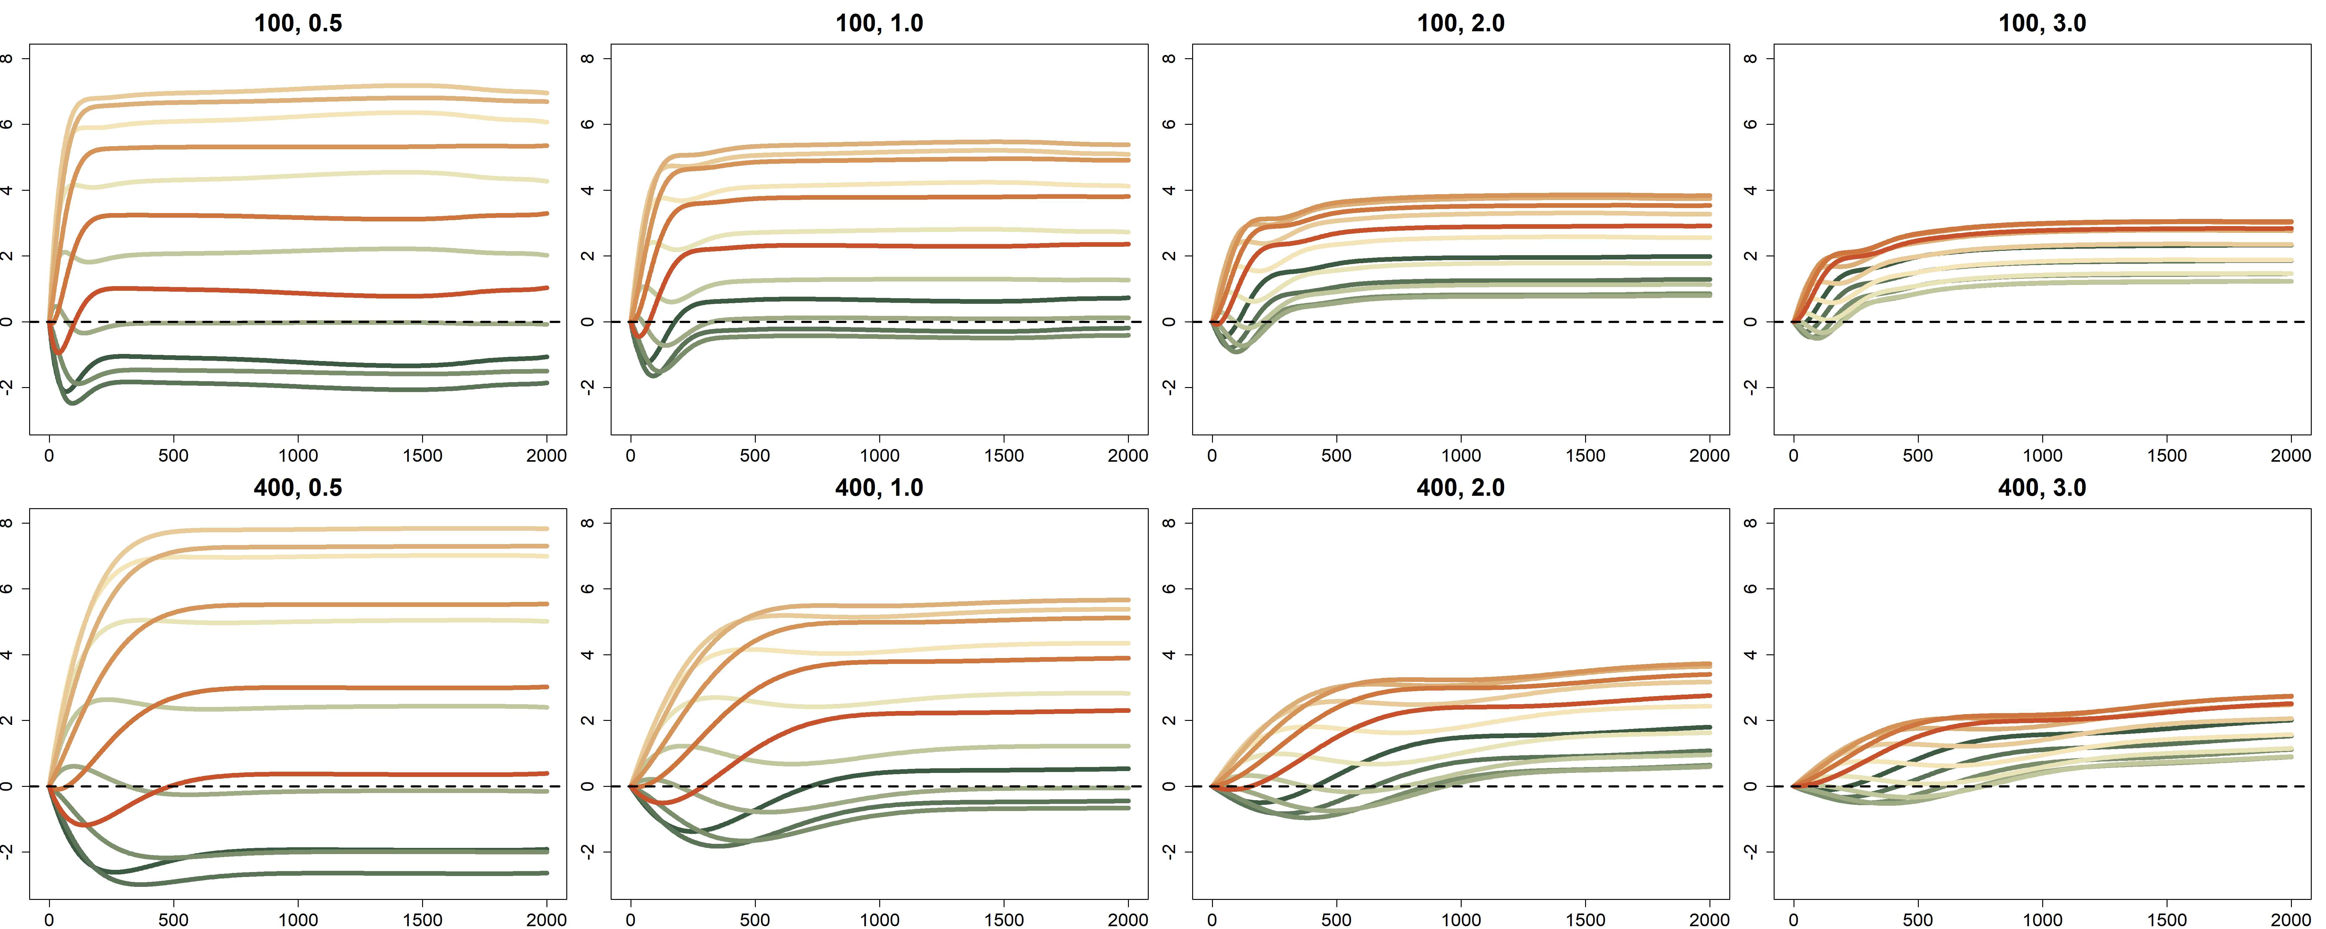
A
Soil 0.5m
Soil 1.0m
Soil 2.0m
Soil 3.0m
Temperature Difference (°C)
B
Soil 0.5m
Soil 1.0m
Soil 2.0m
Soil 3.0m
Temperature Difference (°C)
Flow Path Length (m)

Slide 8
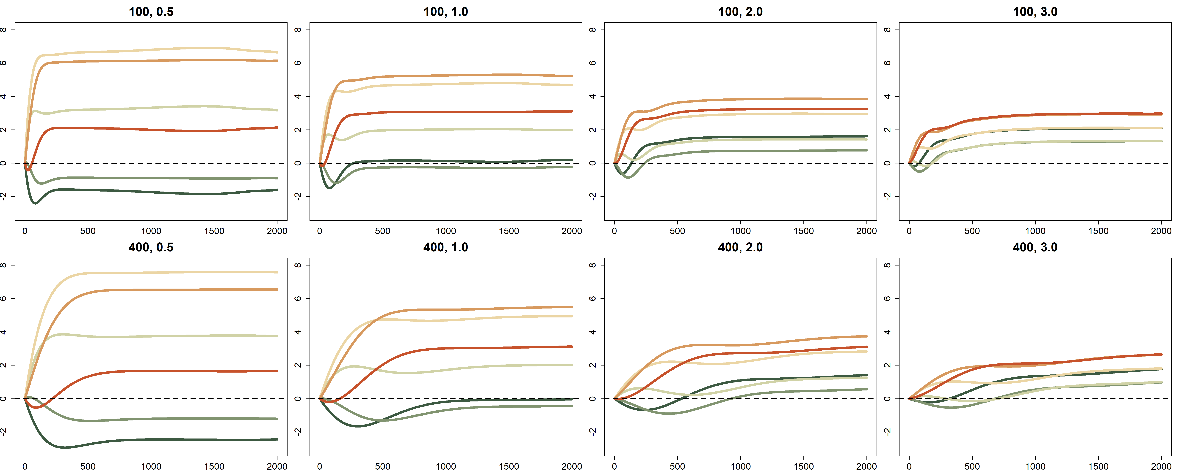
A
Soil 0.5m
Soil 1.0m
Soil 2.0m
Soil 3.0m
Temperature Difference (°C)
B
Soil 0.5m
Soil 1.0m
Soil 2.0m
Soil 3.0m
Temperature Difference (°C)
Flow Path Length (m)

Slide 9
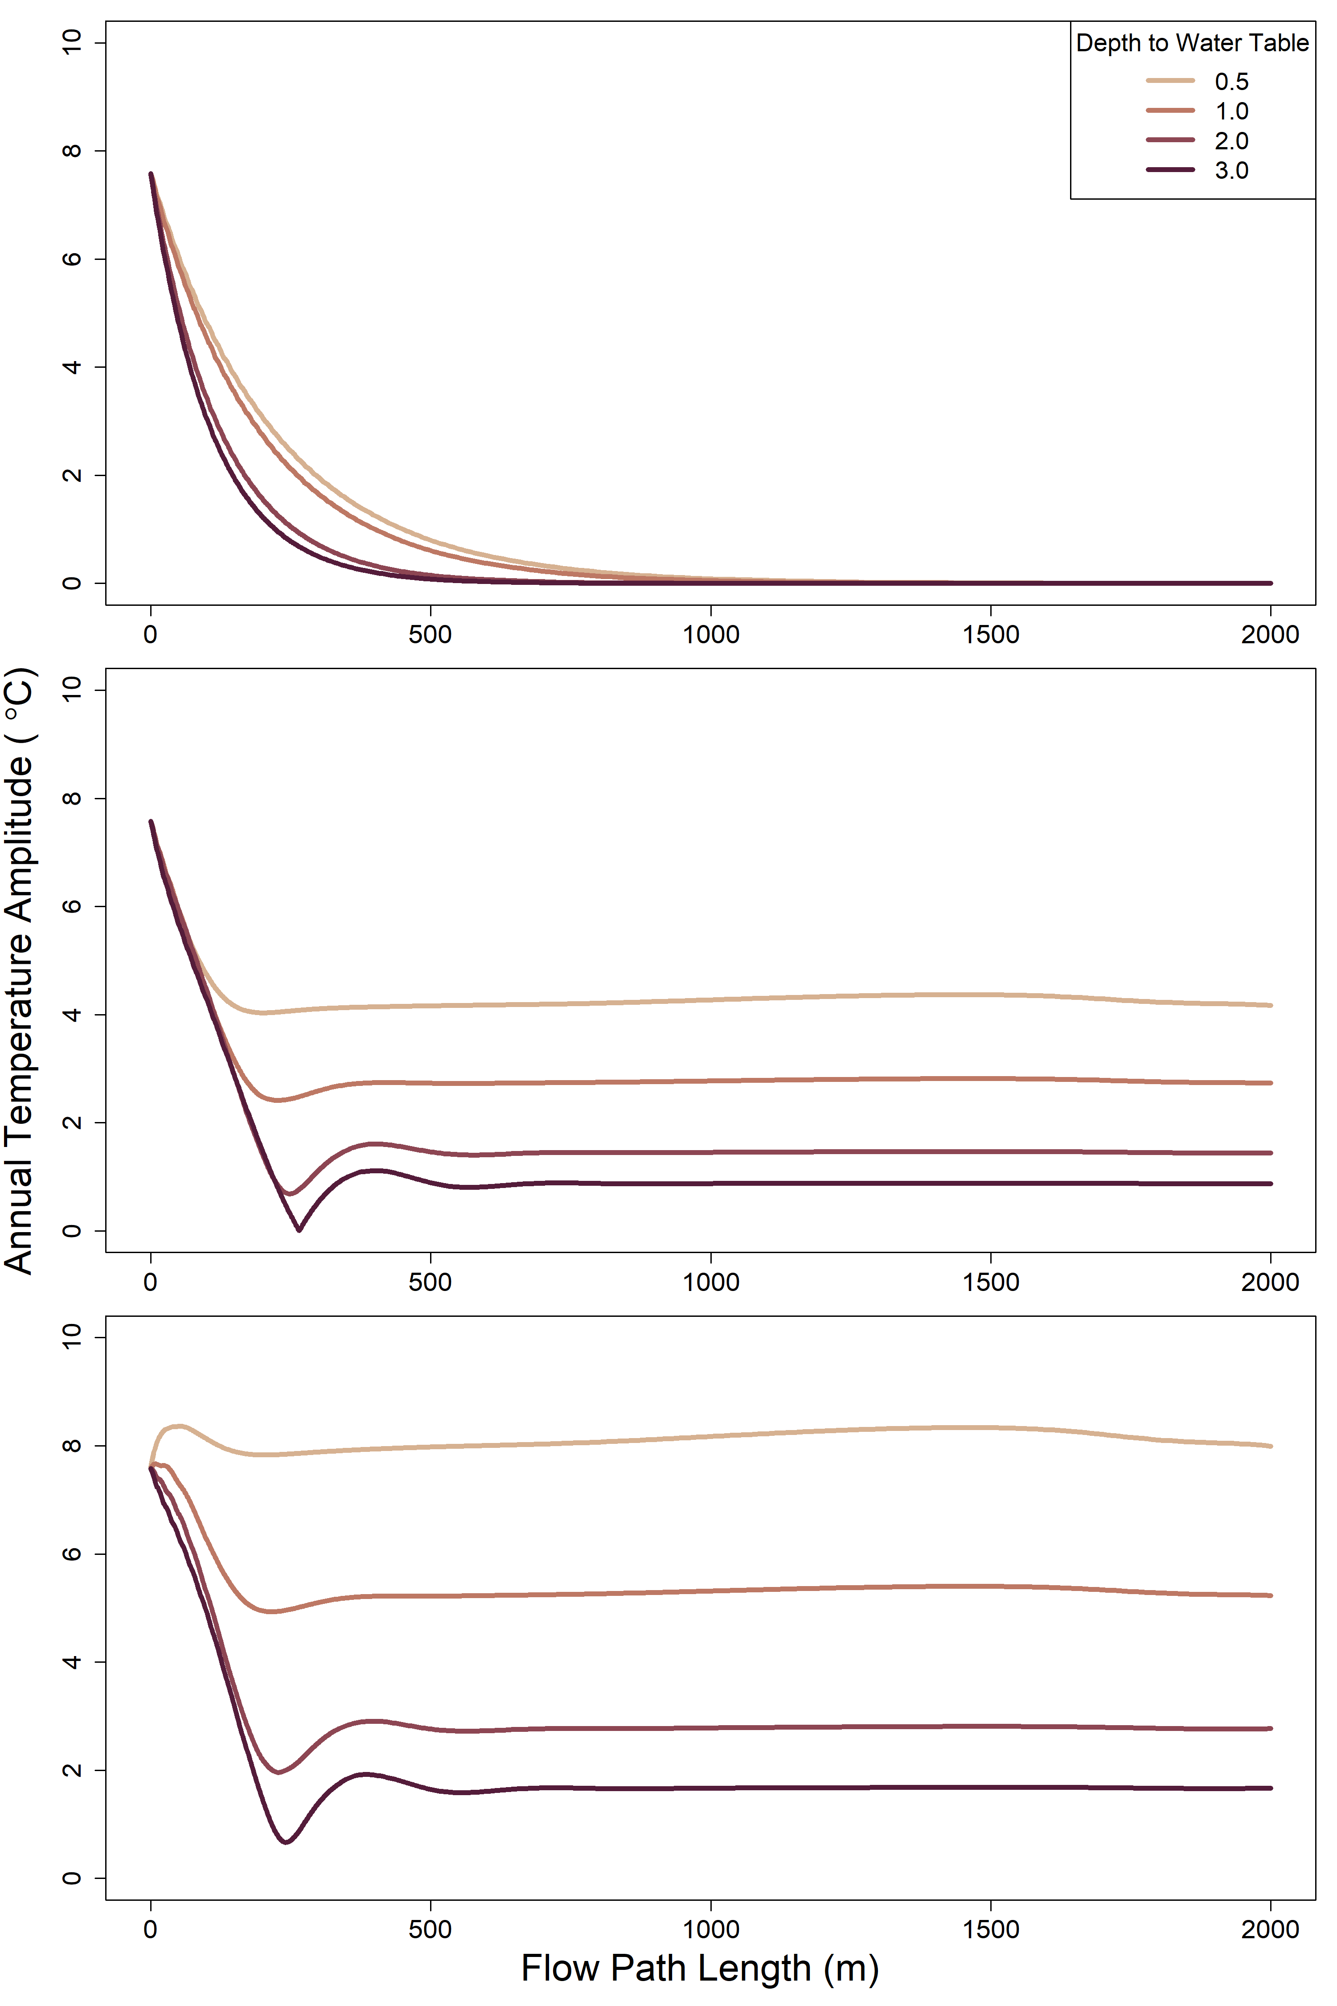
A
B
C

Slide 10
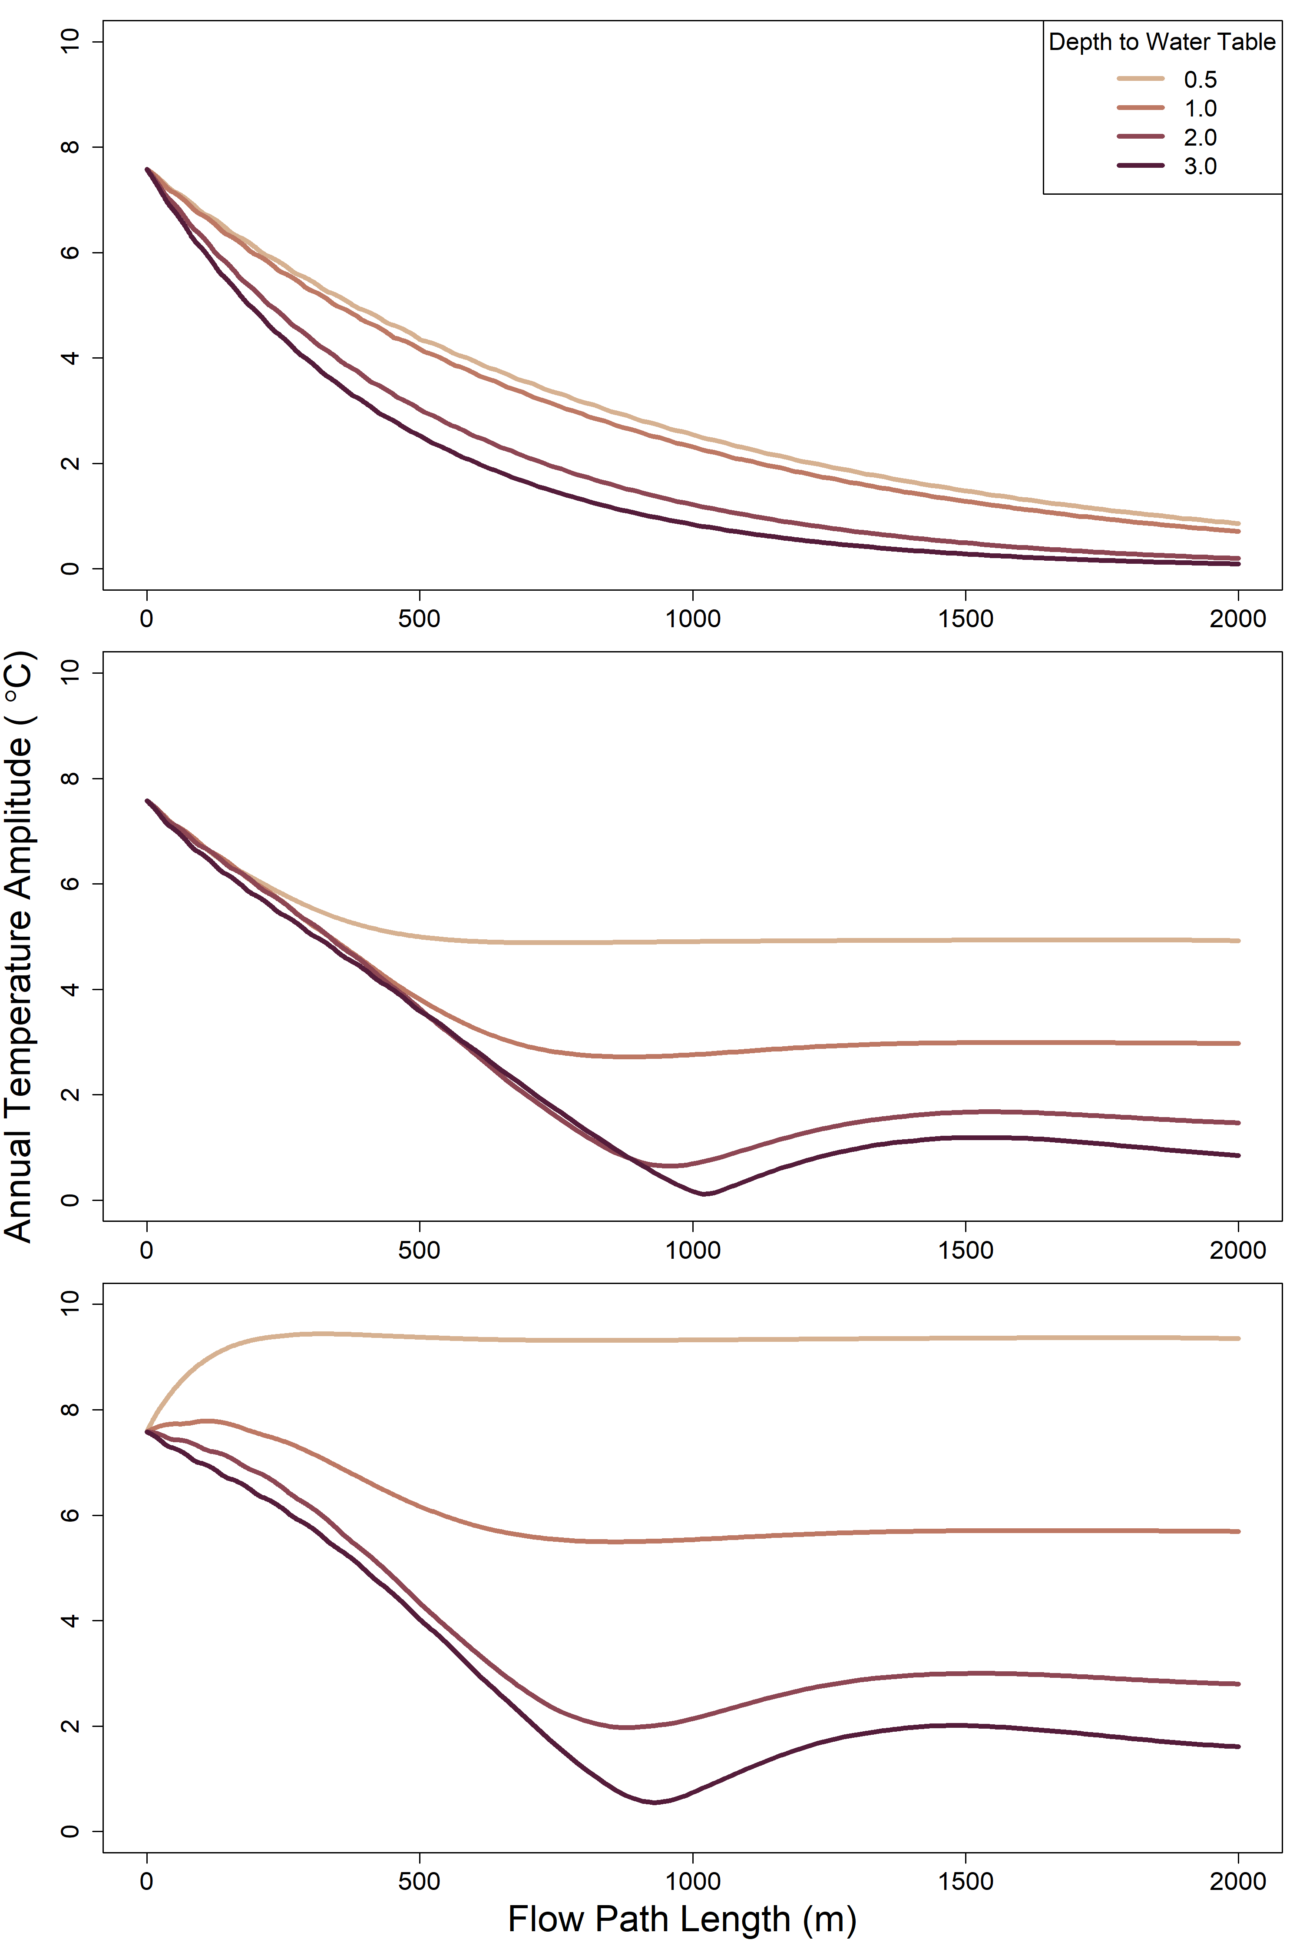
A
B
C

Slide 11
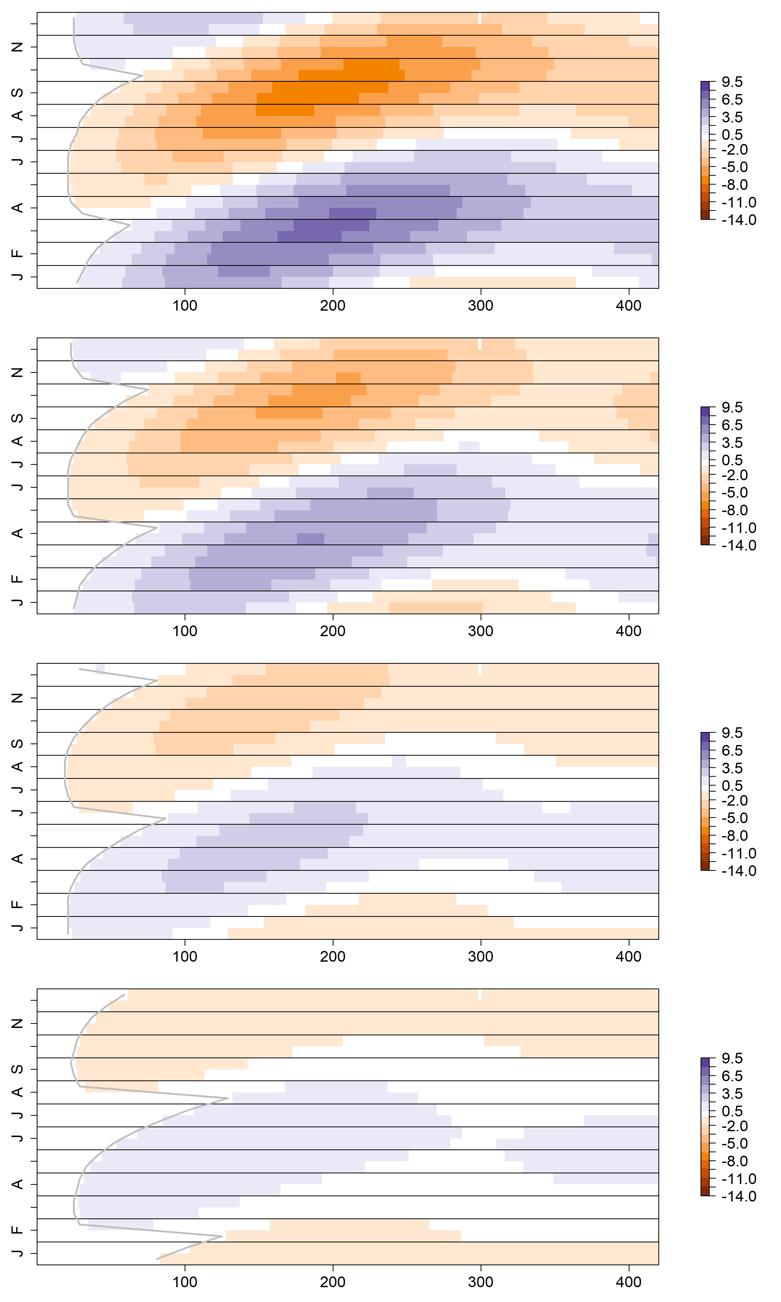
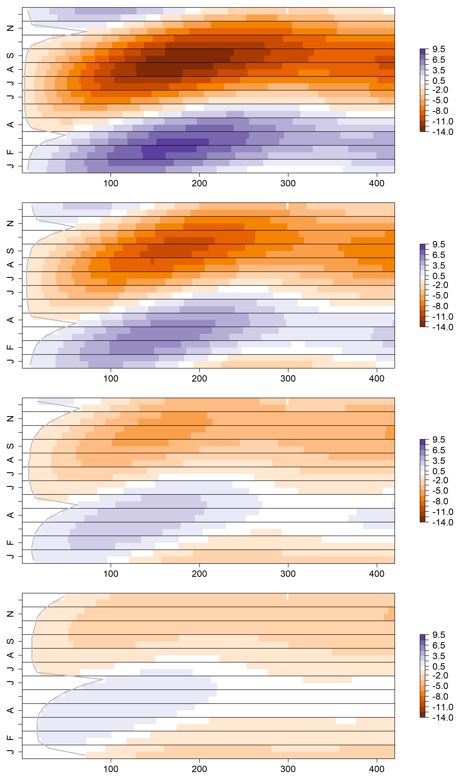
Shady
Sunny
0.5m
1.0m
Month
2.0m
3.0m
Flow Path Length (m)

Slide 12
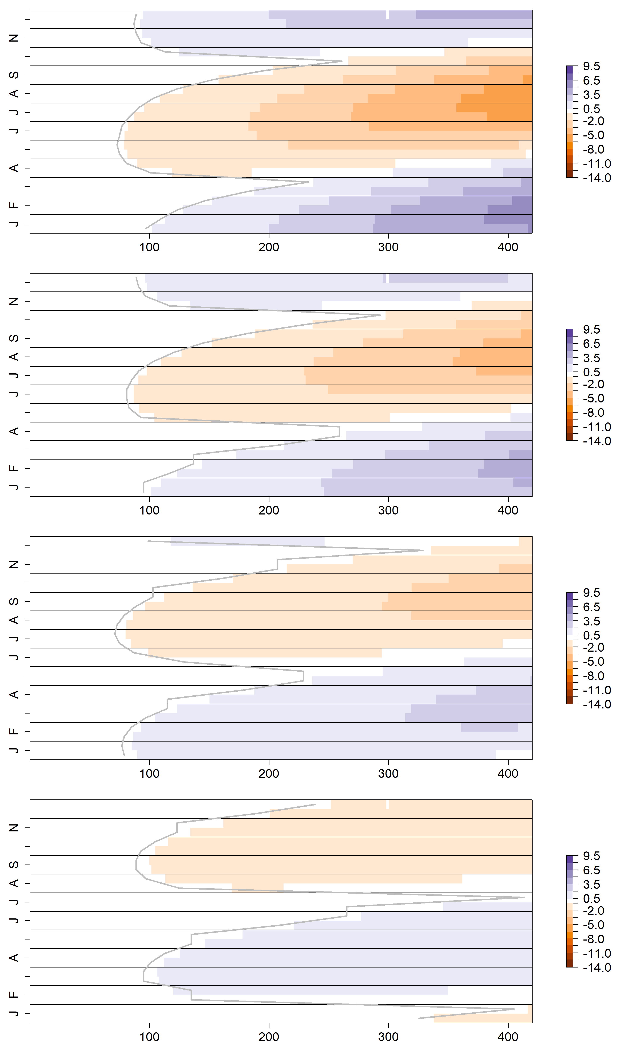
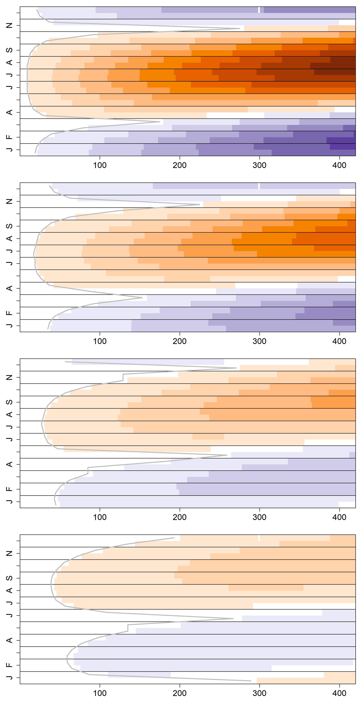
Shady
Sunny
0.5m
1.0m
Month
2.0m
3.0m
Flow Path Length (m)

Slide 13
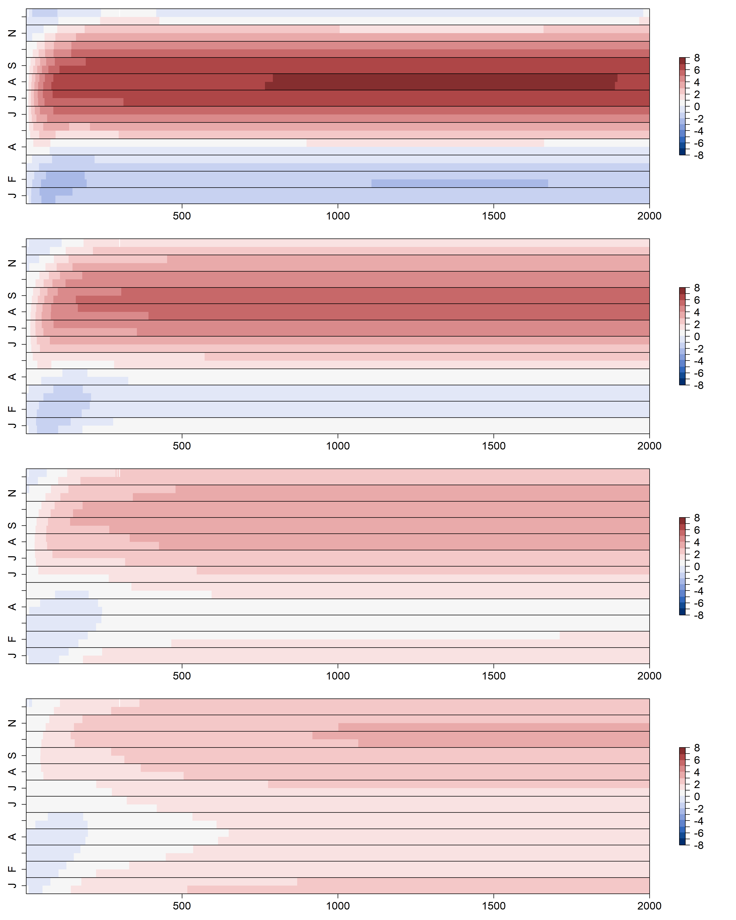
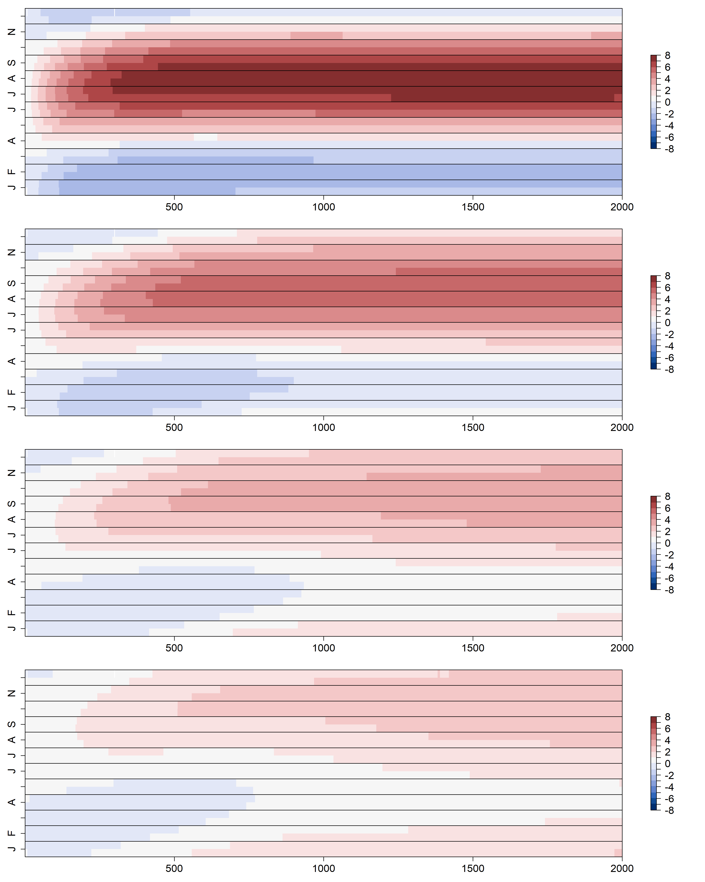
K = 100 m day⁻¹
K = 400 m day⁻¹
0.5 m
1.0 m
Month
2.0 m
3.0 m
Flow Path Length (m)

Slide 14
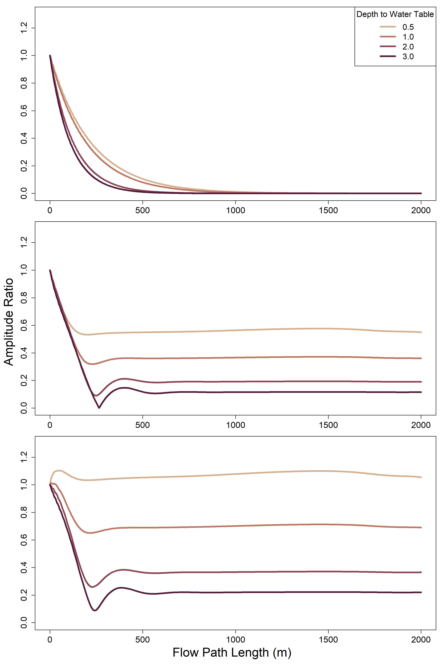
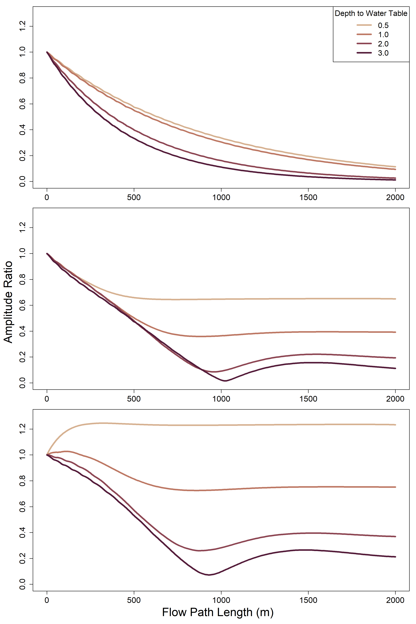
K = 100 m day⁻¹
K = 400 m day⁻¹
River-only
Shady
Sunny

Slide 15
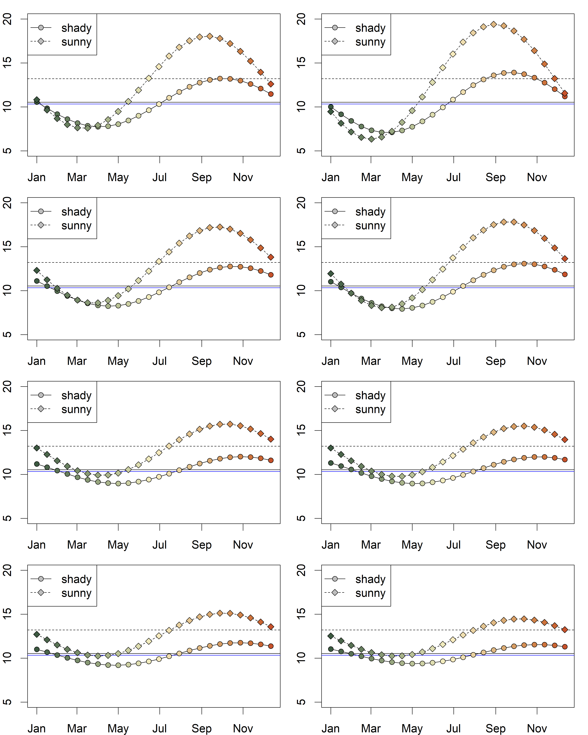
K = 100 m day⁻¹
K = 400 m day⁻¹
Temperature (°C)
Month

