Slide 2
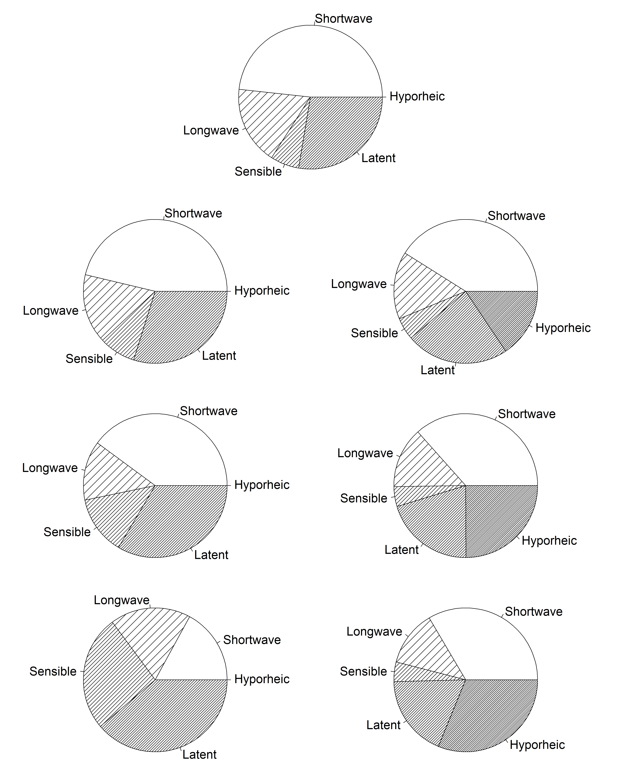
Control
Shade
Hyporheic
30%
Low
60%
Moderate
90%
High

Slide 3
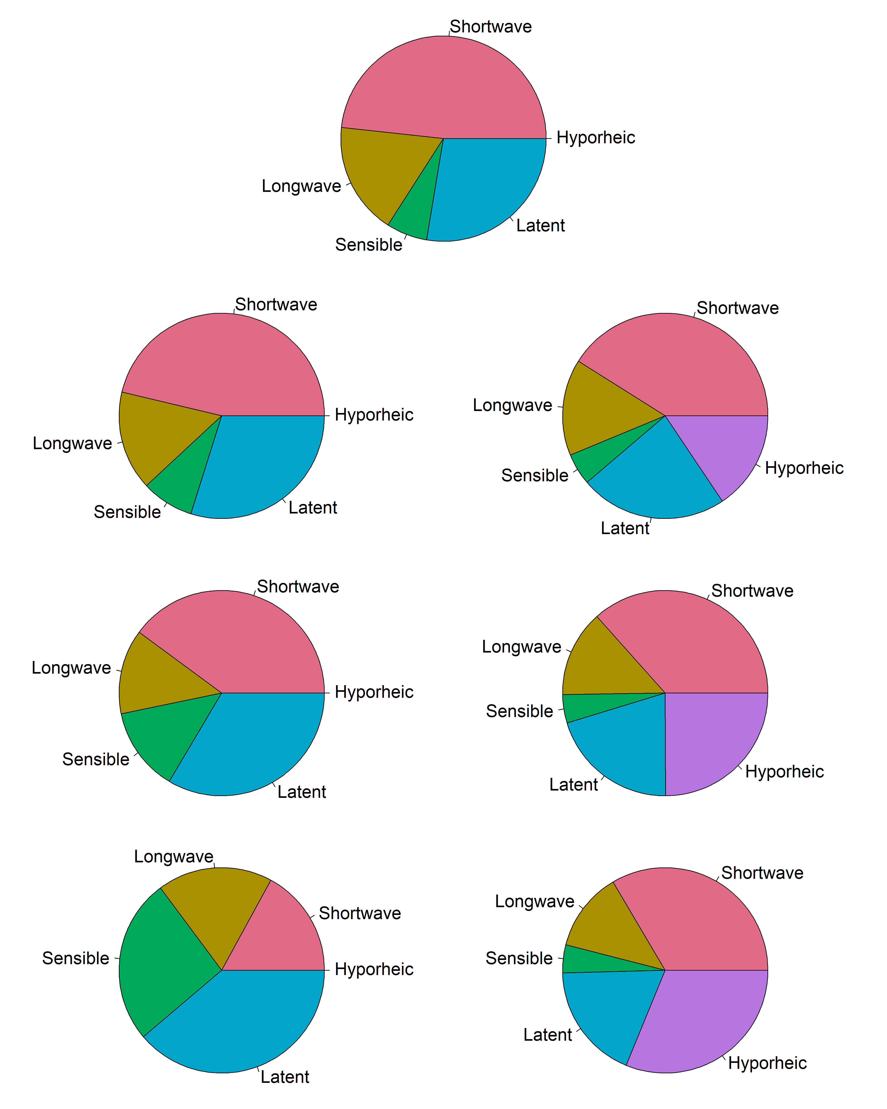
Control
Shade
Hyporheic
30%
Low
60%
Moderate
90%
High

Slide 4
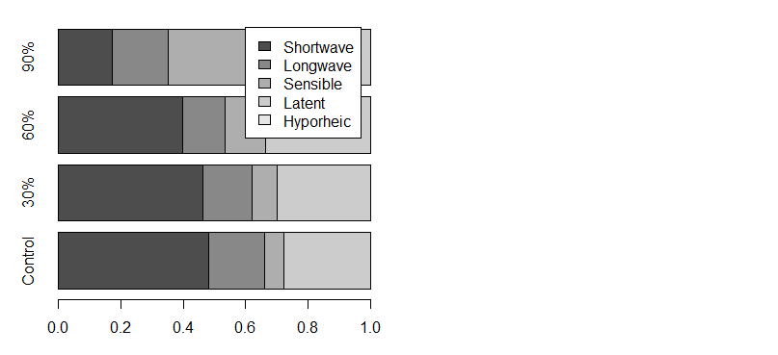
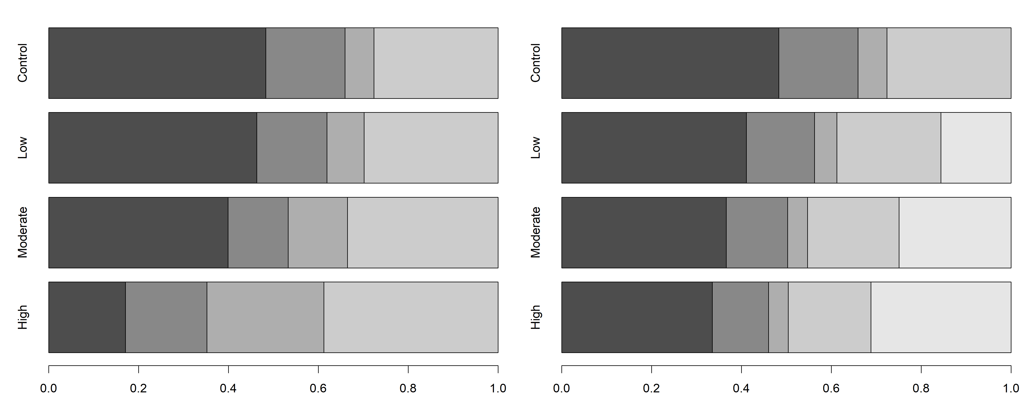
Shade
Hyporheic
Model Scenario
Percentage of Annual Heat Budget

Slide 5
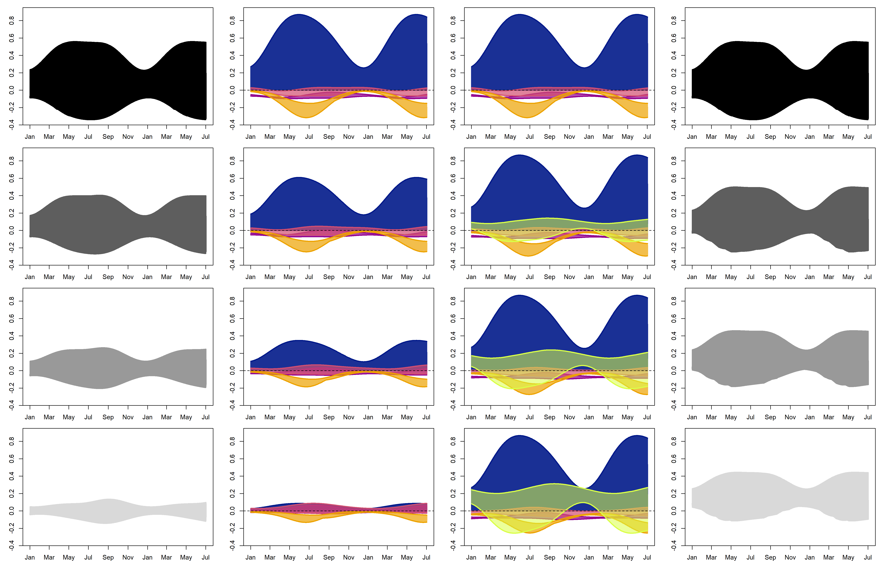
Shortwave
Longwave
Hyporheic
Sensible
Shade
Latent
Hyporheic
Net Flux
Individual Fluxes
Net Flux
Control
Low
Flux (kW m⁻²)
Moderate
High
Month

Slide 6
Shortwave
Longwave
Hyporheic
Sensible
Shade
Latent
Hyporheic
Net Flux
Individual Fluxes
Net Flux
Control
Low
Flux (kW m⁻²)
Moderate
High
Month

Slide 7
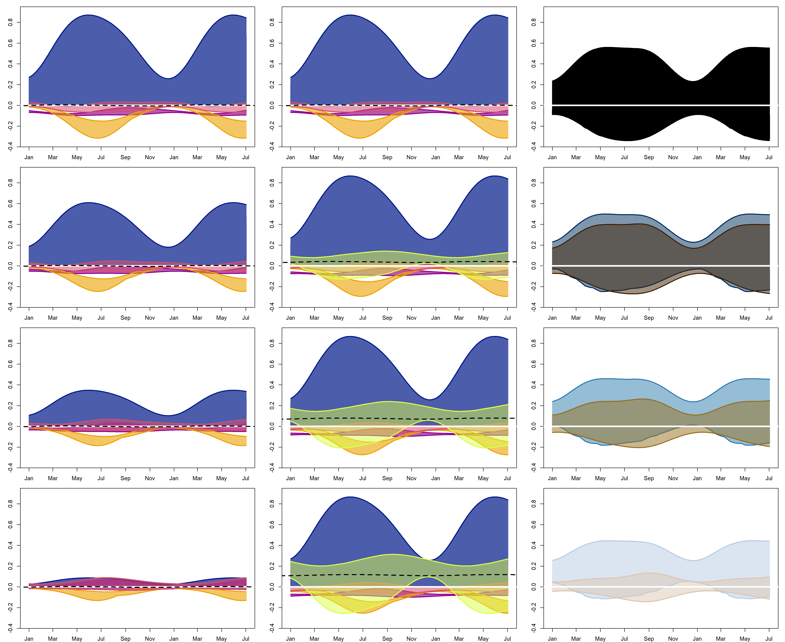
Individual Fluxes
Net Fluxes
Shade
Hyporheic
Control
Low
Flux (kW m⁻²)
Moderate
High
Month
Shade
HE
Low:
Longwave
Hyporheic
Shortwave
Sensible
Moderate:
Latent
Flux:
High:

Slide 8
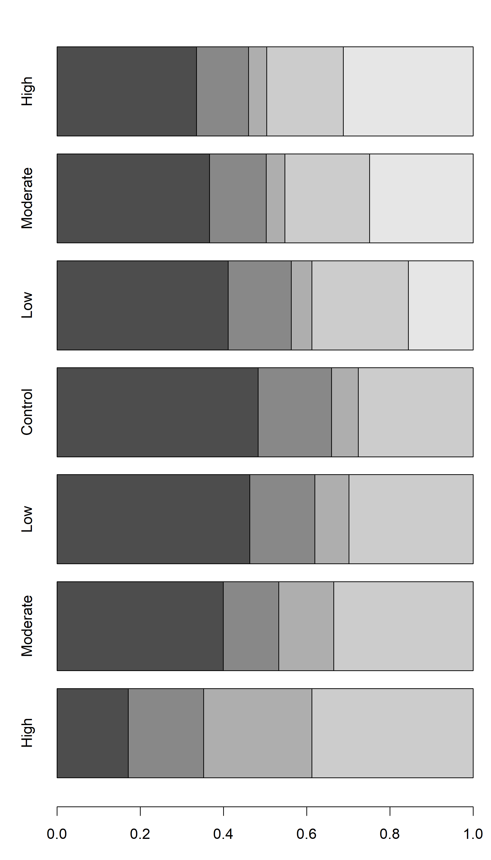
Shortwave
Longwave
Hyporheic
Sensible
Latent
Increasing HE
Shortwave
Longwave
Hyporheic
Sensible
Latent
Control
Increasing Shade
Percentage of Annual Heat Budget

Slide 9
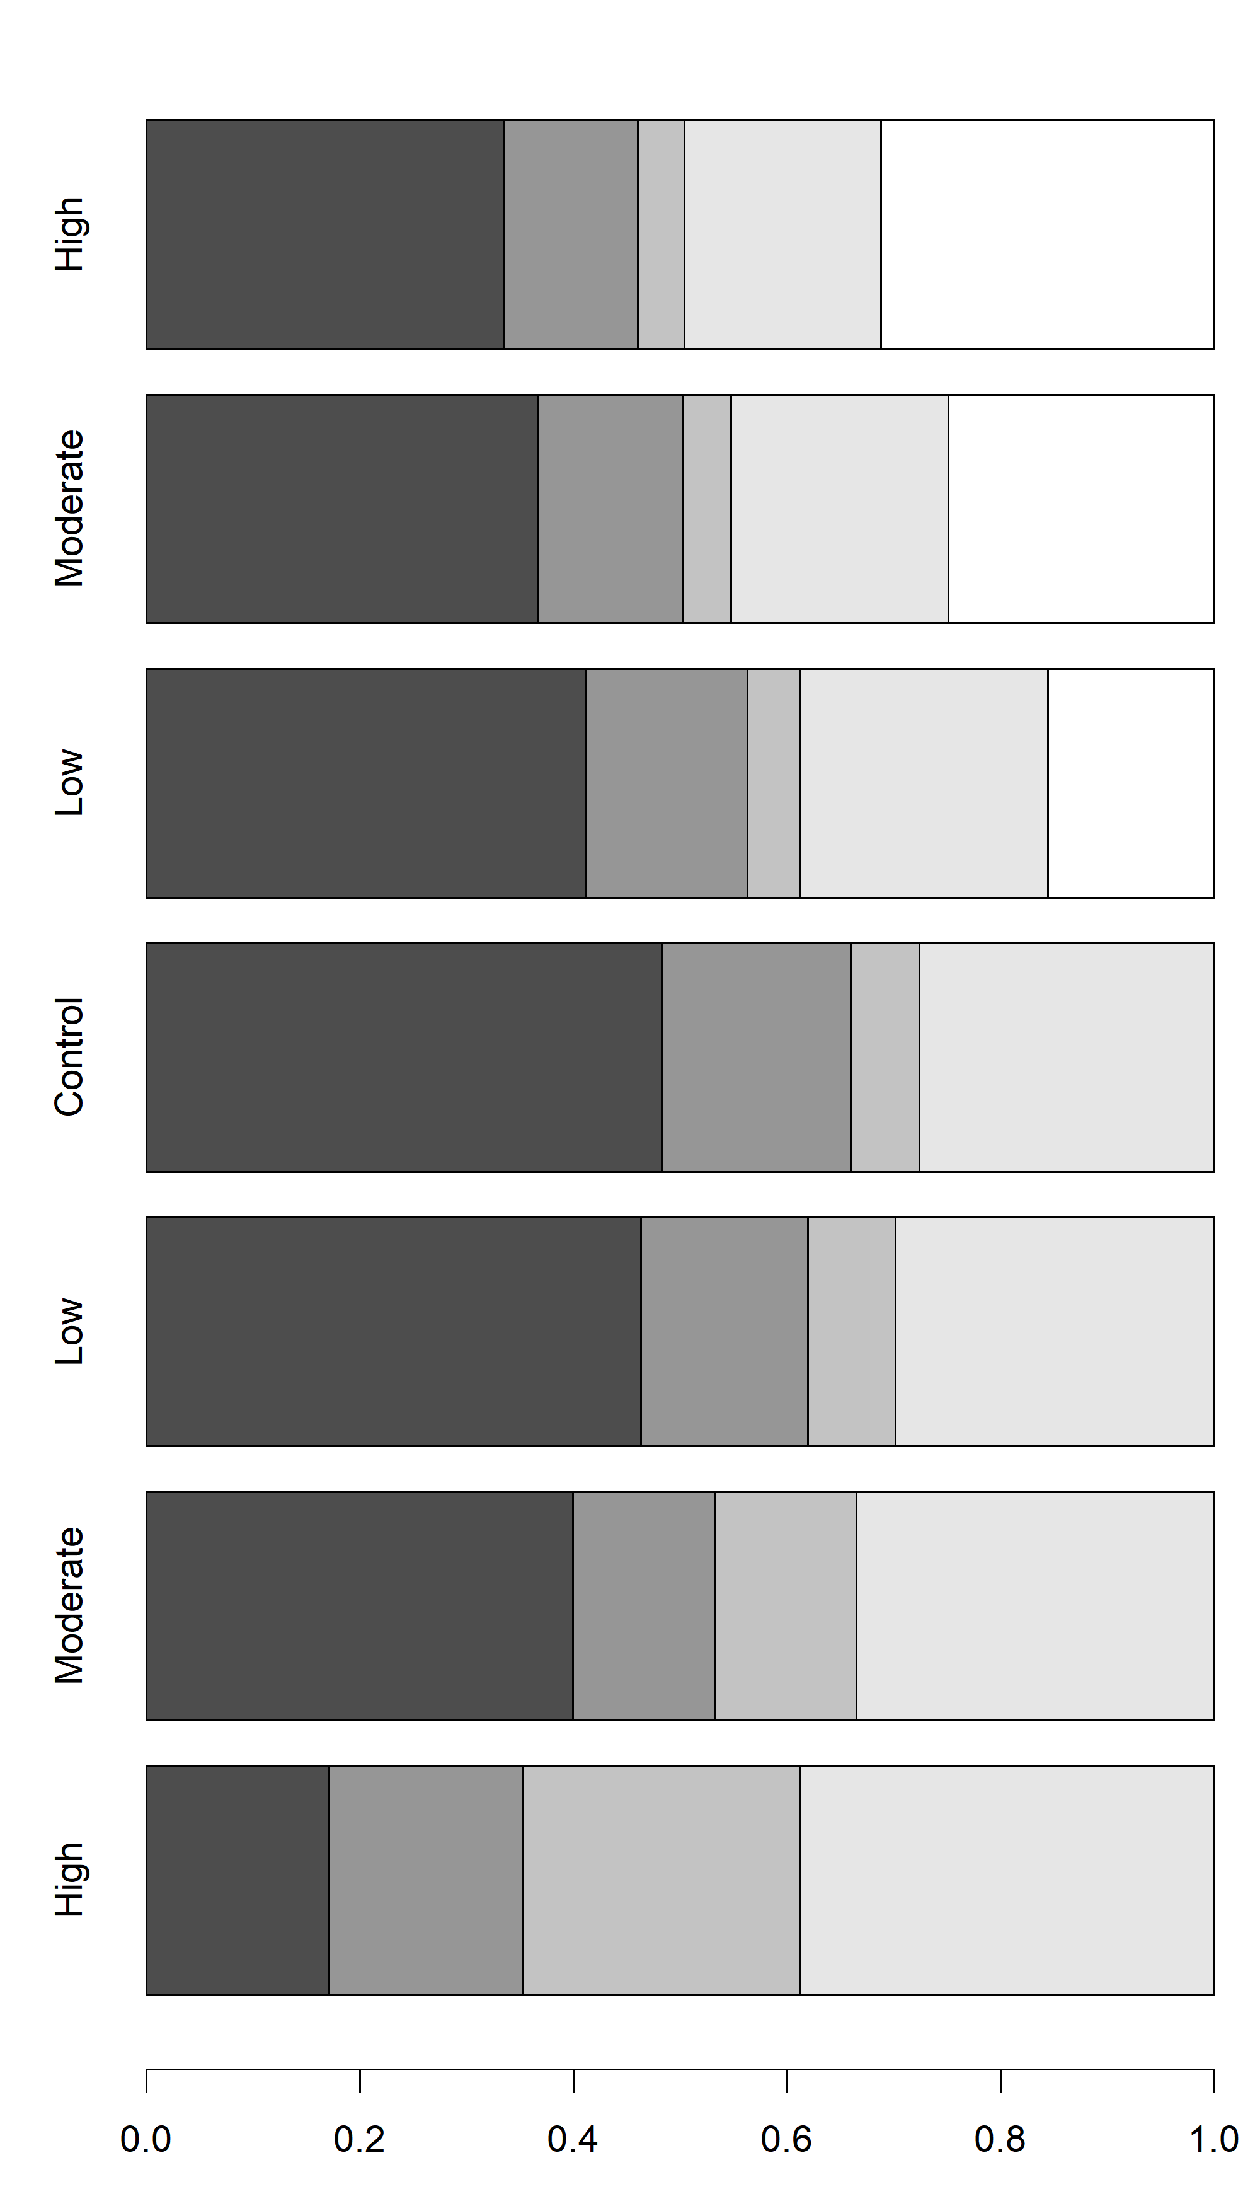
Shortwave
Longwave
Hyporheic
Sensible
Latent
High
Increasing HE
Moderate
Shortwave
Longwave
Hyporheic
Low
Sensible
Latent
Control
Low
Increasing Shade
Moderate
High
Percentage of Annual Heat Budget

Slide 10
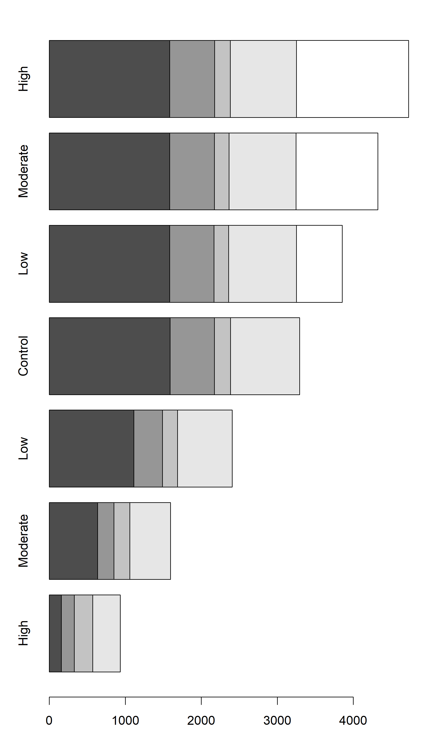
Shortwave
Longwave
Hyporheic
Sensible
Latent
High
Increasing HE
Moderate
Shortwave
Longwave
Hyporheic
Low
Sensible
Latent
Control
Low
Increasing Shade
Moderate
High
Summed Absolute Flux (kJ s⁻¹ m⁻²)

Slide 11
Shortwave
Shortwave
Longwave
Hyporheic
Longwave
Hyporheic
Sensible
Sensible
Latent
Latent
High
High
Increasing HE
Increasing HE
Moderate
Moderate
Low
Low
Control
Control
Low
Low
Increasing Shade
Increasing Shade
Moderate
Moderate
High
High
Proportion of Annual Heat Budget
Summed Absolute Flux (kJ s⁻¹ m⁻²)

Slide 12
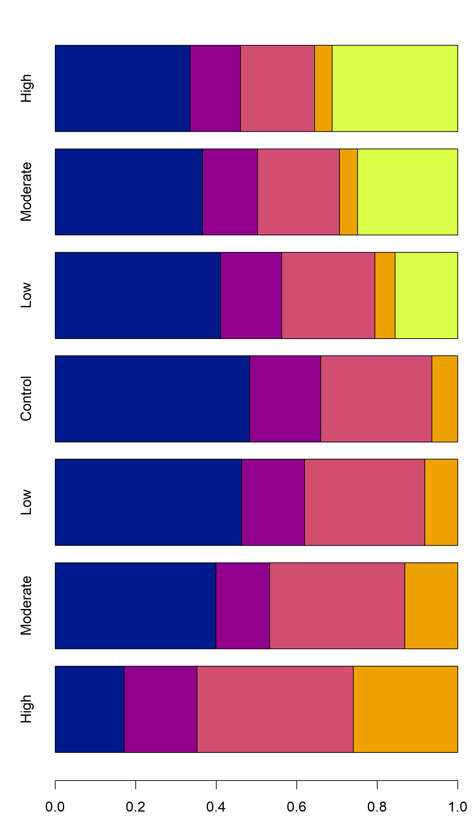
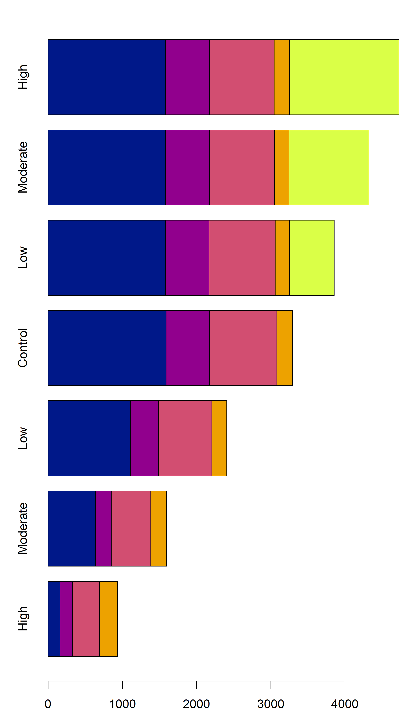
Shortwave
Shortwave
Longwave
Hyporheic
Longwave
Hyporheic
Sensible
Sensible
Latent
Latent
High
High
Increasing HE
Increasing HE
Moderate
Moderate
Low
Low
Control
Control
Low
Low
Increasing Shade
Increasing Shade
Moderate
Moderate
High
High
Proportion of Annual Heat Budget
Summed Absolute Flux (kJ s⁻¹ m⁻²)

Slide 13
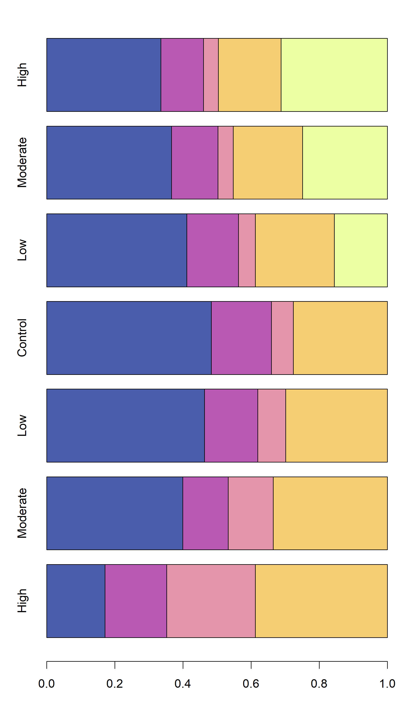
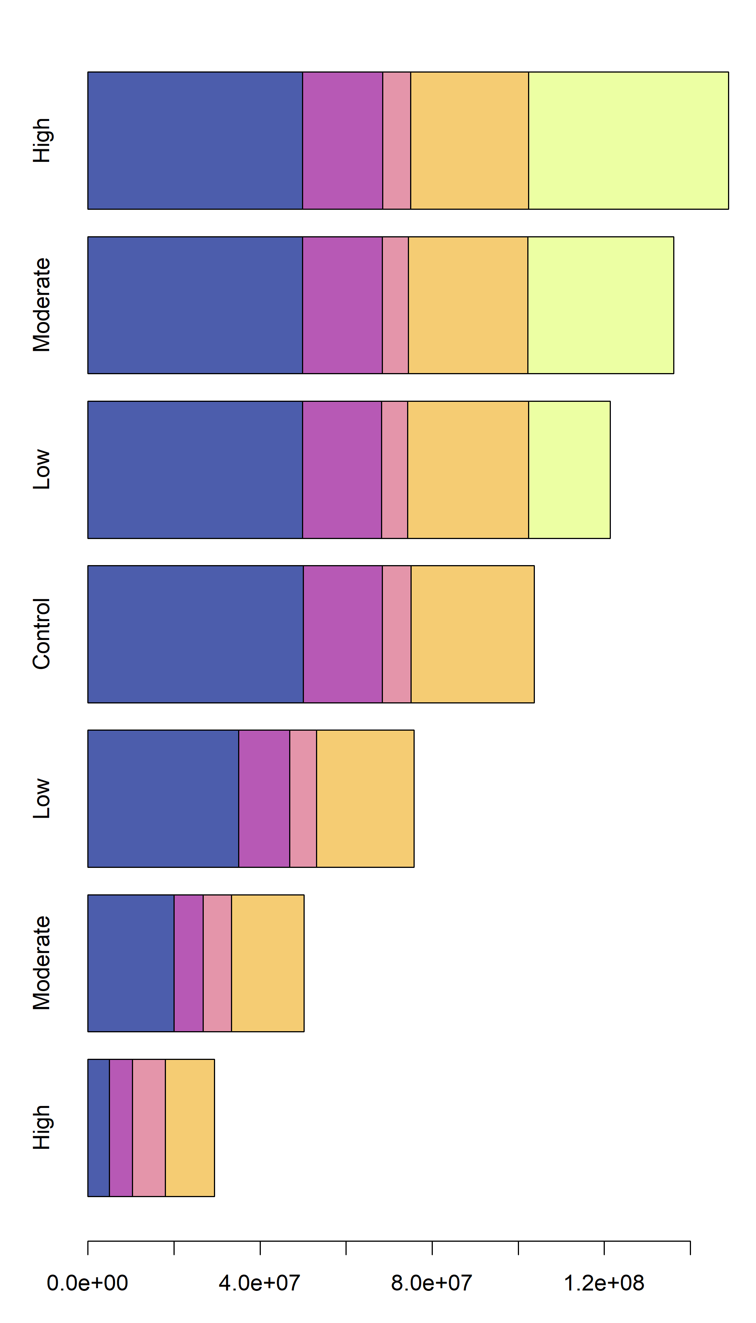
A
B
Shortwave
Shortwave
Longwave
Hyporheic
Longwave
Hyporheic
Sensible
Sensible
Latent
Latent
High
High
Increasing HE
Increasing HE
Moderate
Moderate
Low
Low
Control
Control
Low
Low
Increasing Shade
Increasing Shade
Moderate
Moderate
High
High
Proportion of Annual Heat Budget
Summed Absolute Flux (MJ y⁻¹ m⁻²)

Slide 14
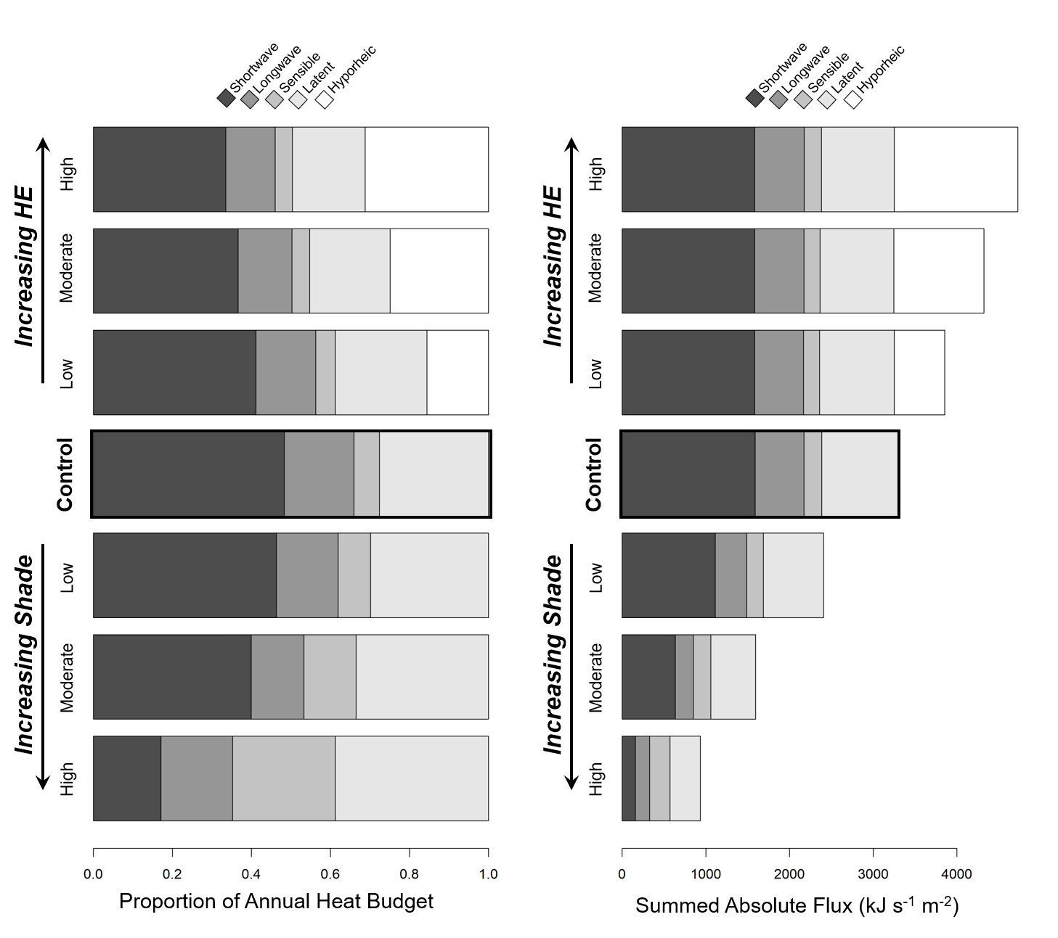

Slide 15
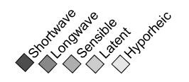
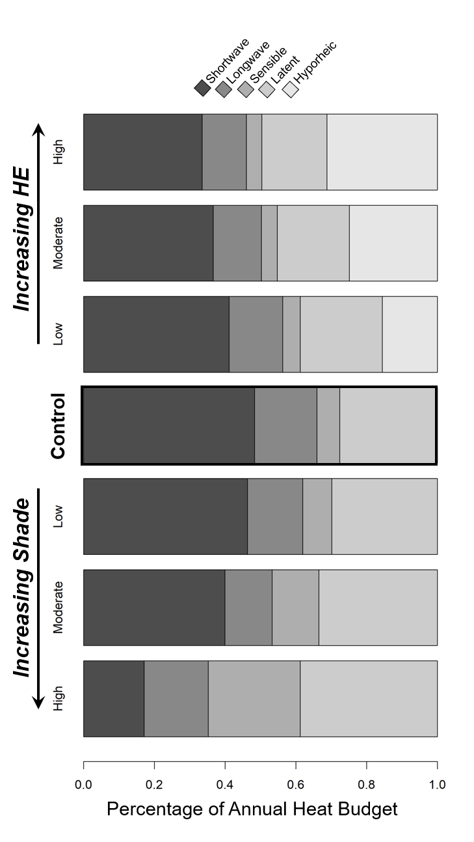
High
Moderate
Low
Low
Moderate
High
Proportion of Annual Heat Budget

Slide 16
33 | 13 | 18 | 31
High
4
37 | 14 | 20 | 25
Moderate
4
41 | 15 | 23 | 16
Low
5
48 | 18 | 6 | 28
Low
46 | 16 | 8 | 30
Moderate
40 | 13 | 13 | 34
High
17 | 18 | 26 | 39
Percentage of Annual Heat Budget

Slide 17
High
Moderate
Low
Low
Moderate
High
Proportion of Annual Heat Budget

