Slide 1
HGS versus TempTool

Slide 2

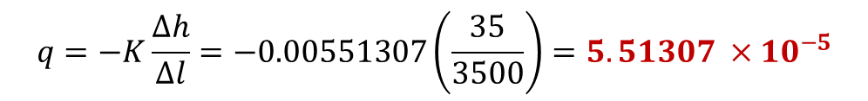


HGS Model
TempTool Model
Iskulpaa
River Temp
Unnecessary channel cell
$$q↓$$
$$−q↓$$
0, 36
3500, 1
Iskulpaa
River Temp
Slope = 0.01
HZ:
18 TSZs
0, 35
3500, 0
(x18)
Upstream BC:
Constant head 36
Downstream BC:
Constant head 1
Porous Media Properties
Porosity = 0.25
b = -1.39
Min RT = 60
Max RT = 182 days (6 mo.)
Porous Media Properties
K = 0.00551307 m/sec (~476 m/day)
Porosity = 0.25
$$q=−K\frac{∆h}{∆l}=−0.00551307\left(\frac{35}{3500}\right)=5.51307 {×10}^{−5}$$
$$q↓=5.51307 ×{10}^{−5}$$

Slide 3
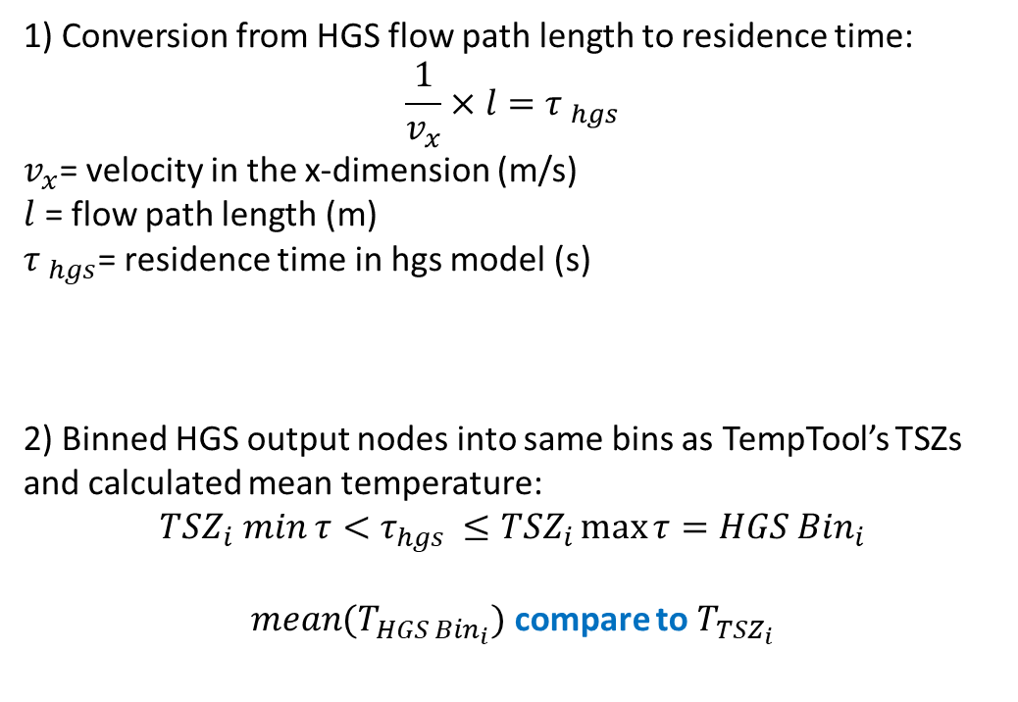
1) Conversion from HGS flow path length to residence time:
$$\frac{1}{v_{x}}×l={τ }_{hgs}$$
$v_{x}$= velocity in the x-dimension (m/s)
$l$ = flow path length (m)
${τ }_{hgs}$= residence time in hgs model (s)
2) Binned HGS output nodes into same bins as TempTool’s TSZs and calculated mean temperature:
$${TSZ}_{i} min τ<τ_{hgs }≤{TSZ}_{i}\max{τ}=HGS {Bin}_{i}$$
$mean(T_{HGS {Bin}_{i}})$ compare to $T_{{TSZ}_{i}}$

Slide 4
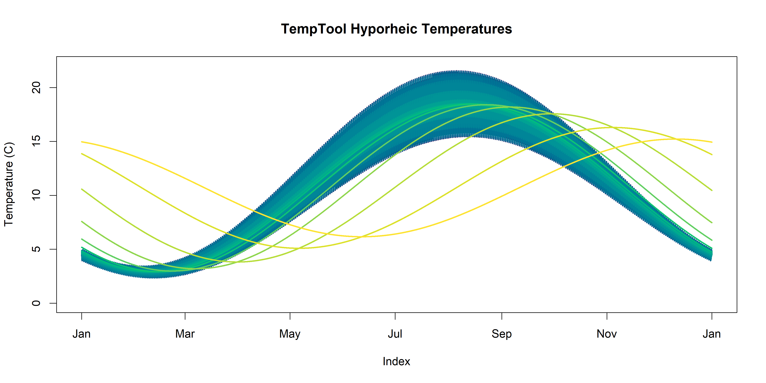
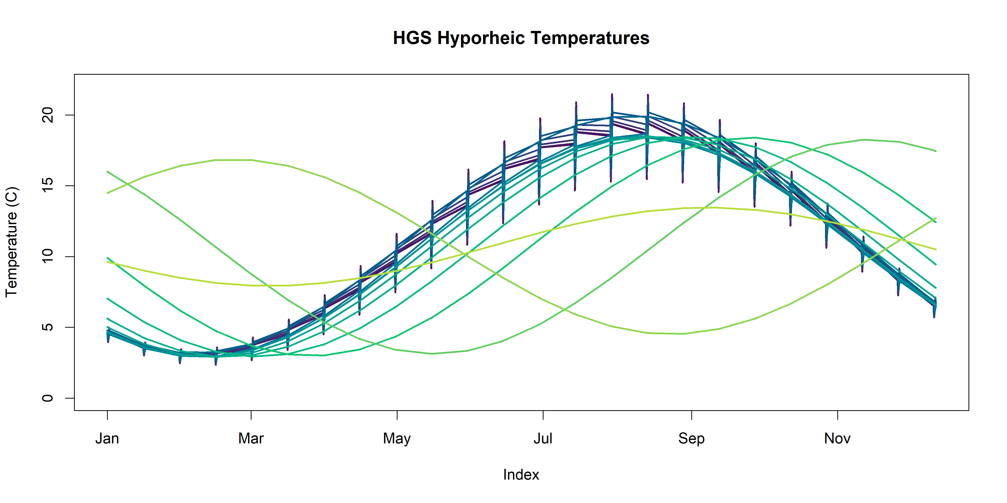

Slide 5
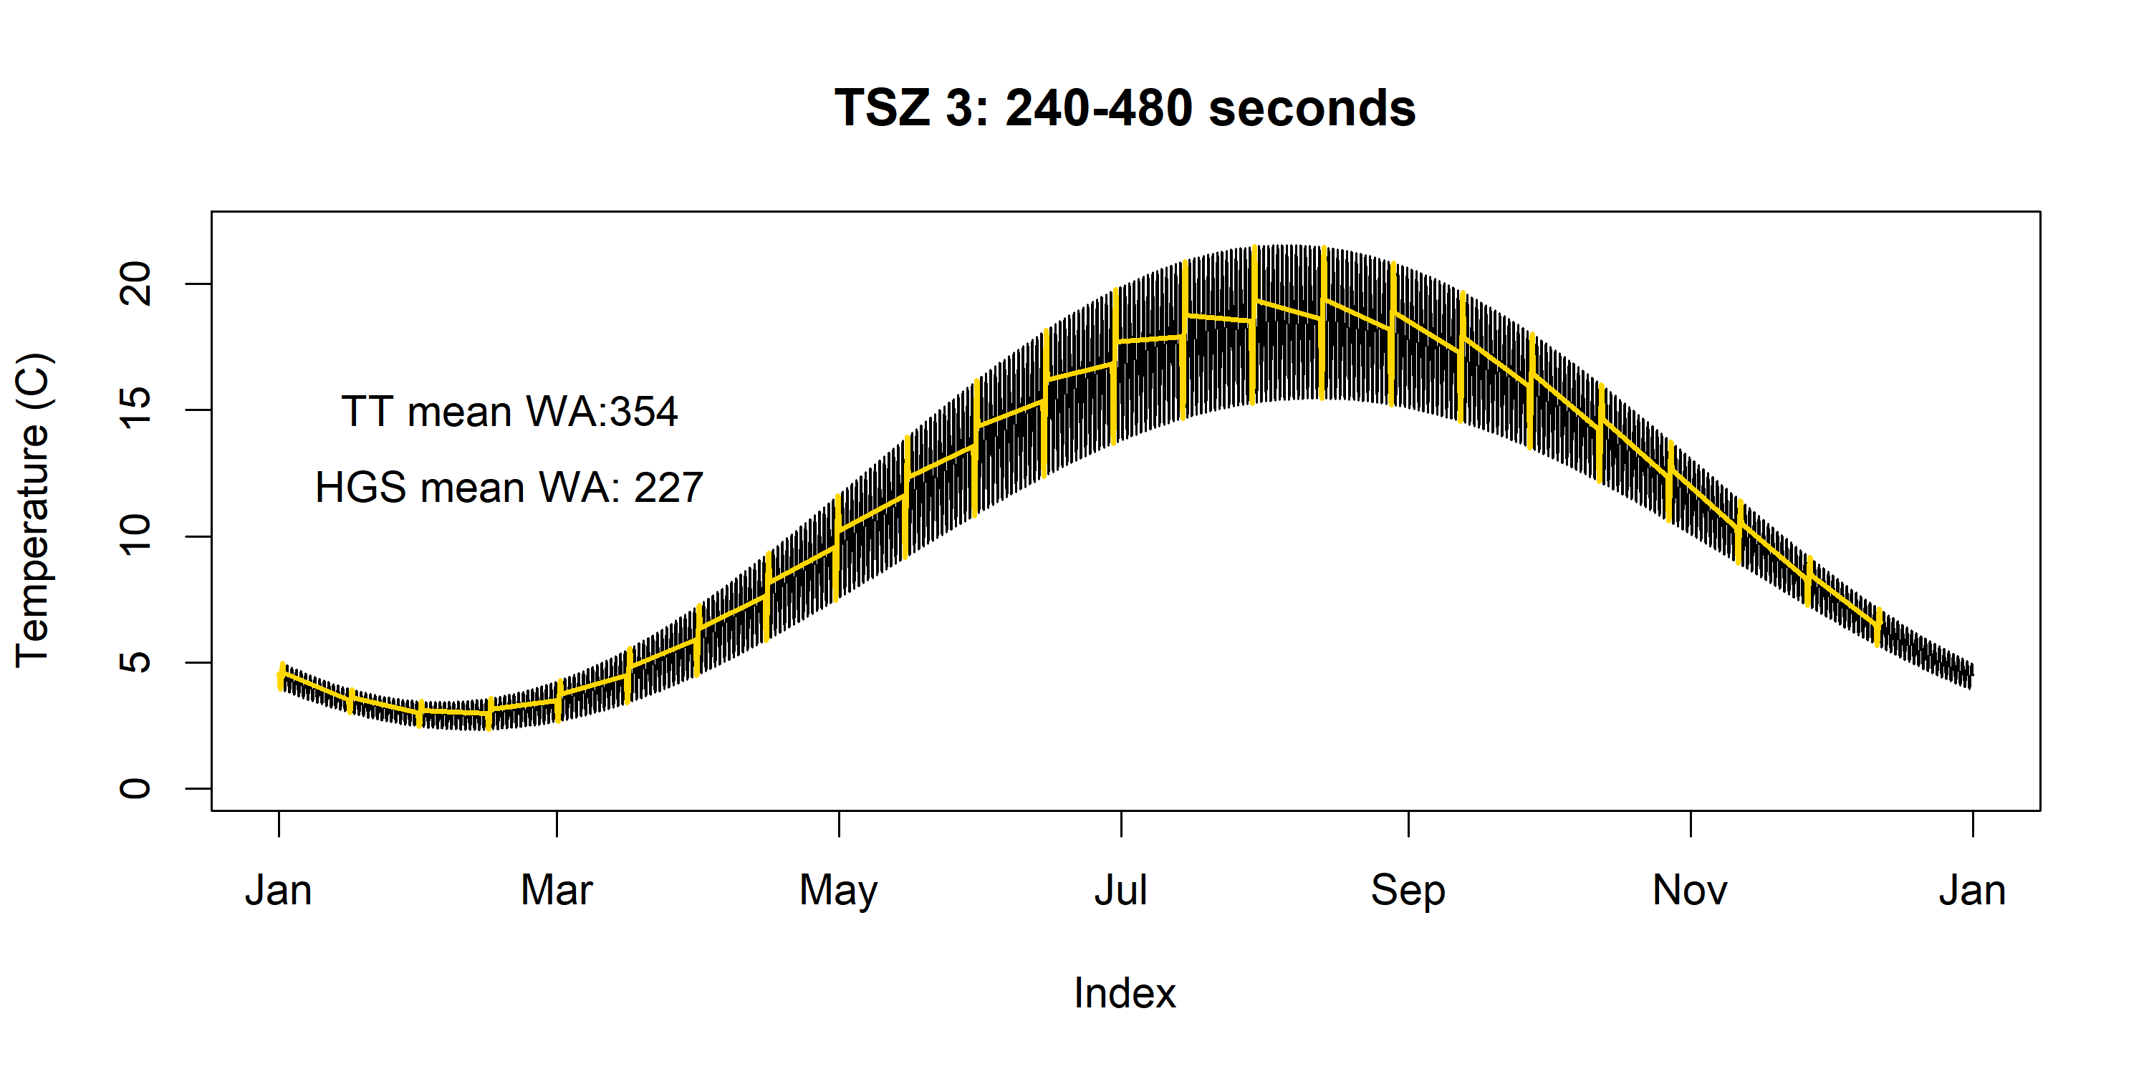

Slide 6


Slide 7


Slide 8


Slide 9


Slide 10
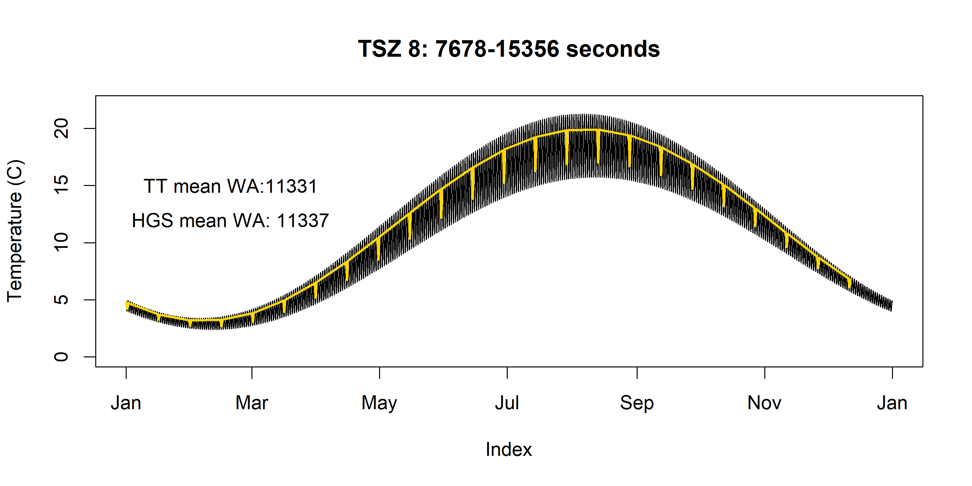

Slide 11
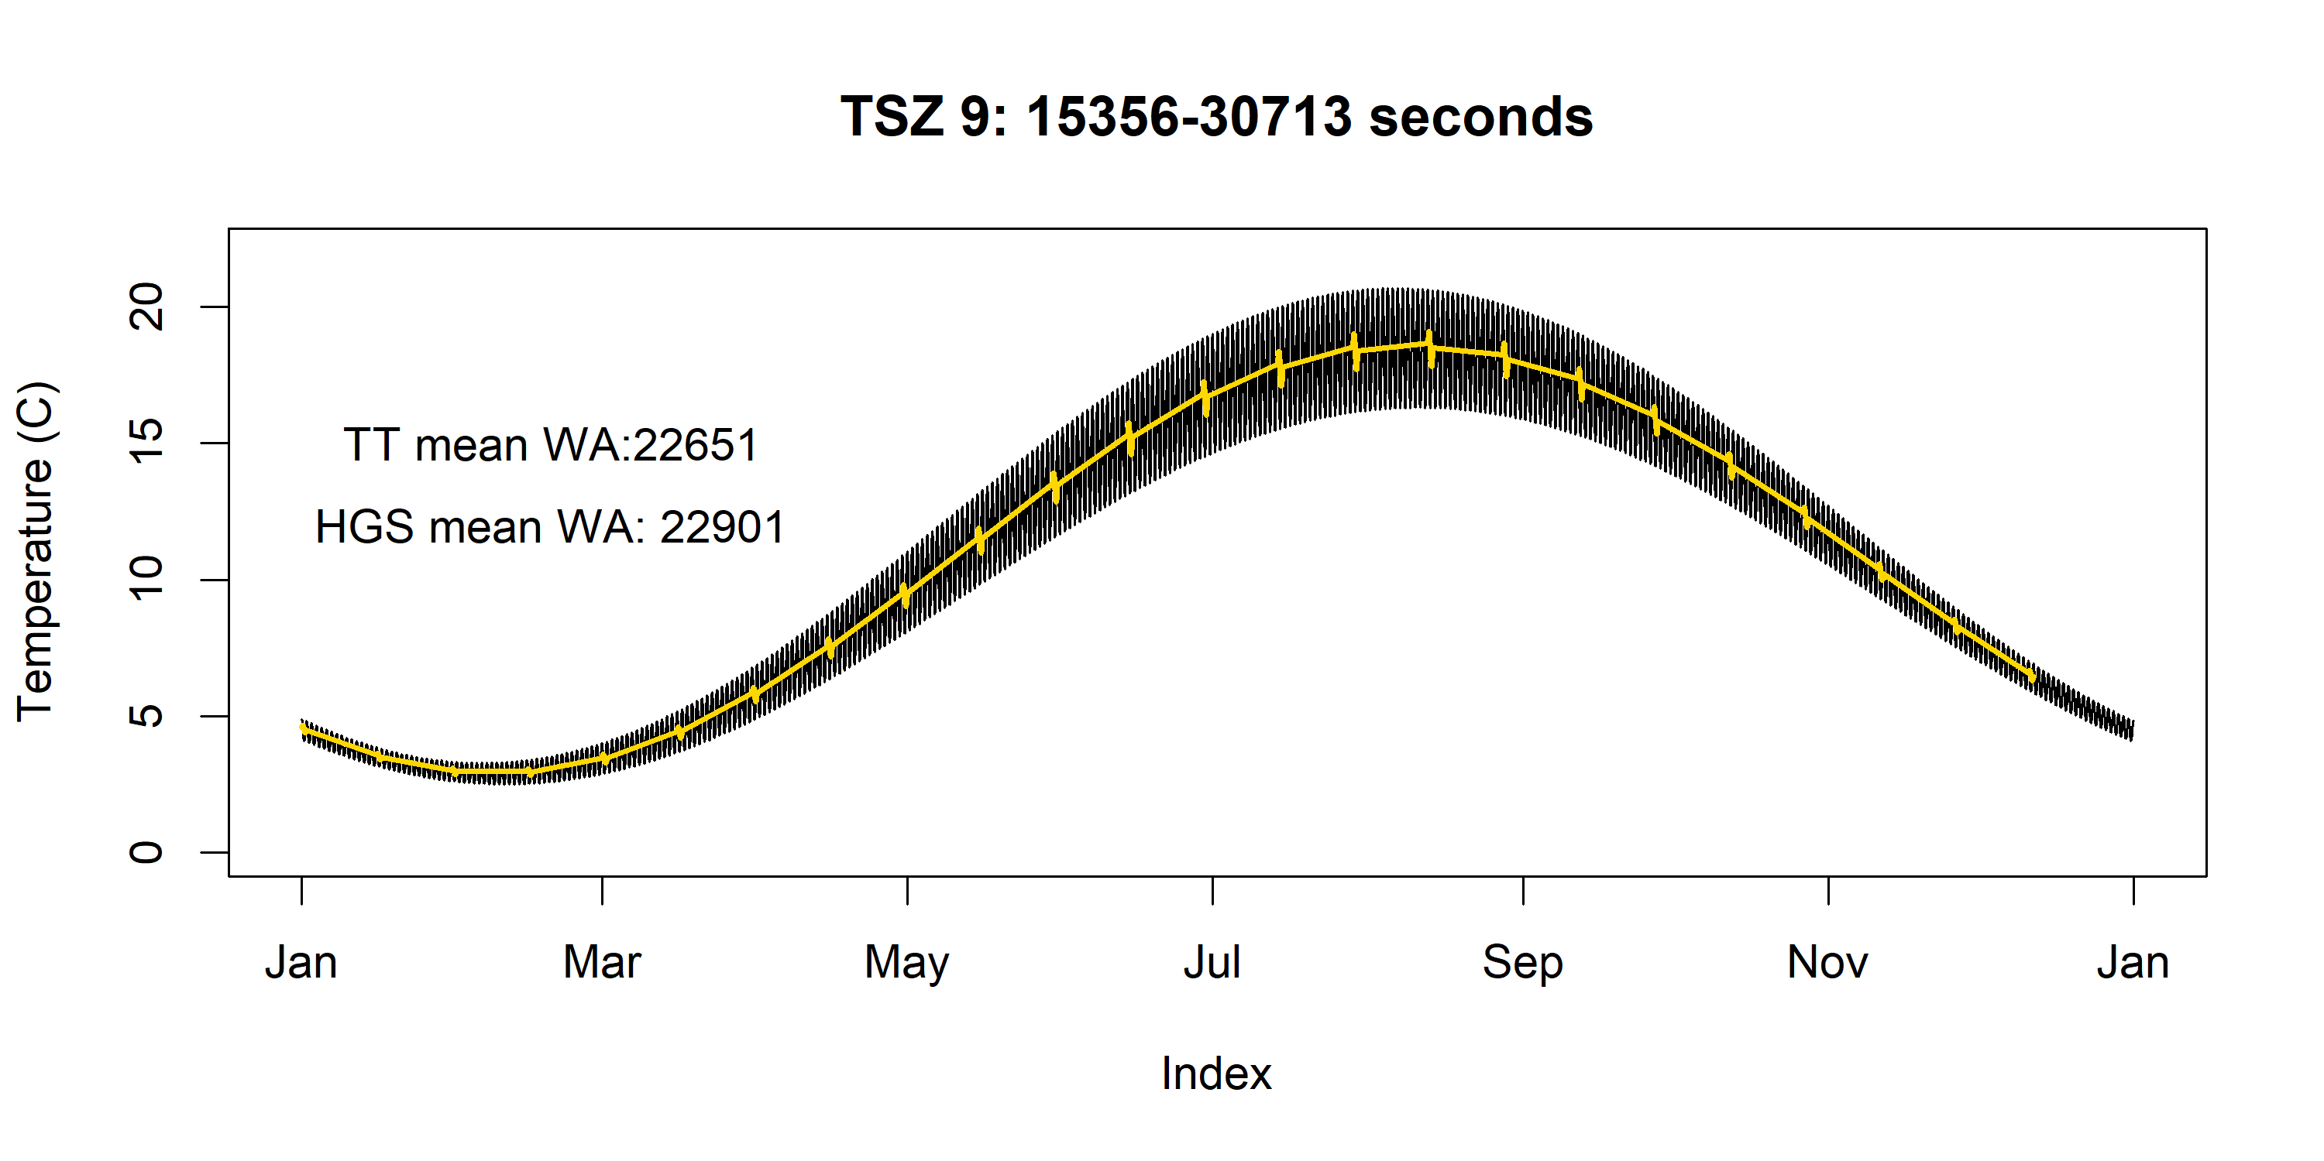

Slide 12
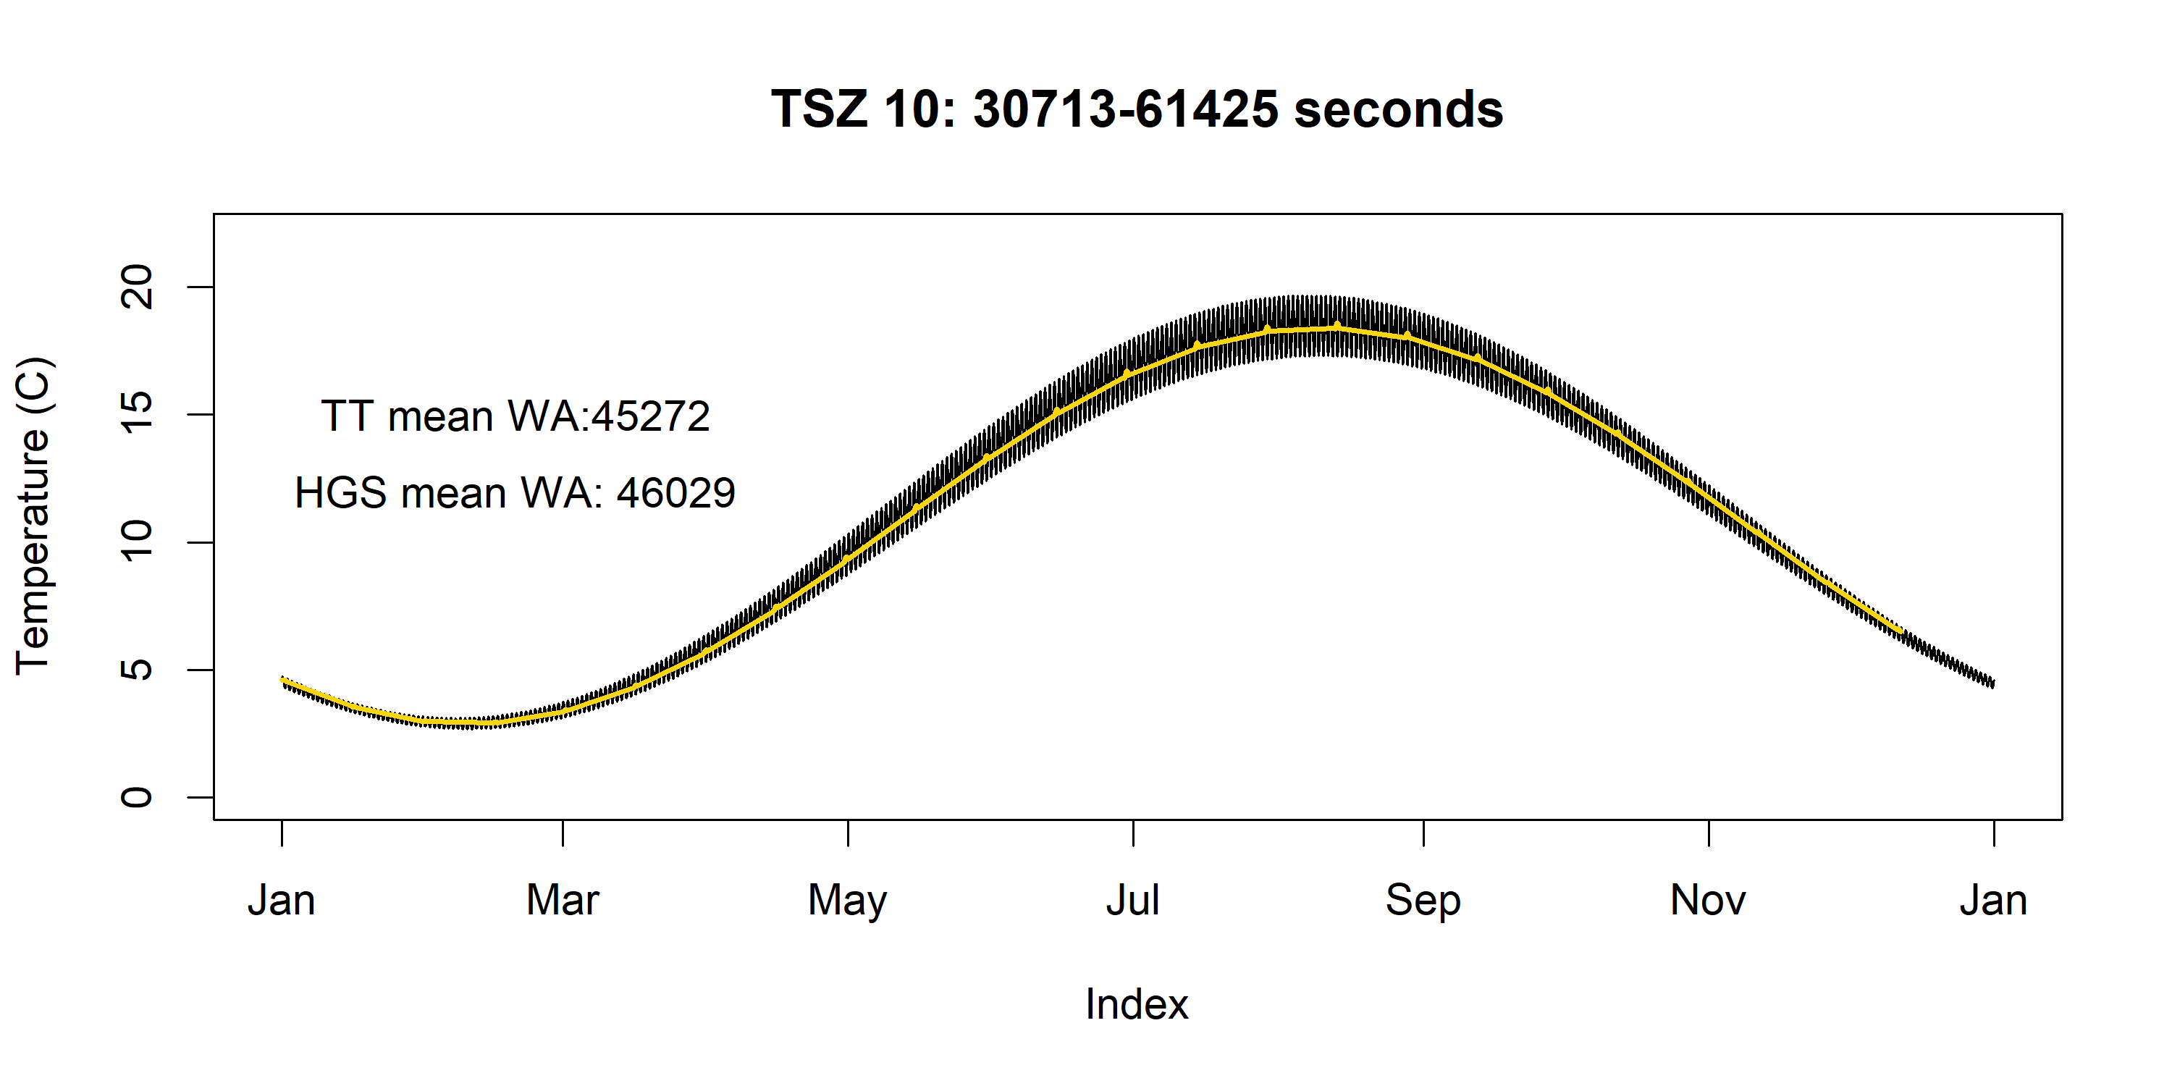

Slide 13
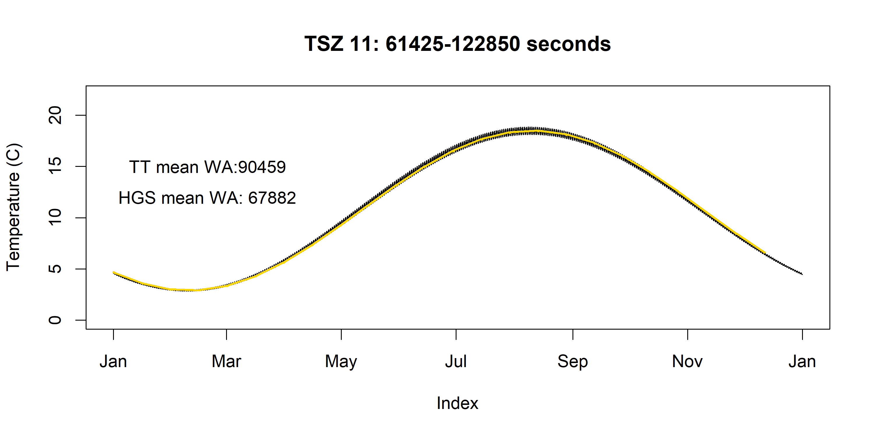

Slide 14
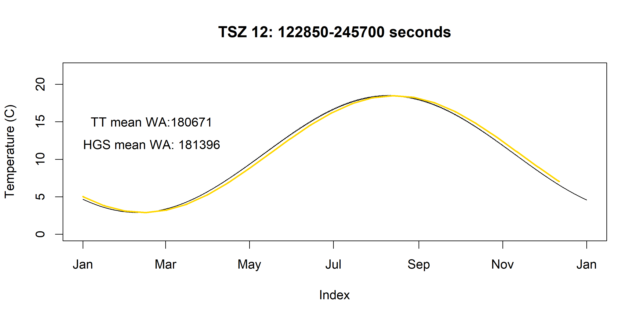

Slide 15
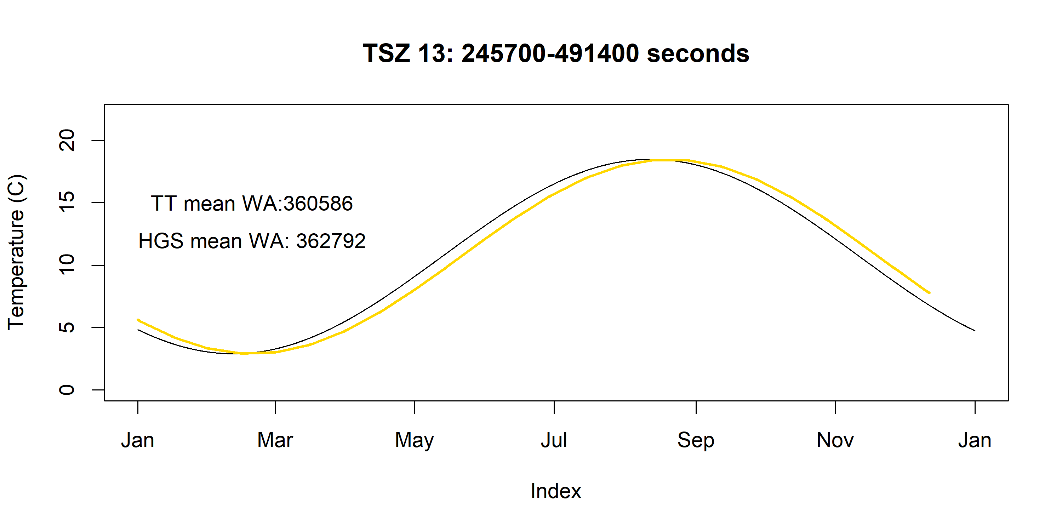

Slide 16
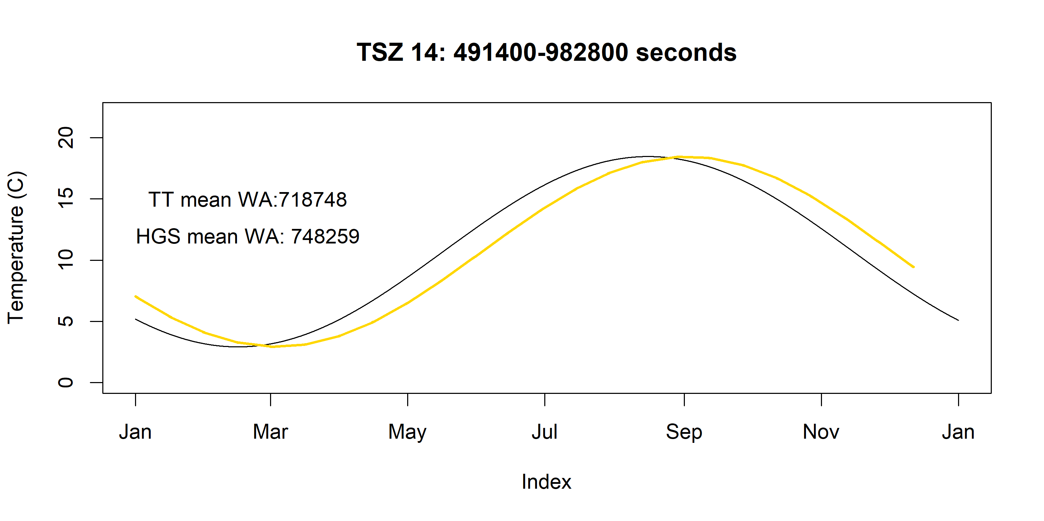

Slide 17
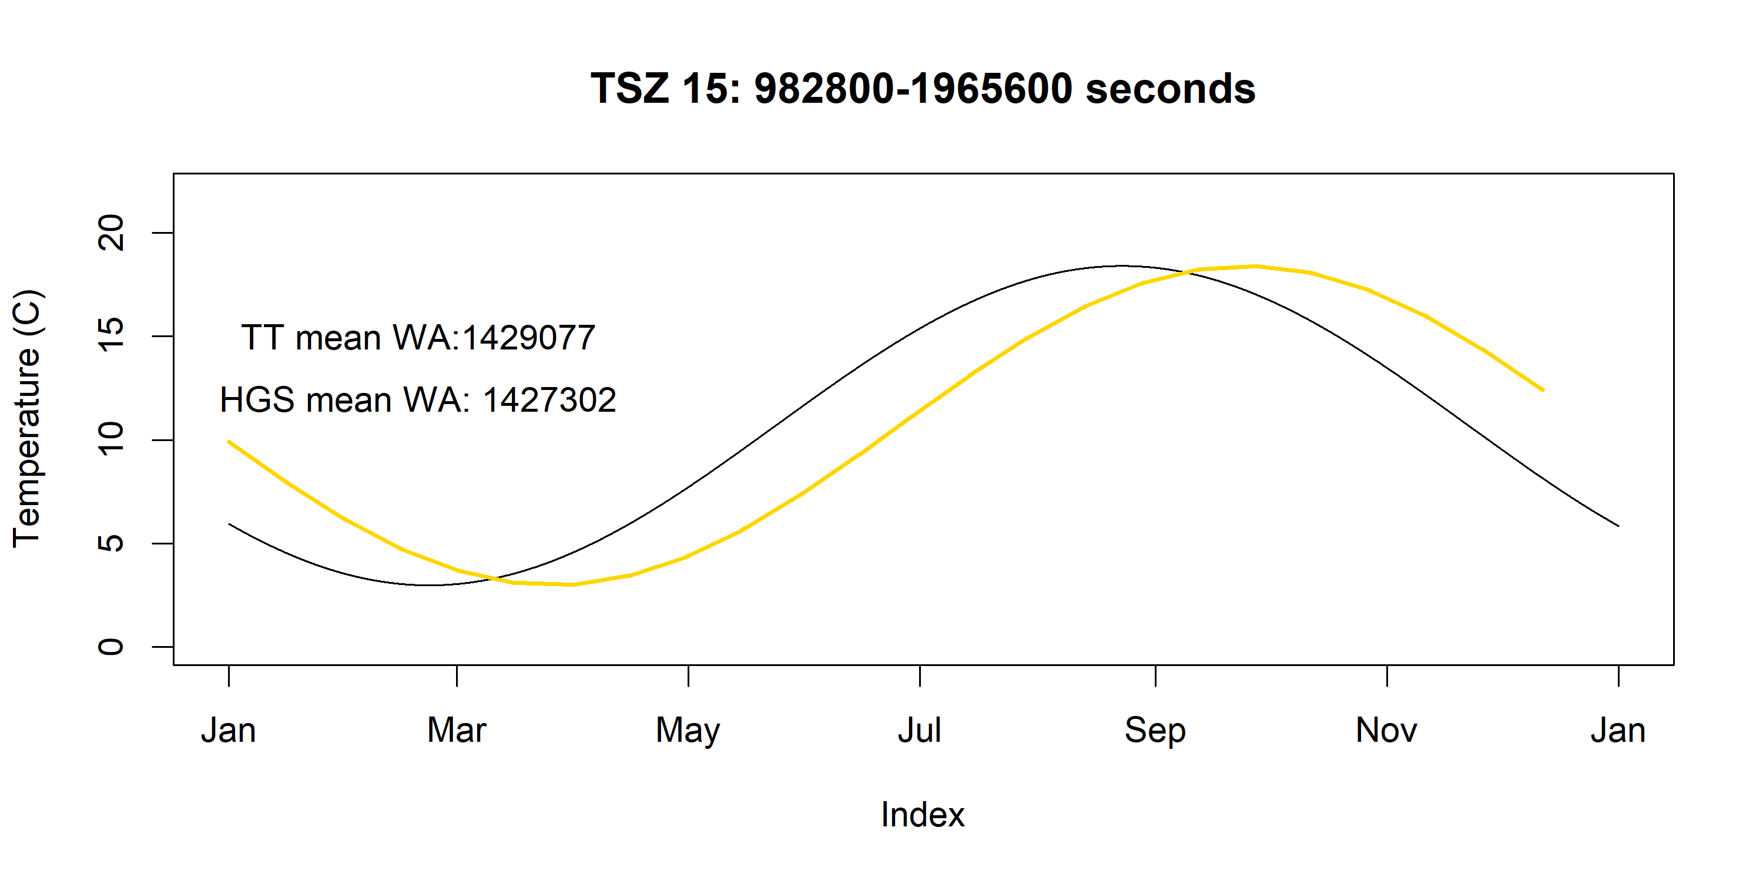

Slide 18
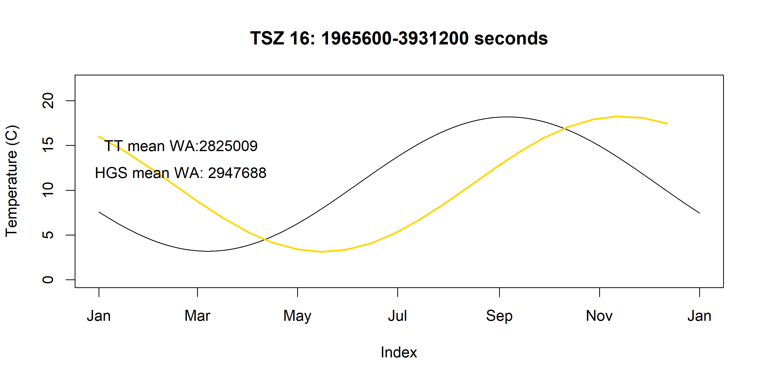

Slide 19
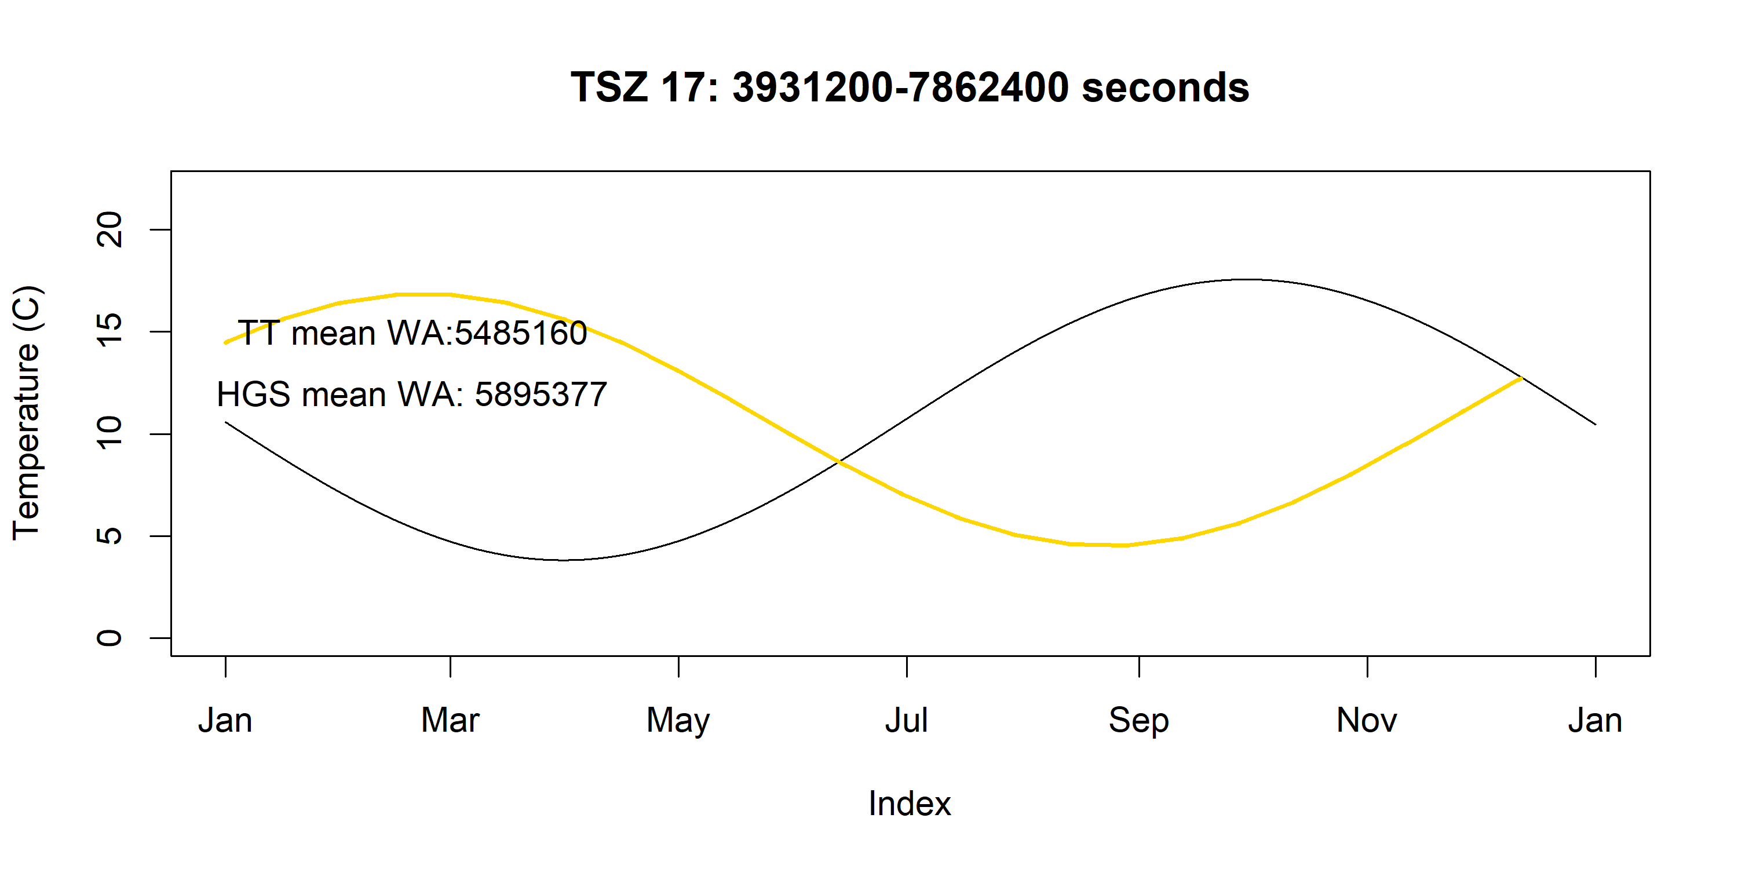

Slide 20
