Slide 2
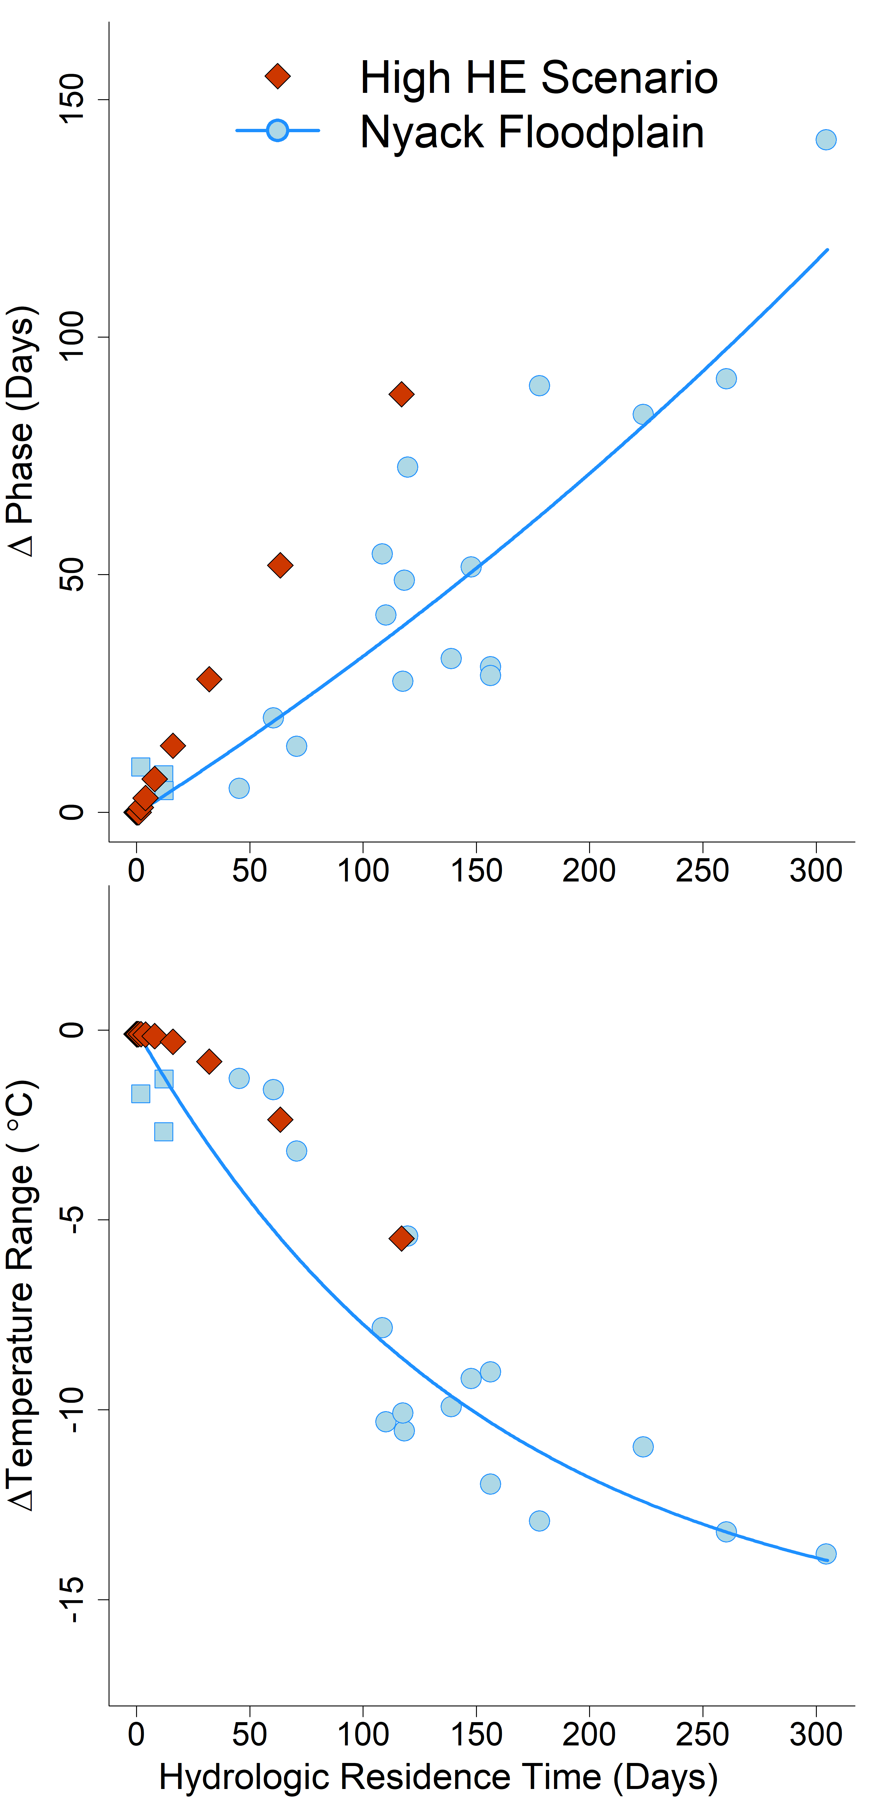


A
$$y= {205e}^{0.0015x}−205$$
B
$$y= {16.2e}^{−0.0065x}−16.2$$

