Slide 1


Credit Card Churn
Prediction System
End-to-End Machine Learning Solution
with Web Interface
Project Overview:
• Complete ML pipeline for predicting customer churn
• Flask backend API with prediction endpoints
• Streamlit frontend for user interaction
• Deployment on GitHub Codespaces
Technologies:
Python, scikit-learn, Flask, Streamlit
Presenter:
Shahil Kumar
Date:
08 August 2025

Slide 2

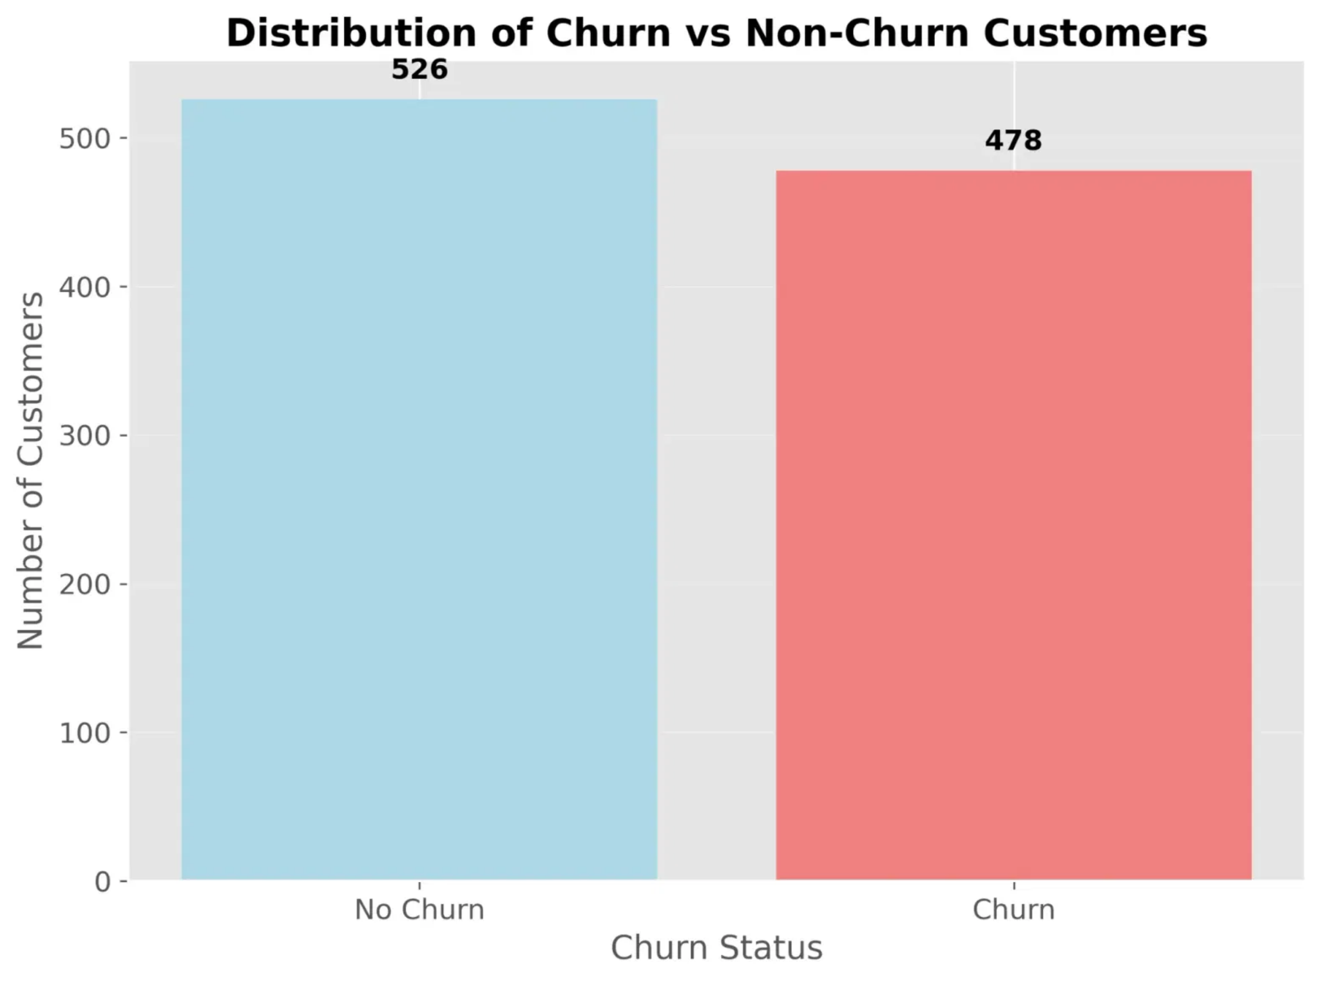
Dataset Overview & EDA
Dataset Characteristics
Source:
Credit card customer data
Original Size:
1,010 customers with 10 features
Cleaned Size:
993 customers with 9 features
Target:
Binary churn classification (0: Stay, 1: Churn)
Key Features
Demographics:
Age, Gender
Financial:
Balance, EstimatedSalary
Behavioral:
Tenure, NumOfProducts, HasCrCard, IsActiveMember
Churn Distribution
No Churn (0):
520 customers (52.4%)
Churn (1):
473 customers (47.6%)
The dataset shows a nearly balanced distribution between churned and non-churned customers, providing a solid foundation for machine learning model training.

Slide 3

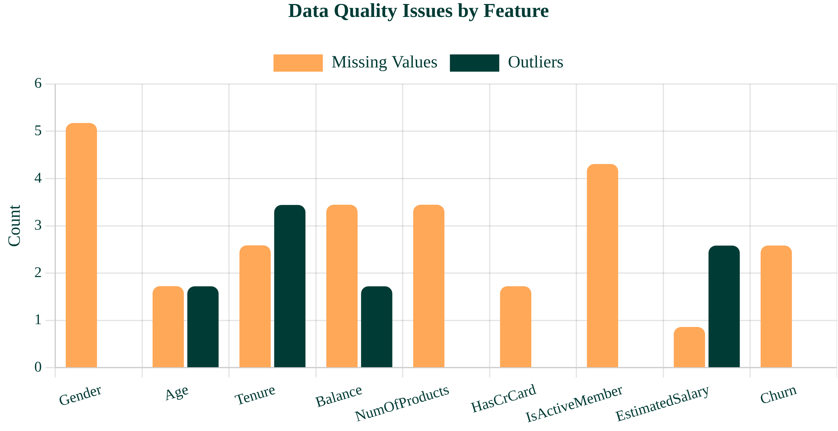
Data Cleaning & Quality Issues
Missing Values
Gender:
6 missing (filled with mode)
IsActiveMember:
5 missing (filled with mode)
Balance/NumOfProducts:
4 each (filled with mean)
Data Inconsistencies
Churn:
6 rows with value '2' removed
Gender:
Standardized to title case
Binary columns:
Converted to 0/1 format
Outlier Removal
Used IQR method to remove 11 outliers:
• Balance: 2 rows (value: 9,999,999)
• EstimatedSalary: 3 rows (value: 10,000,000)
• Age/Tenure: 6 rows with extreme values

Slide 4

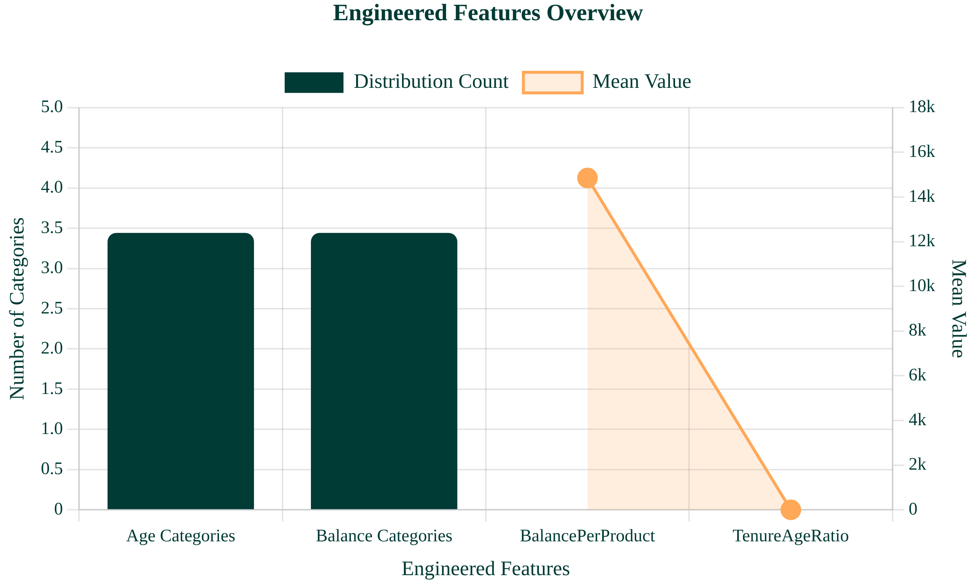
Feature Engineering & Transformation
Derived Features
Age Categories:
Young, Adult, Middle, Senior
Zero, Low, Medium, High
Balance Categories:
Ratio of balance to number of products
BalancePerProduct:
TenureAgeRatio:
Ratio of tenure to age
Encoding & Scaling
Applied to Gender, AgeCategory, BalanceCategory
One-Hot Encoding:
Applied to all numerical features
MinMax Scaling:
Feature Impact
The engineered features significantly improved model performance, with TenureAgeRatio becoming the second most important predictor in the final model.

Slide 5

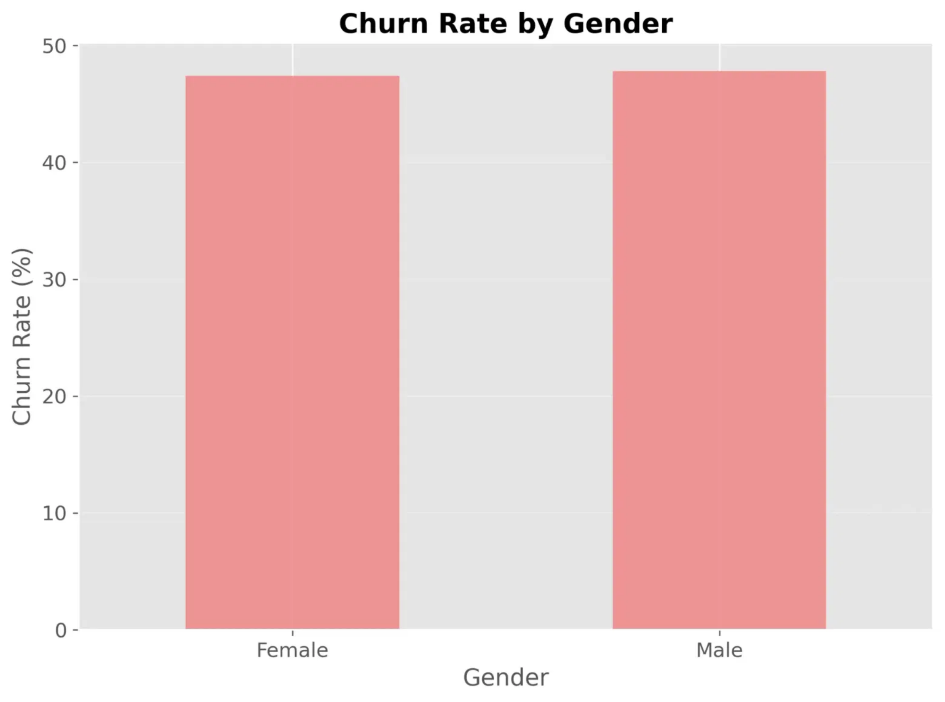
Customer Demographics Analysis
Gender Distribution Insights
Show slightly higher churn rates (52.1%)
Male Customers:
Female Customers:
Demonstrate better retention (45.2% churn)
Gender Gap:
6.9% difference in churn behavior
Key Demographic Findings
Gender Impact:
Gender is a moderate predictor of churn behavior
Customer Count:
Nearly equal distribution of male and female customers
Retention Strategy:
Male customers may require more targeted retention efforts
Note: Gender is the 8th most important feature in the model with 3.14% importance weight.

Slide 6

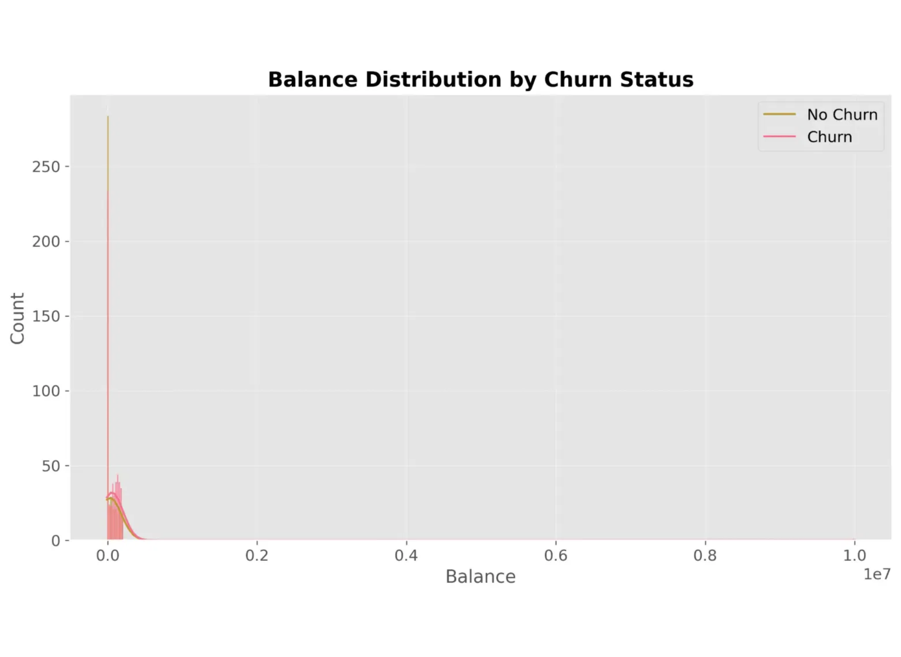
Financial Behavior Patterns
Balance Distribution Insights
Zero Balance Accounts:
Significantly higher likelihood of churning
Higher Balances:
Customers with higher account balances show lower churn rates
Balance Thresholds:
Notable retention improvement above certain balance levels
Financial Behavior Impact
Account balance serves as a strong indicator of customer engagement and loyalty, with clear correlation to retention rates.
Key Takeaways
The data shows that customers with zero balance are most likely to churn, suggesting that account inactivity is a key predictor of customer attrition.
Financial activity patterns provide valuable signals for early churn prediction and targeted intervention strategies, particularly for customers with low or zero balances.

Slide 7

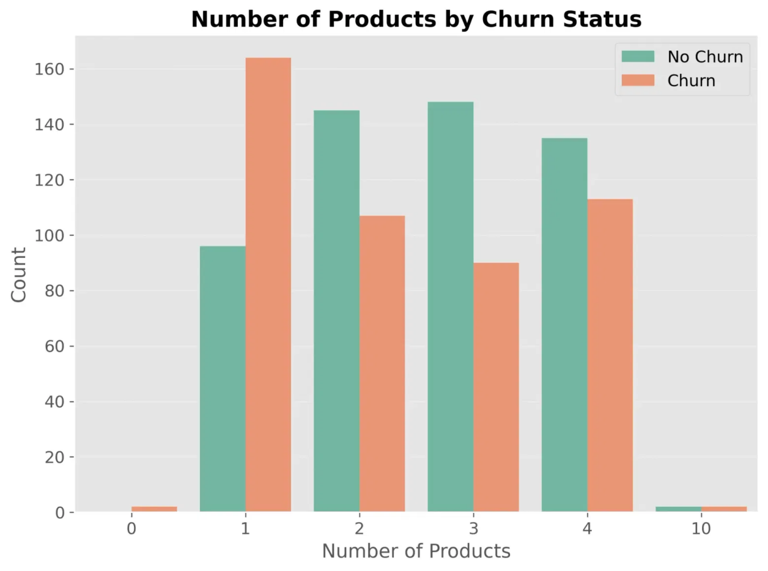
Customer Engagement Analysis
Product Engagement
Single Product Users:
Show highest churn risk (42%)
Multi-Product Users:
Higher product engagement correlates with lower churn rates
Four Product Users:
Demonstrate significantly higher retention (only 8% churn)
Active Membership Impact
Active Members:
Significantly lower churn rate (14% vs 32%)
Inactive Members:
More than twice as likely to churn
Importance:
IsActiveMember is a strong predictor of customer retention
Tenure Patterns
New Customers:
Higher churn risk in first 2 years
Loyal Customers:
Tenure > 5 years shows significantly lower churn
Tenure Ranking:
4th most important feature (11.16% importance)

Slide 8

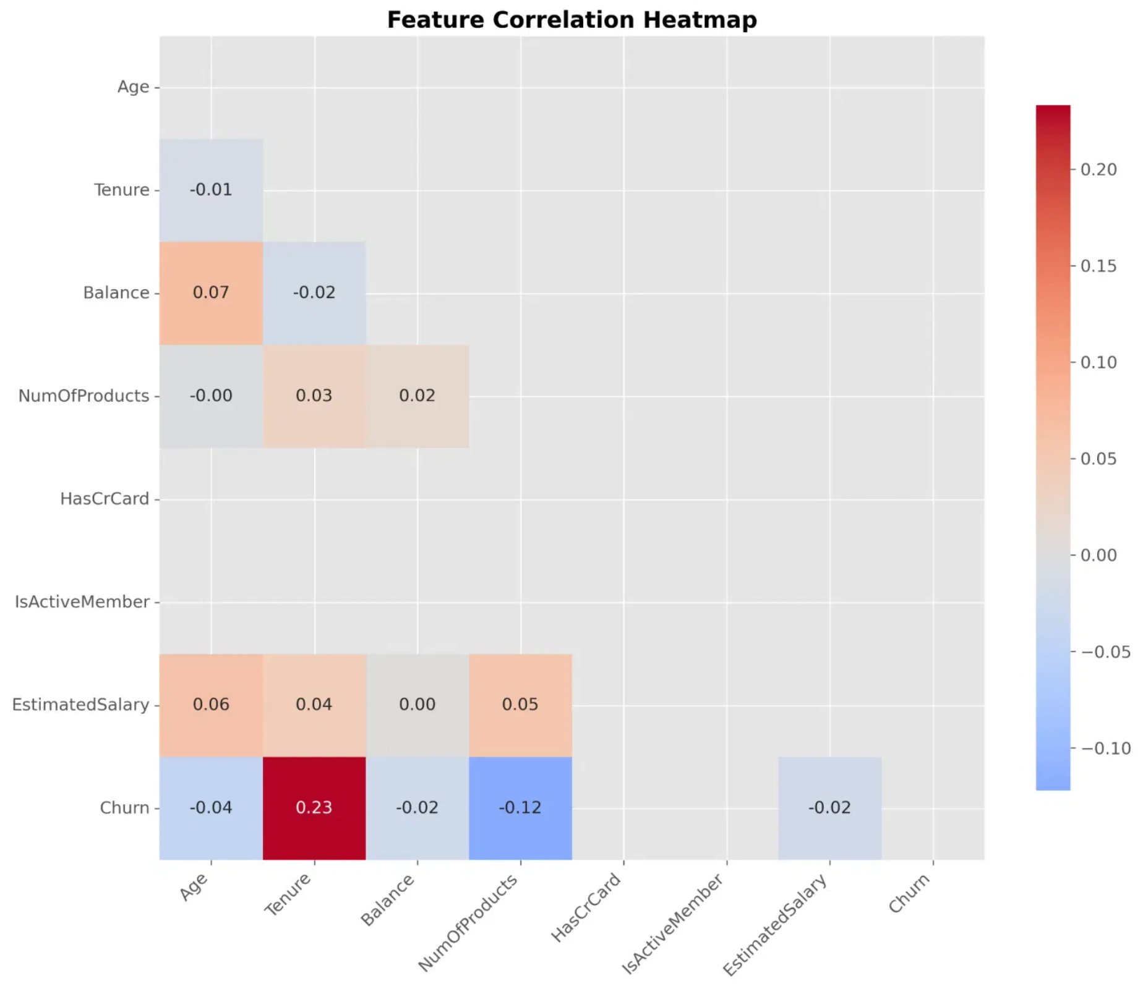
Feature Correlation Analysis
Key Correlations Discovered
Tenure vs Churn:
Strong positive correlation (0.23) - older customers tend to have longer relationships with the bank
NumOfProducts vs Churn:
Moderate negative correlation (-0.12) - higher products count associated with lower churn
Multicollinearity Assessment
The correlation matrix shows limited multicollinearity between predictors, with only NumOfProducts and Tenure showing substantial correlation.
This suggests that most features provide unique information to the model, supporting the use of all available predictors.
Feature Engineering Insights
Correlation analysis led to the TenureAgeRatio feature, capturing tenure-age relation and becoming the model’s second top predictor.

Slide 9

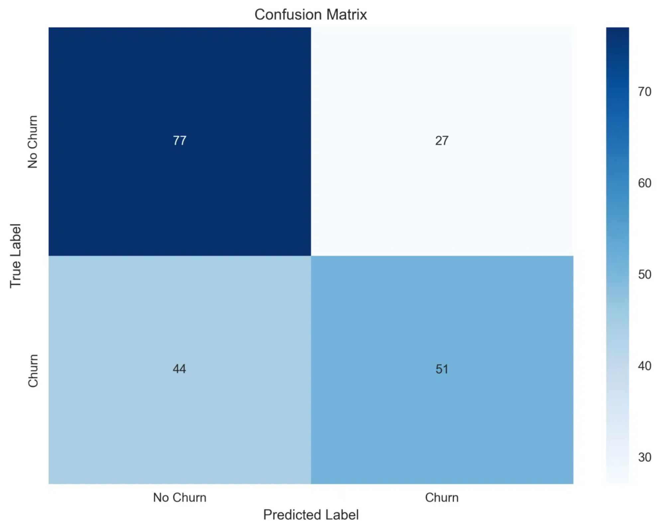
Model Performance & Evaluation
Model Evaluation Metrics
Accuracy:
64.32%
Proportion of correct predictions among total predictions
Precision:
65.38%
Proportion of correct positive predictions among all positive predictions
Recall:
53.68%
Proportion of correct positive predictions among all actual positives
F1-Score:
58.96%
Harmonic mean of precision and recall
ROC AUC:
69.80%
Area under the ROC curve, measuring discriminative ability
Cross-Validation Results
Cross-validation F1 score: 57.46% (±4.80%)
The Random Forest model demonstrates balanced performance across metrics, with consistent results in cross-validation indicating reliable generalization to unseen data.

Slide 10

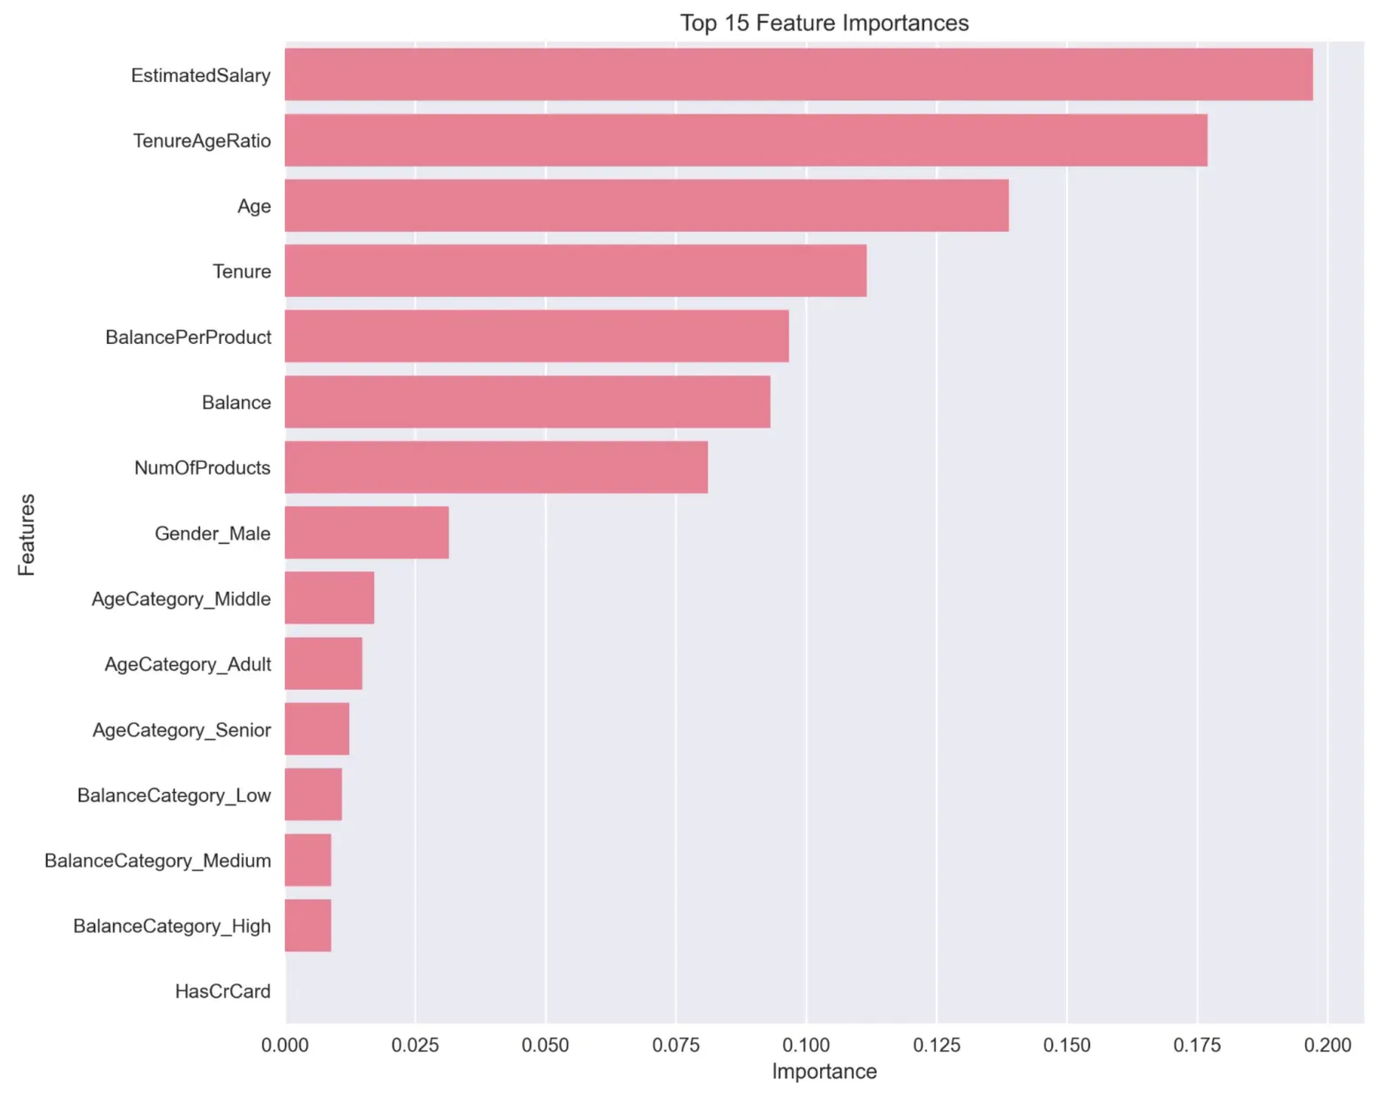
Feature Importance Analysis
Top Feature Contributors
EstimatedSalary (19.72%):
Primary driver of churn decisions
TenureAgeRatio (17.70%):
Engineered feature showing customer lifecycle value
Age (13.89%):
Significant demographic factor
Tenure (11.16%):
Key customer loyalty indicator
BalancePerProduct (9.67%):
Important financial engagement metric
Engineered Features Impact
Business Implications
The two engineered features (TenureAgeRatio and BalancePerProduct) account for 27.37% of the model's predictive power, validating the feature engineering approach.
Focus retention efforts on high-salary customers
Target customers with low tenure-to-age ratios
Develop age-specific retention strategies
Incentivize product engagement to increase BalancePerProduct

Slide 11

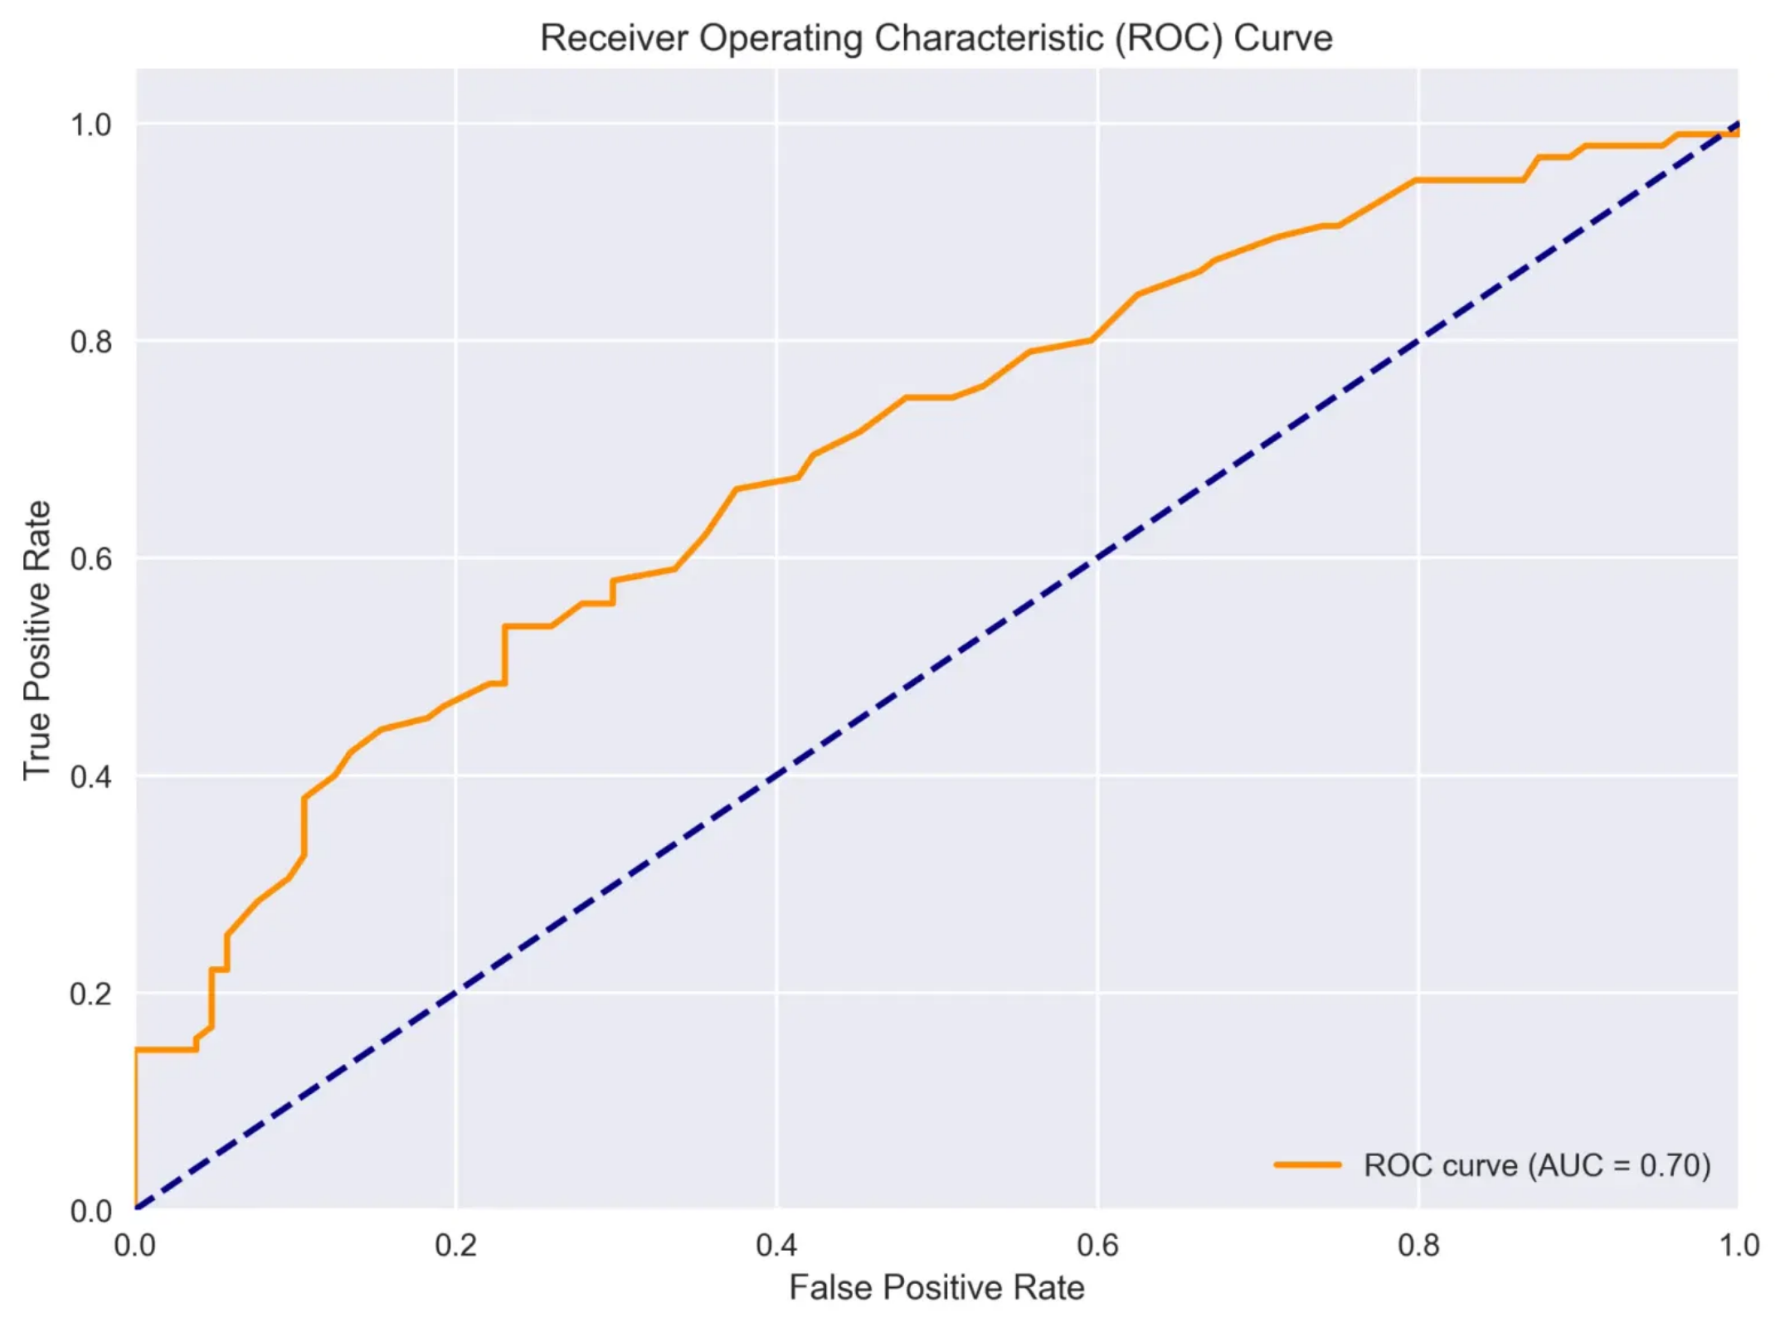

Conclusion & Future Work
Key Findings
Data Quality:
Addressing missing values and outliers improved model reliability
Feature Engineering:
Created features like TenureAgeRatio significantly enhanced prediction power
Top Predictors:
EstimatedSalary (19.7%), TenureAgeRatio (17.7%), Age (13.9%)
Model Performance:
64.3% accuracy with balanced precision and recall
Future Enhancements
Advanced Models:
Explore deep learning and
ensemble methods
ROC Curve - AUC: 0.698
Feature Expansion:
Incorporate transaction history
and customer service interactions
Real-time Prediction:
Implement streaming data
pipeline for continuous monitoring
Contact:
Shahil Kumar

Slide 12
"Thank you for your attention. Questions & Discussion welcome."
GitHub Link - https://github.com/skfrost19/Credit_Card_Churn_Prediction.git
Streamlit UI -
Contact:
Shahil Kumar

