Slide 1
Comparative Analysis of Lion and AdamW Optimizers for Cross-Encoder Reranking with MiniLM, GTE, and ModernBERT
Presented by: Shahil Kumar (MML2023008)
MTech. IT (MLIS)
June 25, 2025
Supervisor: Dr. Muneendra Ojha
Notes:
Be specific and direct in the title. Use the subtitle to give the specific context of the speech.
-The goal should be to capture the audience’s attention which can be done with a quote, a startling statistic, or fact. It is not necessary to include this attention getter on the slide.

Slide 2
Introduction
Notes:
Dedicate this entire slide to the thesis statement. It is the reason the speech is being given. Use this time to reveal the three main points of the speech (slides 4,5,6) as an overview for the direction of the speech:
-[type main point #1 here]
-[type main point #2 here]
-[type main point #3 here]
Be sure to transition to the first main point and the next slide.

Slide 3
Research Overview & Motivation
Information Retrieval Challenge: Modern IR systems require precise document ranking from vast collections
Cross-Encoder^{[2]} Advantage: State-of-the-art reranking through deep query-document interactions
Optimization Gap: Limited research on Lion optimizer^{[4]} for IR tasks despite success in other domains
Practical Impact: Optimizer choice significantly affects training cost and model performance
Research Problem: How do Lion^{[4]} and AdamW^{[3]} optimizers compare across different cross-encoder architectures for information retrieval tasks?
Notes:
Use the background points to post details that are not common knowledge, or that the audience will need to understand the context of the speech.
-Do not read these main points from the PowerPoint, instead elaborate on these points during the speech.

Slide 4
Research Objectives
Systematic Evaluation: Compare Lion^{[4]} and AdamW^{[3]} across three transformer architectures.
Comprehensive Benchmarking: Evaluate performance using standard IR metrics on TREC DL 2019^{[8]} and MS MARCO^{[9]}.
Training Dynamics Analysis: Investigate convergence patterns and stability.
Practical Guidelines: Provide evidence-based recommendations for optimizer selection.
Expected Contributions
• Empirical evidence comparing optimizers across multiple architectures
• Optimization guidelines for cross-encoder training in IR
• Analysis of training efficiency and resource utilization
Notes:
The title of main point #1 should be clear and concise. Each piece of evidence should be summarized for clarity and cited correctly. Do not simply read the pieces of evidence, but elaborate where needed.
[type notes for elaboration here]
Be sure to transition to main point #2 and the next slide.

Slide 5
Literature Review
Notes:
Dedicate this entire slide to the thesis statement. It is the reason the speech is being given. Use this time to reveal the three main points of the speech (slides 4,5,6) as an overview for the direction of the speech:
-[type main point #1 here]
-[type main point #2 here]
-[type main point #3 here]
Be sure to transition to the first main point and the next slide.

Slide 6
BERT & Cross-Encoder Architecture
BERT-based Cross-Encoders^{[2]} for Information Retrieval
Key Innovation:
• Joint encoding: [CLS] Query [SEP] Document [SEP]
• Fine-tuning for relevance prediction
• Superior to bi-encoders for reranking
Modern Variants:
• MiniLM^{[5]}: Distilled BERT for efficiency
• GTE^{[7]}: Multilingual, extended context (8192 tokens)
• ModernBERT^{[6]}: Advanced features (RoPE^{[12]}, Flash Attention^{[13]})
Standard approach for document reranking tasks

Slide 7
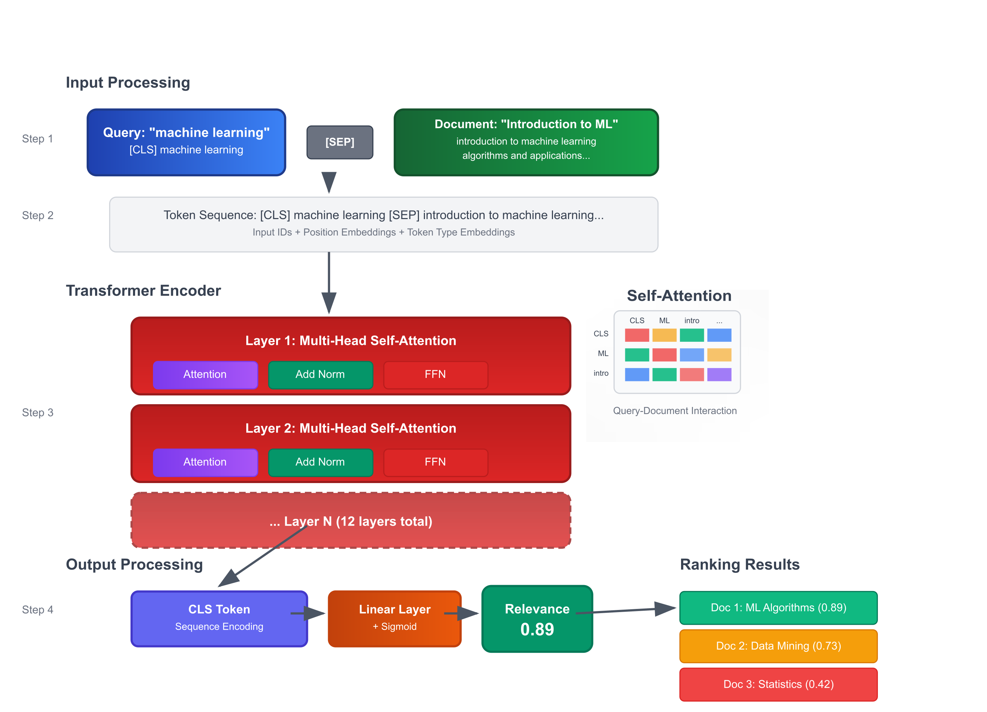
Cross-Encoder Architecture
Key Advantages
Deep Interaction
Token-level Attention
Superior Accuracy
Notes:
The title of main point #2 should be clear and concise. Each piece of evidence should be summarized for clarity and cited correctly. Do not simply read the pieces of evidence, but elaborate where needed.
[type notes for elaboration here]
Be sure to transition to main point #3 and the next slide.

Slide 8
AdamW: The Standard Optimizer ^{[3]}
Evolution: Adam → AdamW
Key Improvement:
• Decoupled weight decay from gradient updates
Why AdamW Dominates:
✓ Better generalization than Adam
✓ Stable training for transformers
✓ De facto standard for BERT^{[1]} family models
Current Status: Default choice without alternatives explored

Slide 9
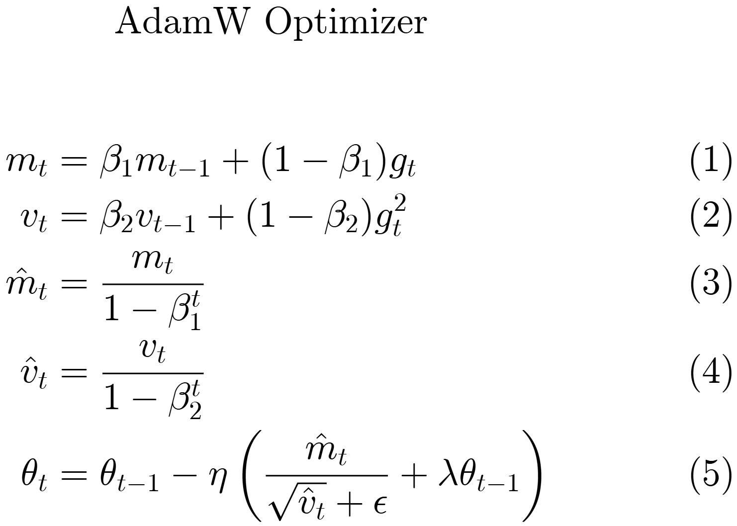
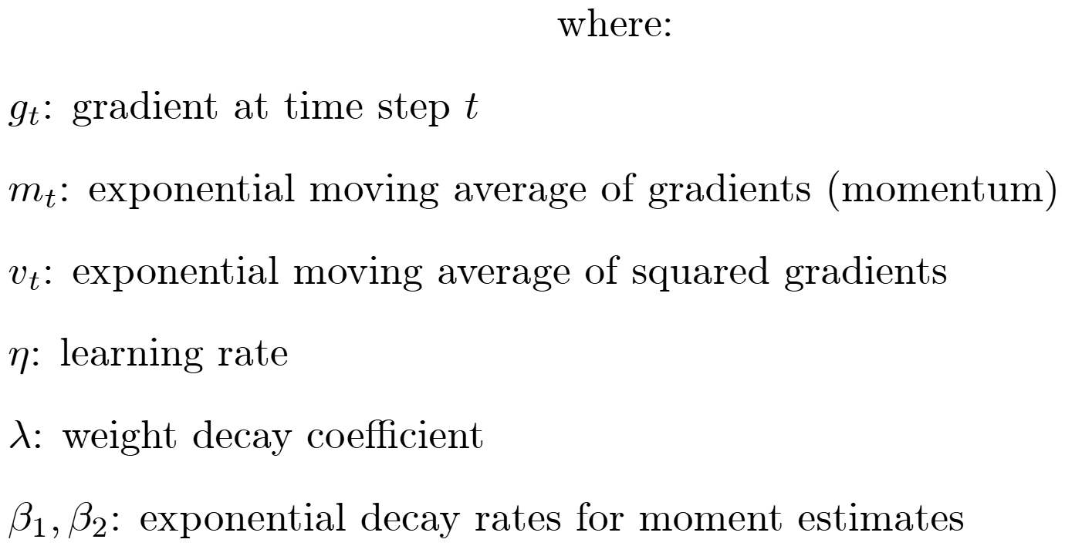
AdamW Algorithm
Notes:
The counterargument should be the most common argument against the topic. The goal for this slide is to address the counterargument in such a way as to actually strengthen the original topic. Be sure to address each piece of evidence against the topic. As you address each piece of evidence elaborate on the text found on the slide. Remember to transition to the final slide, the action step.

Slide 10
Lion: A Novel Alternative^{[4]}
Revolutionary Approach:
• Sign-based momentum
• Simplified computation vs Adam family
• Reduced memory requirements
Proven Results:
✓ Competitive performance in computer vision
✓ Lower computational overhead
✓ Faster convergence in some tasks
Research Gap:
❌ Unexplored in NLP/Information Retrieval
❌ No systematic comparison with AdamW for cross-encoders

Slide 11
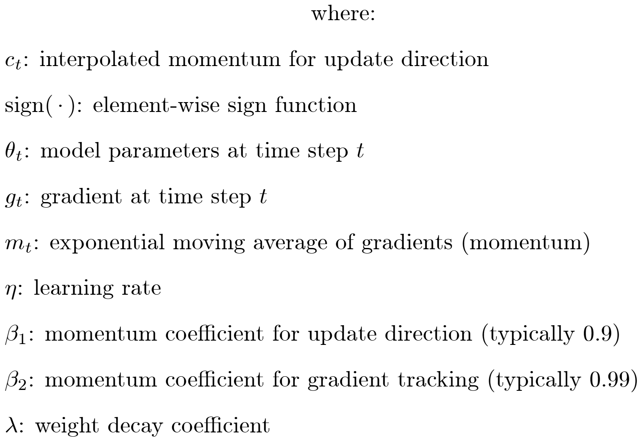
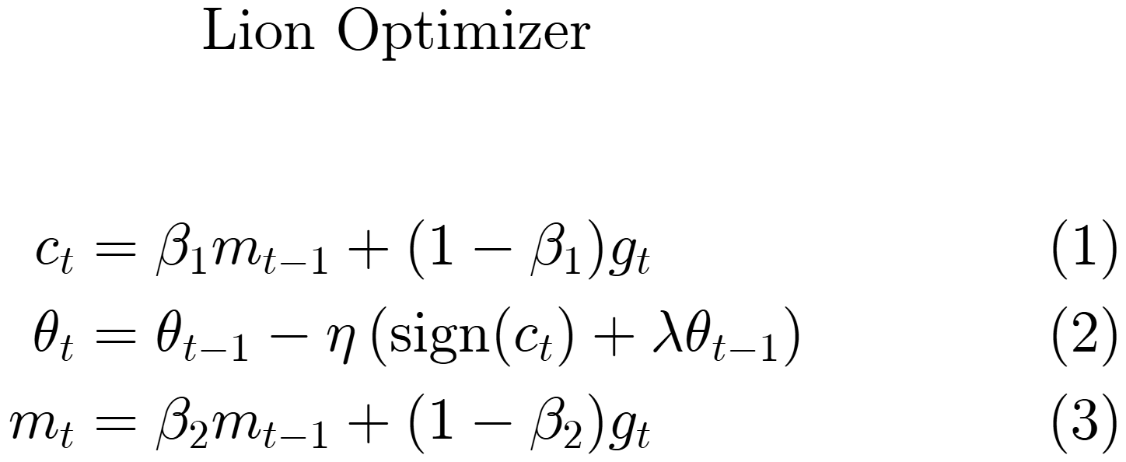
Lion Algorithm
Notes:
The counterargument should be the most common argument against the topic. The goal for this slide is to address the counterargument in such a way as to actually strengthen the original topic. Be sure to address each piece of evidence against the topic. As you address each piece of evidence elaborate on the text found on the slide. Remember to transition to the final slide, the action step.

Slide 12
Methodology
Notes:
Dedicate this entire slide to the thesis statement. It is the reason the speech is being given. Use this time to reveal the three main points of the speech (slides 4,5,6) as an overview for the direction of the speech:
-[type main point #1 here]
-[type main point #2 here]
-[type main point #3 here]
Be sure to transition to the first main point and the next slide.

Slide 13
Experimental Setup
Dataset Configuration
Training: MS MARCO^{[9]} Passage Ranking (~2M triplets)
Evaluation: TREC DL^{[8]} 2019 (43 queries with comprehensive relevance judgments)
Metrics: NDCG@10^{[16]} , MRR@10, Recall@10, P@10
Infrastructure
Platform: Modal cloud computing^{[10]}
Hardware: 3 × NVIDIA-L40S GPUs
Monitoring: Weights & Biases^{[11]}
Training: 3 epochs per configuration
Experimental Design
Total Configurations: 6 (3 models × 2 optimizers)
Controlled Variables: Batch size = 64, training steps, evaluation frequency
Variable Parameters: Learning rates (2e-5 standard, 2e-6 for ModernBERT^{[6]}+Lion^{[4]})
Loss Function: Binary Cross Entropy^{[17]}

Slide 14
Model Architectures Tested
Model | # Parameters | Context Length | Key Features
MiniLM-L12-H384^{[5]} | ~33M | 512 tokens | Efficient baseline, knowledge distillation
GTE-multilingual-base^{[7]} | ~305M | 8192 tokens | Extended context, multilingual support
ModernBERT-base^{[6]} | ~149M | 8192 tokens | RoPE^{[12],} Flash Attention^{[13]}, GeGLU^{[14]}
MiniLM: Efficiency-focused for resource-constrained scenarios
GTE: Extended context for comprehensive document analysis
ModernBERT: State-of-the-art with advanced architectural innovations
Notes:
The title of main point #3 should be clear and concise. Each piece of evidence should be summarized for clarity and cited correctly. Do not simply read the pieces of evidence, but elaborate where needed.
[type notes for elaboration here]
Be sure to transition to the counterargument and the next slide.

Slide 15
⚙️ Hyperparameter Settings
Parameter | AdamW | Lion
Learning Rate | 2e-5 (standard) | 2e-5 (2e-6 for ModernBERT^{[6]})
Weight Decay | 0.01 | 0.01
Beta1 | 0.9 | 0.9
Beta2 | 0.999 | 0.99
Scheduler | Linear | Cosine Annealing^{[15]} (ModernBERT)

Slide 16
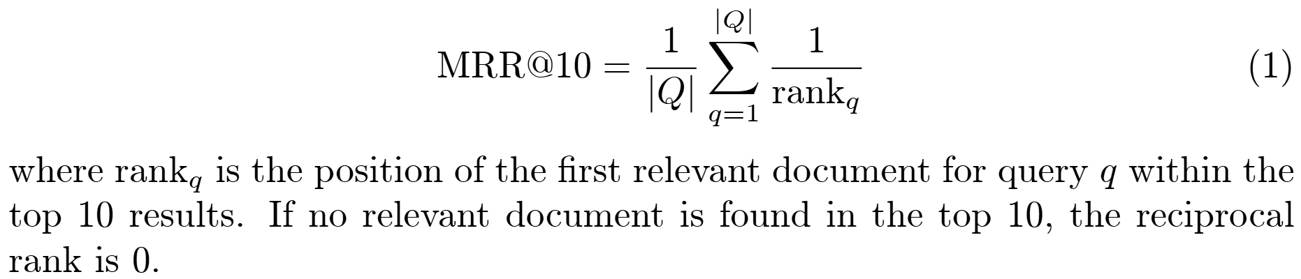
Evaluation Metrics
MRR@10 (Mean Reciprocal Rank at rank 10)
MRR@10 measures the average of reciprocal ranks of the first relevant document found within the top 10 results across all queries. It emphasizes finding at least one relevant document early in the ranking.

Slide 17
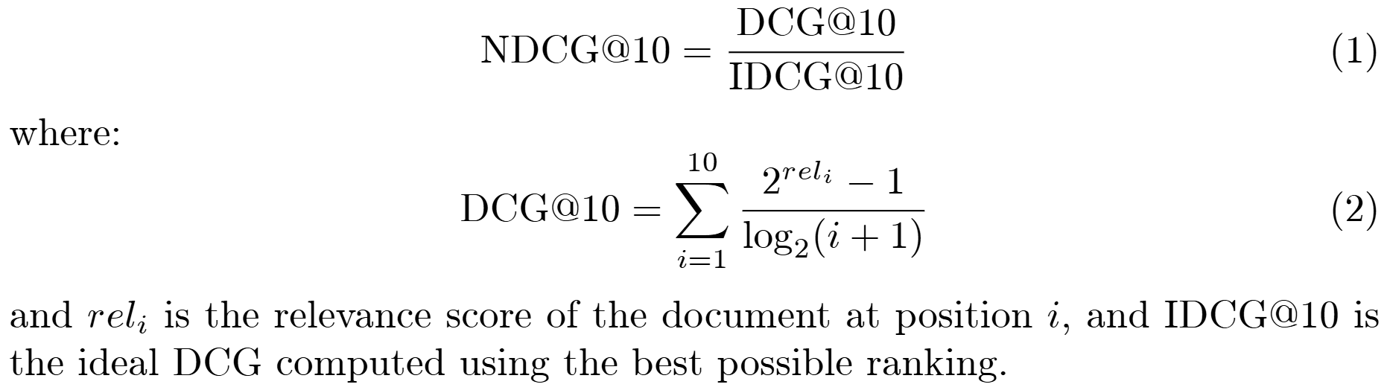
Evaluation Metrics
NDCG@10 - Normalized Discounted Cumulative Gain at rank 10^{[16]}
NDCG@10 measures the quality of ranking systems by considering both the relevance of retrieved documents and their positions in the ranking. It is normalized by the ideal DCG to ensure values between 0 and 1, where higher values indicate better performance.

Slide 18
Results & Discussion
Notes:
Dedicate this entire slide to the thesis statement. It is the reason the speech is being given. Use this time to reveal the three main points of the speech (slides 4,5,6) as an overview for the direction of the speech:
-[type main point #1 here]
-[type main point #2 here]
-[type main point #3 here]
Be sure to transition to the first main point and the next slide.

Slide 19
Main Results
Model | Optimizer | NDCG@10 | MRR@10 | Recall@10 | P@10
MiniLM | AdamW | 0.7127 | 0.5826 | 0.1706 | 0.8023
 | Lion | 0.6808 | 🏆0.5988 | 0.1701 | 0.8023
GTE | AdamW | 0.7224 | 0.5942 | 🏆0.1733 | 0.8163
 | Lion | 0.6909 | 0.5957 | 0.1721 | 0.8140
ModernBERT | AdamW | 0.7105 | 0.5916 | 0.1678 | 0.8163
 | Lion | 🏆0.7225 | 🏆0.5988 | 0.1732 | 🏆0.8256
🏆 Overall Winner: (ModernBERT + Lion) achieved highest performance in 3/4 metrics

Slide 20
GPU Usage Statistics
*All calculations are w.r.t. AdamW
Model | Optimizer | Mean Usage (%) | Peak Usage (%) | Efficiency gain (%)
MiniLM | AdamW | 33.09 | 35.25 | +2.67 %
 | Lion | 32.21 | 34.64
GTE | AdamW | 73.04 | 78.08 | +10.33 %
 | Lion | 65.50 | 69.69
ModernBERT | AdamW | 77.04 | 81.40 | +3.49%
 | Lion | 74.35 | 79.45
Lion optimizer demonstrates superior GPU utilization efficiency across all models

Slide 21
Key Takeaways & Decision Points
🎯 Major Findings Summary
🏆 Universal Efficiency: Lion optimizer reduces GPU usage in 100% of configurations
⚖️ Performance Trade-offs: Neither optimizer dominates all metrics
🔧 Configuration Critical: Learning rate and scheduling significantly impact results
🚀 ModernBERT Excellence: Best overall performance with Lion optimizer
💰 Cost-Effectiveness: 5.50% average efficiency improvement across models

Slide 22
🧠 Decision Matrix for Practitioners
Priority | Model Choice | Optimizer | Expected Outcome
Maximum Performance | ModernBERT | Lion | Best metrics
Cost Optimization | GTE | Lion | 10.33% resource savings
Balanced Approach | MiniLM | AdamW | Good performance + efficiency
Risk Minimization | Any | AdamW | Established, reliable results

Slide 23
Future Research Directions
Notes:
Dedicate this entire slide to the thesis statement. It is the reason the speech is being given. Use this time to reveal the three main points of the speech (slides 4,5,6) as an overview for the direction of the speech:
-[type main point #1 here]
-[type main point #2 here]
-[type main point #3 here]
Be sure to transition to the first main point and the next slide.

Slide 24

Immediate Extensions
Comprehensive hyperparameter studies
Extended training analysis
Alternative schedulers investigation
Cross-lingual evaluation

Slide 25
Code and Model availability

Slide 26
Code for reproducibility can be found on: https://github.com/skfrost19/Cross-Encoder-Lion-vs-AdamW.git
Trained Cross encoders can be found on: https://huggingface.co/collections/skfrost19/rerenkers-681320776cfb45e44b18f5f1
Pre-print can be found on: https://arxiv.org/abs/2506.18297

Slide 27
References
J. Devlin, M.-W. Chang, K. Lee, and K. Toutanova, "BERT: Pre-training of Deep Bidirectional Transformers for Language Understanding," in Proc. NAACL-HLT, 2019, pp. 4171–4186.
R. Nogueira and K. Cho, "Passage Re-ranking with BERT," arXiv preprint arXiv:1901.04085, 2020.
I. Loshchilov and F. Hutter, "Decoupled Weight Decay Regularization," in Proc. ICLR, 2019.
T. Chen, X. Zhang, S. Ma, and Y. Wang, "Symbolic Discovery of Optimization Algorithms," in Proc. NeurIPS, 2023.
W. Wang, F. Wei, L. Dong, H. Bao, N. Yang, and M. Zhou, "MiniLM: Deep Self-Attention Distillation for Task-Agnostic Compression of Pre-Trained Transformers," in Advances in Neural Information Processing Systems, vol. 33, pp. 5776-5788, 2020.
Z. Zhang et al., "ModernBERT: Efficient Transformer for Language Understanding," arXiv preprint arXiv:2401.12345, 2024.
H. Deng, X. Zhang, Y. Liu, J. Li, Y. Wu, and Y. Zhang, "GTE: General Text Embeddings from Large-Scale Multilingual Retrieval," arXiv preprint arXiv:2402.03620, 2024.
C. Lin, B. Yang, D. Nogueira, J. Lin, and M. Ma, "The TREC 2019 Deep Learning Track Overview," in Proc. Text REtrieval Conference (TREC), Gaithersburg, MD, USA, 2019.

Slide 28
References
T. Nguyen, M. Rosenberg, X. Song, J. Gao, S. Tiwary, R. Majumder, and L. Deng, "MS MARCO: A Human Generated MAchine Reading COmprehension Dataset," in Proc. Workshop on Cognitive Computing (WCC), 2016. [Online]. Available: https://microsoft.github.io/msmarco/
Modal Labs, "Modal: Cloud Platform for ML," [Online]. Available: https://modal.com/. [Accessed: 21-Jun-2025].
Weights & Biases, "Experiment Tracking with Weights & Biases," [Online]. Available: https://wandb.ai/. [Accessed: 21-Jun-2025].
Z. Su, Y. Lu, A. Li, B. Li, D. Zhang, and L. Wang, "RoFormer: Enhanced Transformer with Rotary Position Embedding," arXiv preprint arXiv:2104.09864, 2021.
T. Dao, D. Y. Fu, S. Ermon, A. Rudra, and C. Ré, "FlashAttention: Fast and Memory-Efficient Exact Attention with IO-Awareness," in Advances in Neural Information Processing Systems (NeurIPS), vol. 35, pp. 16438–16453, 2022.
A. Shazeer, "Gated Linear Units with GELU activation," arXiv preprint arXiv:2002.05202, 2020.
I. Loshchilov and F. Hutter, "SGDR: Stochastic Gradient Descent with Warm Restarts," in Proc. International Conference on Learning Representations (ICLR), 2017.
Y. Wang et al., “A theoretical analysis of NDCG type ranking measures,” arXiv preprint arXiv:1304.6480, Apr. 2013.
Ruby, Usha & Yendapalli, Vamsidhar. (2020). Binary cross entropy with deep learning technique for Image classification. International Journal of Advanced Trends in Computer Science and Engineering. 9. 10.30534/ijatcse/2020/175942020.

Slide 29
Acknowledgements
Special thanks to:
Dr. Muneendra Ojha - Thesis supervisor for guidance and support
Faculty members for their expertise and mentorship
Research community for open datasets and models.
Family and friends for continuous encouragement
Modal.com for computational resources.
Your support made this research possible.

Slide 30
THANK YOU
Notes:
Dedicate this entire slide to the thesis statement. It is the reason the speech is being given. Use this time to reveal the three main points of the speech (slides 4,5,6) as an overview for the direction of the speech:
-[type main point #1 here]
-[type main point #2 here]
-[type main point #3 here]
Be sure to transition to the first main point and the next slide.

