Slide 1

Statistics for Business
Session 6 of
Dr. Suresh Kumar Gadi
Universidad de las Américas Puebla

Slide 2
Today’s topic
Interval estimate

Slide 3

Normal distribution

Slide 4

Standardization

Slide 5
Z-Score

Slide 6

Standard error
$$σ_{\overline{x}}=\frac{σ}{\sqrt{n}}$$

Slide 7
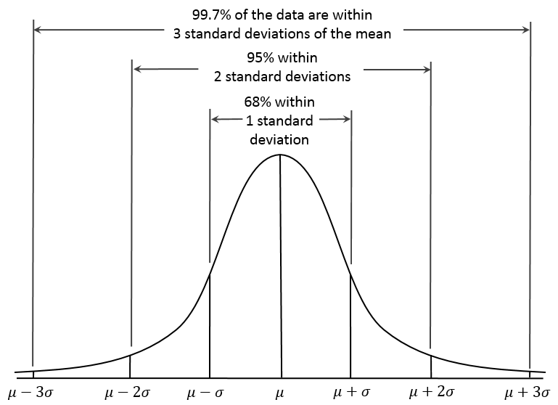

Margin error
$${MOE}_{γ}=z_{γ}\sqrt{\frac{σ^{2}}{n}}$$

Slide 8


Interval estimate
$$\overline{x}±{MOE}_{γ}$$

Slide 9
Student’s t-distribution

Slide 10


Population portion
Standard error
$$σ_{\overline{p}}=\sqrt{\frac{p(1−p)}{n}}$$
Margin of error
$$z_{γ}\sqrt{\frac{ \overline{p}(1−\overline{p})}{n}}$$
Interval estimate
$$\overline{p}±z_{γ}\sqrt{\frac{ \overline{p}(1−\overline{p})}{n}}$$

Slide 11

Thank you

