Slide 1

Statistics for Business
Session 8 of
Dr. Suresh Kumar Gadi
Universidad de las Américas Puebla

Slide 2
Today’s topic
Hypothesis Testing for two populations

Slide 3
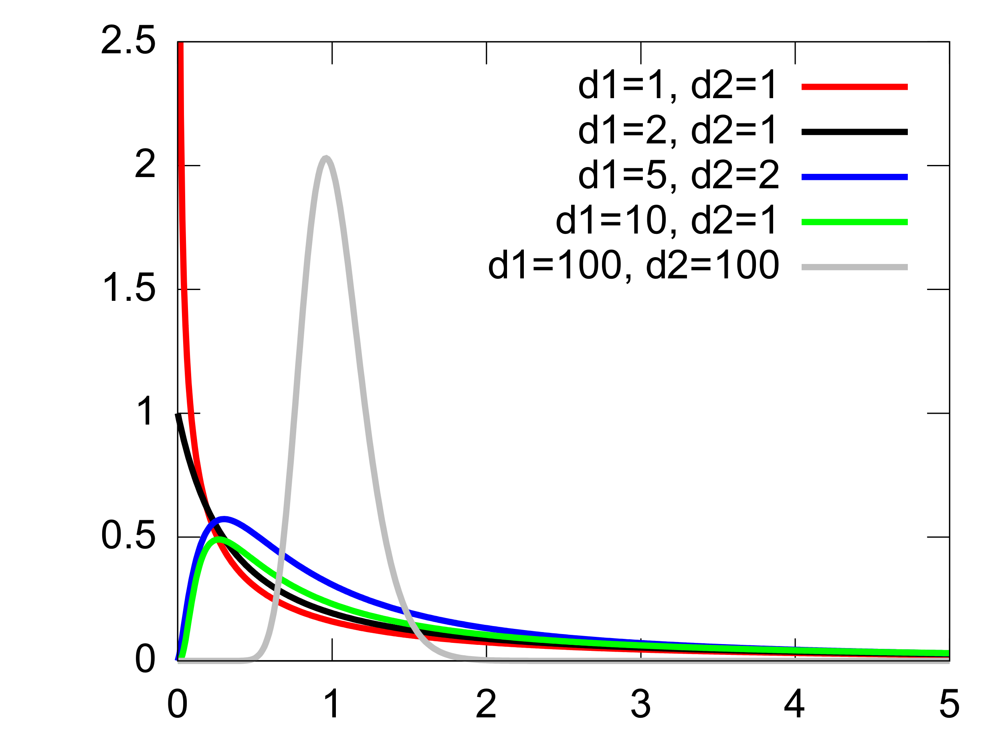
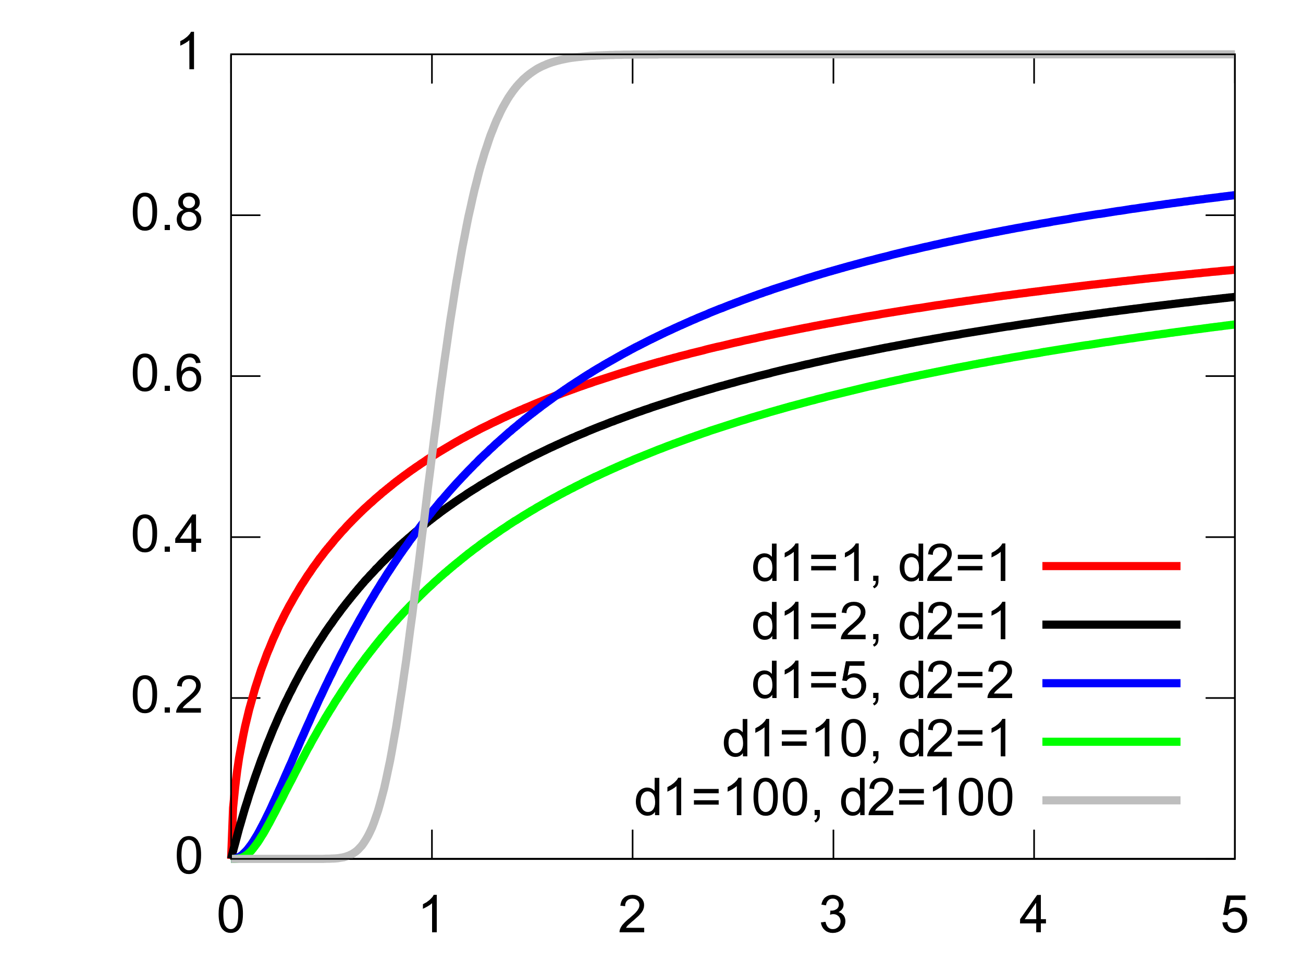
Fisher–Snedecor distribution (F-Distribution)

Slide 4
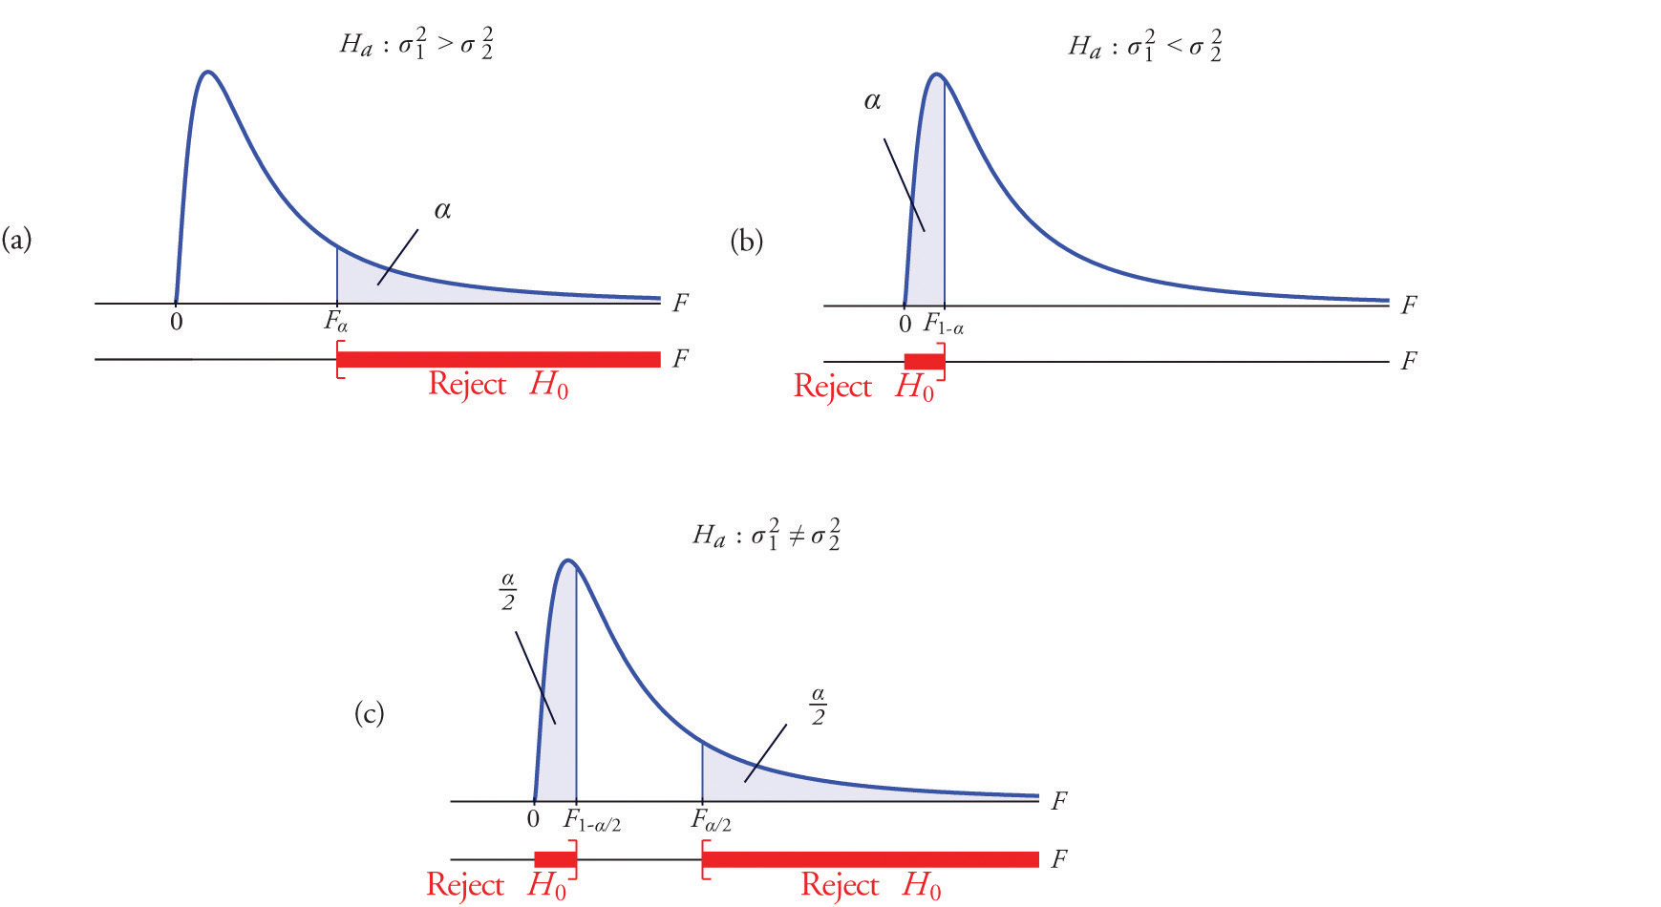
F-Test

Slide 5
Examples
Compare mean salaries between male and female population.
Compare mean quantity packed by two different machines

Slide 6
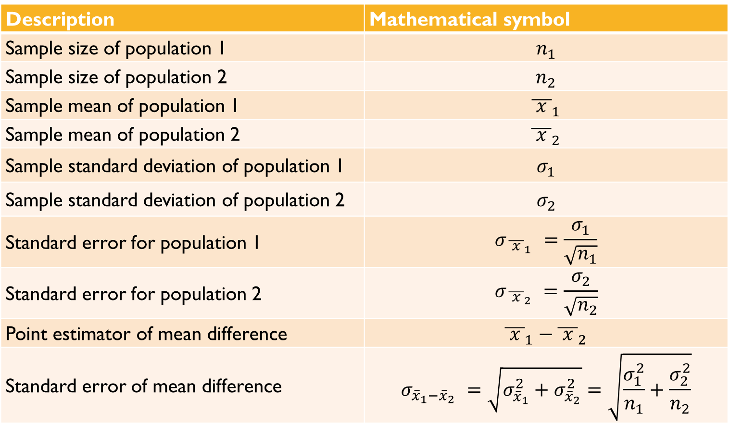
Difference in mean
Description | Mathematical symbol
Sample size of population 1 | $$n_{1}$$
Sample size of population 2 | $$n_{2}$$
Sample mean of population 1 | $${\overline{ x }}_{1}$$
Sample mean of population 2 | $${\overline{ x }}_{2}$$
Sample standard deviation of population 1 | $$σ_{1}$$
Sample standard deviation of population 2 | $$σ_{2}$$
Standard error for population 1 | $$σ_{ {\overline{ x }}_{1} }=\frac{σ_{1}}{\sqrt{n_{1}}}$$
Standard error for population 2 | $$σ_{ {\overline{ x }}_{2} }=\frac{σ_{2}}{\sqrt{n_{2}}}$$
Point estimator of mean difference | $${\overline{ x }}_{1}−{\overline{ x }}_{2}$$
Standard error of mean difference | $$σ_{{\overline{x}}_{1}−{\overline{x}}_{2} }=\sqrt{σ_{{\overline{x}}_{1}}^{2}+σ_{{\overline{x}}_{2}}^{2}}=\sqrt{\frac{σ_{1}^{2}}{n_{1}}+\frac{σ_{2}^{2}}{n_{2}}}$$

Slide 7

Example

Slide 8
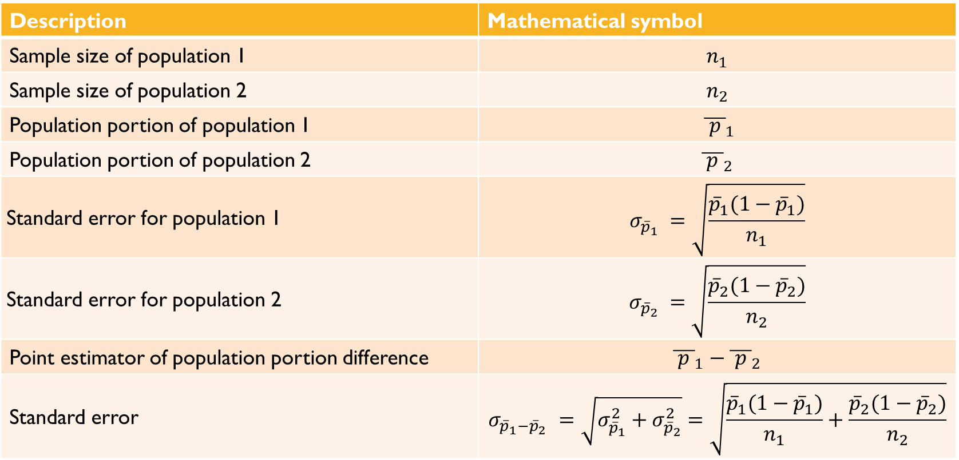
Difference in Population portion
Description | Mathematical symbol
Sample size of population 1 | $$n_{1}$$
Sample size of population 2 | $$n_{2}$$
Population portion of population 1 | $${ \overline{ p }}_{1}$$
Population portion of population 2 | $${\overline{ p }}_{2}$$
Standard error for population 1 | $$σ_{{\overline{p}}_{1} }=\sqrt{\frac{{\overline{p}}_{1}(1−{\overline{p}}_{1})}{n_{1}}}$$
Standard error for population 2 | $$σ_{{\overline{p}}_{2} }=\sqrt{\frac{{\overline{p}}_{2}(1−{\overline{p}}_{2})}{n_{2}}}$$
Point estimator of population portion difference | $${\overline{ p }}_{1}−{\overline{ p }}_{2}$$
Standard error | $$σ_{{\overline{p}}_{1}−{\overline{p}}_{2} }=\sqrt{σ_{{\overline{p}}_{1}}^{2}+σ_{{\overline{p}}_{2}}^{2}}=\sqrt{\frac{{\overline{p}}_{1}(1−{\overline{p}}_{1})}{n_{1}}+\frac{{\overline{p}}_{2}(1−{\overline{p}}_{2})}{n_{2}}}$$

Slide 9
Example

Slide 10

Thank you

