Slide 1

Statistics for Business
Session 5 of
Dr. Suresh Kumar Gadi
Universidad de las Américas Puebla

Slide 2
Content
Point estimation
Central Limit Theorem
Normal distribution

Slide 3
Terminology
Population
Sample

Slide 4
Random sampling
Lottery method
Table of random numbers
Software generated random numbers

Slide 5
Sampling
Example

Slide 6
Point estimation

Slide 7
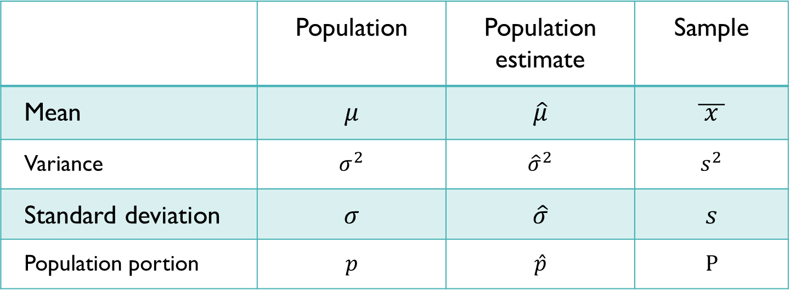
Mathematical notations
 | Population | Population estimate | Sample
Mean | $$μ$$ | $$\hat{μ}$$ | $$\overline{ x }$$
Variance | $$σ^{2}$$ | $${\hat{σ}}^{2}$$ | $$s^{2}$$
Standard deviation | $$σ$$ | $$\hat{σ}$$ | $$s$$
Population portion | $$p$$ | $$\hat{p}$$ | $$P$$

Slide 8

Central limit theorem

Slide 9
Example

Slide 10

Thank you

