Slide 1

Statistics for Business
Session 7 of
Dr. Suresh Kumar Gadi
Universidad de las Américas Puebla

Slide 2
Today’s topic
Hypothesis Testing

Slide 3

By the end of class, we should know
Null and alternative hypothesis
Hypothesis testing
Significance level ($α$)
One and two tailed tests

Slide 4


Null hypothesis ($H_{0}$)
Status quo

Slide 5

Alternate Hypothesis ($H_{A}$)
Proposing

Slide 6
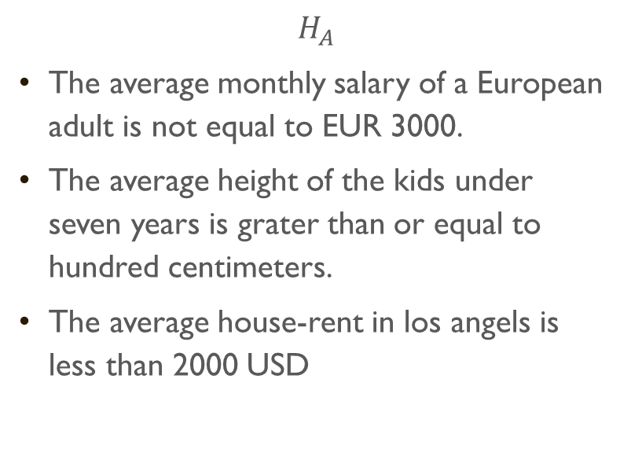
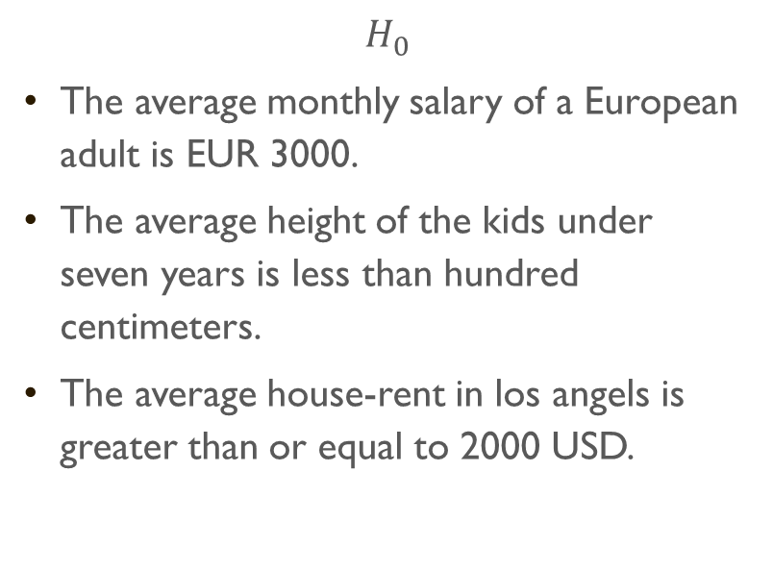
Examples
$$H_{0}$$
The average monthly salary of a European adult is EUR 3000.
The average height of the kids under seven years is less than hundred centimeters.
The average house-rent in los angels is greater than or equal to 2000 USD.
$$H_{A}$$
The average monthly salary of a European adult is not equal to EUR 3000.
The average height of the kids under seven years is grater than or equal to hundred centimeters.
The average house-rent in los angels is less than 2000 USD

Slide 7

Hypothesis testing

Slide 8
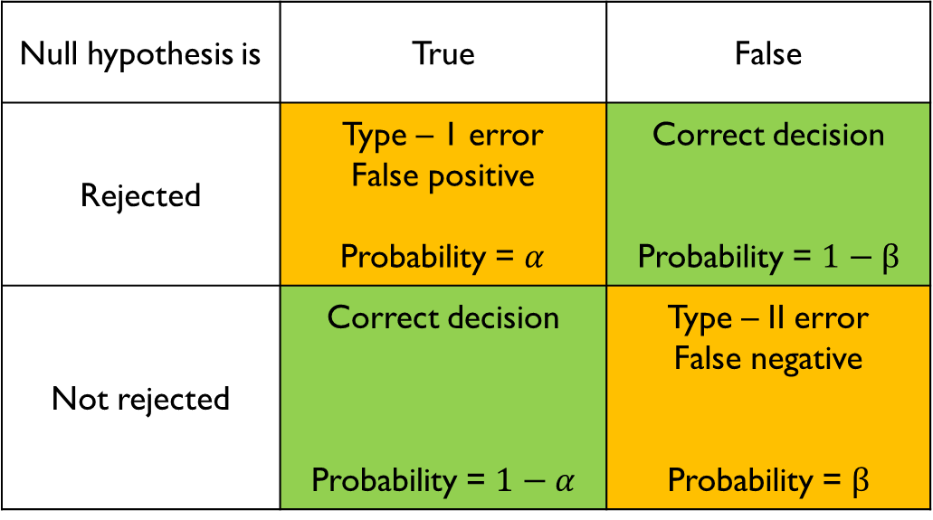
Errors
Null hypothesis is | True | False
Rejected | Type – 1 error False positive Probability = $α$ | Correct decision Probability = $1−β$
Not rejected | Correct decision Probability = $1−α$ | Type – II error False negative Probability = $β$

Slide 9

Type-1 error
$H_{0}$ is true but we reject it.

Slide 10


Significance level ($α$)
$$α=P\left(Type−1 error\right)$$

Slide 11

Type-2 error
$H_{0}$ is false but we failed to reject it.
$$β=P\left(Type−2 error\right)$$

Slide 12


Example
Which error is acceptable for the following?
$H_{0}:$Average battery life of a pacemaker is 300 days or less.

Slide 13

Example One tailed test

Slide 14
Example two tailed test

Slide 15


Example
In recent years, the mean age of all college students in city X has been $23$. A random sample of $42$ students revealed a mean age of $23.8$. Suppose their ages are normally distributed with a population standard deviation of $σ=2.4$. Can we infer at $α=0.05$ that the population mean age has changed?

Slide 16

Thank you

