Slide 1

Statistics for Business
Session 2 of
Dr. Suresh Kumar Gadi
Universidad de las Américas Puebla

Slide 2
What are we learning today?
Grouped data
Relative frequency
Mean
Median, Quartiles, Deciles, and Percentile
Mode
Standard deviation and Variance
Multiple variables

Slide 3
How to prepare grouped data
Excel example

Slide 4
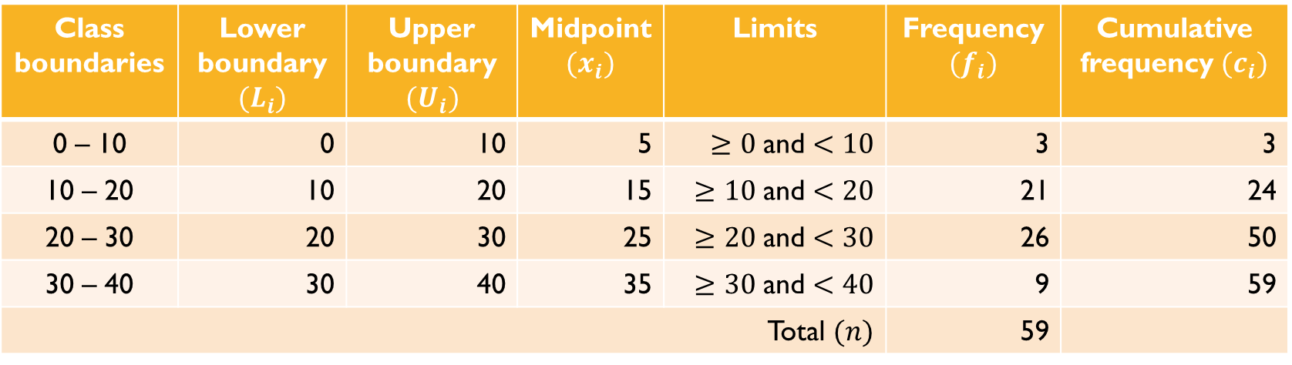
Terminology
Class boundaries | Lower boundary $(L_{i})$ | Upper boundary $(U_{i})$ | Midpoint $(x_{i})$ | Limits | Frequency $(f_{i})$ | Cumulative frequency $(c_{i})$
0 – 10 | 0 | 10 | 5 | $≥0$ and $<10$ | 3 | 3
10 – 20 | 10 | 20 | 15 | $≥10$ and $<20$ | 21 | 24
20 – 30 | 20 | 30 | 25 | $≥20$ and $<30$ | 26 | 50
30 – 40 | 30 | 40 | 35 | $≥30$ and $<40$ | 9 | 59
Total $(n)$ |  |  |  |  | 59
Class interval = class width = class height $\left(h\right)=10$

Slide 5

Relative frequency (RF)
The relative frequency $(f_{R})$ is given by
$$f_{R}=\frac{f_{i}}{\sum{f_{i}}}=\frac{f_{i}}{n}$$
where,
$f_{i}$ is frequency of the $i$^{th} class and
$n$ is total number of data elements

Slide 6
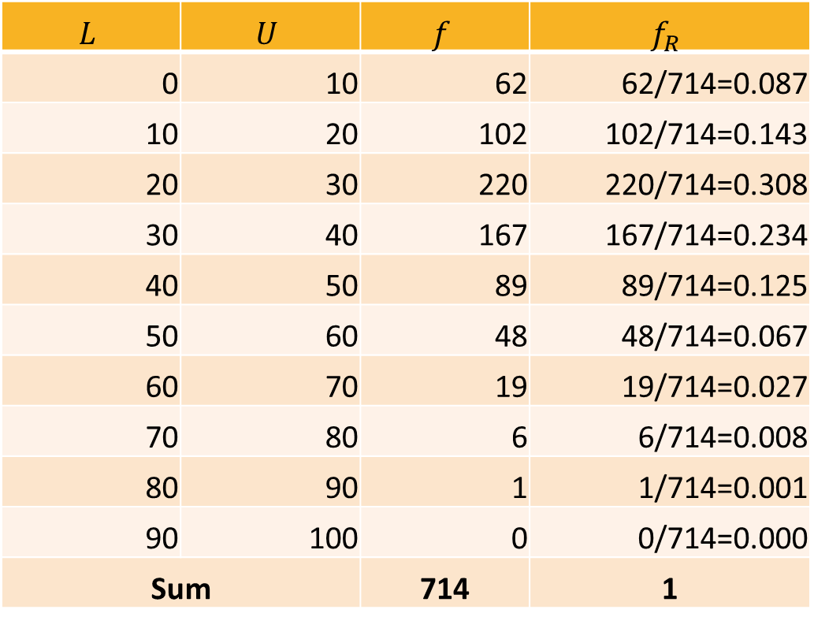
Relative frequency
$$L$$ | $$U$$ | $$f$$ | $$f_{R}$$
0 | 10 | 62 | 62/714=0.087
10 | 20 | 102 | 102/714=0.143
20 | 30 | 220 | 220/714=0.308
30 | 40 | 167 | 167/714=0.234
40 | 50 | 89 | 89/714=0.125
50 | 60 | 48 | 48/714=0.067
60 | 70 | 19 | 19/714=0.027
70 | 80 | 6 | 6/714=0.008
80 | 90 | 1 | 1/714=0.001
90 | 100 | 0 | 0/714=0.000
Sum |  | 714 | 1

Slide 7
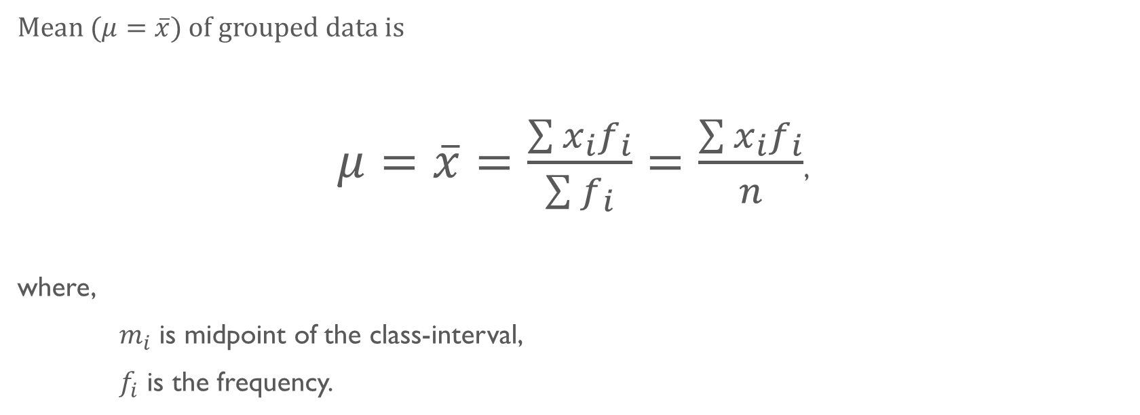
Mean
Mean $(μ=\overline{x}$) of grouped data is
$μ=\overline{x}=\frac{\sum{x_{i}f_{i}}}{\sum{f_{i}}}=\frac{\sum{x_{i}f_{i}}}{n}$,
where,
$m_{i}$ is midpoint of the class-interval,
$f_{i}$ is the frequency.

Slide 8
Example
Generate Random data
01
Group them
02
Obtain mean from the ungrouped data
03
Obtain mean from the grouped data
04

Slide 9

Median
Median $\left(\tilde{x}\right)$ of the grouped data is
$$\tilde{x}=L_{m}+\left[\frac{\frac{n}{2}−c_{m−1}}{f_{m}}\right]h,$$
where,
$L_{m}$ is the lower boundary of the median class

Slide 10
Example
Populate some grouped data
Calculate median

Slide 11


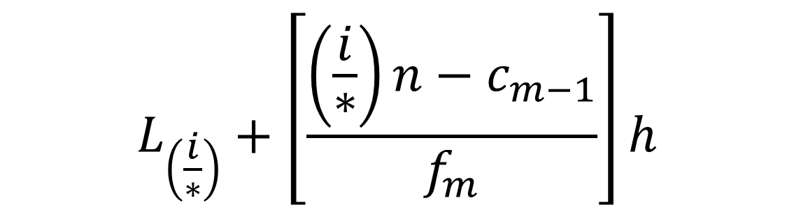
Quartiles, Deciles, and Percentile
Calculations are like Median.
Replace the $L_{m}$ and $\frac{n}{2}$ with the correct proportion.
$$L_{\left(\frac{i}{∗}\right)}+\left[\frac{\left(\frac{i}{∗}\right)n−c_{m−1}}{f_{m}}\right]h$$

Slide 12

Example
Generate random grouped data
Find 3nd quartile
Find 84th percentile
Find 7th decile

Slide 13
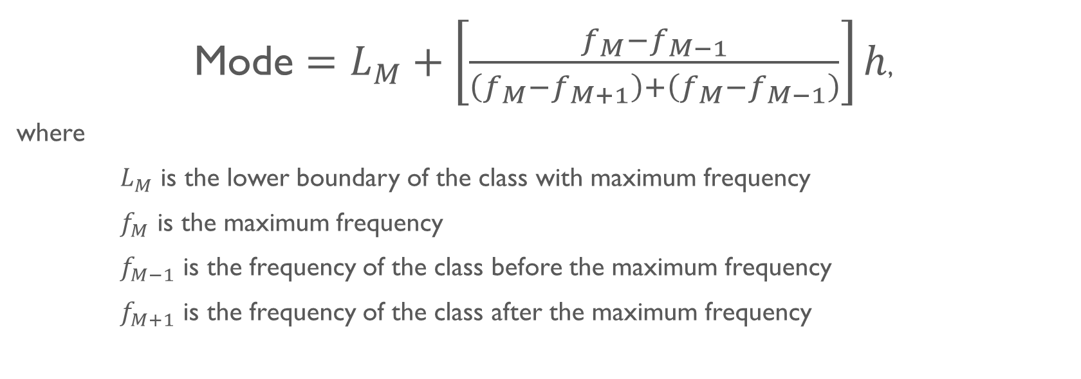
Mode
Mode $=L_{M}+\left[\frac{f_{M}−f_{M−1}}{\left(f_{M}−f_{M+1}\right)+\left(f_{M}−f_{M−1}\right)}\right]h$,
where
$L_{M}$ is the lower boundary of the class with maximum frequency
$f_{M}$ is the maximum frequency
$f_{M−1}$ is the frequency of the class before the maximum frequency
$f_{M+1}$ is the frequency of the class after the maximum frequency

Slide 14
Example
Find mode for a grouped data

Slide 15

Variance (ungrouped data)
Population variance ${(σ}^{2})$ formula is
$$σ^{2}=\frac{\sum{\left[{\left(\overline{x}−x_{i}\right)}^{2}\right]}}{n}$$
Sample variance ${(σ}^{2})$ formula is
$$σ^{2}=\frac{\sum{\left[{\left(\overline{x}−x_{i}\right)}^{2}\right]}}{n−1}$$

Slide 16

Variance (grouped data)
Population variance ${(σ}^{2})$ formula is
$$σ^{2}=\frac{\sum{\left[{f_{i}\left(\overline{x}−x_{i}\right)}^{2}\right]}}{n}$$
Sample variance ${(σ}^{2})$ formula is
$$σ^{2}=\frac{\sum{\left[f_{i}{\left(\overline{x}−x_{i}\right)}^{2}\right]}}{n−1}$$

Slide 17

Standard deviation
Population standard deviation$(σ)$ formula is
$$σ=\sqrt{σ^{2}}$$
Sample standard deviation $(σ)$ formula is
$$σ=\sqrt{σ^{2}}$$

Slide 18
Example
Calculate standard deviation and variance

Slide 19

Multiple variables

Slide 20
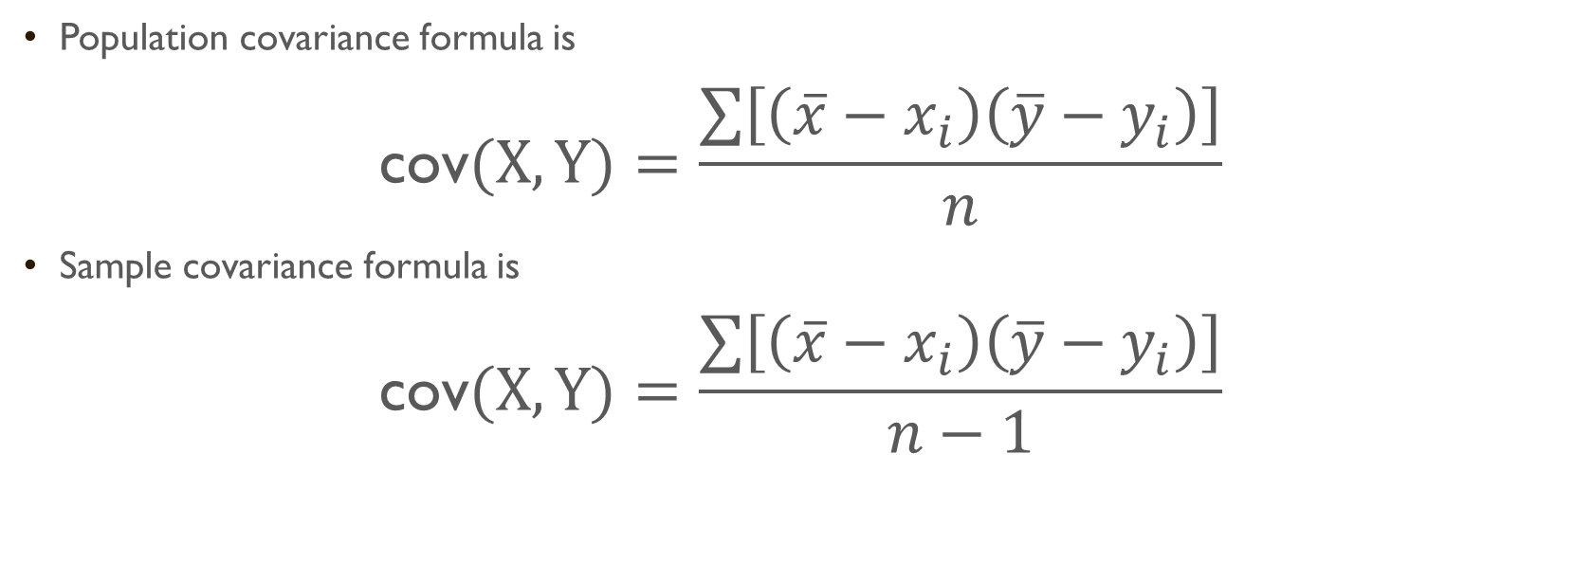
Covariance (ungrouped data)
Population covariance formula is
$$\text{cov}(X,Y)=\frac{\sum{\left[\left(\overline{x}−x_{i}\right)\left(\overline{y}−y_{i}\right)\right]}}{n}$$
Sample covariance formula is
$$\text{cov}(X,Y)=\frac{\sum{\left[\left(\overline{x}−x_{i}\right)\left(\overline{y}−y_{i}\right)\right]}}{n−1}$$

Slide 21
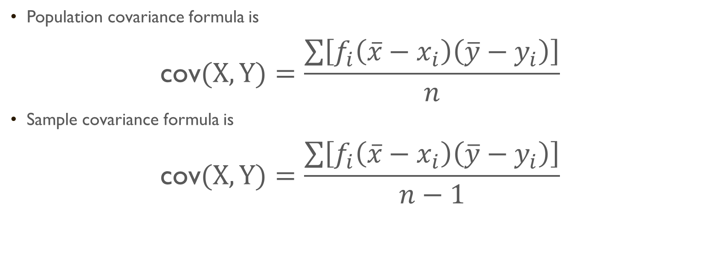
Covariance (grouped data)
Population covariance formula is
$$\text{cov}(X,Y)=\frac{\sum{\left[f_{i}\left(\overline{x}−x_{i}\right)\left(\overline{y}−y_{i}\right)\right]}}{n}$$
Sample covariance formula is
$$\text{cov}(X,Y)=\frac{\sum{\left[f_{i}\left(\overline{x}−x_{i}\right)\left(\overline{y}−y_{i}\right)\right]}}{n−1}$$

Slide 22
Example
Generate grouped data for two variables
Calculate Covariance

Slide 23
Correlation
Sunny weather
Ice cream sales
Sunburns

Slide 24

Pearson correlation coefficient
Pearson correlation coefficient $(ρ)$ is
$$ρ=\frac{\text{cov} (X,Y)}{σ_{x}σ_{y}}$$
where,
$σ_{x}$ is standard deviation of variable $X$
$σ_{y}$ is standard deviation of variable $Y$

Slide 25
Properties of factor of correlation
Value between
1 and -1
Significance of positive and negative signs

Slide 26

Thank you

