Slide 1

Statistics for Business
Session 7 of
Dr. Suresh Kumar Gadi
Universidad de las Américas Puebla

Slide 2
Today’s topic
Hypothesis Testing

Slide 3

By the end of class, we should know
Null and alternative hypothesis
Hypothesis testing
Significance level ($α$)
One and two tailed tests

Slide 4


Null hypothesis ($H_{0}$)
Status quo

Slide 5

Alternate Hypothesis ($H_{A}$)
Proposing

Slide 6
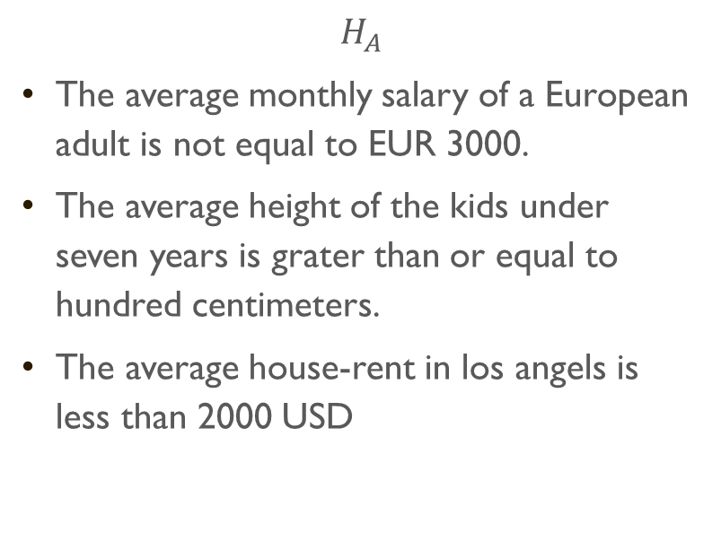
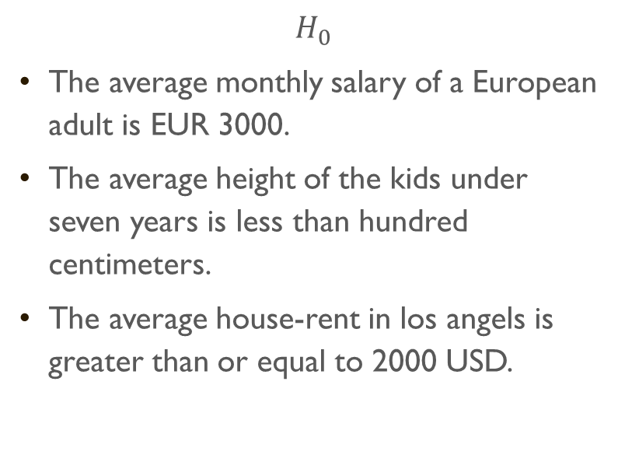
Examples
$$H_{0}$$
The average monthly salary of a European adult is EUR 3000.
The average height of the kids under seven years is less than hundred centimeters.
The average house-rent in los angels is greater than or equal to 2000 USD.
$$H_{A}$$
The average monthly salary of a European adult is not equal to EUR 3000.
The average height of the kids under seven years is grater than or equal to hundred centimeters.
The average house-rent in los angels is less than 2000 USD

Slide 7

Hypothesis testing

Slide 8

Type-1 error
$H_{0}$ is true but we reject it.

Slide 9


Significance level ($α$)
$$α=P\left(Type−1 error\right)$$

Slide 10

Type-2 error
$H_{0}$ is false but we failed to reject it.
$$β=P\left(Type−2 error\right)$$

Slide 11


Example
Which error is acceptable for the following?
$H_{0}:$Average battery life of a pacemaker is 300 days or less.

Slide 12

Example One tailed test

Slide 13
Example two tailed test

Slide 14

Thank you

