Slide 1
Conway’s Game of Life
OOP Design Progression
using
S.O.L.I.D. Principles

Slide 2
Conway’s Game of Life
Invented by British mathematician John Horton Conway in 1970
A zero-player game - its evolution is determined by its initial state (seed), requiring no further input.
The only user interaction with the game is for creating/selecting an initial configuration.
There are several known patterns for seeding the game.

Slide 3
Rules of the Game
The game is a 2-D orthogonal board of square cells.
Each cell will have one of two possible states, alive or dead.
Game progresses in steps.
At each step, the following transitions occur:
Birth: Any dead cell with exactly three live neighbors becomes a live cell.
Death:
Under-population: Any live cell with fewer than two live neighbors dies.
Over-population: Any live cell with more than three live neighbors dies.
Survival: Any live cell with two or three live neighbors lives on to the next generation.

Slide 4
Class design

Slide 5
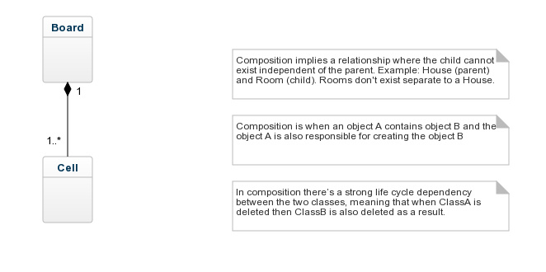
Initial Thought

Slide 6
S.O.L.I.D
S - Single Responsibility Principle - Build classes to do only one thing
O - Open/Close Principle - Open for extension, but closed for modification
L - Liskov's Substitution Principle - Specialized classes (sub-classes) can be used wherever generalized classes (parents) are being used
I - Interface Segregation Principle – Classes be able to implement all the methods in an interface
D - Dependency Inversion Principle - Higher level classes should not directly use lower level classes. Lower level class should implement an interface. Higher level class should program to the interface, i.e. expect any object implementing an interface be given to it.

Slide 7
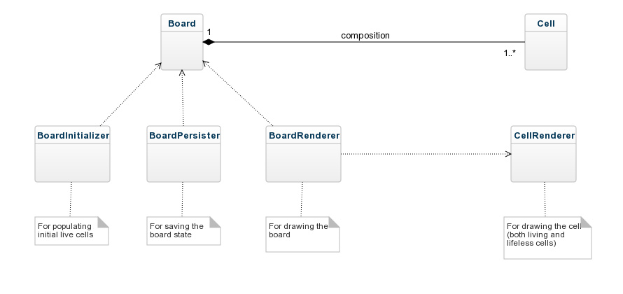
After applying Single Responsibility Principle

Slide 8
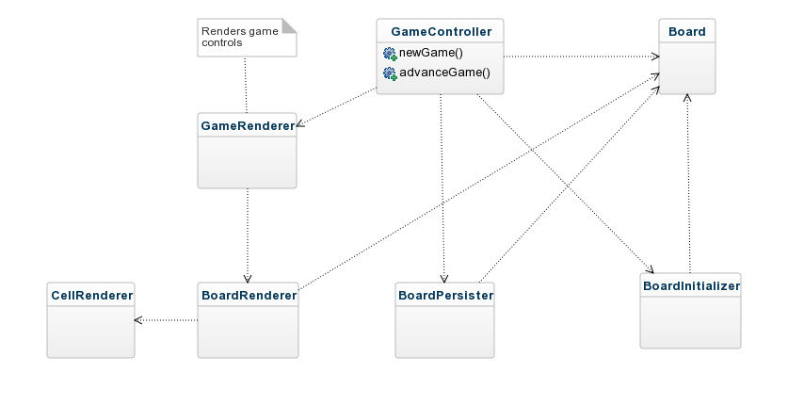
Added Game Controller

Slide 9
After applying Open/Close and Dependency Inversion Principles

Slide 10
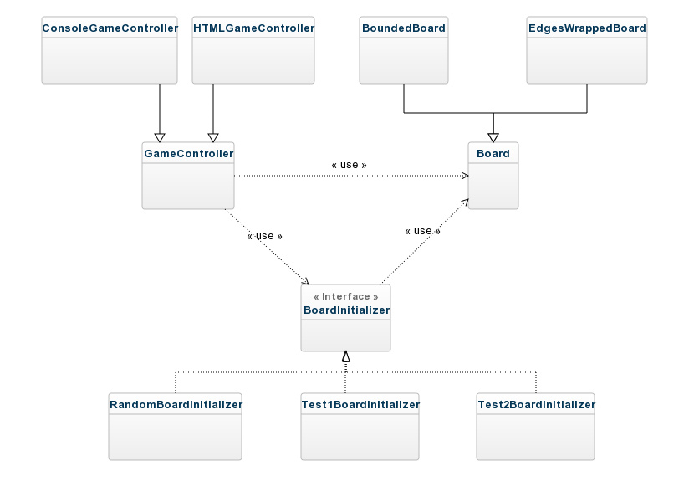
Controllers-Boards-Initializers

Slide 11
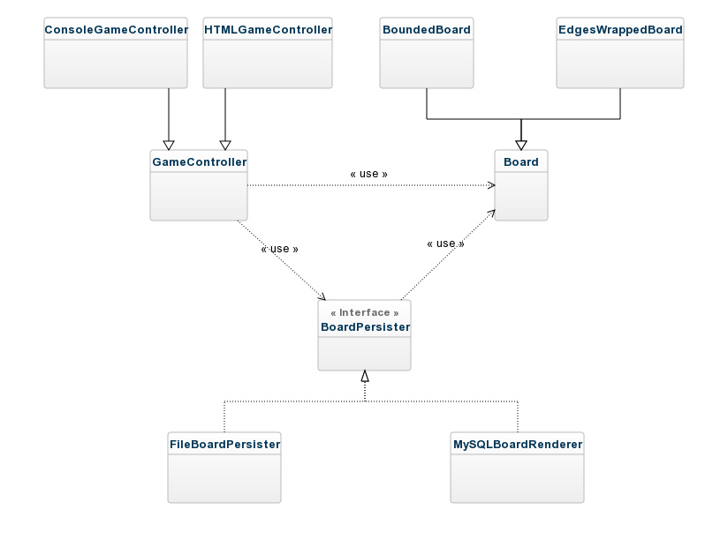
Controllers-Boards-Persisters

Slide 12
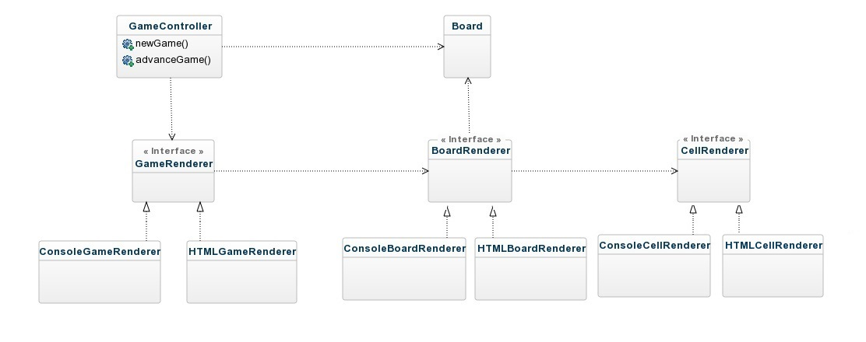
Controllers-Boards-Renderers

