Slide 1

mTimes
BY: Shashank Khandelwal

Slide 2
Agenda
Data Scraping
GUI
Backend

Slide 3
Data Scraping
Approach for scraping data from IMDB website:
Identified the pattern in the URL of each movie page. All the URL’s have base URL as “https://www.imdb.com/title/<str:imdbId>”.
Figured out the source for getting “imdbId”, IMDB itself provides some data for non-commercial use. “https://datasets.imdbws.com/title.akas.tsv.gz”.
Decompress the above downloaded file and load it into the pandas DataFrame. From this DataFrame extract the title column and export it to a csv file for further use.
Open a random page on IMDB and extracted its source.
Copy that source into a text file and try to figure the tag from which required data could be gathered.
Fortunately, there was <script> tag with type=“javascript+json” had all data that was required.

Slide 4
Scripts for scraping data from IMDB website for at least 1000 movies:
Script is available in script directory with name “scraper.py” and “datastore.py”.
“scraper.py”, function has been written for scraping data by ID which has been gathered in the previous section.
“scraper.py”, requests and lxml.html(for parsing) has been used.
“datastore.py”, created for storing scraped data into csv file for further uses.
“datastore.py”, pandas DataFrame has been used for first storing the entire scraped data and then export it to the “movies.csv” file.

Slide 5
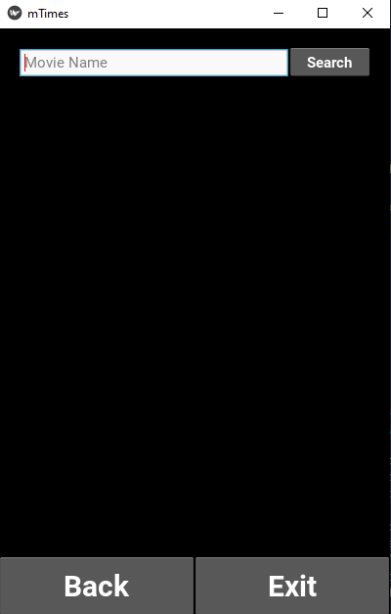

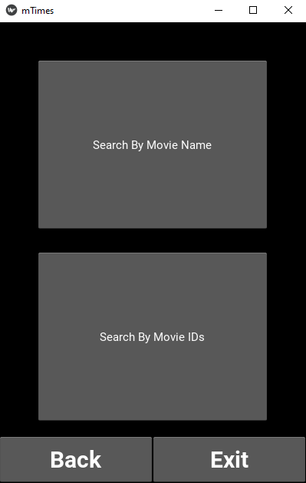
GUI
GUI has been created using a famous python GUI package “kivy”.
UI file with name “mTimes.kv” is available in the “gui” directory.

Slide 6
Backend
Entire backend has been written in “mTimes.py” with well commented.
Process cycle:
When user opt for Search by movie name in the select screen.
Request will go to function “query_name”.
“query_name” function will return exact matched and relative matched result.
Similarly, if user opt for Search by IMDB Id in the select screen.
Request will go to function “query_id”.
“query_id” function will return exact matched id result.

Slide 7
Data Extraction:
Scraped data has been stored into “movies_data.csv” file.
Data CSV is getting imported by the help of pandas.
Relative Search is being performed using regular expression.
Searches are based on “title” column for Search by name and “imdbid” column for Search by id.

Slide 8


Thank you

