Slide 1
SCS consultation about adapting Random forest algorithm for new data type
Ying LI
March 25 2025

Slide 2
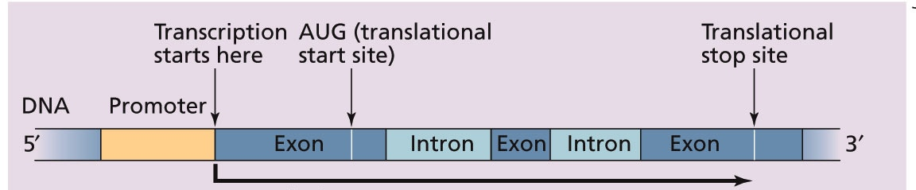
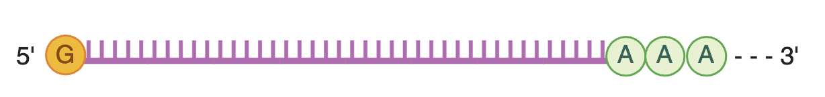
Genes are expressed quantitatively
transcription
Taiz and Zeiger 2010
Abundance of a specific mRNA
proteins
Gene expression level: the abundance of mRNAs transcribed from a gene

Slide 3
 | line 1 |  |  |  |  |  |  |  |  |  |  |  |  |  |  |  |  |  | line 2
 | low CO2 |  |  |  |  |  |  |  |  | high CO2 |  |  |  |  |  |  |  |  | low CO2 |  |  |  |  |  |  |  |  | high CO2
 | low N |  |  | Mid N |  |  | high N |  |  | low N |  |  | Mid N |  |  | high N |  |  | low N |  |  | Mid N |  |  | high N |  |  | low N |  |  | Mid N |  |  | high N
 | rep 1 | rep 2 | rep 3 | rep 1 | rep 2 | rep 3 | rep 1 | rep 2 | rep 3 | rep 1 | rep 2 | rep 3 | rep 1 | rep 2 | rep 3 | rep 1 | rep 2 | rep 3 | rep 1 | rep 2 | rep 3 | rep 1 | rep 2 | rep 3 | rep 1 | rep 2 | rep 3 | rep 1 | rep 2 | rep 3 | rep 1 | rep 2 | rep 3 | rep 1 | rep 2 | rep 3
Gene 1 | 120 | 316 | 116 | 457 | 45 | 431 | 433 | 223 | 506 | 159 | 299 | 199 | 132 | 125 | 179 | 64 | 134 | 140 | 48 | 506 | 381 | 229 | 246 | 44 | 140 | 149 | 57 | 441 | 17 | 484 | 272 | 323 | 492 | 410 | 416 | 77
Gene 2 | 58 | 174 | 204 | 507 | 152 | 89 | 349 | 196 | 292 | 403 | 118 | 64 | 84 | 153 | 88 | 127 | 120 | 83 | 473 | 292 | 213 | 228 | 146 | 182 | 154 | 152 | 319 | 438 | 495 | 235 | 363 | 6 | 77 | 292 | 164 | 185
Gene 3 | 117 | 245 | 360 | 221 | 296 | 286 | 341 | 352 | 274 | 70 | 78 | 59 | 131 | 170 | 197 | 224 | 154 | 505 | 252 | 329 | 177 | 459 | 252 | 428 | 459 | 254 | 349 | 394 | 198 | 71 | 442 | 429 | 9 | 465 | 343 | 104
Gene 4 | 269 | 419 | 313 | 260 | 343 | 287 | 164 | 278 | 400 | 484 | 354 | 236 | 98 | 390 | 382 | 182 | 39 | 34 | 38 | 208 | 443 | 104 | 168 | 351 | 364 | 33 | 486 | 183 | 418 | 128 | 339 | 150 | 153 | 191 | 4 | 85
Gene 5 | 225 | 415 | 229 | 402 | 33 | 198 | 179 | 306 | 359 | 476 | 214 | 475 | 252 | 43 | 275 | 216 | 77 | 326 | 71 | 9 | 259 | 218 | 289 | 6 | 258 | 5 | 170 | 455 | 507 | 211 | 316 | 279 | 183 | 363 | 429 | 399
Gene 6 | 359 | 224 | 381 | 39 | 200 | 136 | 273 | 95 | 502 | 429 | 186 | 329 | 0 | 336 | 82 | 402 | 100 | 284 | 315 | 105 | 480 | 25 | 385 | 219 | 169 | 126 | 29 | 72 | 185 | 131 | 86 | 272 | 30 | 206 | 35 | 498
Gene 7 | 120 | 440 | 110 | 389 | 371 | 200 | 326 | 179 | 184 | 480 | 130 | 336 | 82 | 467 | 488 | 345 | 181 | 486 | 10 | 128 | 190 | 106 | 223 | 293 | 43 | 418 | 262 | 354 | 119 | 395 | 483 | 96 | 413 | 511 | 249 | 10
Gene 8 | 73 | 445 | 482 | 275 | 399 | 157 | 177 | 318 | 26 | 233 | 91 | 173 | 236 | 101 | 268 | 361 | 204 | 299 | 155 | 343 | 163 | 220 | 152 | 428 | 10 | 261 | 481 | 323 | 306 | 15 | 291 | 359 | 457 | 465 | 163 | 105
Gene 9 | 361 | 68 | 219 | 261 | 313 | 338 | 251 | 165 | 151 | 503 | 389 | 280 | 263 | 459 | 11 | 472 | 196 | 233 | 145 | 59 | 268 | 357 | 302 | 222 | 61 | 309 | 125 | 456 | 298 | 72 | 343 | 366 | 344 | 441 | 445 | 272
Gene 10 | 455 | 110 | 290 | 172 | 289 | 143 | 250 | 255 | 136 | 366 | 337 | 113 | 266 | 257 | 316 | 98 | 2 | 429 | 239 | 442 | 262 | 51 | 271 | 476 | 223 | 289 | 12 | 149 | 330 | 362 | 133 | 21 | 385 | 485 | 60 | 491
Gene 11 | 76 | 292 | 91 | 57 | 467 | 383 | 225 | 317 | 363 | 228 | 443 | 78 | 496 | 385 | 379 | 75 | 54 | 284 | 197 | 389 | 333 | 287 | 119 | 433 | 511 | 183 | 127 | 95 | 91 | 379 | 439 | 187 | 397 | 466 | 13 | 346
Gene 12 | 485 | 471 | 354 | 80 | 373 | 180 | 344 | 162 | 422 | 394 | 73 | 222 | 221 | 472 | 143 | 223 | 97 | 392 | 108 | 512 | 114 | 284 | 454 | 18 | 309 | 387 | 264 | 412 | 341 | 502 | 177 | 458 | 191 | 140 | 10 | 320
Gene 13 | 186 | 148 | 181 | 450 | 141 | 18 | 100 | 376 | 95 | 0 | 241 | 477 | 156 | 193 | 60 | 13 | 224 | 493 | 55 | 329 | 265 | 198 | 494 | 302 | 486 | 471 | 88 | 312 | 315 | 17 | 495 | 307 | 132 | 108 | 42 | 310
Gene 14 | 327 | 108 | 345 | 299 | 400 | 168 | 162 | 202 | 47 | 261 | 470 | 178 | 226 | 342 | 44 | 356 | 265 | 307 | 346 | 468 | 360 | 104 | 403 | 372 | 457 | 449 | 158 | 490 | 339 | 70 | 187 | 131 | 506 | 401 | 396 | 182
Gene 15 | 76 | 489 | 435 | 228 | 230 | 427 | 357 | 214 | 318 | 230 | 172 | 129 | 66 | 441 | 413 | 35 | 346 | 209 | 411 | 138 | 161 | 264 | 294 | 349 | 15 | 0 | 112 | 282 | 212 | 290 | 330 | 447 | 176 | 225 | 188 | 225
Gene 16 | 357 | 130 | 456 | 470 | 156 | 458 | 411 | 39 | 351 | 444 | 57 | 312 | 38 | 320 | 508 | 137 | 10 | 412 | 209 | 411 | 407 | 164 | 367 | 229 | 266 | 56 | 371 | 154 | 445 | 306 | 432 | 30 | 324 | 34 | 130 | 320
Gene 17 | 470 | 473 | 459 | 60 | 216 | 437 | 433 | 436 | 473 | 417 | 102 | 166 | 76 | 328 | 464 | 415 | 230 | 340 | 505 | 16 | 445 | 326 | 419 | 452 | 337 | 230 | 162 | 106 | 247 | 145 | 48 | 282 | 209 | 90 | 41 | 259
Gene 18 | 379 | 152 | 233 | 330 | 348 | 477 | 448 | 270 | 140 | 38 | 362 | 154 | 216 | 115 | 332 | 141 | 339 | 329 | 96 | 202 | 11 | 12 | 245 | 199 | 285 | 304 | 206 | 168 | 137 | 103 | 10 | 103 | 93 | 176 | 392 | 164
Gene 19 | 362 | 108 | 312 | 349 | 280 | 241 | 304 | 372 | 129 | 222 | 347 | 391 | 344 | 496 | 207 | 473 | 87 | 390 | 339 | 275 | 125 | 276 | 452 | 371 | 384 | 317 | 69 | 323 | 263 | 315 | 466 | 15 | 102 | 97 | 406 | 329
Gene 20 | 146 | 201 | 291 | 203 | 401 | 238 | 33 | 179 | 89 | 509 | 191 | 444 | 312 | 509 | 430 | 406 | 302 | 175 | 283 | 61 | 217 | 506 | 348 | 383 | 161 | 40 | 47 | 118 | 499 | 201 | 308 | 367 | 385 | 506 | 466 | 401
Gene 21 | 501 | 316 | 105 | 469 | 295 | 367 | 96 | 453 | 80 | 264 | 118 | 172 | 235 | 47 | 331 | 278 | 206 | 122 | 245 | 179 | 94 | 49 | 457 | 475 | 358 | 386 | 255 | 454 | 283 | 432 | 503 | 36 | 503 | 464 | 351 | 412
Gene 22 | 199 | 468 | 504 | 438 | 335 | 124 | 478 | 347 | 484 | 79 | 140 | 6 | 366 | 170 | 303 | 274 | 94 | 360 | 133 | 79 | 180 | 99 | 308 | 225 | 163 | 503 | 458 | 90 | 496 | 80 | 55 | 319 | 333 | 485 | 495 | 324
Gene 23 | 493 | 42 | 170 | 192 | 48 | 300 | 466 | 94 | 248 | 140 | 5 | 258 | 187 | 255 | 45 | 212 | 190 | 490 | 358 | 411 | 206 | 101 | 74 | 27 | 461 | 15 | 370 | 232 | 105 | 251 | 448 | 95 | 445 | 154 | 433 | 467
Gene 24 | 280 | 111 | 492 | 486 | 442 | 417 | 61 | 87 | 138 | 201 | 390 | 385 | 189 | 341 | 351 | 413 | 430 | 15 | 285 | 110 | 104 | 188 | 422 | 397 | 1 | 43 | 249 | 32 | 108 | 427 | 466 | 87 | 495 | 99 | 316 | 55
Expression data (numeric, from 0 -10,000, could be log2 transformed to 0-16)
Gene N (total = 30,000)

Slide 4
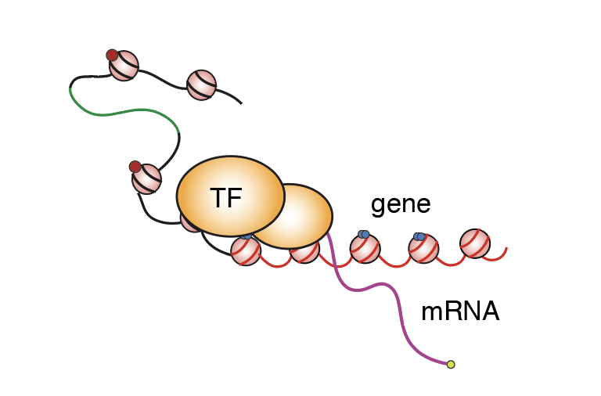
TF proteins controls gene expression

Slide 5
 | line 1 |  |  |  |  |  |  |  |  |  |  |  |  |  |  |  |  |  | line 2
 | low CO2 |  |  |  |  |  |  |  |  | high CO2 |  |  |  |  |  |  |  |  | low CO2 |  |  |  |  |  |  |  |  | high CO2
 | low N |  |  | Mid N |  |  | high N |  |  | low N |  |  | Mid N |  |  | high N |  |  | low N |  |  | Mid N |  |  | high N |  |  | low N |  |  | Mid N |  |  | high N
 | rep 1 | rep 2 | rep 3 | rep 1 | rep 2 | rep 3 | rep 1 | rep 2 | rep 3 | rep 1 | rep 2 | rep 3 | rep 1 | rep 2 | rep 3 | rep 1 | rep 2 | rep 3 | rep 1 | rep 2 | rep 3 | rep 1 | rep 2 | rep 3 | rep 1 | rep 2 | rep 3 | rep 1 | rep 2 | rep 3 | rep 1 | rep 2 | rep 3 | rep 1 | rep 2 | rep 3
Gene 1 | 120 | 316 | 116 | 457 | 45 | 431 | 433 | 223 | 506 | 159 | 299 | 199 | 132 | 125 | 179 | 64 | 134 | 140 | 48 | 506 | 381 | 229 | 246 | 44 | 140 | 149 | 57 | 441 | 17 | 484 | 272 | 323 | 492 | 410 | 416 | 77
Gene 2 | 58 | 174 | 204 | 507 | 152 | 89 | 349 | 196 | 292 | 403 | 118 | 64 | 84 | 153 | 88 | 127 | 120 | 83 | 473 | 292 | 213 | 228 | 146 | 182 | 154 | 152 | 319 | 438 | 495 | 235 | 363 | 6 | 77 | 292 | 164 | 185
Gene 3 | 117 | 245 | 360 | 221 | 296 | 286 | 341 | 352 | 274 | 70 | 78 | 59 | 131 | 170 | 197 | 224 | 154 | 505 | 252 | 329 | 177 | 459 | 252 | 428 | 459 | 254 | 349 | 394 | 198 | 71 | 442 | 429 | 9 | 465 | 343 | 104
Gene 4 | 269 | 419 | 313 | 260 | 343 | 287 | 164 | 278 | 400 | 484 | 354 | 236 | 98 | 390 | 382 | 182 | 39 | 34 | 38 | 208 | 443 | 104 | 168 | 351 | 364 | 33 | 486 | 183 | 418 | 128 | 339 | 150 | 153 | 191 | 4 | 85
Gene 5 | 225 | 415 | 229 | 402 | 33 | 198 | 179 | 306 | 359 | 476 | 214 | 475 | 252 | 43 | 275 | 216 | 77 | 326 | 71 | 9 | 259 | 218 | 289 | 6 | 258 | 5 | 170 | 455 | 507 | 211 | 316 | 279 | 183 | 363 | 429 | 399
Gene 6 | 359 | 224 | 381 | 39 | 200 | 136 | 273 | 95 | 502 | 429 | 186 | 329 | 0 | 336 | 82 | 402 | 100 | 284 | 315 | 105 | 480 | 25 | 385 | 219 | 169 | 126 | 29 | 72 | 185 | 131 | 86 | 272 | 30 | 206 | 35 | 498
Gene 7 | 120 | 440 | 110 | 389 | 371 | 200 | 326 | 179 | 184 | 480 | 130 | 336 | 82 | 467 | 488 | 345 | 181 | 486 | 10 | 128 | 190 | 106 | 223 | 293 | 43 | 418 | 262 | 354 | 119 | 395 | 483 | 96 | 413 | 511 | 249 | 10
Gene 8 | 73 | 445 | 482 | 275 | 399 | 157 | 177 | 318 | 26 | 233 | 91 | 173 | 236 | 101 | 268 | 361 | 204 | 299 | 155 | 343 | 163 | 220 | 152 | 428 | 10 | 261 | 481 | 323 | 306 | 15 | 291 | 359 | 457 | 465 | 163 | 105
Gene 9 | 361 | 68 | 219 | 261 | 313 | 338 | 251 | 165 | 151 | 503 | 389 | 280 | 263 | 459 | 11 | 472 | 196 | 233 | 145 | 59 | 268 | 357 | 302 | 222 | 61 | 309 | 125 | 456 | 298 | 72 | 343 | 366 | 344 | 441 | 445 | 272
Gene 10 | 455 | 110 | 290 | 172 | 289 | 143 | 250 | 255 | 136 | 366 | 337 | 113 | 266 | 257 | 316 | 98 | 2 | 429 | 239 | 442 | 262 | 51 | 271 | 476 | 223 | 289 | 12 | 149 | 330 | 362 | 133 | 21 | 385 | 485 | 60 | 491
Gene 11 | 76 | 292 | 91 | 57 | 467 | 383 | 225 | 317 | 363 | 228 | 443 | 78 | 496 | 385 | 379 | 75 | 54 | 284 | 197 | 389 | 333 | 287 | 119 | 433 | 511 | 183 | 127 | 95 | 91 | 379 | 439 | 187 | 397 | 466 | 13 | 346
Gene 12 | 485 | 471 | 354 | 80 | 373 | 180 | 344 | 162 | 422 | 394 | 73 | 222 | 221 | 472 | 143 | 223 | 97 | 392 | 108 | 512 | 114 | 284 | 454 | 18 | 309 | 387 | 264 | 412 | 341 | 502 | 177 | 458 | 191 | 140 | 10 | 320
Gene 13 | 186 | 148 | 181 | 450 | 141 | 18 | 100 | 376 | 95 | 0 | 241 | 477 | 156 | 193 | 60 | 13 | 224 | 493 | 55 | 329 | 265 | 198 | 494 | 302 | 486 | 471 | 88 | 312 | 315 | 17 | 495 | 307 | 132 | 108 | 42 | 310
Gene 14 | 327 | 108 | 345 | 299 | 400 | 168 | 162 | 202 | 47 | 261 | 470 | 178 | 226 | 342 | 44 | 356 | 265 | 307 | 346 | 468 | 360 | 104 | 403 | 372 | 457 | 449 | 158 | 490 | 339 | 70 | 187 | 131 | 506 | 401 | 396 | 182
Gene 15 | 76 | 489 | 435 | 228 | 230 | 427 | 357 | 214 | 318 | 230 | 172 | 129 | 66 | 441 | 413 | 35 | 346 | 209 | 411 | 138 | 161 | 264 | 294 | 349 | 15 | 0 | 112 | 282 | 212 | 290 | 330 | 447 | 176 | 225 | 188 | 225
Gene 16 | 357 | 130 | 456 | 470 | 156 | 458 | 411 | 39 | 351 | 444 | 57 | 312 | 38 | 320 | 508 | 137 | 10 | 412 | 209 | 411 | 407 | 164 | 367 | 229 | 266 | 56 | 371 | 154 | 445 | 306 | 432 | 30 | 324 | 34 | 130 | 320
Gene 17 | 470 | 473 | 459 | 60 | 216 | 437 | 433 | 436 | 473 | 417 | 102 | 166 | 76 | 328 | 464 | 415 | 230 | 340 | 505 | 16 | 445 | 326 | 419 | 452 | 337 | 230 | 162 | 106 | 247 | 145 | 48 | 282 | 209 | 90 | 41 | 259
Gene 18 | 379 | 152 | 233 | 330 | 348 | 477 | 448 | 270 | 140 | 38 | 362 | 154 | 216 | 115 | 332 | 141 | 339 | 329 | 96 | 202 | 11 | 12 | 245 | 199 | 285 | 304 | 206 | 168 | 137 | 103 | 10 | 103 | 93 | 176 | 392 | 164
Gene 19 | 362 | 108 | 312 | 349 | 280 | 241 | 304 | 372 | 129 | 222 | 347 | 391 | 344 | 496 | 207 | 473 | 87 | 390 | 339 | 275 | 125 | 276 | 452 | 371 | 384 | 317 | 69 | 323 | 263 | 315 | 466 | 15 | 102 | 97 | 406 | 329
Gene 20 | 146 | 201 | 291 | 203 | 401 | 238 | 33 | 179 | 89 | 509 | 191 | 444 | 312 | 509 | 430 | 406 | 302 | 175 | 283 | 61 | 217 | 506 | 348 | 383 | 161 | 40 | 47 | 118 | 499 | 201 | 308 | 367 | 385 | 506 | 466 | 401
Gene 21 | 501 | 316 | 105 | 469 | 295 | 367 | 96 | 453 | 80 | 264 | 118 | 172 | 235 | 47 | 331 | 278 | 206 | 122 | 245 | 179 | 94 | 49 | 457 | 475 | 358 | 386 | 255 | 454 | 283 | 432 | 503 | 36 | 503 | 464 | 351 | 412
Gene 22 | 199 | 468 | 504 | 438 | 335 | 124 | 478 | 347 | 484 | 79 | 140 | 6 | 366 | 170 | 303 | 274 | 94 | 360 | 133 | 79 | 180 | 99 | 308 | 225 | 163 | 503 | 458 | 90 | 496 | 80 | 55 | 319 | 333 | 485 | 495 | 324
Gene 23 | 493 | 42 | 170 | 192 | 48 | 300 | 466 | 94 | 248 | 140 | 5 | 258 | 187 | 255 | 45 | 212 | 190 | 490 | 358 | 411 | 206 | 101 | 74 | 27 | 461 | 15 | 370 | 232 | 105 | 251 | 448 | 95 | 445 | 154 | 433 | 467
Gene 24 | 280 | 111 | 492 | 486 | 442 | 417 | 61 | 87 | 138 | 201 | 390 | 385 | 189 | 341 | 351 | 413 | 430 | 15 | 285 | 110 | 104 | 188 | 422 | 397 | 1 | 43 | 249 | 32 | 108 | 427 | 466 | 87 | 495 | 99 | 316 | 55
Expression data (numeric, from 0 -10,000, could be log2 transformed to 0-16)
Gene N (total = 30,000)
TF are a subset of genes (~2000)

Slide 6
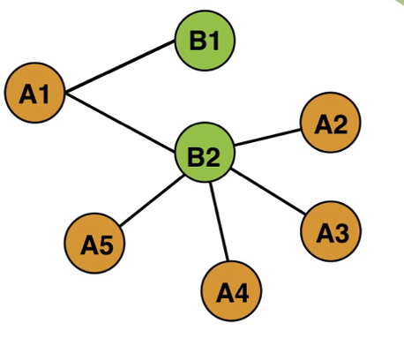
How all TFs control all genes? - gene network
TF
gene
TF
gene
gene
gene
gene

Slide 7
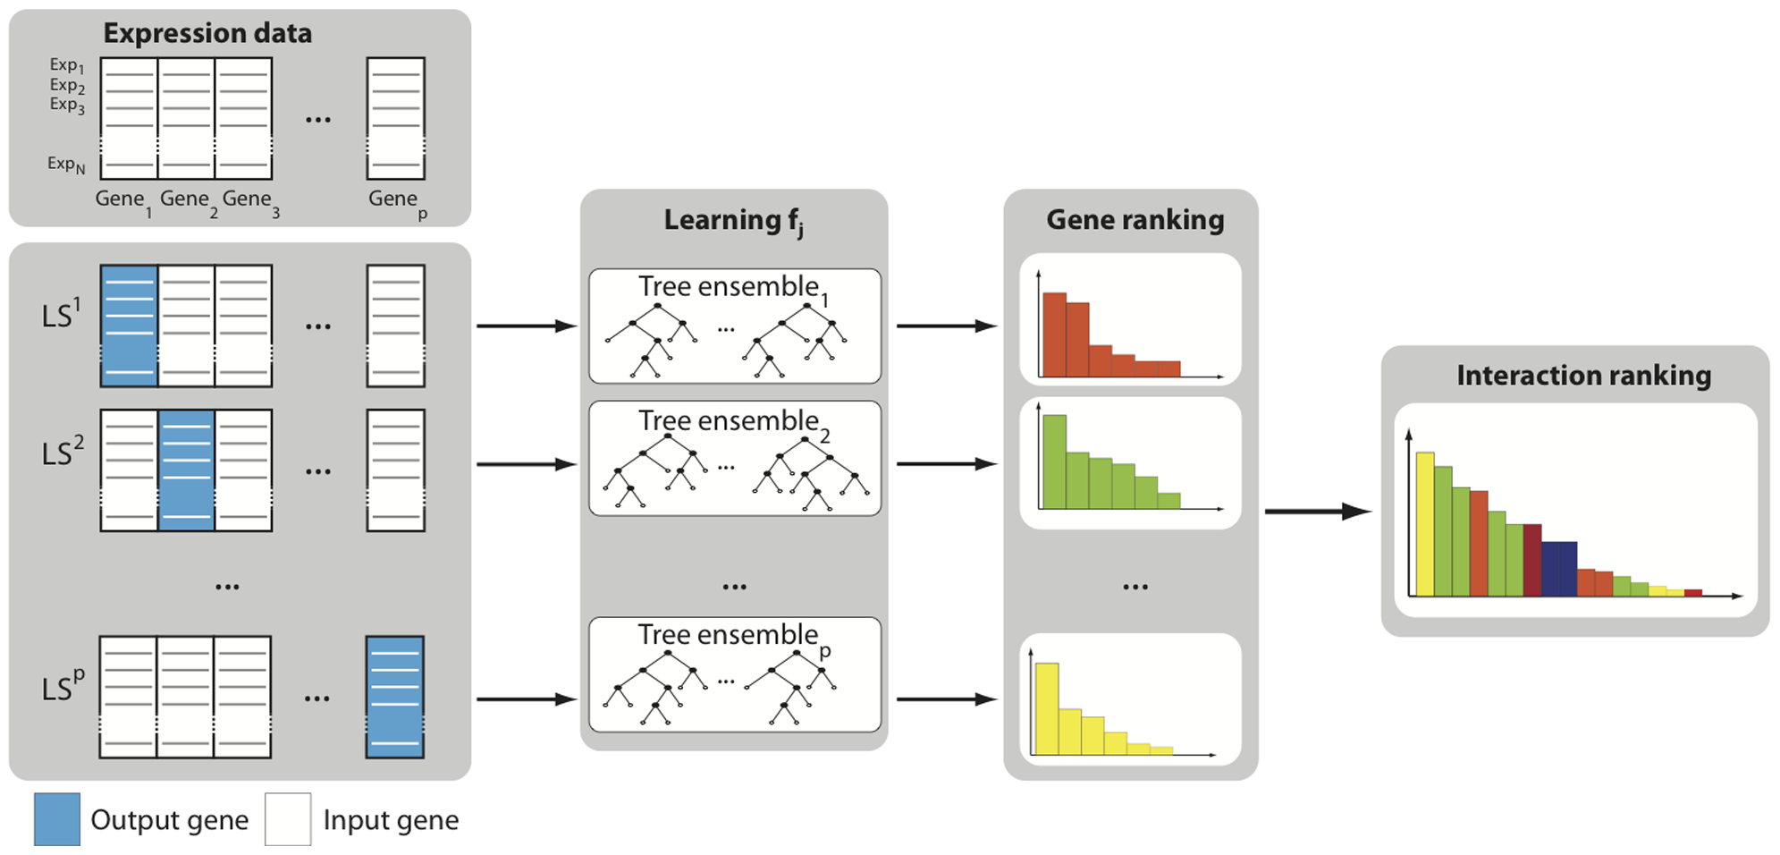
GENIE 3 – random forest
https://journals.plos.org/plosone/article?id=10.1371/journal.pone.0012776

Slide 8
GENIE3 has been well implemented.
Input: gene expression matrix, list of TF (regulatory genes)
GENIE3 software in python, R, etc
Output: gene network of how TFs regulate genes
But…

Slide 9
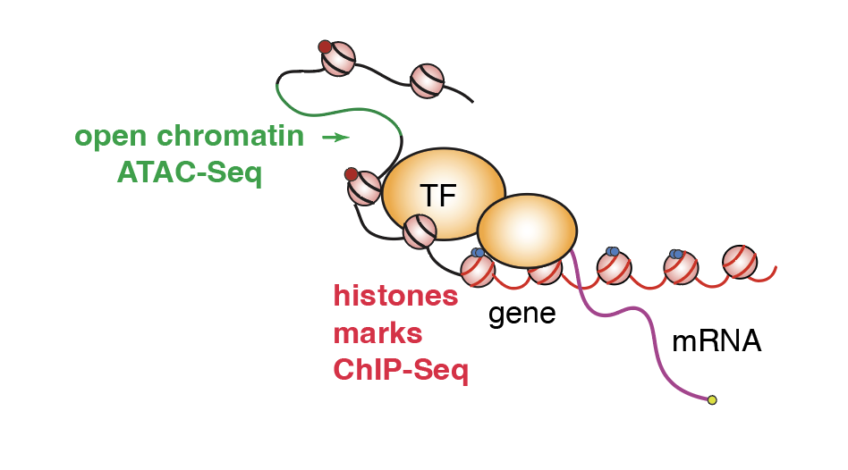
There are more factors to influence gene expression in addition to TF – chromatin changes

Slide 10
We will generate additional data matrix to describe these chromatin changes, and they will look like…

Slide 11
Histone mark 1
 | line 1 |  |  |  |  |  |  |  |  |  |  |  |  |  |  |  |  |  | line 2
 | low CO2 |  |  |  |  |  |  |  |  | high CO2 |  |  |  |  |  |  |  |  | low CO2 |  |  |  |  |  |  |  |  | high CO2
 | low N |  |  | Mid N |  |  | high N |  |  | low N |  |  | Mid N |  |  | high N |  |  | low N |  |  | Mid N |  |  | high N |  |  | low N |  |  | Mid N |  |  | high N
 | rep 1 | rep 2 | rep 3 | rep 1 | rep 2 | rep 3 | rep 1 | rep 2 | rep 3 | rep 1 | rep 2 | rep 3 | rep 1 | rep 2 | rep 3 | rep 1 | rep 2 | rep 3 | rep 1 | rep 2 | rep 3 | rep 1 | rep 2 | rep 3 | rep 1 | rep 2 | rep 3 | rep 1 | rep 2 | rep 3 | rep 1 | rep 2 | rep 3 | rep 1 | rep 2 | rep 3
Gene 1 | 120 | 316 | 116 | 457 | 45 | 431 | 433 | 223 | 506 | 159 | 299 | 199 | 132 | 125 | 179 | 64 | 134 | 140 | 48 | 506 | 381 | 229 | 246 | 44 | 140 | 149 | 57 | 441 | 17 | 484 | 272 | 323 | 492 | 410 | 416 | 77
Gene 2 | 58 | 174 | 204 | 507 | 152 | 89 | 349 | 196 | 292 | 403 | 118 | 64 | 84 | 153 | 88 | 127 | 120 | 83 | 473 | 292 | 213 | 228 | 146 | 182 | 154 | 152 | 319 | 438 | 495 | 235 | 363 | 6 | 77 | 292 | 164 | 185
Gene 3 | 117 | 245 | 360 | 221 | 296 | 286 | 341 | 352 | 274 | 70 | 78 | 59 | 131 | 170 | 197 | 224 | 154 | 505 | 252 | 329 | 177 | 459 | 252 | 428 | 459 | 254 | 349 | 394 | 198 | 71 | 442 | 429 | 9 | 465 | 343 | 104
Gene 4 | 269 | 419 | 313 | 260 | 343 | 287 | 164 | 278 | 400 | 484 | 354 | 236 | 98 | 390 | 382 | 182 | 39 | 34 | 38 | 208 | 443 | 104 | 168 | 351 | 364 | 33 | 486 | 183 | 418 | 128 | 339 | 150 | 153 | 191 | 4 | 85
Histone mark 2
 | line 1 |  |  |  |  |  |  |  |  |  |  |  |  |  |  |  |  |  | line 2
 | low CO2 |  |  |  |  |  |  |  |  | high CO2 |  |  |  |  |  |  |  |  | low CO2 |  |  |  |  |  |  |  |  | high CO2
 | low N |  |  | Mid N |  |  | high N |  |  | low N |  |  | Mid N |  |  | high N |  |  | low N |  |  | Mid N |  |  | high N |  |  | low N |  |  | Mid N |  |  | high N
 | rep 1 | rep 2 | rep 3 | rep 1 | rep 2 | rep 3 | rep 1 | rep 2 | rep 3 | rep 1 | rep 2 | rep 3 | rep 1 | rep 2 | rep 3 | rep 1 | rep 2 | rep 3 | rep 1 | rep 2 | rep 3 | rep 1 | rep 2 | rep 3 | rep 1 | rep 2 | rep 3 | rep 1 | rep 2 | rep 3 | rep 1 | rep 2 | rep 3 | rep 1 | rep 2 | rep 3
Gene 1 | 120 | 316 | 116 | 457 | 45 | 431 | 433 | 223 | 506 | 159 | 299 | 199 | 132 | 125 | 179 | 64 | 134 | 140 | 48 | 506 | 381 | 229 | 246 | 44 | 140 | 149 | 57 | 441 | 17 | 484 | 272 | 323 | 492 | 410 | 416 | 77
Gene 2 | 58 | 174 | 204 | 507 | 152 | 89 | 349 | 196 | 292 | 403 | 118 | 64 | 84 | 153 | 88 | 127 | 120 | 83 | 473 | 292 | 213 | 228 | 146 | 182 | 154 | 152 | 319 | 438 | 495 | 235 | 363 | 6 | 77 | 292 | 164 | 185
Gene 3 | 117 | 245 | 360 | 221 | 296 | 286 | 341 | 352 | 274 | 70 | 78 | 59 | 131 | 170 | 197 | 224 | 154 | 505 | 252 | 329 | 177 | 459 | 252 | 428 | 459 | 254 | 349 | 394 | 198 | 71 | 442 | 429 | 9 | 465 | 343 | 104
Gene 4 | 269 | 419 | 313 | 260 | 343 | 287 | 164 | 278 | 400 | 484 | 354 | 236 | 98 | 390 | 382 | 182 | 39 | 34 | 38 | 208 | 443 | 104 | 168 | 351 | 364 | 33 | 486 | 183 | 418 | 128 | 339 | 150 | 153 | 191 | 4 | 85
 | line 1 |  |  |  |  |  |  |  |  |  |  |  |  |  |  |  |  |  | line 2
 | low CO2 |  |  |  |  |  |  |  |  | high CO2 |  |  |  |  |  |  |  |  | low CO2 |  |  |  |  |  |  |  |  | high CO2
 | low N |  |  | Mid N |  |  | high N |  |  | low N |  |  | Mid N |  |  | high N |  |  | low N |  |  | Mid N |  |  | high N |  |  | low N |  |  | Mid N |  |  | high N
 | rep 1 | rep 2 | rep 3 | rep 1 | rep 2 | rep 3 | rep 1 | rep 2 | rep 3 | rep 1 | rep 2 | rep 3 | rep 1 | rep 2 | rep 3 | rep 1 | rep 2 | rep 3 | rep 1 | rep 2 | rep 3 | rep 1 | rep 2 | rep 3 | rep 1 | rep 2 | rep 3 | rep 1 | rep 2 | rep 3 | rep 1 | rep 2 | rep 3 | rep 1 | rep 2 | rep 3
Gene 1 | 120 | 316 | 116 | 457 | 45 | 431 | 433 | 223 | 506 | 159 | 299 | 199 | 132 | 125 | 179 | 64 | 134 | 140 | 48 | 506 | 381 | 229 | 246 | 44 | 140 | 149 | 57 | 441 | 17 | 484 | 272 | 323 | 492 | 410 | 416 | 77
Gene 2 | 58 | 174 | 204 | 507 | 152 | 89 | 349 | 196 | 292 | 403 | 118 | 64 | 84 | 153 | 88 | 127 | 120 | 83 | 473 | 292 | 213 | 228 | 146 | 182 | 154 | 152 | 319 | 438 | 495 | 235 | 363 | 6 | 77 | 292 | 164 | 185
Gene 3 | 117 | 245 | 360 | 221 | 296 | 286 | 341 | 352 | 274 | 70 | 78 | 59 | 131 | 170 | 197 | 224 | 154 | 505 | 252 | 329 | 177 | 459 | 252 | 428 | 459 | 254 | 349 | 394 | 198 | 71 | 442 | 429 | 9 | 465 | 343 | 104
Gene 4 | 269 | 419 | 313 | 260 | 343 | 287 | 164 | 278 | 400 | 484 | 354 | 236 | 98 | 390 | 382 | 182 | 39 | 34 | 38 | 208 | 443 | 104 | 168 | 351 | 364 | 33 | 486 | 183 | 418 | 128 | 339 | 150 | 153 | 191 | 4 | 85
Histone mark 3
ATAC-seq
 | line 1 |  |  |  |  |  |  |  |  |  |  |  |  |  |  |  |  |  | line 2
 | low CO2 |  |  |  |  |  |  |  |  | high CO2 |  |  |  |  |  |  |  |  | low CO2 |  |  |  |  |  |  |  |  | high CO2
 | low N |  |  | Mid N |  |  | high N |  |  | low N |  |  | Mid N |  |  | high N |  |  | low N |  |  | Mid N |  |  | high N |  |  | low N |  |  | Mid N |  |  | high N
 | rep 1 | rep 2 | rep 3 | rep 1 | rep 2 | rep 3 | rep 1 | rep 2 | rep 3 | rep 1 | rep 2 | rep 3 | rep 1 | rep 2 | rep 3 | rep 1 | rep 2 | rep 3 | rep 1 | rep 2 | rep 3 | rep 1 | rep 2 | rep 3 | rep 1 | rep 2 | rep 3 | rep 1 | rep 2 | rep 3 | rep 1 | rep 2 | rep 3 | rep 1 | rep 2 | rep 3
Gene 1 | 120 | 316 | 116 | 457 | 45 | 431 | 433 | 223 | 506 | 159 | 299 | 199 | 132 | 125 | 179 | 64 | 134 | 140 | 48 | 506 | 381 | 229 | 246 | 44 | 140 | 149 | 57 | 441 | 17 | 484 | 272 | 323 | 492 | 410 | 416 | 77
Gene 2 | 58 | 174 | 204 | 507 | 152 | 89 | 349 | 196 | 292 | 403 | 118 | 64 | 84 | 153 | 88 | 127 | 120 | 83 | 473 | 292 | 213 | 228 | 146 | 182 | 154 | 152 | 319 | 438 | 495 | 235 | 363 | 6 | 77 | 292 | 164 | 185
Gene 3 | 117 | 245 | 360 | 221 | 296 | 286 | 341 | 352 | 274 | 70 | 78 | 59 | 131 | 170 | 197 | 224 | 154 | 505 | 252 | 329 | 177 | 459 | 252 | 428 | 459 | 254 | 349 | 394 | 198 | 71 | 442 | 429 | 9 | 465 | 343 | 104
Gene 4 | 269 | 419 | 313 | 260 | 343 | 287 | 164 | 278 | 400 | 484 | 354 | 236 | 98 | 390 | 382 | 182 | 39 | 34 | 38 | 208 | 443 | 104 | 168 | 351 | 364 | 33 | 486 | 183 | 418 | 128 | 339 | 150 | 153 | 191 | 4 | 85

Slide 12
How to adapt GENIE 3 to incorporate chromatin data?
Adjusting the learning parameter based on chromatin data?
Gate the output gene?
Limit the feature selection of the input gene?

