Slide 1
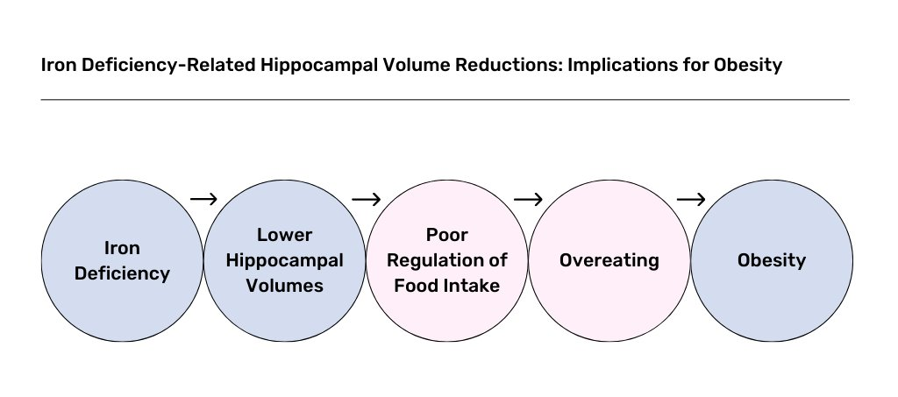
Iron deficiency hippocampal volume obesity risk
Using the NIH ABCD dataset

Slide 2
Variables of interest
Iron: Ferritin, Hb (measured every year starting follow-up year 2)
Hippocampal Volume: MRI data is minimally processed, and numbers are available. We will need supercomputers for FreeSurfer software perhaps, for subfields and subregions. (measured every two years)
Anthropometrics: Weight, height, and waist circumference (measured every year)
Confounders: Age, stress, estimated total intracranial volume, age, sex, SES, pubertal status, physical activity levels, stress levels
Additional analysis: Assess dietary data to see proximal effects

Slide 3
Aims
Aim 1: Investigate the relation between iron status and hippocampal subregion/subfield volumes, specifically the cornu ammonis regions (i.e. CA1, CA2, CA3, and CA4), dentate gyrus, and the subiculum.
Aim 2: Examine the association between iron status and anthropometric measures using body mass index and waist circumference (BMI-WC)
Aim 3: Investigate hippocampal volumes as mediators between ID and higher BMI-WC

Slide 4
Mediation

