Slide 1
The perfect solution for our apps
Introduction to Parse

Slide 2
Parse is a platform that provides a complete backend solution for our mobile application. Parse's goal is to totally eliminate the need for writing server code or maintaining servers.
What's Parse

Slide 3
Why Parse?
Easy to use.
Focus on the app.
Easy manageable data.
Cheap enough.
Export or Import of data.
No need to worry about the server.
Supports multiple platform.

Slide 4
How to get started
Create free account on parse.com.
Download and include the SDK in your project or download the blank project.
Include the Application Id and Client Key generated by parse into your project.
Import <Parse/Parse.h>
Start coding.

Slide 5
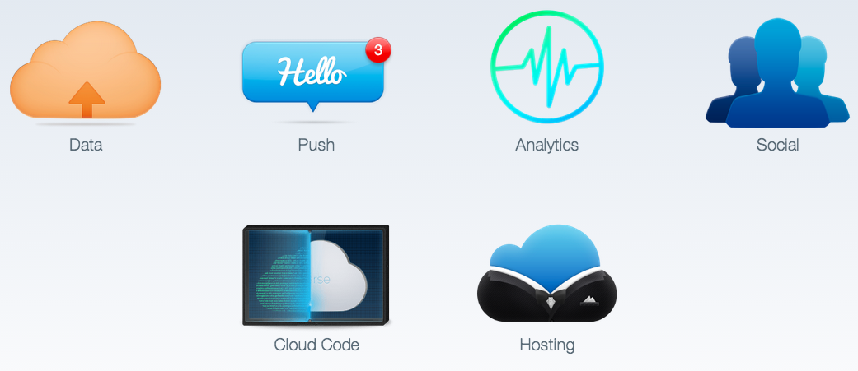
Parse services

Slide 6
DATA
Storing data on Parse is built around the PFObject. Each PFObject contains key-value pairs of JSON-compatible data. This data is schema less, which means that you don't need to specify ahead of time what keys exist on each PFObject. You simply set whatever key-value pairs you want, and our backend will store it.

Slide 7
PFObject
Each PFObject has a class name that you can use to distinguish different sorts of data.
Saving Objects:-
PFObject *userInfo = [PFObject objectWithClassName:@"PushObject"];
userInfo[@"company_name"] = self.companyNameText.text;
userInfo[@"telephone_number"] = self.telephoneNumText.text;
[userInfo saveInBackground];
Note: You can use the saveInBackgroundWithBlock or saveInBackgroundWithTarget:selector: methods to provide additional logic which will run after the save completes.

Slide 8
Retrieving Objects:
PFQuery *query = [PFQuery queryWithClassName:@"PushObject"];
[query findObjectsInBackgroundWithId:@”objectId” block:^(PFObject *userInfo, NSError *error) {
// Do something with the returned PFObject in the gameScore variable.
NSLog(@"%@", userInfo);}];

Slide 9
To get the values out of the PFObject
NSString *c_name = [userInfo objectForKey:@"company_name"] ;
NSString *c_name = userInfo[@"company_name"];
Special values provided by PFObject:-
NSString *objectId = userInfo.objectId;
NSDate *updatedAt = userInfo.updatedAt;
NSDate *createdAt = userInfo.createdAt;

Slide 10
Saving Objects Offline:-
PFObject *gameScore = [PFObject objectWithClassName:@"GameScore"];
gameScore[@"score"] = @1337;
gameScore[@"playerName"] = @"Sean Plott";
gameScore[@"cheatMode"] = @NO;
[gameScore saveEventually];
Updating Objects:-
PFQuery *query = [PFQuery queryWithClassName:@"GameScore"];
// Retrieve the object by id
[query getObjectInBackgroundWithId:@"xWMyZ4YEGZ" block:^(PFObject *gameScore, NSError *error) {
gameScore[@"cheatMode"] = @YES;
gameScore[@"score"] = @1338;
[gameScore saveInBackground];
}];

Slide 11
Relational Data :-
Objects can have relationships with other objects. To model this behavior, any PFObject can be used as a value in other PFObjects. Internally, the Parse framework will store the referred-to object in just one place, to maintain consistency.

Slide 12
Example :-
// Create the post
PFObject *myPost = [PFObject objectWithClassName:@"Post"];
myPost[@"title"] = @"I'm Hungry";
myPost[@"content"] = @"Where should we go for lunch?";
// Create the comment
PFObject *myComment = [PFObject objectWithClassName:@"Comment"];
myComment[@"content"] = @"Let's do Sushirrito.";
// Add a relation between the Post and Comment
myComment[@"parent"] = myPost;
// This will save both myPost and myComment
[myComment saveInBackground];

Slide 13
Push Notifications
Push Notifications are a great way to keep your users engaged and informed about your app. You can reach your entire user base quickly and effectively.

Slide 14
We will begin on the Apple Developer website to create an SSL certificate associated to an App ID and a provisioning profile.
Link- https://www.parse.com/tutorials/ios-push-notifications

Slide 15
Adding Code for a Push Enabled iOS Application :
To register the current device for push, call the method [application registerForRemoteNotificationTypes:] in the app delegate's [application:didFinishLaunchingWithOptions:] method.
[application registerForRemoteNotificationTypes:
UIRemoteNotificationTypeBadge |
UIRemoteNotificationTypeAlert |
UIRemoteNotificationTypeSound];

Slide 16
If the registration is successful, the callback method [application:didRegisterForRemoteNotificationsWithDeviceToken:] in the application delegate will be executed. We will need to implement this method and use it to inform Parse about this new device:
- (void)application:(UIApplication *)application
didRegisterForRemoteNotificationsWithDeviceToken:(NSData *)newDeviceToken {
// Store the deviceToken in the current installation and save it to Parse.
PFInstallation *currentInstallation = [PFInstallation currentInstallation];
[currentInstallation setDeviceTokenFromData:newDeviceToken];
[currentInstallation saveInBackground];
}

Slide 17
When a push notification is received while the application is not in the foreground, it is displayed in the iOS Notification Center. However, if the notification is received while the app is active, it is up to the app to handle it. To do so, we can implement the [application:didReceiveRemoteNotification] method in the app delegate.
- (void)application:(UIApplication *)application
didReceiveRemoteNotification:(NSDictionary *)userInfo {
[PFPush handlePush:userInfo];
}

Slide 18
Sending Push Notifications
Parse website.
REST API.
From the App.
From Cloud Code.

Slide 19
Analytics
Parse provides a number of hooks for us to get a glimpse into the ticking heart of our app .without having to implement any client-side logic, we can view real-time graphs and breakdowns (by device type, Parse class name, or REST verb) of our API Requests in our app's dashboard and save these graph filters to quickly access just the data we're interested in.
Example:-

Slide 20
App-Open / Push Analytics:
By adding the following line we'll begin to collect data on when and how often your application is opened.
[PFAnalytics trackAppOpenedWithLaunchOptions:launchOptions];

Slide 21
Custom Analytics :
PFAnalytics also allows us to track free-form events, with a handful of NSString keys and values. These extra dimensions allow segmentation of our custom events via our app's Dashboard.
Example:
Say our app offers search functionality for any listings, and you want to track how often the feature is used, with some additional metadata.

Slide 22
NSDictionary *dimensions = @{
// Define ranges to bucket data points into meaningful segments
@"priceRange": @"1000-1500",
// Did the user filter the query?
@"source": @"craigslist",
// Do searches happen more often on weekdays or weekends?
@"dayType": @"weekday"
};
// Send the dimensions to Parse along with the 'search' event
[PFAnalytics trackEvent:@"search" dimensions:dimensions];

Slide 23
Cloud Code
Parse has provided the option of writing our own logic.For complex apps, sometimes we just need a bit of logic that isn't running on a mobile device.Cloud code makes this possible.The only difference is that this code runs in the Parse Cloud rather than running on a mobile device.When we update our Cloud Code, it becomes available to all mobile environments instantly

Slide 24
Data & Security
Valid Data Types:Internally, Parse stores data as JSON, so any datatype that can be converted to JSON can be stored on Parse. The framework can also handle Date, Bytes, and File types. Overall, the following types are allowed for each field in your object:
String
Number
Boolean
Array
Object
Date
Bytes
File
Null

Slide 25
Security
Connection Between Client and Server :
All connections are made with HTTPS and SSL, and Parse will reject all non-HTTPS connections.
Class-Level Permissions :
Restricting class creation from your app
Configuring class-level permissions on your schema
Creating restrictions on how your data is accessed by other users
Object-Level Access Control :
The easiest way to control who can access data is through access control lists, commonly known as ACLs.

Slide 26
Why not
Backend computation.
Third Party Services.

Slide 27
Questions ?

Slide 28
THANK YOU

