Slide 1
Letter Recognition Using Various Classifiers
Bengio Team

Slide 2
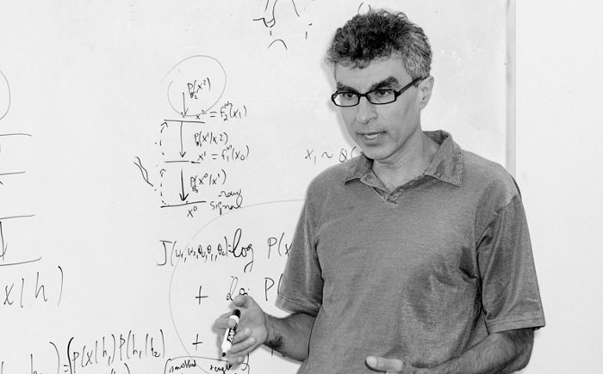
The Bengio team
Aidyn Kemeldinov
Kirtika Khetarpal
Sachin Ganpule
Sandesh Kumar Sodhi
Shahnam Khabiri
Shruthi Bhat
Supriya Tantry Agrahara
YOSHUA BENGIO
Professor
Department of Computer Science and Operations Research
University of Montreal
North America Lead
Front End Lead

Slide 3
Objectives

Slide 4
Objective 1
Objective 3
Based on the results obtained, identify the best classifier.
Objective 2
Objective 4
To identify each of a large number of black-and-white rectangular pixel displays as one of the 26 capital letters in the English alphabet.
Design multiclass, Histogram, Bayesian and Linear Classifiers, which when given the query, classifies the letter.
Perform PCA before applying classifiers and find out how many dimensions would the give most accurate results for the query.

Slide 5
Dataset

Slide 6
Dataset
Source: Letter Recognition Data Set http://archive.ics.uci.edu/ml/datasets/Letter+Recognition
Sample Data set:
T,2,8,3,5,1,8,13,0,6,6,10,8,0,8,0,8 I,5,12,3,7,2,10,5,5,4,13,3,9,2,8,4,10 D,4,11,6,8,6,10,6,2,6,10,3,7,3,7,3,9 N,7,11,6,6,3,5,9,4,6,4,4,10,6,10,2,8 G,2,1,3,1,1,8,6,6,6,6,5,9,1,7,5,10 S,4,11,5,8,3,8,8,6,9,5,6,6,0,8,9,7 B,4,2,5,4,4,8,7,6,6,7,6,6,2,8,7,10 A,1,1,3,2,1,8,2,2,2,8,2,8,1,6,2,7 J,2,2,4,4,2,10,6,2,6,12,4,8,1,6,1,7 M,11,15,13,9,7,13,2,6,2,12,1,9,8,1,1,8 X,3,9,5,7,4,8,7,3,8,5,6,8,2,8,6,7 O,6,13,4,7,4,6,7,6,3,10,7,9,5,9,5,8 G,4,9,6,7,6,7,8,6,2,6,5,11,4,8,7,8

Slide 7
Attribute Information (T,2,8,3,5,1,8,13,0,6,6,10,8,0,8,0,8)
1 | letter | capital letter | (26 values from A to Z)
2. | x-box | horizontal position of box | (integer)
3 | y-box | vertical position of box | (integer)
4. | width | width of box | (integer)
5 | height | height of box | (integer)
6 | onpix | total # on pixels | (integer)
7 | x-bar | mean x of on pixels in box | (integer)
8 | y-bar | mean y of on pixels in box | (integer)
9. | x2bar | mean x variance | (integer)
10 | y2bar | mean y variance | (integer)
11. | xybar | mean x y correlation | (integer)
12. | x2ybr | mean of x * x * y | (integer)
13. | xy2br | mean of x * y * y | (integer)
14. | x-ege | mean edge count left to right | (integer)
15. | xegvy | correlation of x-ege with y | (integer)
16. | y-ege | mean edge count bottom to top | (integer)
17. | yegvx | correlation of y-ege with x | (integer)

Slide 8
Dataset Description
http://citeseerx.ist.psu.edu/viewdoc/download?doi=10.1.1.466.6265&rep=rep1&type=pdf
Data Set Characteristics | Multivariate
Number of Instances | 20000
Number of Attributes | 17 (Letter category and 16 numeric features)
Attribute Characteristics | Integer
Missing Attribute Values | None
Number of Classes | 26 (Number of Unique Alphabets)

Slide 9
PCA For Classification

Slide 10


Principal Components Analysis
X
Original Coordinates (x)
Z
Original coordinates subtracted by mean
C
Find Covariance Matrix
V
Find Normalized Eigenvectors
P
Find Principal Coordinates

Slide 11
Bayesian Classifier Observations

Slide 12
Bayesian Classifier Raw Observations
A B C D E F G H I J K L M N O P Q R S T U V W X Y Z
A 751 0 0 4 0 0 0 1 0 0 0 0 6 0 0 1 0 0 2 0 8 2 0 0 14 0
B 2 704 0 8 5 3 1 6 2 0 1 0 0 0 2 1 0 20 7 0 0 2 0 0 2 0
C 0 0 667 0 14 2 16 0 0 0 8 6 3 0 14 0 1 1 0 0 3 1 0 0 0 0
D 0 6 0 751 0 0 0 2 0 0 1 1 7 3 7 2 3 6 5 4 6 0 0 1 0 0
E 0 4 7 0 665 8 33 3 1 0 5 11 0 0 0 0 9 2 7 1 0 0 0 3 1 8
F 0 3 1 5 8 700 7 3 5 2 1 0 1 14 1 9 0 0 2 10 0 0 0 0 3 0
G 0 5 33 5 0 6 681 0 0 0 3 4 1 0 9 0 5 4 13 0 0 3 1 0 0 0
H 0 18 3 36 0 7 13 515 0 2 46 1 4 0 27 3 2 30 0 0 5 1 1 7 12 1
I 0 3 1 16 2 15 0 0 662 17 6 0 0 1 0 0 0 2 16 2 0 0 0 3 1 8
J 1 0 0 5 0 3 0 7 10 687 0 1 1 2 2 0 8 2 11 0 0 0 0 1 0 6
K 0 3 21 5 1 0 3 12 0 0 635 2 0 0 0 0 1 34 2 0 1 1 1 17 0 0
L 0 4 2 2 7 0 11 7 0 0 2 682 1 0 0 0 9 3 20 0 0 0 0 7 4 0
M 1 8 0 0 0 0 6 7 0 0 5 0 753 0 1 0 0 4 0 1 0 1 5 0 0 0
N 0 0 0 12 0 2 0 19 0 0 4 0 5 713 11 0 0 11 0 0 0 0 2 0 4 0
O 6 0 0 8 0 0 6 9 0 0 0 1 5 0 683 0 20 1 0 0 2 0 11 1 0 0
P 0 3 0 3 0 32 12 2 0 0 3 1 0 0 0 732 6 3 0 0 0 0 0 0 6 0
Q 8 2 0 1 0 0 3 4 0 0 0 2 0 0 59 1 688 3 8 0 0 0 3 0 0 1
R 1 18 0 10 0 0 4 3 0 0 9 1 1 4 1 0 1 698 2 0 2 3 0 0 0 0
S 0 15 3 2 9 9 1 1 9 3 0 0 0 0 0 0 0 1 664 8 0 0 0 1 1 21
T 2 1 0 3 11 15 13 6 0 0 10 1 1 0 0 1 3 3 4 699 12 0 0 3 8 0
U 1 0 0 0 0 0 4 1 0 1 2 1 16 0 7 0 0 0 0 0 761 0 19 0 0 0
V 0 12 0 3 0 1 10 2 0 0 0 0 0 0 1 1 1 4 0 1 1 704 15 0 8 0
W 0 0 0 0 0 0 2 3 0 0 1 0 13 1 11 0 0 0 0 0 8 0 712 0 1 0
X 0 1 1 2 3 1 0 11 9 2 16 2 0 0 0 0 2 4 18 5 3 0 0 699 3 5
Y 2 0 0 0 0 9 0 2 0 1 0 0 1 0 0 13 0 0 5 21 3 69 0 1 659 0
Z 5 0 0 1 3 0 0 0 0 2 1 0 0 0 0 0 7 0 20 5 1 0 0 3 1 685
Ground Truth
Predicted Value

Slide 13
Bayesian Classifier Interesting Observations
A B C D E F G H I J K L M N O P Q R S T U V W X Y Z
A 751 0 0 4 0 0 0 1 0 0 0 0 6 0 0 1 0 0 2 0 8 2 0 0 14 0
B 2 704 0 8 5 3 1 6 2 0 1 0 0 0 2 1 0 20 7 0 0 2 0 0 2 0
C 0 0 667 0 14 2 16 0 0 0 8 6 3 0 14 0 1 1 0 0 3 1 0 0 0 0
D 0 6 0 751 0 0 0 2 0 0 1 1 7 3 7 2 3 6 5 4 6 0 0 1 0 0
E 0 4 7 0 665 8 33 3 1 0 5 11 0 0 0 0 9 2 7 1 0 0 0 3 1 8
F 0 3 1 5 8 700 7 3 5 2 1 0 1 14 1 9 0 0 2 10 0 0 0 0 3 0
G 0 5 33 5 0 6 681 0 0 0 3 4 1 0 9 0 5 4 13 0 0 3 1 0 0 0
H 0 18 3 36 0 7 13 515 0 2 46 1 4 0 27 3 2 30 0 0 5 1 1 7 12 1
I 0 3 1 16 2 15 0 0 662 17 6 0 0 1 0 0 0 2 16 2 0 0 0 3 1 8
J 1 0 0 5 0 3 0 7 10 687 0 1 1 2 2 0 8 2 11 0 0 0 0 1 0 6
K 0 3 21 5 1 0 3 12 0 0 635 2 0 0 0 0 1 34 2 0 1 1 1 17 0 0
L 0 4 2 2 7 0 11 7 0 0 2 682 1 0 0 0 9 3 20 0 0 0 0 7 4 0
M 1 8 0 0 0 0 6 7 0 0 5 0 753 0 1 0 0 4 0 1 0 1 5 0 0 0
N 0 0 0 12 0 2 0 19 0 0 4 0 5 713 11 0 0 11 0 0 0 0 2 0 4 0
O 6 0 0 8 0 0 6 9 0 0 0 1 5 0 683 0 20 1 0 0 2 0 11 1 0 0
P 0 3 0 3 0 32 12 2 0 0 3 1 0 0 0 732 6 3 0 0 0 0 0 0 6 0
Q 8 2 0 1 0 0 3 4 0 0 0 2 0 0 59 1 688 3 8 0 0 0 3 0 0 1
R 1 18 0 10 0 0 4 3 0 0 9 1 1 4 1 0 1 698 2 0 2 3 0 0 0 0
S 0 15 3 2 9 9 1 1 9 3 0 0 0 0 0 0 0 1 664 8 0 0 0 1 1 21
T 2 1 0 3 11 15 13 6 0 0 10 1 1 0 0 1 3 3 4 699 12 0 0 3 8 0
U 1 0 0 0 0 0 4 1 0 1 2 1 16 0 7 0 0 0 0 0 761 0 19 0 0 0
V 0 12 0 3 0 1 10 2 0 0 0 0 0 0 1 1 1 4 0 1 1 704 15 0 8 0
W 0 0 0 0 0 0 2 3 0 0 1 0 13 1 11 0 0 0 0 0 8 0 712 0 1 0
X 0 1 1 2 3 1 0 11 9 2 16 2 0 0 0 0 2 4 18 5 3 0 0 699 3 5
Y 2 0 0 0 0 9 0 2 0 1 0 0 1 0 0 13 0 0 5 21 3 69 0 1 659 0
Z 5 0 0 1 3 0 0 0 0 2 1 0 0 0 0 0 7 0 20 5 1 0 0 3 1 685
Ground Truth
Predicted Value

Slide 14
Bayesian Classifier PPVs
A B C D E F
96.28 86.91 90.26 85.14 91.34 86.10
G H I J K L
82.44 82.26 94.84 95.81 83.66 95.11
M N O P Q R
91.94 96.61 81.69 95.81 89.81 83.49
S T U V W X
82.38 92.33 93.25 89.45 92.46 93.57
Y Z
90.52 93.19

Slide 15
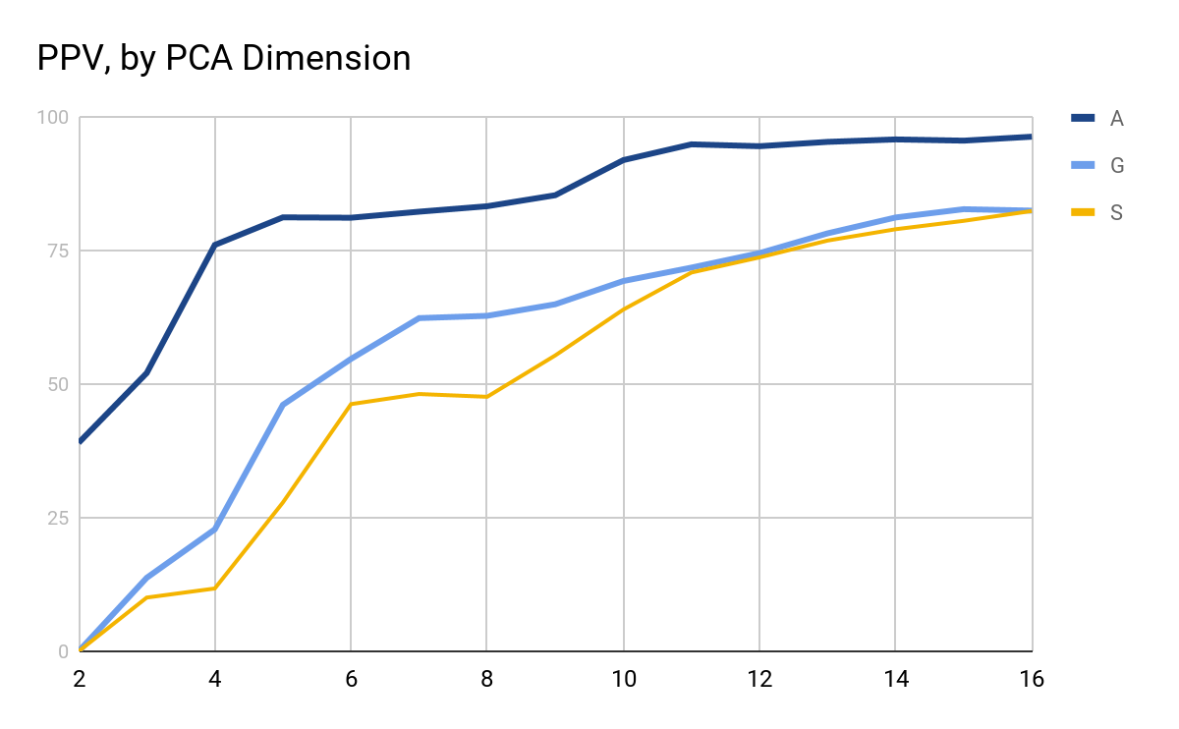
Bayesian Classifier, Some PPVs

Slide 16
Bayesian Classifier, 75%, 16 Components
A B C D E F G H I J K L M N O P Q R S T U V W X Y Z
A 113 4 0 3 0 0 2 0 0 5 1 8 29 6 0 4 3 0 1 0 3 1 0 2 7 0
B 0 53 0 5 11 3 40 7 1 2 2 0 0 0 0 1 5 12 36 1 0 0 0 9 1 1
C 1 0 18 2 0 0 82 3 4 1 0 5 0 0 2 7 4 10 14 2 12 0 1 10 4 0
D 2 11 7 15 3 0 8 16 5 0 8 0 3 2 42 2 4 7 39 1 4 0 0 2 4 1
E 0 5 4 0 7 0 31 4 5 2 5 4 0 1 0 1 5 13 74 10 0 0 2 19 7 3
F 0 5 0 0 11 14 2 6 0 1 1 0 0 3 0 2 0 0 99 6 4 0 1 1 19 0
G 0 5 9 5 3 1 82 8 5 0 5 11 1 1 5 2 15 14 4 4 6 0 0 3 0 0
H 1 1 0 7 2 1 10 68 0 1 4 0 1 32 14 6 3 6 1 0 4 1 2 3 7 0
I 0 1 0 2 6 2 1 6 5 11 8 5 0 0 0 0 47 0 61 0 0 0 0 17 0 9
J 6 4 0 18 0 3 0 21 3 38 4 1 0 0 39 0 12 0 31 0 3 0 0 6 1 7
K 0 0 5 2 0 0 5 15 0 1 18 5 23 4 1 0 8 7 5 3 64 1 0 20 12 0
L 0 0 18 1 6 0 27 3 1 49 3 58 8 0 4 0 8 1 12 0 1 0 0 2 3 0
M 2 0 0 0 1 0 6 3 0 0 1 0 53 122 1 0 0 2 0 0 1 0 9 0 0 0
N 1 1 0 1 0 0 2 42 0 0 10 0 8 82 5 0 1 0 16 0 2 1 10 1 8 0
O 0 0 0 16 0 0 9 27 1 1 4 0 3 1 97 6 9 4 1 0 1 1 11 0 0 0
P 1 7 6 18 10 1 6 2 3 0 1 0 7 4 10 2 0 0 120 0 0 2 0 1 9 0
Q 3 2 0 3 0 0 13 15 26 1 5 3 6 1 16 5 58 16 12 1 4 0 0 6 1 0
R 3 1 5 1 5 1 16 30 0 0 8 2 2 0 16 5 37 36 3 0 2 1 0 3 2 1
S 3 40 3 5 23 3 11 2 4 2 1 0 3 0 0 2 1 2 79 5 0 0 0 2 6 12
T 2 1 4 0 13 3 3 5 0 4 1 3 0 0 1 1 2 0 38 10 3 25 12 1 44 12
U 2 0 2 0 0 0 15 68 0 1 21 0 7 15 4 2 0 0 0 0 51 0 2 0 11 0
V 1 0 1 0 0 0 7 8 0 0 12 0 2 6 0 0 0 4 2 24 0 66 22 2 26 0
W 0 0 0 0 0 0 2 0 0 0 2 0 43 7 2 0 0 1 0 0 1 25 101 0 4 0
X 0 1 13 1 17 6 11 31 0 0 15 15 0 0 0 0 14 1 26 2 7 0 0 26 3 1
Y 0 5 5 0 14 1 4 13 0 3 4 0 2 7 1 2 0 0 25 3 3 35 28 14 36 0
Z 0 5 2 3 67 0 2 2 1 5 1 0 0 0 0 0 3 0 61 13 0 0 0 3 12 12
Ground Truth
Predicted Value

Slide 17
Bayesian Classifier, 75%, 16 Components
A B C D E F G H I J K L M N O P Q R S T U V W X Y Z
A 113 4 0 3 0 0 2 0 0 5 1 8 29 6 0 4 3 0 1 0 3 1 0 2 7 0
B 0 53 0 5 11 3 40 7 1 2 2 0 0 0 0 1 5 12 36 1 0 0 0 9 1 1
C 1 0 18 2 0 0 82 3 4 1 0 5 0 0 2 7 4 10 14 2 12 0 1 10 4 0
D 2 11 7 15 3 0 8 16 5 0 8 0 3 2 42 2 4 7 39 1 4 0 0 2 4 1
E 0 5 4 0 7 0 31 4 5 2 5 4 0 1 0 1 5 13 74 10 0 0 2 19 7 3
F 0 5 0 0 11 14 2 6 0 1 1 0 0 3 0 2 0 0 99 6 4 0 1 1 19 0
G 0 5 9 5 3 1 82 8 5 0 5 11 1 1 5 2 15 14 4 4 6 0 0 3 0 0
H 1 1 0 7 2 1 10 68 0 1 4 0 1 32 14 6 3 6 1 0 4 1 2 3 7 0
I 0 1 0 2 6 2 1 6 5 11 8 5 0 0 0 0 47 0 61 0 0 0 0 17 0 9
J 6 4 0 18 0 3 0 21 3 38 4 1 0 0 39 0 12 0 31 0 3 0 0 6 1 7
K 0 0 5 2 0 0 5 15 0 1 18 5 23 4 1 0 8 7 5 3 64 1 0 20 12 0
L 0 0 18 1 6 0 27 3 1 49 3 58 8 0 4 0 8 1 12 0 1 0 0 2 3 0
M 2 0 0 0 1 0 6 3 0 0 1 0 53 122 1 0 0 2 0 0 1 0 9 0 0 0
N 1 1 0 1 0 0 2 42 0 0 10 0 8 82 5 0 1 0 16 0 2 1 10 1 8 0
O 0 0 0 16 0 0 9 27 1 1 4 0 3 1 97 6 9 4 1 0 1 1 11 0 0 0
P 1 7 6 18 10 1 6 2 3 0 1 0 7 4 10 2 0 0 120 0 0 2 0 1 9 0
Q 3 2 0 3 0 0 13 15 26 1 5 3 6 1 16 5 58 16 12 1 4 0 0 6 1 0
R 3 1 5 1 5 1 16 30 0 0 8 2 2 0 16 5 37 36 3 0 2 1 0 3 2 1
S 3 40 3 5 23 3 11 2 4 2 1 0 3 0 0 2 1 2 79 5 0 0 0 2 6 12
T 2 1 4 0 13 3 3 5 0 4 1 3 0 0 1 1 2 0 38 10 3 25 12 1 44 12
U 2 0 2 0 0 0 15 68 0 1 21 0 7 15 4 2 0 0 0 0 51 0 2 0 11 0
V 1 0 1 0 0 0 7 8 0 0 12 0 2 6 0 0 0 4 2 24 0 66 22 2 26 0
W 0 0 0 0 0 0 2 0 0 0 2 0 43 7 2 0 0 1 0 0 1 25 101 0 4 0
X 0 1 13 1 17 6 11 31 0 0 15 15 0 0 0 0 14 1 26 2 7 0 0 26 3 1
Y 0 5 5 0 14 1 4 13 0 3 4 0 2 7 1 2 0 0 25 3 3 35 28 14 36 0
Z 0 5 2 3 67 0 2 2 1 5 1 0 0 0 0 0 3 0 61 13 0 0 0 3 12 12
Ground Truth
Predicted Value

Slide 18
Bayesian PPVs, 75%, 16 Components
A B C D E F
83.25 44.59 27.78 36.28 31.01 47.18
G H I J K L
37.14 14.44 43.68 7.04 29.31 27.88
M N O P Q R
47.56 56.00 43.75 71.20 24.07 35.64
S T U V W X
16.92 56.57 72.73 65.12 75.45 18.81
Y Z
34.02 66.39

Slide 19
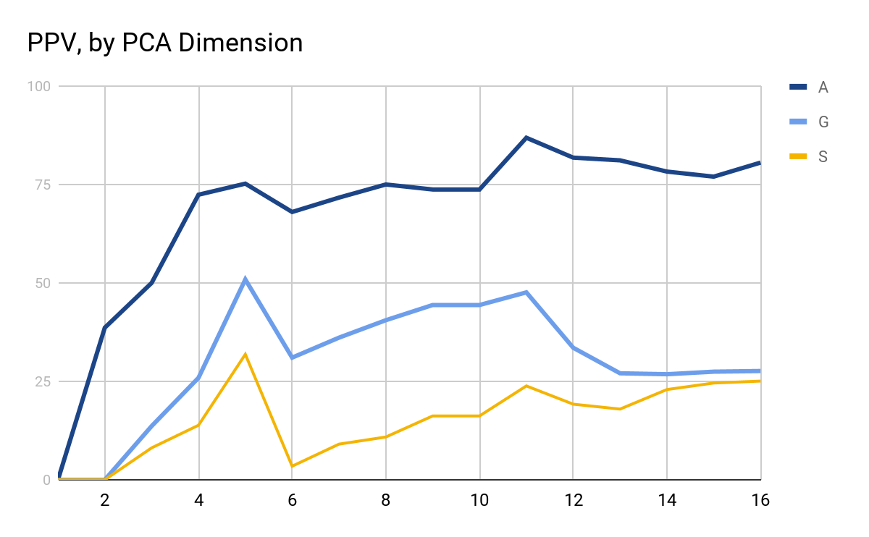
Bayesian Classifier, PPVs, 75% Training

Slide 20
Histogram Classifier Observations

Slide 21
Histogram Classifier (16 Components)
A B C D E F G H I J K L M N O P Q R S T U V W X Y Z
A 8 3 8 8 8 2 9 13 8 7 6 11 11 7 5 6 10 7 10 2 13 12 5 2 6 5
B 4 5 6 9 6 6 13 7 4 2 11 11 8 8 7 8 5 8 15 3 8 5 6 1 10 9
C 8 2 7 13 8 5 3 2 10 3 5 7 5 8 5 6 4 8 9 10 5 9 9 11 3 7
D 10 2 8 9 8 6 2 7 6 7 4 13 11 8 10 5 7 8 4 8 5 10 8 12 7 7
E 6 10 9 7 9 5 8 5 13 13 7 6 4 4 5 7 7 11 14 6 4 10 7 4 7 4
F 9 7 7 7 8 7 13 6 6 10 8 5 7 10 9 10 6 6 10 6 5 5 6 3 10 9
G 5 7 4 5 10 6 6 11 9 7 5 6 7 7 5 4 5 4 8 12 6 12 7 7 9 5
H 5 7 14 9 6 6 3 5 9 1 6 8 2 4 9 11 5 11 8 7 7 6 9 5 3 7
I 5 14 8 6 6 9 9 13 9 7 9 9 13 4 8 12 8 12 13 6 7 7 9 6 9 7
J 9 11 6 9 7 3 9 8 5 10 10 8 2 14 5 12 2 5 12 4 9 8 7 8 10 3
K 6 4 5 5 8 9 10 9 8 8 12 7 8 10 6 7 5 10 9 6 10 10 10 7 5 4
L 5 2 7 12 7 6 8 9 6 10 9 6 6 9 7 5 9 8 11 5 8 5 6 5 9 12
M 6 4 9 6 12 6 9 12 4 8 7 6 13 9 13 5 4 8 9 7 7 8 9 5 8 7
N 10 4 9 3 5 4 10 6 10 7 7 10 4 10 7 11 9 2 5 6 10 5 4 7 15 6
O 8 7 7 6 3 11 7 8 6 6 9 10 5 5 11 7 6 6 5 8 4 9 10 11 7 9
P 3 4 8 10 11 9 4 6 5 6 3 6 10 7 12 12 8 6 11 10 9 6 9 6 10 14
Q 8 9 6 8 10 5 7 7 4 13 9 9 7 5 8 10 8 9 4 6 7 10 12 7 6 10
R 6 4 4 9 6 3 10 6 7 8 6 7 9 3 8 7 11 7 9 6 8 8 6 4 8 12
S 9 10 10 7 6 8 5 4 8 9 8 7 6 6 9 10 7 7 5 9 8 10 7 7 7 12
T 7 7 9 10 8 5 13 11 5 5 13 10 11 6 13 5 4 8 4 9 6 8 5 9 14 7
U 12 8 11 10 7 6 12 10 5 9 5 9 6 8 6 6 9 9 8 6 6 7 11 6 10 8
V 4 9 2 8 10 11 3 14 11 8 7 8 7 9 8 14 2 10 2 4 8 6 8 5 4 3
W 5 10 11 5 11 9 9 9 2 6 9 6 4 5 7 2 7 9 10 4 8 6 14 7 8 7
X 6 3 8 2 7 6 2 10 5 7 6 6 9 6 6 9 3 11 11 5 8 5 6 4 7 15
Y 10 11 8 7 5 7 8 9 12 2 11 4 10 6 4 5 9 8 11 6 5 8 9 8 9 8
Z 6 4 10 3 6 2 10 6 7 5 12 6 9 5 8 4 9 5 10 7 2 9 8 4 4 8
Ground Truth
Predicted Value

Slide 22
Histogram Classifier PPVs
A B C D E F
5.02 6.32 3.14 1.60 3.72 4.34
G H I J K L
7.89 3.72 4.86 3.84 4.73 7.14
M N O P Q R
4.76 4.45 7.05 4.08 4.41 4.29
S T U V W X
2.15 3.66 5.72 2.92 5.05 7.39
Y Z
3.31 3.50

Slide 23
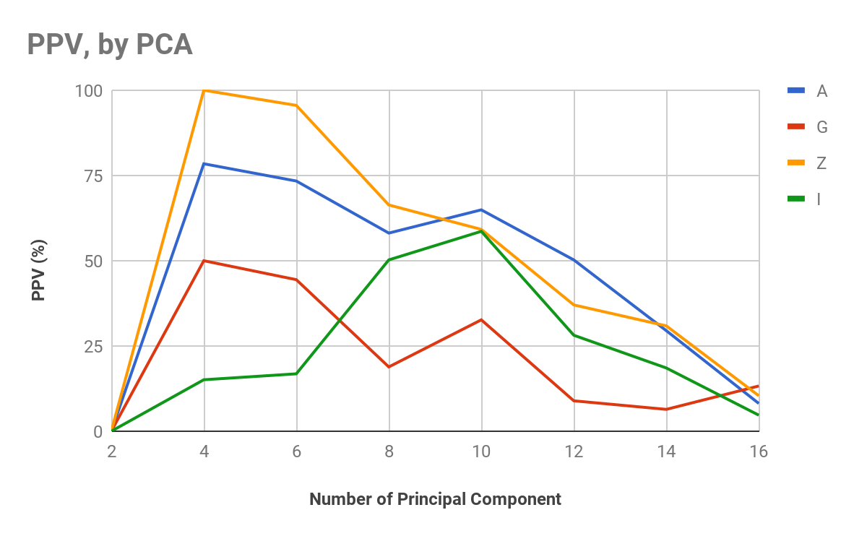
Histogram Classifier, Some PPVs

Slide 24
Histogram Classifier (4 Components)
A B C D E F G H I J K L M N O P Q R S T U V W X Y Z
A 120 0 0 22 0 0 0 0 0 0 0 54 2 0 0 0 0 0 0 0 0 0 0 0 0 0
B 2 0 14 130 0 0 1 0 23 0 0 10 10 0 0 0 0 0 0 0 0 0 0 0 0 0
C 0 0 50 112 0 0 1 0 29 0 0 0 1 0 0 0 0 0 0 2 0 0 0 0 0 0
D 4 0 1 150 0 0 0 0 28 1 0 10 7 0 0 0 0 0 0 0 0 0 0 0 0 0
E 0 0 51 81 0 0 0 0 46 0 0 2 1 0 0 0 0 0 0 0 0 0 0 0 0 0
F 0 0 0 54 0 0 0 0 77 1 0 0 1 1 0 0 0 0 0 56 0 0 0 2 0 0
G 2 0 3 141 0 0 4 0 17 0 0 29 5 0 0 0 0 0 0 0 0 0 0 0 0 0
H 2 0 0 105 0 0 0 0 13 0 0 7 12 46 0 0 0 0 0 0 0 0 0 0 0 0
I 0 0 0 45 0 0 0 0 149 0 0 2 0 1 0 0 0 0 0 0 0 0 0 0 0 0
J 7 0 0 50 0 0 0 0 108 10 0 27 0 0 0 0 0 0 0 0 0 0 0 0 0 0
K 4 0 1 140 0 0 0 0 25 0 0 12 11 0 0 0 0 0 0 1 0 0 1 0 0 0
L 0 0 0 33 0 0 0 0 6 0 0 160 4 0 0 0 1 0 0 0 0 0 0 0 0 0
M 7 0 0 66 0 0 0 0 5 0 0 0 38 82 0 1 0 0 0 0 0 0 1 0 0 0
N 1 0 0 100 0 0 0 0 11 0 0 0 13 63 0 0 0 0 0 3 0 0 4 0 0 0
O 0 0 0 135 0 0 0 0 37 0 0 9 3 0 0 0 0 0 0 0 0 0 0 0 0 0
P 0 0 0 135 0 0 0 0 34 0 0 1 3 1 0 0 0 0 0 8 0 0 1 0 0 0
Q 0 0 0 124 0 0 0 0 40 0 0 31 1 4 0 0 1 0 0 0 0 0 0 1 0 0
R 0 0 0 137 0 0 0 0 26 1 0 17 12 1 0 0 0 0 0 0 0 0 0 0 0 0
S 4 0 17 94 0 0 2 0 43 0 0 16 1 0 0 0 0 0 0 0 0 0 0 0 0 0
T 0 0 0 45 0 0 0 0 45 0 0 0 0 0 0 0 0 0 0 89 0 0 0 3 0 0
U 0 0 0 118 0 0 0 0 19 0 0 0 15 39 0 0 0 0 0 9 0 0 0 0 0 0
V 0 0 0 66 0 0 0 0 20 0 0 0 3 0 0 0 0 0 0 91 0 0 0 0 0 0
W 0 1 0 93 0 0 0 0 12 0 0 0 5 27 0 0 0 0 0 41 0 0 18 0 0 0
X 0 0 0 114 0 0 0 0 68 0 0 5 2 0 0 0 0 0 0 3 0 0 0 1 0 0
Y 0 0 0 72 0 0 0 0 34 0 0 0 5 0 0 0 0 0 0 87 0 0 1 0 0 0
Z 0 0 6 39 0 0 0 0 72 0 0 15 3 0 0 0 1 0 0 0 0 0 0 4 0 33
Ground Truth
Predicted Value

Slide 25
Histogram Classifier PPVs (6 Components)
A B C D E F
73.37 18.18 28.57 0.00 52.27 0.00
G H I J K L
44.44 16.07 16.83 91.11 18.81 38.27
M N O P Q R
36.74 42.55 7.57 98.66 57.14 0.00
S T U V W X
14.13 26.66 43.85 0.00 52.23 28.00
Y Z
12.50 95.56

Slide 26
Linear Classifier Observations

Slide 27
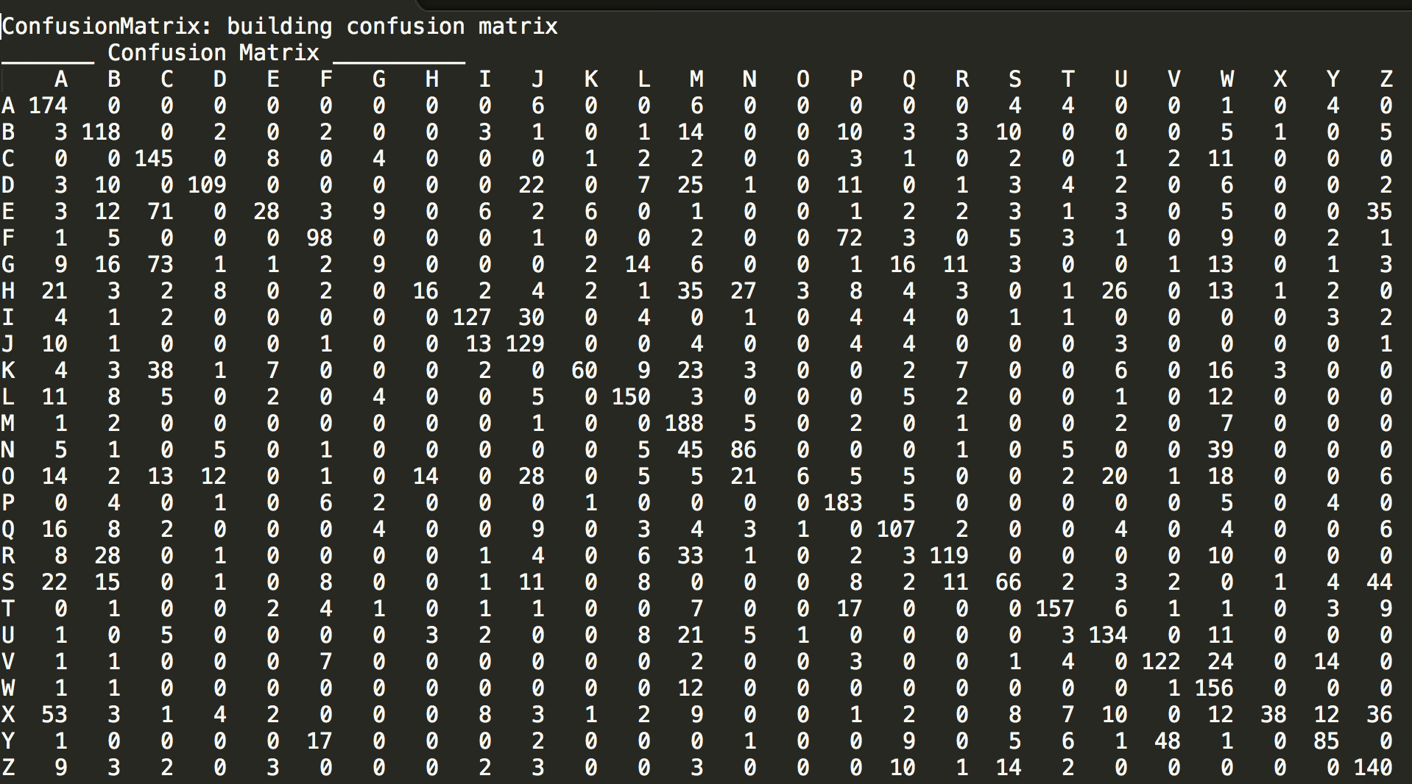

Slide 28
PPV for all class labels with 75% training set fitting
A | B | C | D | E | F | G | H | I | J | K | L | M
46 | 48 | 40 | 75 | 53 | 64 | 27 | 49 | 76 | 49 | 82 | 67 | 42
N | O | P | Q | R | S | T | U | V | W | X | Y | Z
56 | 55 | 55 | 57 | 73 | 53 | 78 | 60 | 69 | 41 | 86 | 63 | 48
The values of feature vectors do not seem to be weighted based on class labels!

Slide 29
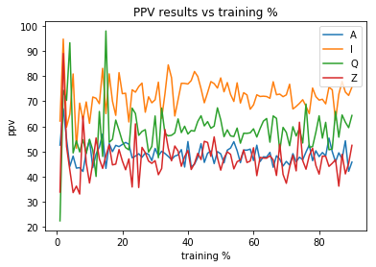
PPV sensitivity to the size of training set
Weights converge above 20% training data

Slide 30
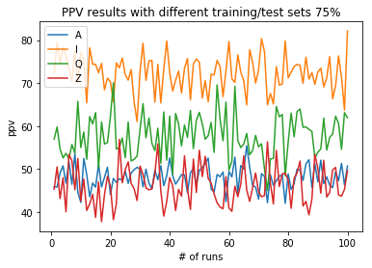
PPV variance for 75% training set

Slide 31
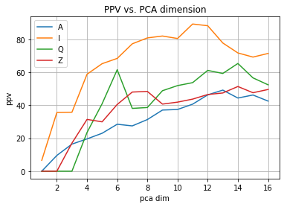
Effect of PCA dimensional reduction on PPV
Allow some level of reduction without affecting ppv

Slide 32
Comparison
Bayesian vs Histogram vs Linear

Slide 33
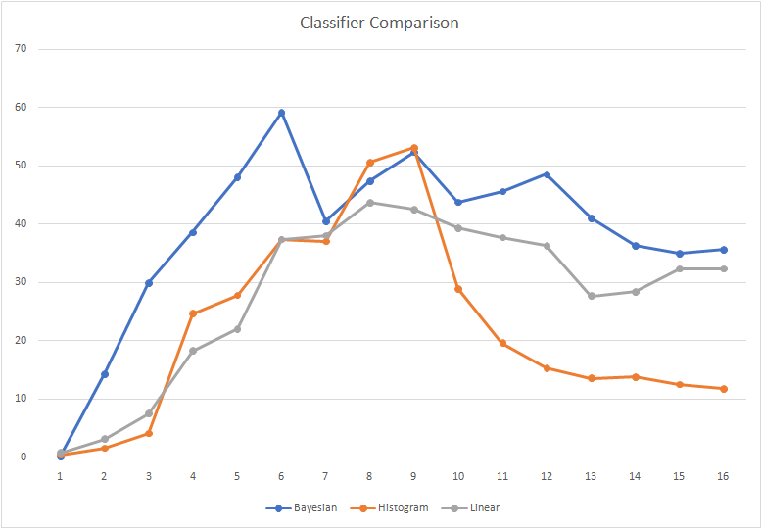

Slide 34
Q & A

