Slide 1

FINAL DEFENSE | AGRICULTURE & SUSTAINABILITY
KP Smart Crop Doctor
An Explainable AI and Retrieval-Augmented Agricultural Advisory System for Khyber Pakhtunkhwa
Computer Vision (CNN / Transfer Learning) · Grad-CAM · Retrieval-Augmented Generation · Deterministic Extractive Synthesis · Streamlit (English / Urdu)
Prepared by: Saqib Hussain
Institute of Management Sciences (IM|Sciences), Peshawar
Employable Digital Skills Initiative for Youth (EDSIY-KP) · Package G6 – Artificial Intelligence and Machine Learning
12 weeks · 144 contact hours · Date: ______________
KP Smart Crop Doctor | Saqib Hussain | IM|Sciences
1
Notes:
Opening: this is an integrated AI/ML advisory prototype (vision + explainability + retrieval + bilingual output), not only a disease classifier. Duration 12 weeks under EDSIY-KP Package G6.

Slide 2
PROBLEM
Why Disease Diagnosis Needs More Than a Label
1. Opaque predictions
2. Ungrounded advice
3. Language barrier
A bare class label is neither actionable nor auditable. Users cannot see whether the model looked at the lesion or the background.
Free-form language-model generation can invent pesticides or dosages. Advice must be traceable to a source.
Extension literature is largely English, while many intended users read Urdu.
Scope: Apple, Maize and Potato · 11 disease and healthy classes · Khyber Pakhtunkhwa leaf diseases
Positioned as an advisory prototype that supplements, never replaces, licensed extension officers.
KP Smart Crop Doctor | Saqib Hussain | IM|Sciences
2
Notes:
Why this matters: three gaps - opaque labels, risk of ungrounded chemical advice, and English-only delivery. Scope is deliberately narrow: 3 crops, 11 classes, advisory prototype.

Slide 3
PROPOSED ARCHITECTURE
End-to-End Pipeline: From Leaf Image to Cited Advisory
1
2
3
4
5
Leaf Image
CNN Classification
Crop / Disease Metadata
Grad-CAM
Metadata-Conditioned Retrieval
256 resize, 224 crop
MobileNetV3-Large
Top-1 + Top-2, confidence
features.16 heatmap
scope guardrail, τ = 0.45
6
7
8
9
FAISS
Retrieved Evidence
Deterministic Extractive Synthesis
English / Urdu Advisory
local vector similarity search
164 passages, 11 bulletins
copies text, no free generation
+ source citations
Vision output conditions retrieval: predicted crop and disease filter the FAISS search (cross-crop contamination 13.33% → 0%).
KP Smart Crop Doctor | Saqib Hussain | IM|Sciences
3
Notes:
Walk left-to-right: the vision branch (green) produces crop/disease metadata and a Grad-CAM; that metadata conditions retrieval (teal); the synthesiser (amber) only copies from retrieved passages. Key contribution: vision output filters retrieval, so the stages are coupled, not independent.

Slide 4
DATASET
Leak-Controlled Benchmark: 9,175 Images, 11 Classes
9,175
11
70/15/15
0
Foliar images
Classes
Train / Val / Test
Shared leaf clusters
PlantVillage-style taxonomy
Apple 4 · Maize 4 · Potato 3
6,422 / 1,376 / 1,377
across splits (tested)
Crop | Classes | Train / Val / Test
Apple | Scab, Black rot, Cedar rust, Healthy | 2,220 / 475 / 476
Maize | Gray leaf spot, Common rust, N. blight, Healthy | 2,694 / 580 / 578
Potato | Early blight, Late blight, Healthy | 1,508 / 321 / 323
Leakage safeguards
Images grouped by leaf session (file-naming pattern)
64-bit dHash; Hamming distance ≤ 4 forced into one partition
Group-stratified split (GroupKFold on leaf_id)
Class-weighted cross-entropy for imbalance
Near-duplicates missed by both checks cannot be excluded.
KP Smart Crop Doctor | Saqib Hussain | IM|Sciences
4
Notes:
Leakage control: multiple photos of one leaf inflate test accuracy. We grouped images by leaf session from file naming, forced near-duplicates (dHash Hamming distance <= 4) into the same partition, and used a group-stratified 70/15/15 split. Tests found no leaf cluster shared across splits. Limit: this cannot exclude near-duplicates both checks miss. Class-weighted loss handles imbalance (e.g. 108 healthy-potato training images).

Slide 5
MODEL COMPARISON
MobileNetV3-Large vs. EfficientNet-B0
Metric (held-out test set, N = 1,377) | MobileNetV3-Large | EfficientNet-B0
Validation macro-F1 (selection criterion) | 0.9773 | 0.9535
Test Top-1 accuracy | 97.53% (1,343) | 95.06% (1,309)
Test Top-2 accuracy | 99.78% (1,374) | 99.35% (1,368)
Test macro-F1 | 0.9657 | 0.9352
Expected calibration error (ECE) | 1.40% | 5.89%
CPU latency per image | 28.38 ms (35.2 FPS) | 48.01 ms (20.8 FPS)
Parameters / size | 4.22 M / 16.28 MB | 4.02 M / 15.63 MB
Identical training protocol for both: seed 42, AdamW, cosine-annealed LR, class-weighted loss, ≤10 epochs. Model chosen on validation macro-F1 before test evaluation.
KP Smart Crop Doctor | Saqib Hussain | IM|Sciences
5
Notes:
Why MobileNetV3? Both backbones were fine-tuned under identical conditions (seed 42, AdamW, cosine LR, class-weighted loss, up to 10 epochs). Selection was made on validation macro-F1 before the test set was evaluated. MobileNetV3 was more accurate, faster on CPU and better calibrated, at similar size - important for a CPU-deployable prototype.

Slide 6
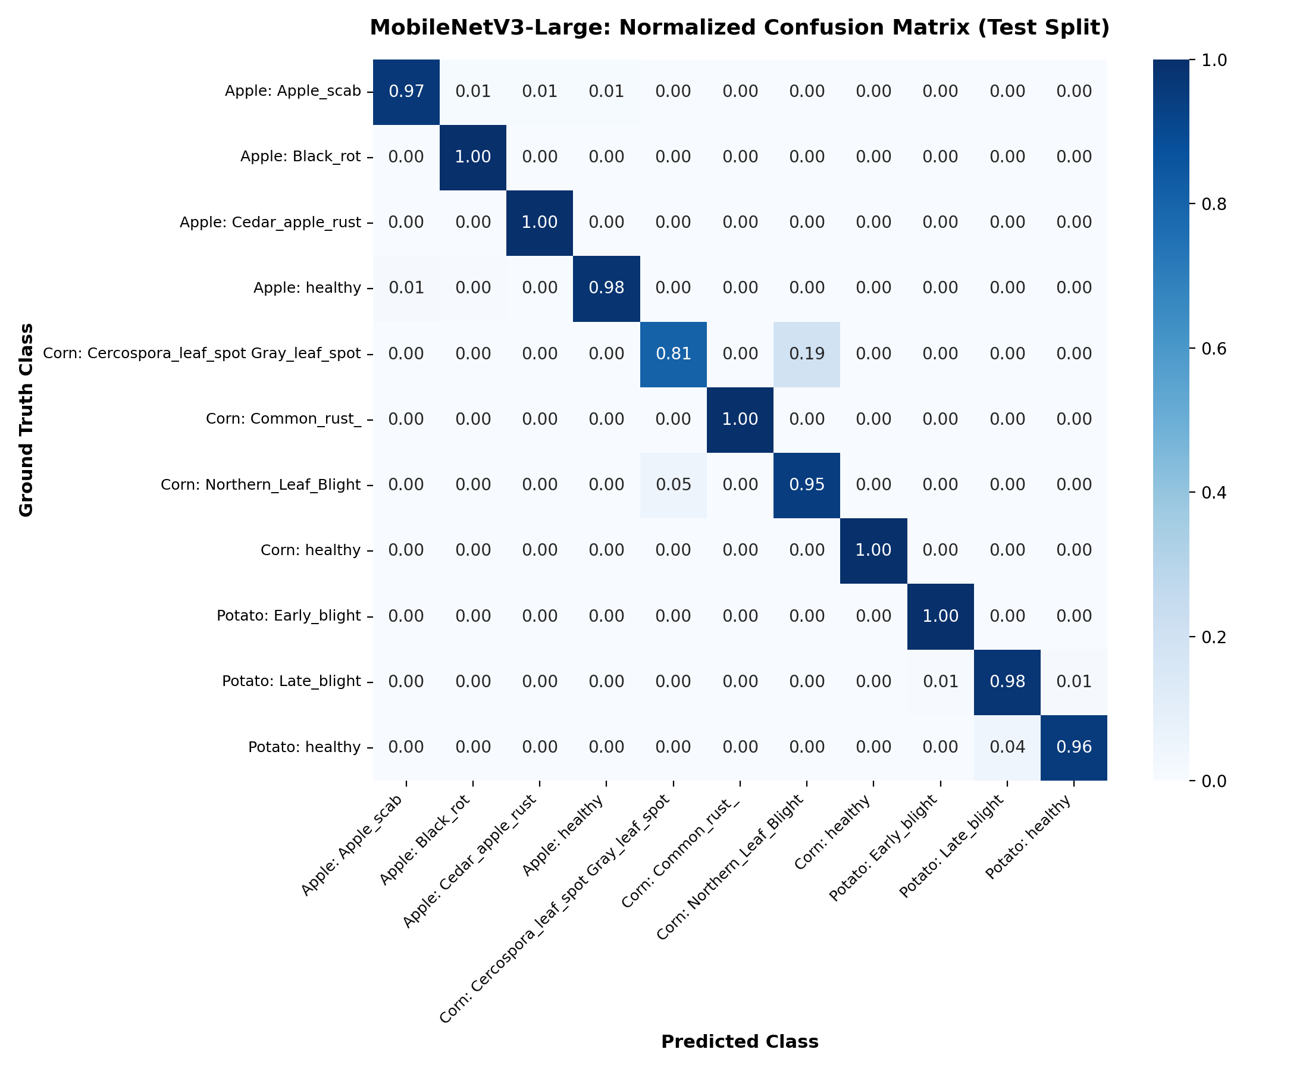
HELD-OUT TEST PERFORMANCE
Classification Results on the Held-Out Test Set (N = 1,377)
97.53%
34 errors: none cross-crop; 23 are maize gray leaf spot ↔ northern leaf blight.
Top-1
1,343 / 1,377
99.78%
Top-2
1,374 / 1,377
0.9657
Macro-F1
11 classes
97.53% is held-out test-set performance, not real-world KP field accuracy. Requires Field Validation.
KP Smart Crop Doctor | Saqib Hussain | IM|Sciences
6
Notes:
Is 97.53% field accuracy? No. It is held-out test-set performance on laboratory-condition images from a leak-controlled split; it is an upper bound for field use and requires prospective field validation in KP. All 34 errors stay within a crop; 23 (67.6%) are maize gray leaf spot vs northern leaf blight.

Slide 7
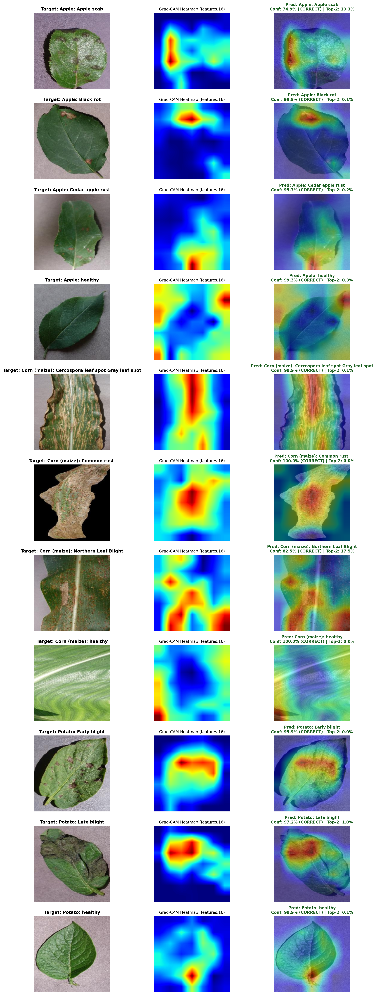
EXPLAINABILITY
Grad-CAM: Showing Where the Model Looked
What Grad-CAM does
Highlights the image regions that most increased the predicted class score, using gradients at the final convolutional layer (7×7×960). No architecture change is needed.
Lesion-centred salience on disease classes; diffuse on healthy leaves
Overlay opacity adjustable live in the interface
Coarse 7×7 grid: regional evidence, not biological proof
KP Smart Crop Doctor | Saqib Hussain | IM|Sciences
7
Notes:
Grad-CAM weights the 960 feature maps at the last convolution (features.16, 7x7) by globally pooled class gradients, applies ReLU, upsamples and overlays. For disease classes salience generally coincides with lesions; for healthy leaves it is diffuse. The map is coarse (7x7) and does not establish biological causality.

Slide 8
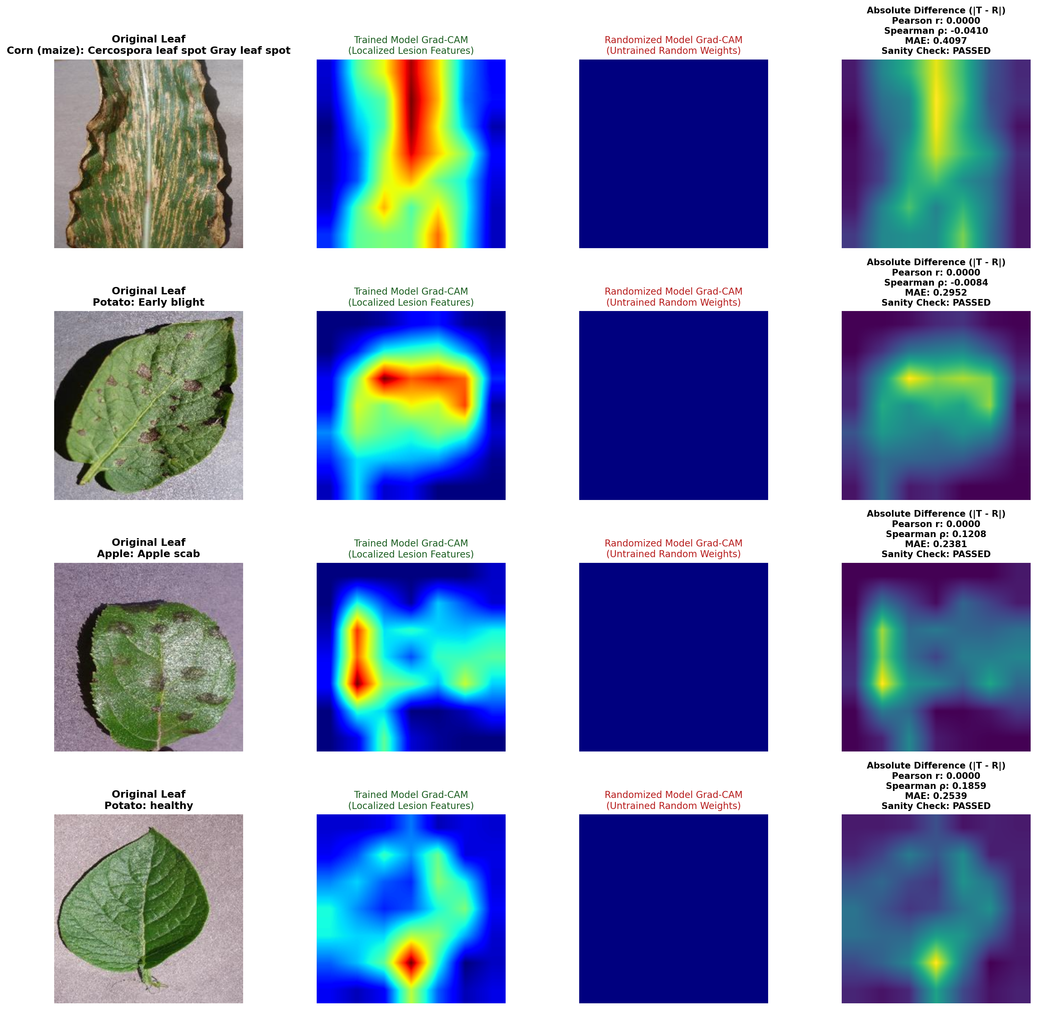
EXPLAINABILITY CHECK
Randomisation Sanity Check (4 Images)
Class (4 images) | Spearman ρ | MAE
Maize gray leaf spot | −0.0410 | 0.4097
Potato early blight | −0.0084 | 0.2952
Apple scab | 0.1208 | 0.2381
Potato healthy | 0.1859 | 0.2539
Pearson r = 0.0000 for all four (degenerate: randomised maps are constant).
Interpretation: maps depend on learned weights. Evidence is limited to four images.
KP Smart Crop Doctor | Saqib Hussain | IM|Sciences
8
Notes:
How was Grad-CAM validated? Following Adebayo et al. (2018) we recomputed maps on a randomised-parameter model. Maps changed completely, so they depend on learned weights. Caveats: only four images; randomised maps are constant so Pearson r is degenerate (0.0000) and Spearman/MAE carry the comparison. A larger sample would strengthen the claim.

Slide 9
RETRIEVAL / RAG ARCHITECTURE
Source-Constrained Advisory Architecture
Metadata-conditioned retrieval
FAISS (local)
Deterministic extraction
Predicted crop and disease form the query and filter the search. Key contribution: removes cross-crop leakage.
Exact inner-product vector similarity search over 384-d MiniLM embeddings. Runs on CPU, offline.
Copies structured sections from retrieved passages and attaches the citation. No free text generation.
Knowledge base | Value
Extension bulletins (ARI Tarnab, CCRI Pirsabak, PRC Abbottabad, KP Agri Ext.) | 11
Passages (≤500 chars, 50 overlap) | 164
Out-of-scope crops rejected (cotton, wheat, sugarcane, citrus) | 4 / 4
KP Smart Crop Doctor | Saqib Hussain | IM|Sciences
9
Notes:
Why RAG? Advice must be traceable to extension bulletins. Why FAISS? A local, exact inner-product index over 164 passages - fast on CPU, no network. Why deterministic extraction instead of LLM generation? It cannot introduce unretrieved dosages or trade names; every sentence maps to a source passage. Unsupported crops: a crop whitelist plus cosine threshold (0.45) abstains (4/4 correct).

Slide 10
RETRIEVAL RESULTS
Retrieval Results (33 Domain Queries)
96.97%
100%
0.9848
21.84 ms
Hit@1
Hit@3
MRR
Retrieval latency
32 / 33
33 / 33
mean reciprocal rank
embedding + search, CPU
Metadata filtering ablation
Source-grounded advisory
13.33% → 0%
15-case advisory benchmark: groundedness, citation correctness and faithfulness all 100%
Faithful by construction: verifies the implementation, not a generative model
Real constraint is coverage of the 11 bulletins
cross-crop contamination, unfiltered vs. vision-conditioned retrieval
KP Smart Crop Doctor | Saqib Hussain | IM|Sciences
10
Notes:
Ablation: unfiltered semantic search returned the wrong crop in 13.33% of queries (e.g. potato early blight for a generic maize query); conditioning on the vision output reduced this to 0%. Groundedness of 100% on the 15-case benchmark verifies the extractive implementation; it is faithful by construction and does not measure a generative model. The real limit is bulletin coverage.

Slide 11
BILINGUAL INTERFACE
Streamlit Application: English / Urdu Advisory
Diagnosis and explanation
Tabbed, cited advisory
Top-1 and Top-2 diagnoses with confidence; Grad-CAM overlay with opacity slider; Top-2 always shown because maize confusions dominate.
Symptoms, likely cause, integrated management, cultural prevention and crop-stage guidance, each with its KP-AGRI source ID.
Entity-preserving Urdu
Guardrail and follow-up
33-term glossary; Latin binomials and citation keys restored verbatim after translation; right-to-left layout with Noto Nastaliq.
Unsupported crops are rejected; follow-up question box answers only from the knowledge base.
KP Smart Crop Doctor | Saqib Hussain | IM|Sciences
11
Notes:
Urdu: a 33-term agricultural glossary; Latin binomials (e.g. Phytophthora infestans) and citation keys are protected by tokens before translation and restored verbatim, so pathogen and chemical names are never altered. Right-to-left CSS and Noto Nastaliq typography. Localisation changes text length by about 3%.

Slide 12
END-TO-END DEMONSTRATION
Full Pipeline on 17 Cases (CPU)
17 / 17
12 / 13
4 / 4
184.22 ms
Executed
Diagnoses correct
Abstentions
Mean latency
no unhandled exceptions
11 canonical + 1 of 2 difficult
out-of-scope crops
P95 271.51 ms
Stage | Mean (ms) | P95 (ms) | Share
Vision inference (MobileNetV3) | 71.56 | 116.52 | 38.8%
Grad-CAM generation | 58.55 | 95.33 | 31.8%
FAISS retrieval (top-3) | 15.94 | 18.88 | 8.7%
Advisory synthesis (EN) | 18.62 | 22.09 | 10.1%
Urdu localisation + RTL | 19.54 | 23.73 | 10.6%
KP Smart Crop Doctor | Saqib Hussain | IM|Sciences
12
Notes:
The 17 cases: 11 canonical, 2 difficult borderline, 4 out-of-scope. All executed without unhandled exceptions. Diagnostic accuracy 92.31% (12/13); abstention 4/4; citation linkage 13/13. Small evaluation set - indicative only. Table V latencies come from the end-to-end harness and should not be compared with the per-image benchmark in the model comparison.

Slide 13
LIMITATIONS
Limitations and Requirements for Field Validation
Closed-set classification
Domain shift
No prospective KP field validation
Only 3 crops, 11 classes. An unseen crop or nutrient deficiency is forced into the nearest class; softmax may be overconfident on non-leaf inputs.
Training images are controlled laboratory captures; glare, weeds, blur and co-infections may reduce performance.
Reported accuracy is an upper bound. Requires Field Validation before any field-readiness claim.
Limited Grad-CAM validation
Limited, static knowledge base
Advisory only
Sanity test on four images; 7×7 map is coarse and does not establish biological causality.
Advice covers 11 bulletins only; end-to-end (17) and advisory (15) sets are small.
Chemical products carry toxicological and environmental risk; supplements licensed on-site assessment.
KP Smart Crop Doctor | Saqib Hussain | IM|Sciences
13
Notes:
Be direct: 97.53% is an upper bound. Domain shift (glare, weeds, blur, co-infections), closed-set softmax (unseen crops forced into nearest class; guardrail and Top-2 mitigate but do not remove this), 7x7 Grad-CAM, four-image sanity test, 17-case end-to-end set, and a static 11-bulletin knowledge base. Chemical advice carries toxicological and environmental risk, so the tool supplements licensed on-site assessment.

Slide 14
CONTRIBUTIONS
What This Work Contributes
1. Leak-controlled benchmark
2. Sanity-checked Grad-CAM
9,175 images, leaf-group isolation + dHash; MobileNetV3-L vs EfficientNet-B0 with calibration (held-out test: 97.53%, ECE 1.40%).
Explanations on a lightweight backbone, with a randomisation check on four images and limitations reported.
3. Metadata-conditioned retrieval
4. Source-constrained advisory
Vision output filters FAISS search: cross-crop contamination 13.33% → 0%; Hit@1 96.97%, MRR 0.9848.
Deterministic extractive synthesis with citations; entity-preserving English–Urdu localisation; guardrail rejects unsupported crops.
KP Smart Crop Doctor | Saqib Hussain | IM|Sciences
14
Notes:
Research story: an integrated AI/ML prototype in which the vision output explains itself (Grad-CAM), conditions retrieval (metadata filtering), and feeds a source-constrained advisory in two languages. Each claim is bounded by the evaluation scale stated on the limitations slide.

Slide 15
FUTURE WORK
Future Work and Questions
Annotated in-situ field dataset (Swat, Mardan, Abbottabad) for domain adaptation
Coverage of wheat stripe rust, sugarcane red rot and citrus canker
Open-set rejection class for non-target inputs
Pashto speech interface
INT8 ONNX / TFLite export for Android
Course context
EDSIY-KP · Package G6 – AI & ML
Intermediate · 144 contact hours
12 weeks: 3 sessions × 4 h
Physical and online delivery
Youth aged 18–35 from KP
Thank you · Questions
KP Smart Crop Doctor | Saqib Hussain | IM|Sciences
15
Notes:
Planned work follows directly from the limitations: field data from Swat, Mardan and Abbottabad; more crops; open-set rejection; Pashto speech interface; INT8 mobile export. Course context: EDSIY-KP Package G6 - AI & ML, intermediate level, 144 contact hours over 12 weeks (3 sessions/week x 4 hours), physical and online; target audience youth aged 18-35 from KP.

