Slide 1





SEIZURE PREDICTION
The Effect of Preprocessing Order,
Model Complexity & Regularisation
on Generalisation
[Saqib Hussain] · [256406202]
Data Mining · Semester Major Assignment
3 Datasets
2 Pipelines
3 Regularisers
4 Imbalance Methods
1

Slide 2
OVERVIEW
Presentation Agenda
01
02
03
04
Problem & Motivation
Dataset Collection
Preprocessing Pipelines
Baseline Model
Why seizure prediction? Why ML?
CHB-MIT · Bonn-EEG · Kaggle
Pipeline A vs Pipeline B
Logistic Regression + metrics
05
06
07
08
Over/Underfitting
Regularisation Study
Imbalance Handling
Comparative Analysis
Validation & learning curves
L1, L2, Elastic Net comparison
SMOTE, undersample, weighting
4 key research questions
AGENDA
2

Slide 3
01 – PROBLEM
Why Seizure Prediction?
50M
Core ML Challenges
people worldwide affected by epilepsy
Severe class imbalance (seizure epochs rare)
High-dimensional correlated EEG features
Preprocessing artefacts (baseline drift, noise)
Generalisation across patients and datasets
Choosing the right regularisation strategy
70%
of seizures could be controlled with treatment
2–10%
of EEG recording is ictal (seizure) activity
MOTIVATION
3

Slide 4
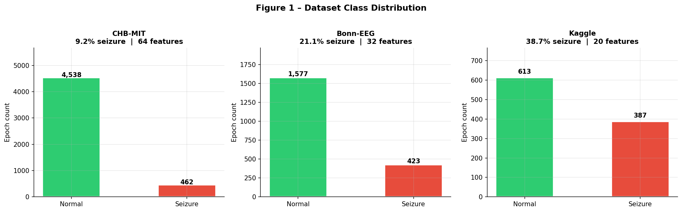
02 – DATASETS
Three Benchmark Datasets
CHB-MIT
Bonn-EEG
Kaggle
n = 5,000
n = 2,000
n = 1,000
9.2% seizure
21.1% seizure
38.7% seizure
64 features
32 features
20 features
Sep = 0.9
Sep = 1.1
Sep = 1.3
Paediatric scalp EEG
Severely imbalanced
High-dim, hard to separate
Intracranial EEG
Moderate imbalance
Mid-dim spectral features
Extracted stat features
Near-balanced classes
Easiest separability
DATASET COLLECTION
4

Slide 5
02 – DATASETS
Class Distribution Across Datasets
9.2%
21.1%
38.7%
Severely Imbalanced
Moderately Imbalanced
Near Balanced
DATASET DISTRIBUTION
5

Slide 6
03 – PREPROCESSING
Two Preprocessing Pipelines
PIPELINE A
PIPELINE B
1. StandardScaler
1. MinMaxScaler [0,1]
2. SelectKBest (ANOVA-F, k=15)
2. StandardScaler (re-centre)
KEY INSIGHT: Scale-invariant ranking
3. PCA (n=10 components)
LIMITATION: PCA discards minority-class variance
Normalise BEFORE scoring
to avoid scale bias in ANOVA-F
Bound → Centre → Project
order suppresses spike artefacts
PREPROCESSING PIPELINES
6

Slide 7
04 – BASELINE
Baseline: Logistic Regression (C=1.0, L2)
P(y = 1 | x) = 1 / (1 + exp(−(β₀ + βᵀx)))
Accuracy
F1-Score
PR-AUC
Overall % correctly classified
Harmonic mean of precision & recall
Area under precision-recall curve
For balanced sets; misleading on imbalanced data
Better than accuracy for imbalanced classes
PRIMARY metric — unaffected by true-negative inflation
BASELINE MODEL
7

Slide 8
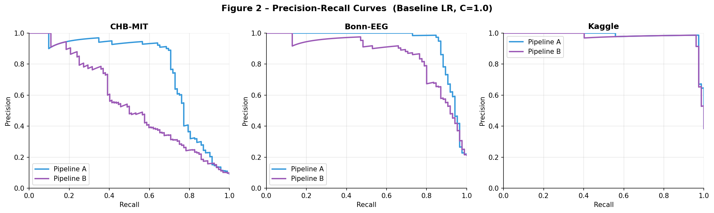
04 – BASELINE RESULTS
Pipeline A vs B — Baseline PR-AUC
CHB-MIT
Bonn-EEG
Kaggle
A: 0.766 B: 0.554
A: 0.937 B: 0.854
A: 0.984 B: 0.977
Pipeline A leads by +0.212
Pipeline A leads by +0.083
Pipeline A leads by +0.007
BASELINE RESULTS
8

Slide 9
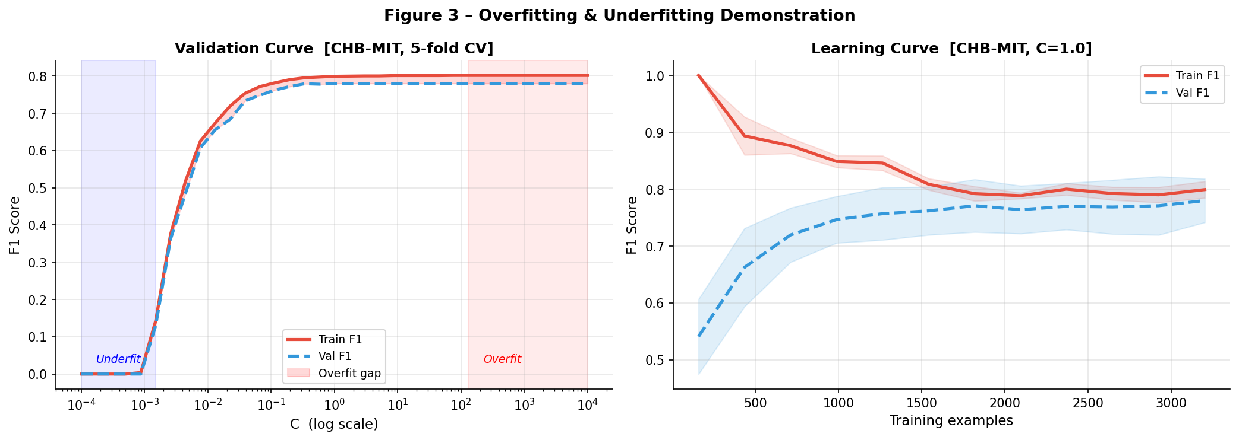
05 – OVER/UNDERFITTING
Demonstrating Bias-Variance Trade-off
Underfitting (C=0.0001)
Balanced (C=1.0)
Overfitting (C=10,000)
F1 = 0.000
All coef → 0
Predicts majority only
F1 = 0.807
Optimal bias-variance
Sweet spot
F1 ≈ 0.815
Train/val gap widens
Excess variance
OVERFITTING & UNDERFITTING
9

Slide 10
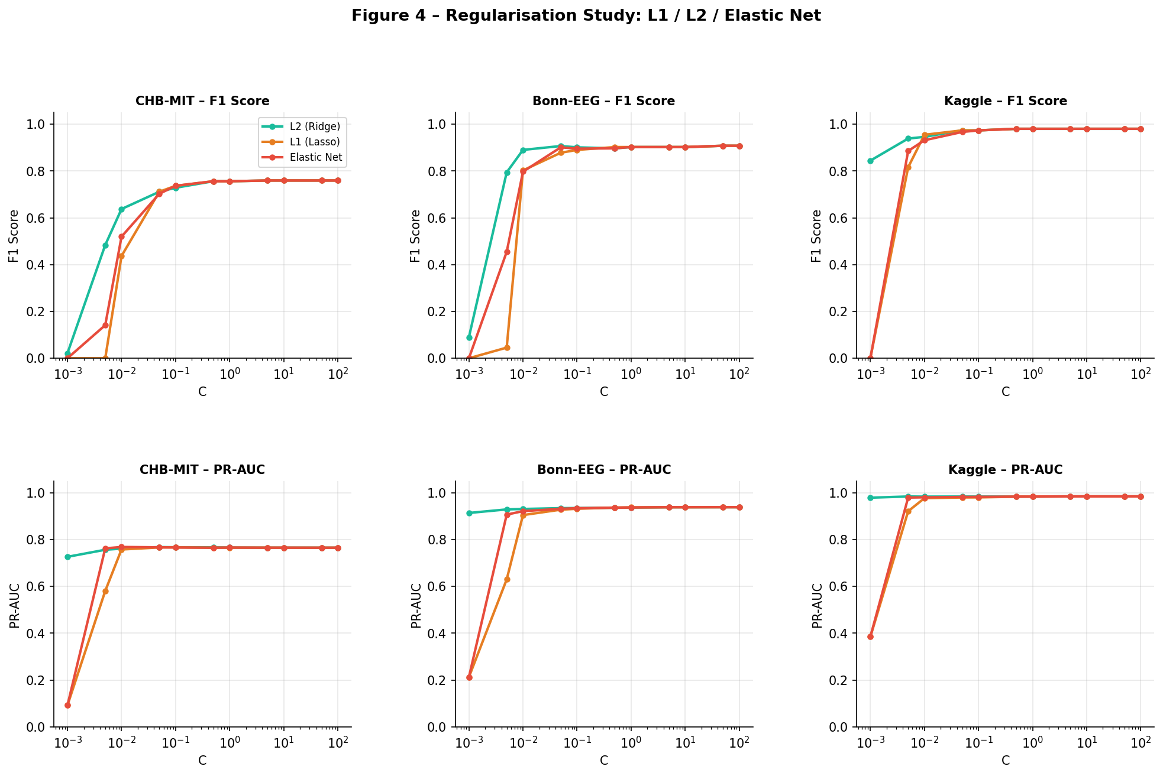
06 – REGULARISATION
L1 / L2 / Elastic Net Study
L2 Ridge
Smooth shrinkage
Best mean PR-AUC
No zeros
L1 Lasso
Sparsity via zeros
Collapses at low C
Weakest overall
Elastic Net
L1 + L2 hybrid
2nd-best stability
Safer default
REGULARISATION STUDY
10

Slide 11
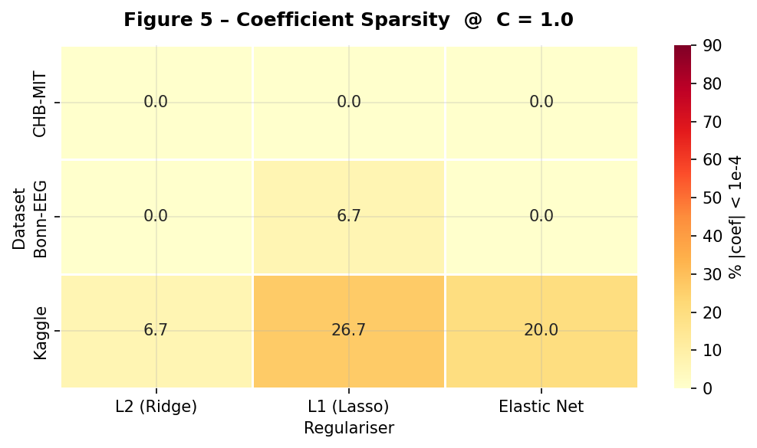
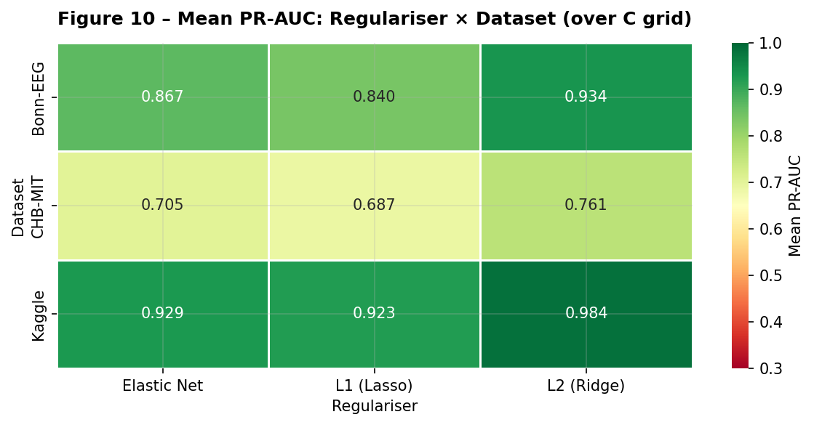
06 – REGULARISATION RESULTS
Sparsity Analysis & Mean PR-AUC
#1
L2 leads mean PR-AUC on ALL 3 datasets across C grid
#2
L1 sparsity peaks at 26.7% (Kaggle) – SelectKBest already pre-filters
#3
L2–L1 gap largest on CHB-MIT: +0.074 PR-AUC
REGULARISATION FINDINGS
11

Slide 12
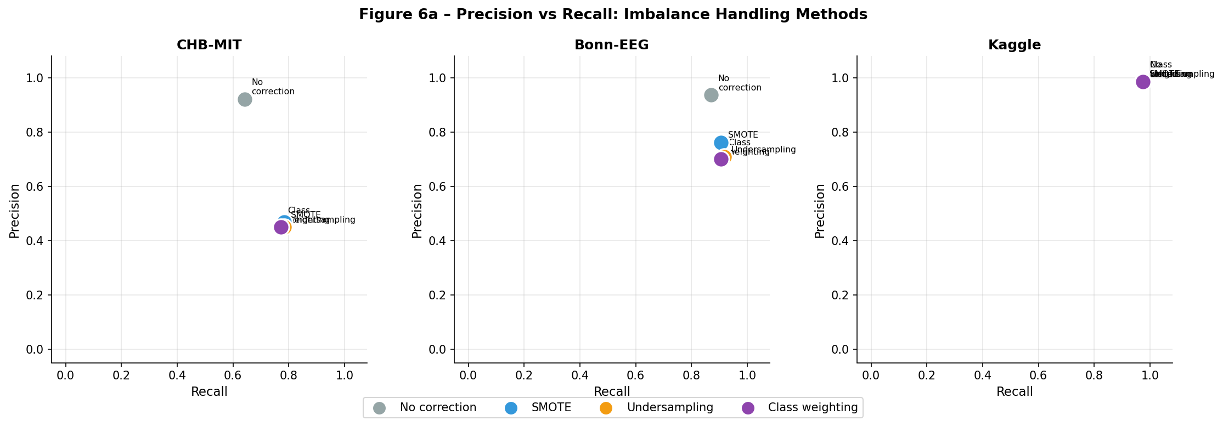
07 – IMBALANCE HANDLING
Class Imbalance: Four Strategies
Method | Precision | Recall | F1 | PR-AUC
No Correction | 0.922 | 0.641 | 0.756 | 0.766
SMOTE | 0.468 | 0.783 | 0.585 | 0.761
Undersampling | 0.450 | 0.783 | 0.571 | 0.758
Class Weighting | 0.449 | 0.772 | 0.568 | 0.767
CHB-MIT (9.2% seizure)
IMBALANCE HANDLING
12

Slide 13
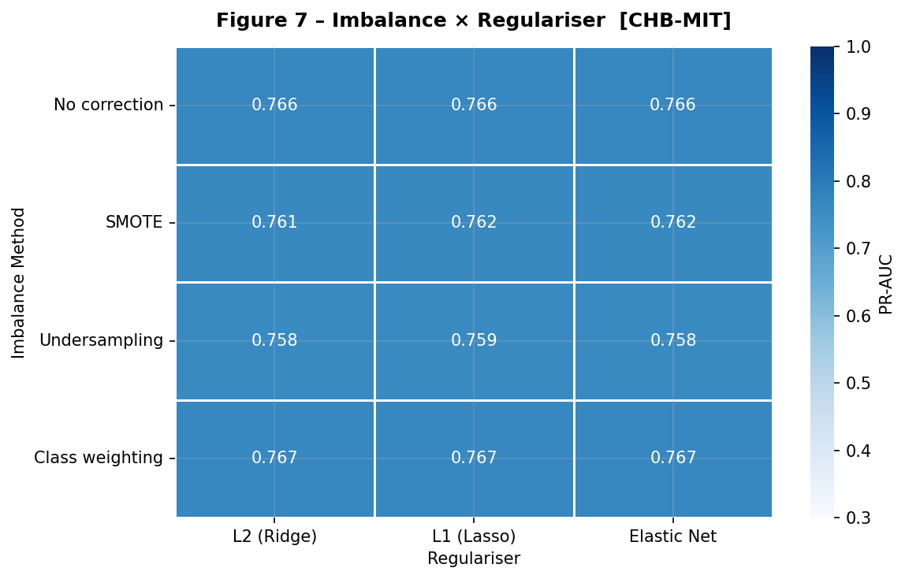
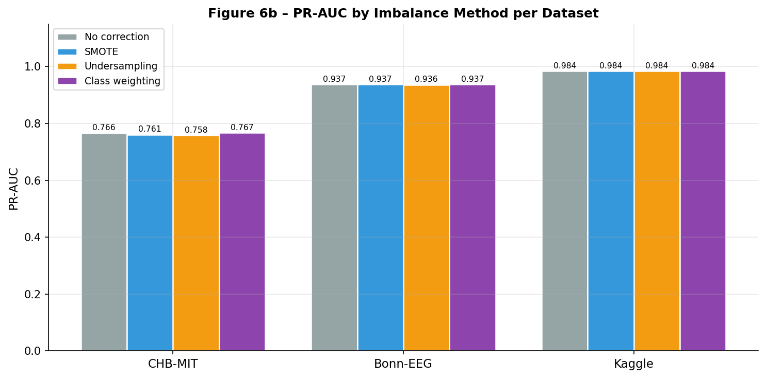
07 – INTERACTION ANALYSIS
Imbalance Method × Regulariser Interaction
★ Class weighting + L2 → best PR-AUC (0.767)
★ SMOTE + L2 close behind (0.761)
Interaction strongest on CHB-MIT (most imbalanced)
Nearly absent on Kaggle (near-balanced)
Any correction ↑ recall vs no correction
INTERACTION ANALYSIS
13

Slide 14
08 – COMPARATIVE ANALYSIS
4 Research Questions — Answered
Q1 Does preprocessing ORDER matter?
Q2 Which regulariser generalises best?
YES — Pipeline A beats B on all datasets.
+0.213 PR-AUC on CHB-MIT (most imbalanced).
Normalise before ANOVA-F to avoid scale bias.
L2 (Ridge) achieves highest mean PR-AUC
across the full C grid on all 3 datasets.
Smooth quadratic penalty avoids abrupt collapse.
Q3 Does Elastic Net outperform L1/L2?
Q4 Imbalance × regulariser interaction?
EN outperforms L1 in all cases.
EN does NOT outperform L2 here — SelectKBest
pre-applies sparsity, making L2 sufficient.
Interaction strongest on CHB-MIT (9.2%).
Class weighting + L2 → best PR-AUC.
Correction shifts precision-recall trade-off.
COMPARATIVE ANALYSIS
14

Slide 15
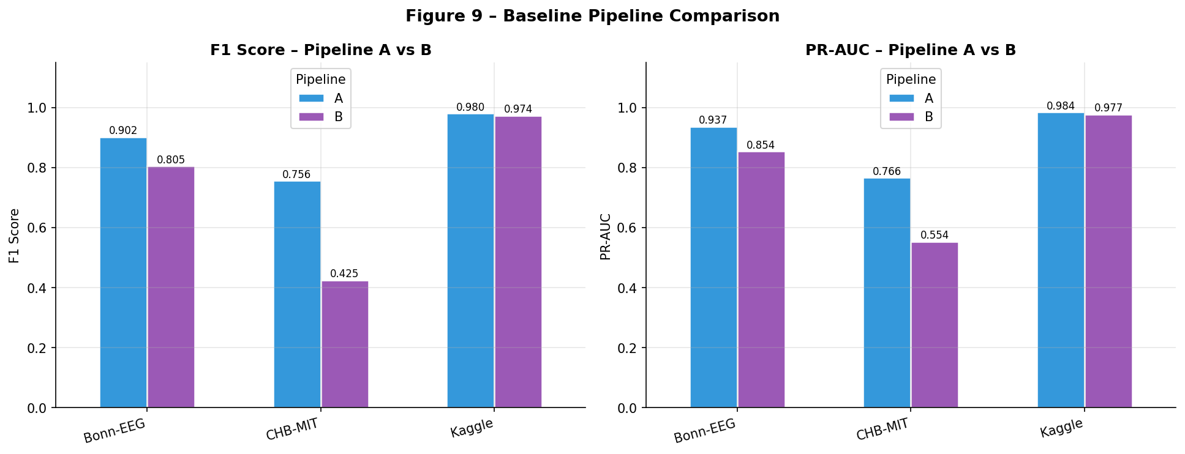
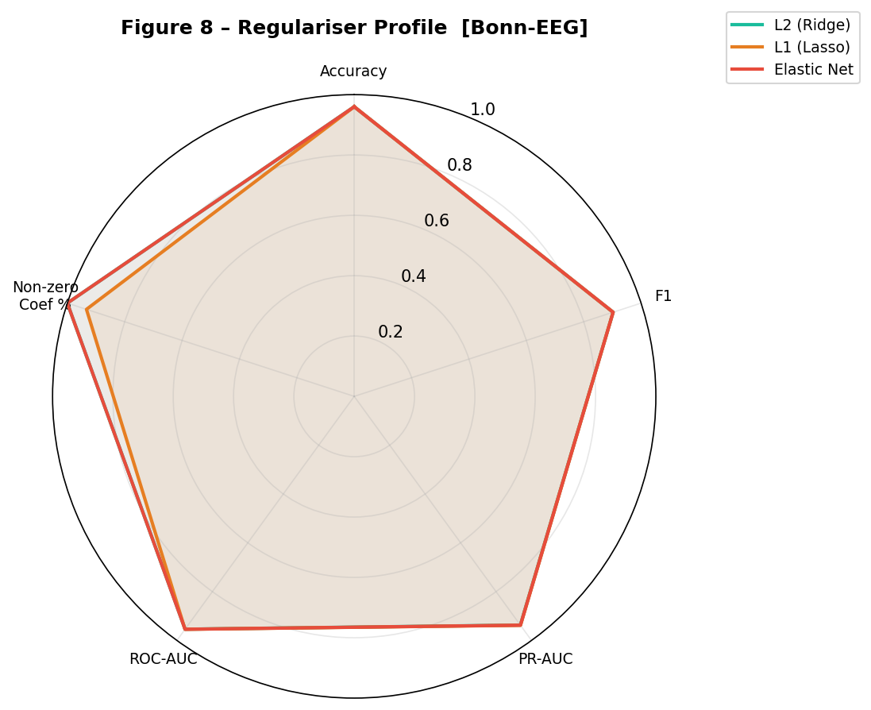
08 – SUMMARY
Overall Performance Summary
0.766
0.937
+0.213
0.767
CHB-MIT PR-AUC
Pipeline A, L2
Bonn PR-AUC
Pipeline A, L2
PR-AUC gain
A vs B on CHB-MIT
Best PR-AUC
Weighting + L2
SUMMARY
15

Slide 16

KEY CONCLUSIONS
Three Principal Contributions
① Preprocessing ORDER is not stylistic
StandardScaler → SelectKBest yields +0.213 PR-AUC on CHB-MIT vs PCA pipeline.
Normalise BEFORE feature ranking to ensure scale-invariant ANOVA-F scoring.
② L2 leads; Elastic Net is the safe default
L2 achieves best mean PR-AUC when upstream feature selection is applied.
Elastic Net outperforms L1 in all settings and is recommended without SelectKBest.
③ PR-AUC is the right metric
Imbalance correction shifts precision-recall operating point — not PR-AUC.
Use PR-AUC (not F1 or accuracy) as the primary selection criterion for clinical tasks.
Future Work: Extend to SVM / Gradient Boosting and cross-patient generalisation scenarios.
16

