Slide 1

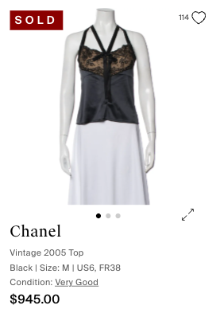
The RealReal — Item Attribute Enrichment Taxon: Ready-to-Wear
Aesthetic
Romantic, Classic, Feminine
Colorway
Black with nude/tan lace backing
Occasion
Evening Wear, Date Night, Party
Target Customer
Women seeking elegant, feminine evening wear.
Body Shape Suitability
Best suited for: Hourglass, Inverted Triangle, or Athletic body types.
This piece beautifully highlights the shoulders and helps define the waist line.
Chanel Vintage Top
Very Good Condition • $945.00

Slide 2




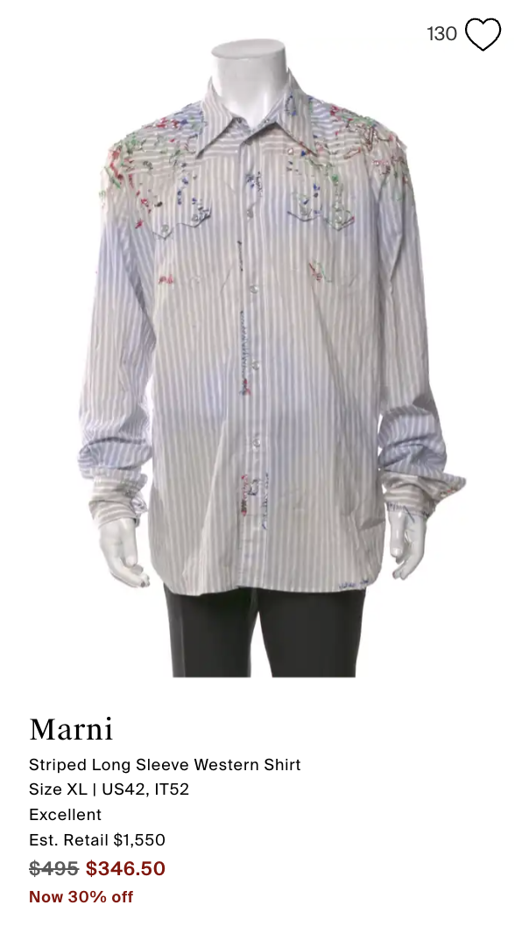

THE REALREAL|ITEM ATTRIBUTE ENRICHMENTTAXON: READY-TO-WEAR
Aesthetic
Streetwear; luxury; modern; casual
Colorway
White and blue striped with multi-color paint splatters
Occasion
Casual, Everyday Wear, Streetwear, Resort
Target Customer
Fashion-forward men, luxury streetwear enthusiasts
Body Shape Suitability
Best suited for: This relaxed-fit short-sleeved shirt is versatile and can suit various body types, offering a comfortable and stylish silhouette. Its straight cut allows for ease of movement and a casual drape, making it suitable for most proportions.
Marni Striped Shirt
EXCELLENT CONDITION • $346.00

