Slide 1
Global Terrorism Data
Data Description:
Terrorism Data from 2000 to 2017
Main Columns: Year, Country, Region, City, Group, Attack Type, Killed, Wounded, Summary
Data is somewhat hierarchical
Year > Country > Group > Attack Type > Casualties > City > Summary

Slide 2
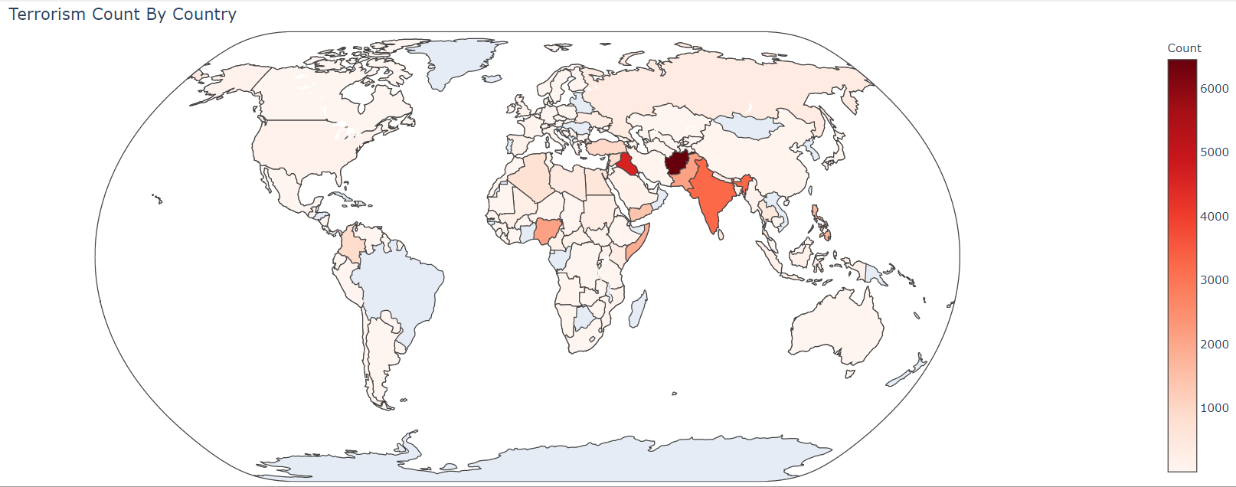
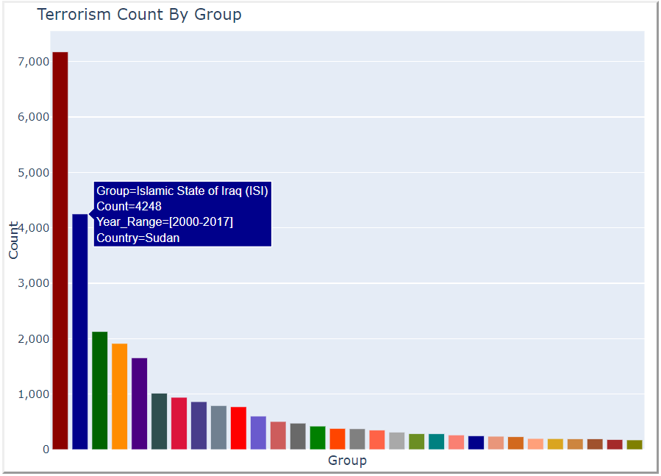
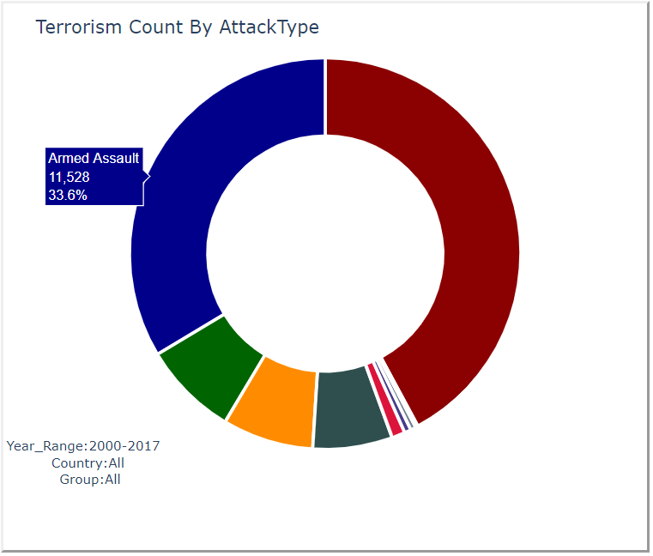
Representation Choice
Choropleth map
The boundaries between countries are well defined allowing the audience to distinguish the countries clearly
The color bar (with color gradient) besides the map shows the frequency of terrorism attacks
Bar Chart
Simple yet effective way to sort the group with the highest terrorist attacks using a bar char compared to other charts e.g. bubble chart
Exploded Donut Chart
We are analyzing one dimension (Attack Type) for 1 specific terrorist group
The donut chart is elegant and conveys a lot of information at first sight e.g. the proportions of each Attack Type is visible right away when you look at the chart.
the colors show the different categories of Attack Types employed.
Notes:
Representation is a formal system or mapping by which the information can be specified

Slide 3
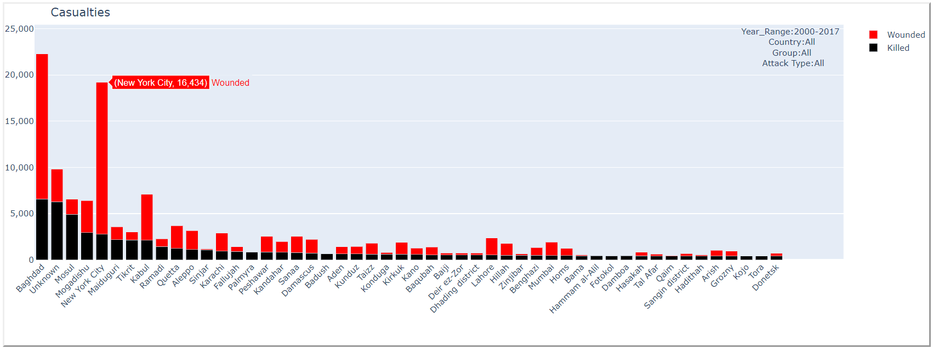
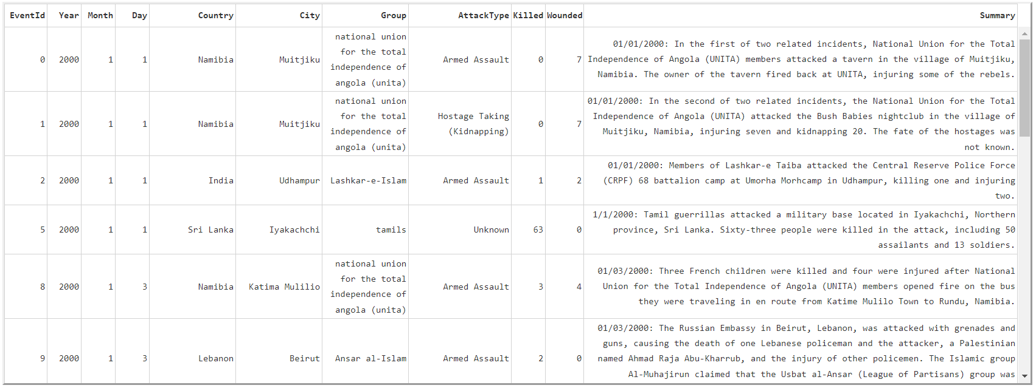
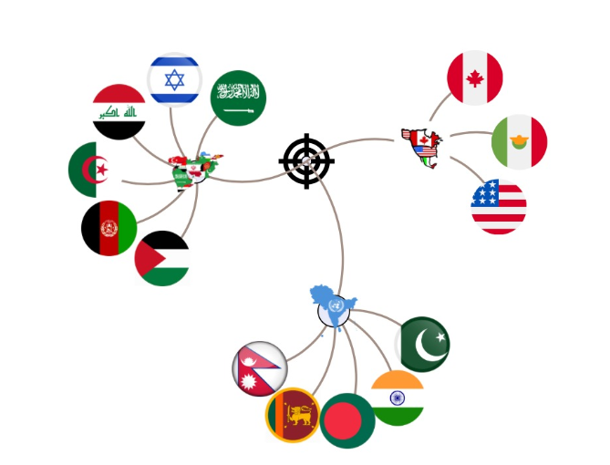
Representation Choice (continued)
Stacked Bar Chart
We have multiple measures (Killed and Wounded Counts) and a single dimension (City) and the stacked bar chart can gracefully represent this information.
Data Table
Since we have textual information about the summary of most terrorism attacks, we wanted to expose this information to the audience because this the deepest and most detailed information present in our entire dataset.
Forced Layout
It does fulfill our need to display all the data in our subset on a single visualization
The forced layout is flexible in terms of restricting the amount information on the screen. All the data could be confined under 1 single node.
a very powerful visualization tool for analyzing hierarchical data.

Slide 4
Presentation Choice
Full Screen Use
We have used the entire screen to minimize vacant spaces
Scrolling
Since all this information could not be confined in one single page, we have enabled the scrolling capability to move from one level to the next and to navigate vertically on the page.
Organizing Data Components on Screen
The charts have been arranged in a hierarchical manner where Year is at the top of the screen (top level in the hierarchy) while Summary (lowest level in hierarchy) is at the bottom of the page.
Year > Country > Group > Attack Type > City > Summary
Flow Indicator
The data flow is indicated by red arrows having specific directions on the screen. It provides a path to navigate from one chart to the other on the screen.

Slide 5
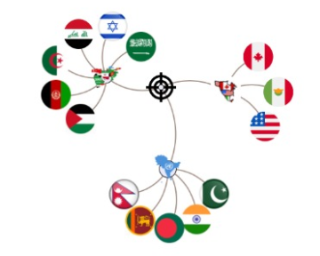
Presentation Choice (continued)
Data Point Selection Indicator
On every click or selection made on the map or charts, the selected data is displayed on the screen to indicate the user that a selection has been made. This is more of a user experience benefit but is helpful in the drilldown process.
Chart Size
The Choropleth Map and Stacked Bar Chart are wider (occupy the full width of the screen) because these charts enable more interactivity than others. For example, the Choropleth Map provides zoom in, zoom out, mouse move for rotation, hover capabilities over the world map which occupies quite a large space on the screen.
Use of Icons in D3 Force Layout
We have used icons to represent the data attributes in the forced layout which attracts user attention and is more visually appealing. For example, using the flag to represent a Country is more informative than just the text.

Slide 6
Interaction Choice
Range Slider
We have used a horizontal range slider to select Year Range
We can easily see the minimum and the maximum year values right away while at the same time one can view the selected year range.
Onclick Events on Maps and Charts
This technique of dynamic filtering would not be possible with other types of interactions.
Map Zoom In Zoom Out, Rotate, Double Click, Hover
It allows zooming in and zooming out to explore specific regions in the world map.
The map can be rotated horizontally to view the globe from different sides. Double clicking on a specific Country enables zooming on that Country.
Hovering over a Country displays the Country Name, Count of Terrorist Attacks on the Country, the selected Year Range from the range slider and the Country Code.
Notes:
if you click on any Country on the map, the OnClick event will trigger a callback function in Python to filter the data based on the selected Country and render the next chart (follow the arrow) with the filtered information.

Slide 7
Interaction Choice (continued)
Hover Over data Points
Hovering on any chart data point will show data from the previous selections as well as the current selection on that chart.
Forced Layout – Expand Collapse, Hover, Drag and Drop
expand and collapse functionality controls the amount of information displayed on the screen.
Hovering over a specific icon, enlarges the icon to show it has been selected and it also displays the data value of that icon.
The data points could also be moved to isolate an individual data point from the rest.
Filter Legend on Stacked Bar Chart
The stacked bar chart could also filter the chart based on the selected measures in the legend. For example, if you unselect ‘Wounded’ on the legend it will display only the Killed Counts by City instead of the Stacked Bar Chart with both Killed and Wounded Counts by City.
Area Selection For Zoom
By selecting an area on the chart (i.e. selecting multiple bars at once) will allow further drill down to those specific bars. Double-clicking on any area on the chart will revert to the original unselected state.

Slide 8
Bertin’s Visual Variable
Position
We arranged the forced layout source node in the center of the visualization area to allow uniform spread of the data points all around the source node.
Data points are floating making it easy to isolate a specific data point on the screen
The map and charts have been positioned in an orderly way to follow the hierarchical structure
Size:
The map provides more interactions and more information to display. Hence it is bigger in size.
Size of icons becomes bigger on hover event showing it has been selected
Color:
We used mostly darker colors based on the Terrorism theme
Map – Color Scale used: Reds (Lighter red means less terrorism activity while darker means more Terrorist Attacks)
Stacked Bar chart – Black for Killed and Red for Wounded
Value:
All the measures (Terrorist Count, Number of people Killed/) in this project take whole numbers so, we made the axes take whole numbers only
Orientation:
The x-labels on the stacked bar chart have been angled at -45 degrees to able to read the cities easily.

Slide 9
Characterizing data
Data characteristics
Interval - Year
Categorical – Country, Groups, Attack Type, City
Ratio – Count of People killed, Count of People Wounded, Count of Terrorism attacks
Hierarchy
dataset has a hierarchical structure which has been used consistently in this project
Network – forced Layout
The entire data subset could be represented with the forced layout network structure
Hierarchy-based
2D Maps
Choropleth Map provided a 2 dimensional space to analyzing terrorism count by country
Temporal Nature of Data
We analyzed the terrorism data by year – could also have used Month and Date for more granular analysis

Slide 10
Discovering Data Tasks
Using traditional data needs
Looking at yearly trends in terrorism activity
Comparing – terrorism activity v/s countries, attack types v/s groups
Grouping by region
Schneiderman's Mantra
Overview – looking at the big picture of the dataset (Forced Layout)
Selection/Filter – the drilldown section makes full use of selection and Filter
Details on demand – OnClick Events on All charts provide more details
Revealing What is in the data
Exploring how each measure varies with the dimension changes
Exposing hidden trends – movement of groups within a country

Slide 11
Ideation
Initial design
20 Conceptually different Charts/Plots
Elaborate → Reduce → Repeat
Choose 10 best designs that fits the purpose/needs for the project
Refine
Choose top 4 or 3 for the final design

Slide 12
self-reflection, peer evaluation and experimenter evaluation
Self Reflection
to show everything on 1 screen without compromising the size of the visualizations
To encode the data in such a way that is not offensive to anyone
Peer Evaluation
Asked classmates opinions of our choices on color tones, icons and placements
Experimenter Evaluation
You had a look at our design and provided some feedbacks which were implemented
Add Directional arrow to show where to go next
Add annotations (text area to show selected data points)

Slide 13
Different Layout approaches
3 Different approaches – Good
Using Pie Chart instead of Donut Chart
Bubble Map for Analyzing Terrorism Count By Country
Interactive Sunburst instead of Forced Layout
3 Different approaches – problematic
Using a Stacked Bar Chart instead of Donut chart (Representing 2 dimensions is not efficient with stacked bar chart)
Replacing Choropleth Map by scatter plot (we‘ll Lose the geographical positioning of countries)
Using a tree map instead of Forced Layout – (Tree maps are quite confusing to read especially when we have many dimensions)

Slide 14
Cognitive and Perceptual factors
Color blindness
we tried to use colors combinations that would not affect people who are color blind e.g. Light Green and Yellow, Blue and Gray
In both the bar chart and the donut chart the data points are separated by different colors
Factors you read very quickly and factors that take longer (require scanning)
Choosing the cities on the stacked bar chart takes longer then choosing attack type (donut chart)
Color models
We used the Reds Color Scale to denote the frequency of Terrorism attacks

