Slide 1
A Literature Review on Image Steganography
Presented By
Minakshi Sarkar
Enrollment No- 2022ITP002,3rd August,2023
Research Scholar, IT Dept.
IIEST, Shibpur
Supervisors:
Dr. Indrajit Banerjee, Associate Prof. of IT Dept.(IIEST, Shibpur)
Dr. Tarun Kr. Ghosh, Professor and Head of the Dept. of CSE-AIML (HIT, Haldia)

Slide 2
Contents
Introduction
Objective
Introduction to GAN
Studied so far
Conclusion and Future scope
References

Slide 3
Introduction
With the digitalization of information, a lot of multimedia data are under attack, information security has become a key issue of public concern .
Image steganography, aiming at using cover images to convey secret information has become one of the most challenge and important subjects in the field of information security recently.
3 types of Steganography:
1. Traditional Steganography
2. CNN based Steganography
3. GAN based Steganography

Slide 4
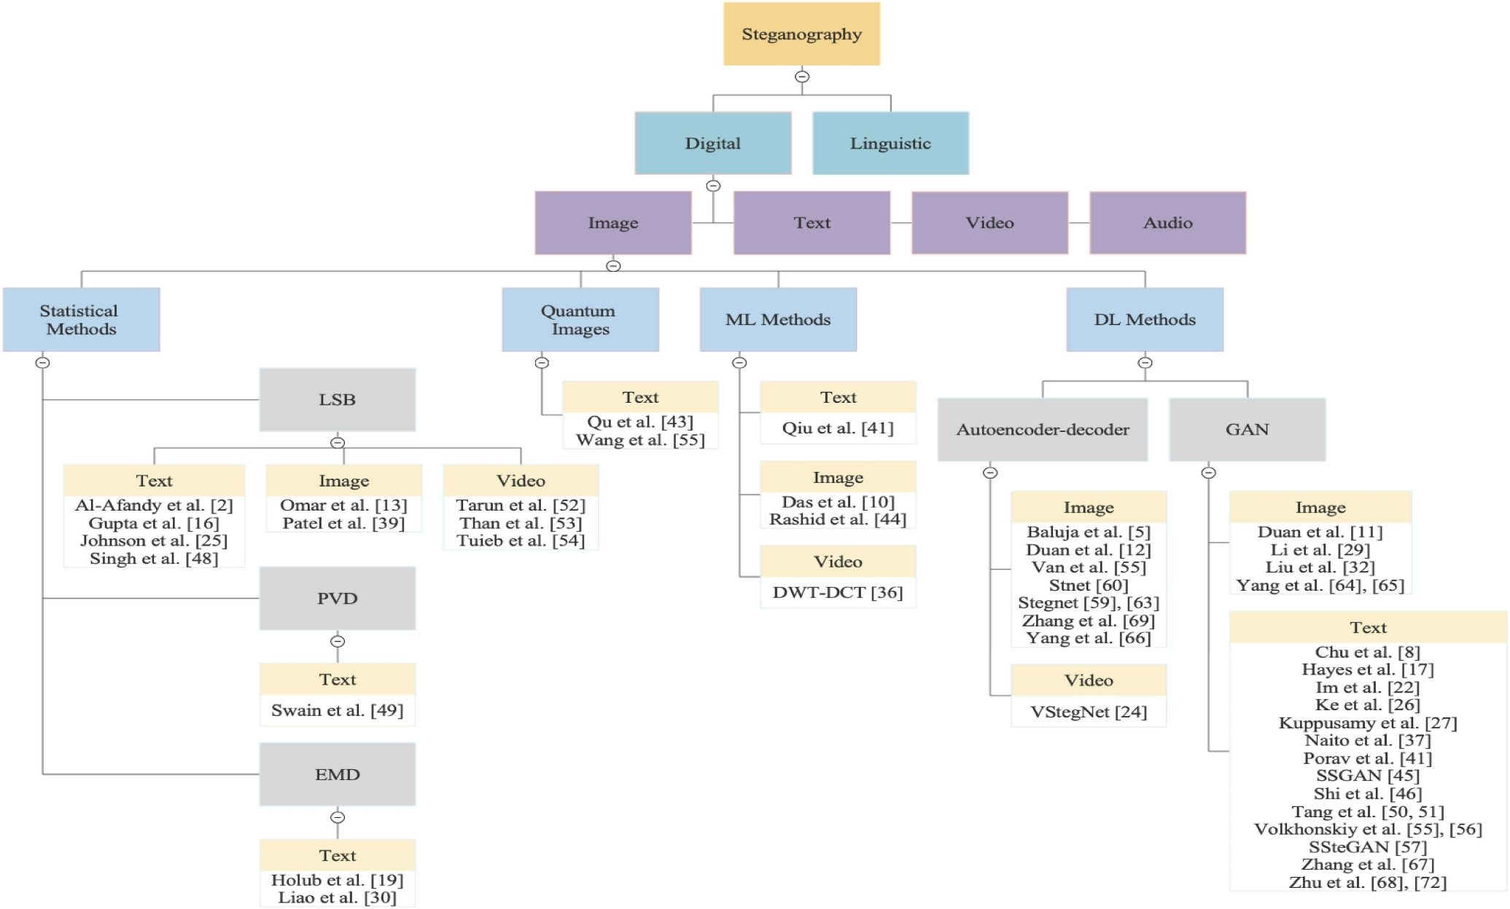
Introduction

Slide 5
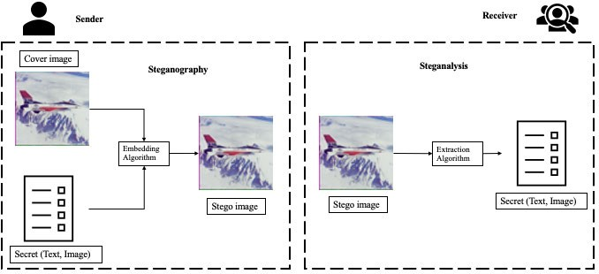
Introduction
Steganographic system consists of two essential components:
Embedding and Extraction algorithms.
FIGURE 1. General working principle of steganography and steganalysis.

Slide 6
Objectives
1. Our main purpose is to make a lot of unique and natural looking images, we can use GAN.
2. We need to make sure about the secure communication and for adapting to the covert communication and privacy preserving of the information by improving anti detection rate of generating stego-images.
3.GAN can improve the performance of the traditional steganography.
4. This approach(GAN) may allow for generating more steganalysis-secure cover that can carry messages using standard steganography algorithms such as LSB .

Slide 7
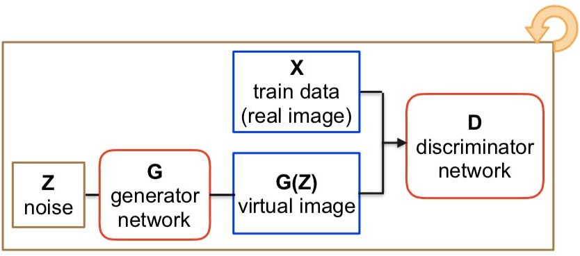
Introduction to GAN
GAN-based steganography methods :
Generative Adversarial Networks are a type of deep CNNs introduced by Goodfellow et al. [1] in 2014.
GAN has Two networks – generator and discriminator they compete against each other to generate a perfect image in GAN architecture.
FIGURE 2. Flow chart of GAN

Slide 8
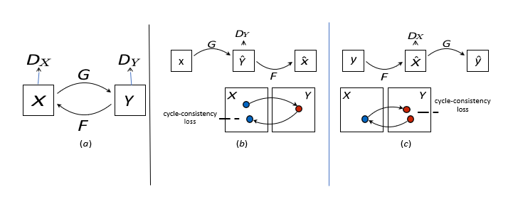
Introduction to GAN
Structure of Cycle GAN:
FIGURE 3: (a) G : X → Y and F : Y → X
(b) forward cycle-consistency loss: x → G(x) → F (G(x)) ≈ x and
(c) backward cycle-consistency loss: y → F (y) → G(F (y)) ≈ y

Slide 9
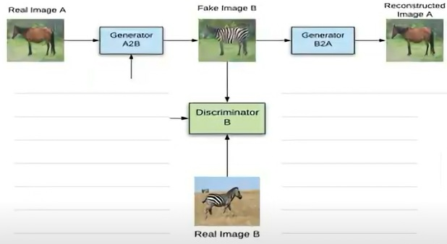
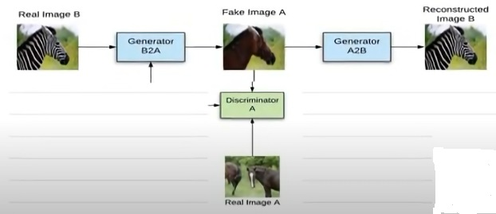
Introduction to GAN
FIGURE 5: (a) forward cycle-consistency loss: Pictorial representation
(b) backward cycle-consistency loss: Pictorial representation

Slide 10
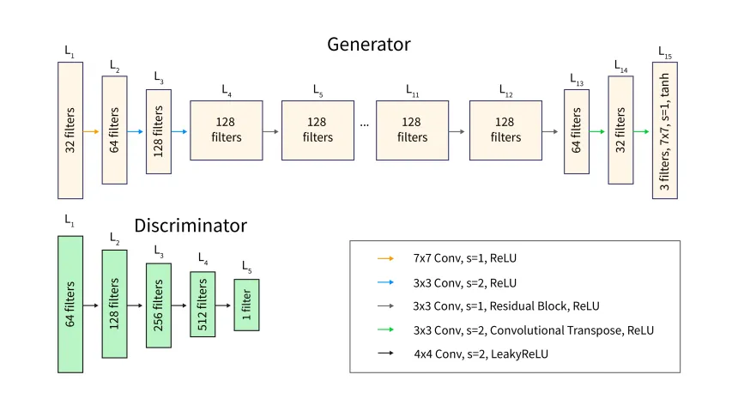
Introduction to CycleGAN

Slide 11
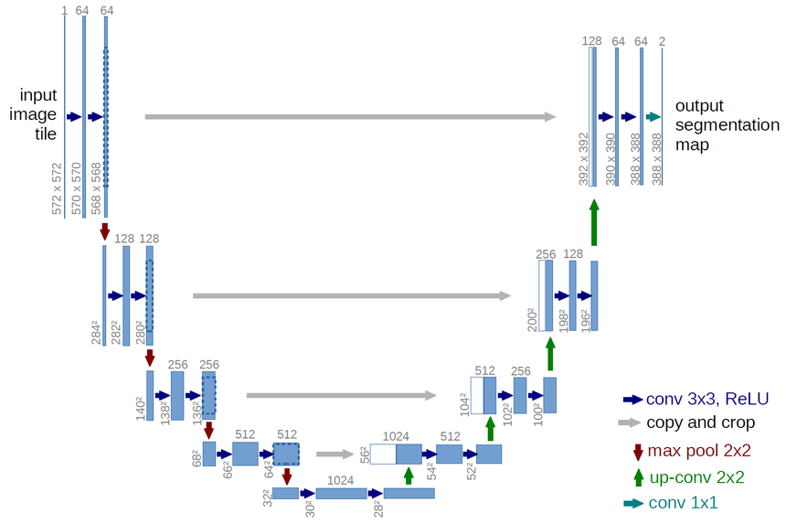
Introduction to ResUNET-CycleGAN
Structure of ResUNET-CycleGAN: Generator
Residual
ResUNET Generator with Cycle Consistency Loss
Residual Connection with Skip-connection
Preserves more information to generate better quality output.

Slide 12
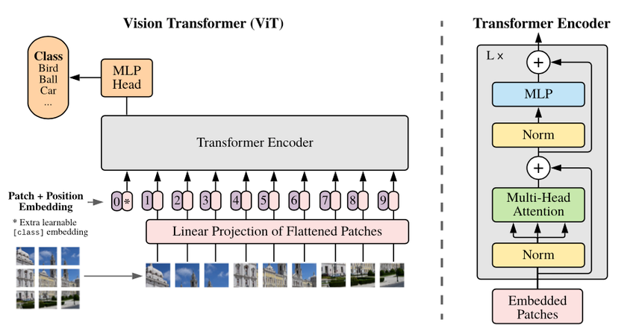
Introduction to ResUNET-CycleGAN
Structure of ResUNET-Cycle GAN with ViT : Discriminator
ViT is robust Discriminator with Multi-Head Attention
ViT will push Generator to generate better quality image to fool.

Slide 13
Performance of Studied Architectures
Horse2Zebra (Last 5 Epochs of 20) |  | Mean | Median | STD
CycleGAN | Generator Loss | 3.81 | 3.74 | 0.28
ResUNET-CycleGAN | Generator Loss | 2.86 | 2.76 | 0.36
ResUNET-CycleGAN with ViT | Generator Loss | 2.11 | 2.27 | 0.17

Slide 14
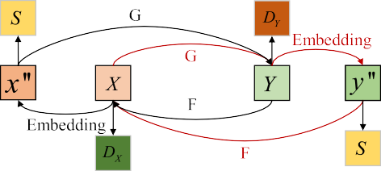
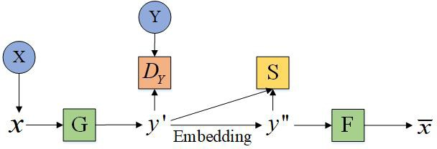
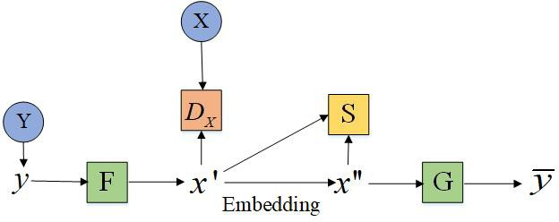
Introduction to GAN
Structure of S-Cycle GAN:
(a)
(b)
FIGURE 6.(a) is the transformation and steganography process from X domain to Y domain
(b) is the transformation and steganography process from Y domain to X domain.

Slide 15
Conclusion and future scope
Besides, the introduction of GANs into the research ideas of information hiding will also have a significant impact on the development of other information hiding technologies, such as digital watermarking technology.
ResUNET-CycleGAN with ViT approach can be further extended by incorporating with the S-CycleGAN approach.
In conclusion, for the long term development of image steganography, using State Of The Art GAN Architectures to enhance the abilities of steganographer to design a more safety and efficiency methods is a question worth studying.

Slide 16
References
1. Goodfellow, J. Pouget-Abadie, M. Mirza, B. Xu, D. Warde-Farley,
S. Ozair, A. Courville, and Y. Bengio, ‘‘Generative adversarial nets,’’ in
Proc. Adv. Neural Inf. Process. Syst., 2014, pp. 2672–2680.
2. K. A. Al-Afandy, O. S. Faragallah, A. Elmhalawy, E.-S.-M. El-Rabaie, and
G. M. El-Banby, ``High security data hiding using image cropping and LSB
least signicant bit steganography,'' in Proc. 4th IEEE Int. Colloq. Inf. Sci.
Technol. (CiSt), Oct. 2016, pp. 400-404.
3. S. Dhawan and R. Gupta, “High-quality steganography scheme using hybrid edge detector and Vernam algorithm based on hybrid fuzzy neural network,” Concurr. Comput. Pract. Exp., vol. 33, no. 24, p. e6448, Dec. 2021, doi: 10.1002/CPE.6448.
4. A. Pradhan, K. R. Sekhar, and G. Swain, “Digital Image Steganography Using LSB Substitution, PVD, and EMD,” Math. Probl. Eng., vol. 2018, 2018, doi: 10.1155/2018/1804953.

Slide 17
References
5. M.-m. Liu, M.-q. Zhang, J. Liu, Y.-n. Zhang, and Y. Ke, ‘‘Coverless information hiding based on generative adversarial networks,’’ 2017, arXiv:1712.06951. [Online]. Available: http://arxiv.org/abs/1712.06951.
6. Y. Ke, M. Zhang, J. Liu, T. Su, and X. Yang, ‘‘Generative steganography with Kerckhoffs’ principle,’’ Multimedia Tools Appl., vol. 78, no. 10, pp. 13805–13818, 2019.
7. Z. Zhang, J. Liu, Y. Ke, Y. Lei, J. Li, M. Zhang, and X. Yang, ‘‘Generative steganography by sampling,’’ IEEE Access, vol. 7, pp. 118586–118597, 2019.
8. H. Shi, J. Dong, W. Wang, Y. Qian, and X. Zhang, ‘‘SSGAN: Secure steganography based on generative adversarial networks,’’ 2018, arXiv:1707.01613. [Online]. Available: http://arxiv.org/abs/1707.01613
9. Yang, K. Chen, W. Zhang, and N. Yu, ``Provably secure generative
steganography based on autoregressive model,'' in Proc. Int. Workshop
Digit. Watermarking. Cham, Switzerland: Springer, 2018, pp. 5568.
10. X. Duan, K. Jia, B. Li, D. Guo, E. Zhang, and C. Qin, ``Reversible image
steganography scheme based on a U-Net structure,'' IEEE Access, vol. 7,
pp. 93149323, 2019.

Slide 18
References
11. T. P.Van, T. H. Dinh, and T. M. Thanh, ``Simultaneous convolutional neural network for highly efficient image steganography,'' in Proc. 19th Int. Symp. Commun. Inf. Technol. (ISCIT), Sep. 2019, pp. 410415.
12. D.Volkhonskiy, I. Nazarov, and E. Burnaev, ``Steganographic generative adversarial networks,'' in Proc. 12th Int. Conf. Mach. Vis. (ICMV), vol. 11433, 2020, Art. no. 114333M.
13. H. Shi, X.-Y. Zhang, S. Wang, G. Fu, and J. Tang, ``Synchronized detection and recovery of steganographic messages with adversarial learning,‘’ in Proc. Int. Conf. Comput. Sci. Cham, Switzerland: Springer, 2019, pp. 3143.
14. C. Chu, A. Zhmoginov, and M. Sandler, ``CycleGAN, a master of steganography,‘’ 2017, arXiv:1712.02950. [Online]. Available :http://arxiv.org/ abs/1712.02950.

Slide 19
References
15. W. Tang, S. Tan, B. Li, and J. Huang, ``Automatic steganographic distortion learning using a generative adversarial network,'' IEEE Signal Process. Lett., vol. 24, no. 10, pp. 15471551, Oct. 2017.
16. Meng, Ruohan, Qi Cui, Zhili Zhou, Zhangjie Fu, and Xingming Sun. "A steganography algorithm based on CycleGAN for covert communication in the Internet of Things." IEEE Access 7 (2019): 90574-90584.

Slide 20
Thank you

