Slide 1

World Happiness
University Of Toronto Bootcamp
By:
Shariq Khatri, Anwer Dolemeri, Jennifer Manchero,
Deniza Robinson

Slide 2

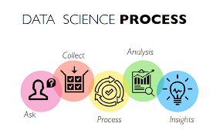
Project Overview
Conduct detailed analysis of the World Happiness Report 2024.
Happiness is a pillar of good mental health and it should be something we should strive for in ourselves and others.
More and more people have come to believe that our success as countries should be judged by the happiness of our people.

Slide 3

World Happiness Report
The World Happiness Report is a partnership of Gallup, the Oxford Wellbeing Research Centre, the UN Sustainable Development Solutions Network, and the WHR’s Editorial Board.
Reviews the state of happiness in the world today and shows how the science of happiness explains personal and national variations in happiness.
Uses observed data on the six variables and estimates of their associations with life evaluations to explain the variation across countries. They include GDP per capita, social support, healthy life expectancy, freedom, generosity, and corruption.

Slide 4
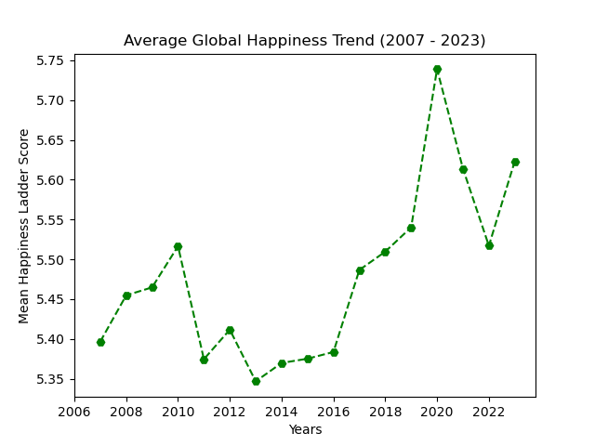
Ask: What is causing the variance in trendline?
Insight:
The recession is often considered to have started in late 2007. The global economy contracted, and GDP growth slowed significantly in many countries.
Recovery began in 2009-2010, aided by fiscal stimulus and monetary easing. However, the pace of recovery varied by country.
Decline in 2020 can be explained by COVID.

Slide 5
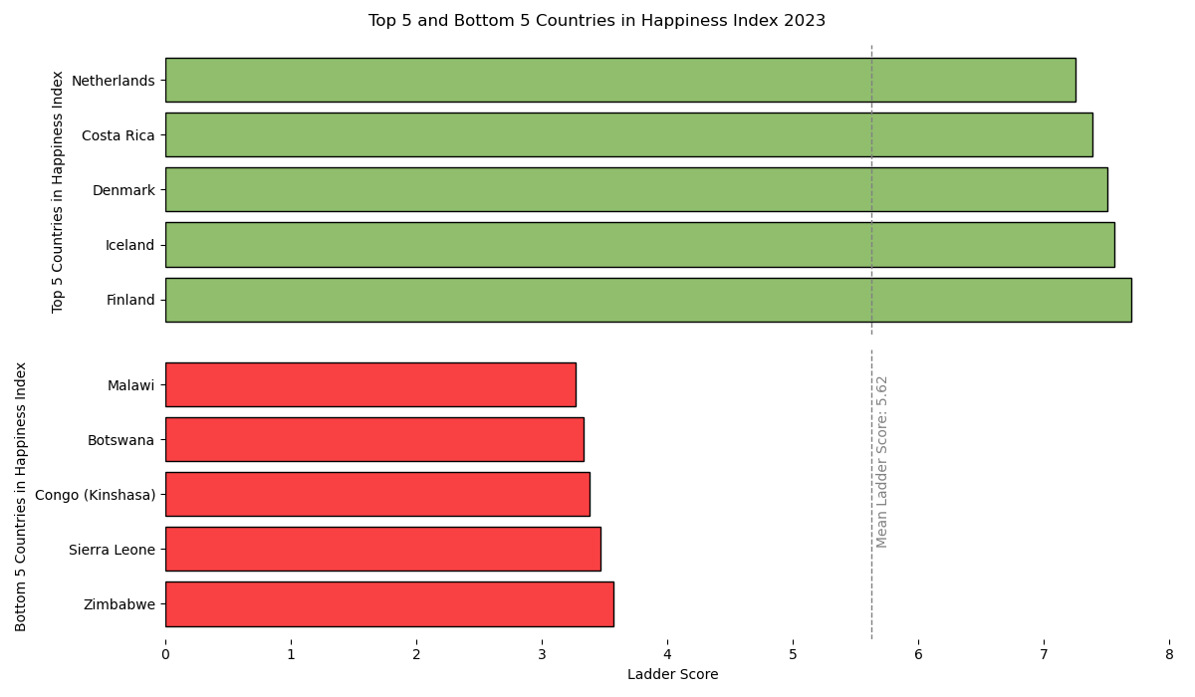
Ask: What are some potential contributions to the stark difference between those countries score?
Insight:
Top 5
Economic Stability
Social Welfare/Public Services
High Trust and cohesion
Bottom 5:
Economic Challenges
Political instability
Limited public services

Slide 6
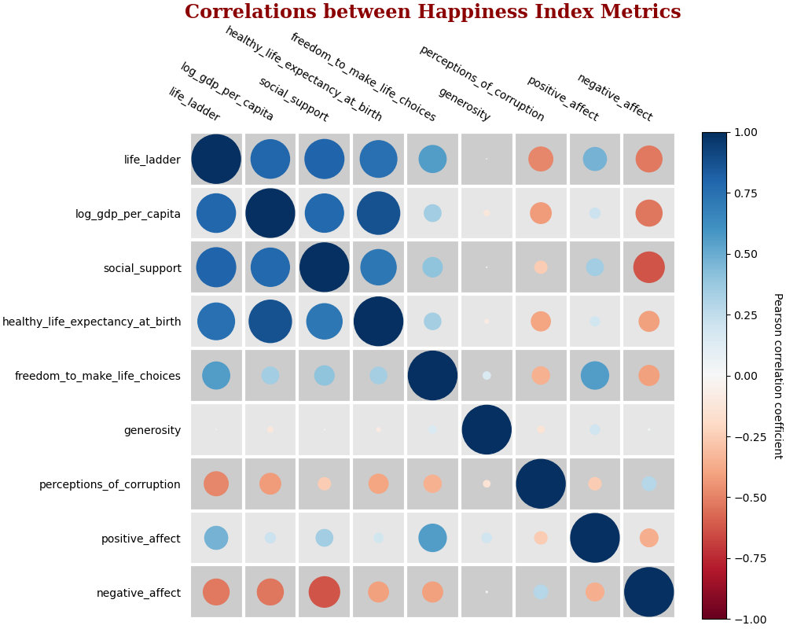
Correlation Between Happiness Metrics

Slide 7
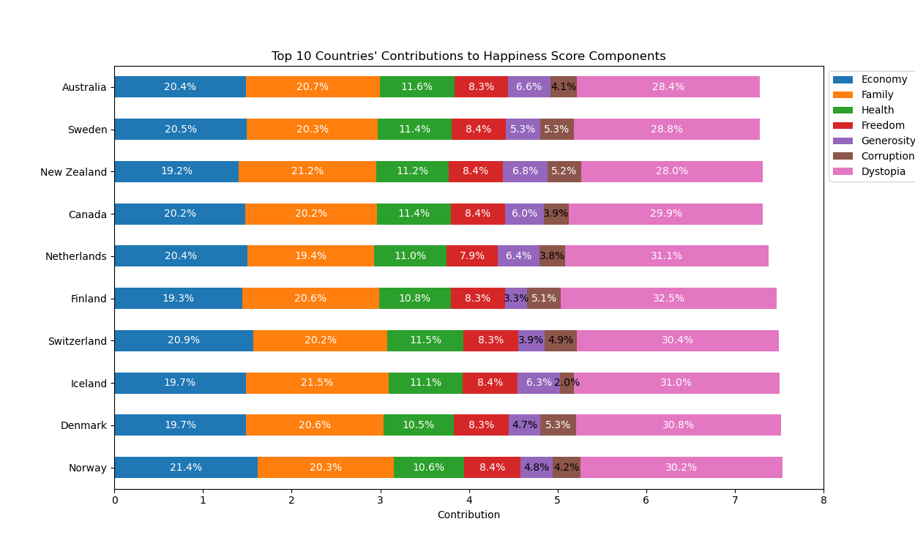
Happiness Score Components
The stacked bar chart will display the overall happiness score, with each bar segmented into seven components: Economy, Family, Health, Freedom, Generosity, Corruption, and Dystopia.
Each category will be represented by a different color, with a corresponding legend to ensure clarity.
The percentage contribution of each component is clearly labeled within its respective section, allowing for easy comparison.
This visualization allows for an easy comparison of how each factor contributes to the overall happiness score of the top 10 countries.

Slide 8
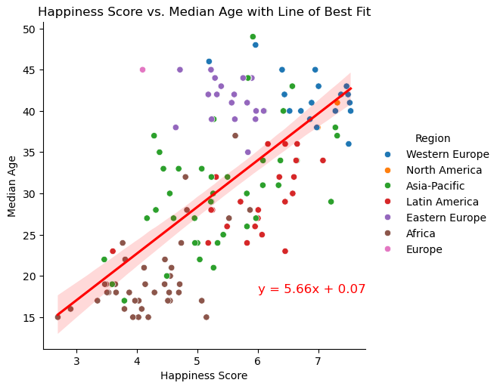
Happiness Score vs Median age
A grid of scatterplots for 2023 visualizes the relationship between 'Happiness Score' and 'Median Age,' with points color-coded by region to highlight regional differences.
The scatterplots reveal whether countries with higher median ages tend to have higher or lower happiness scores, and whether these patterns vary across regions.
A regression line is included to show the overall trend in the data, providing insights into how age influences happiness globally.

Slide 9
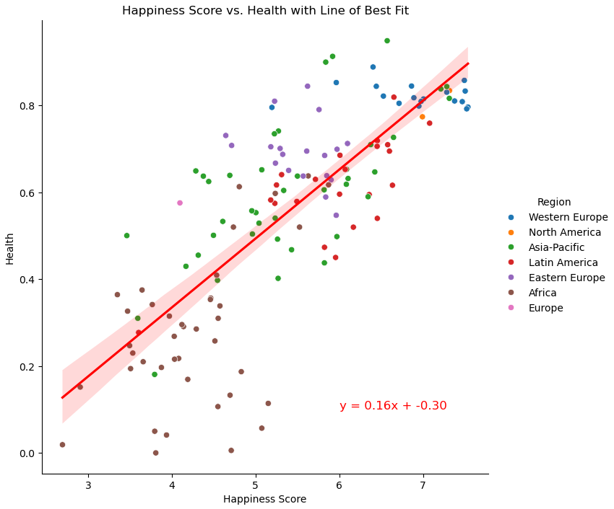
Happiness score vs health
A grid of scatterplots for 2023 illustrates the relationship between 'Happiness Score' and 'Health,' with each point representing a country.
The scatterplots are color-coded by region, allowing for clear differentiation between different parts of the world.
A line of best fit is included in each plot to highlight the overall trend, making it easier to see how health impacts happiness across various regions.
This visualization provides a comprehensive view of the connection between health and happiness, with regional distinctions clearly emphasized.

Slide 10
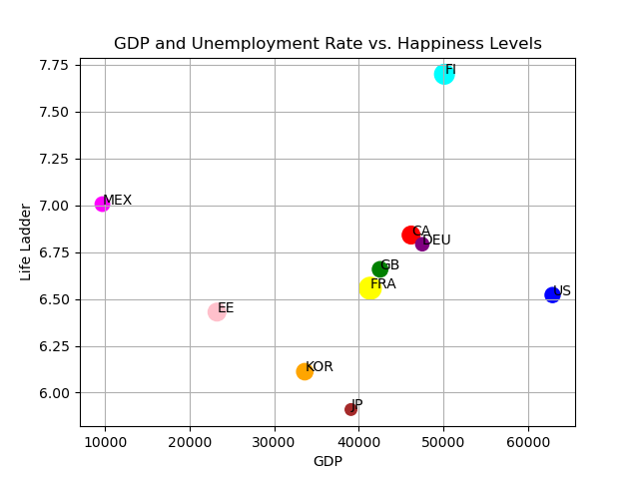
10 Countries’ GDP and Unemployment Rate Analysis
GDP:
Highest GDP US
Lowest GDP Mexico
Unemployment Rate: (size of the scatterplot point)
Highest rate France
Lowest rate Japan
The Life Ladder:
Highest level is Finland
Lowest level is Japan
By: Jennifer Mancheno

Slide 11

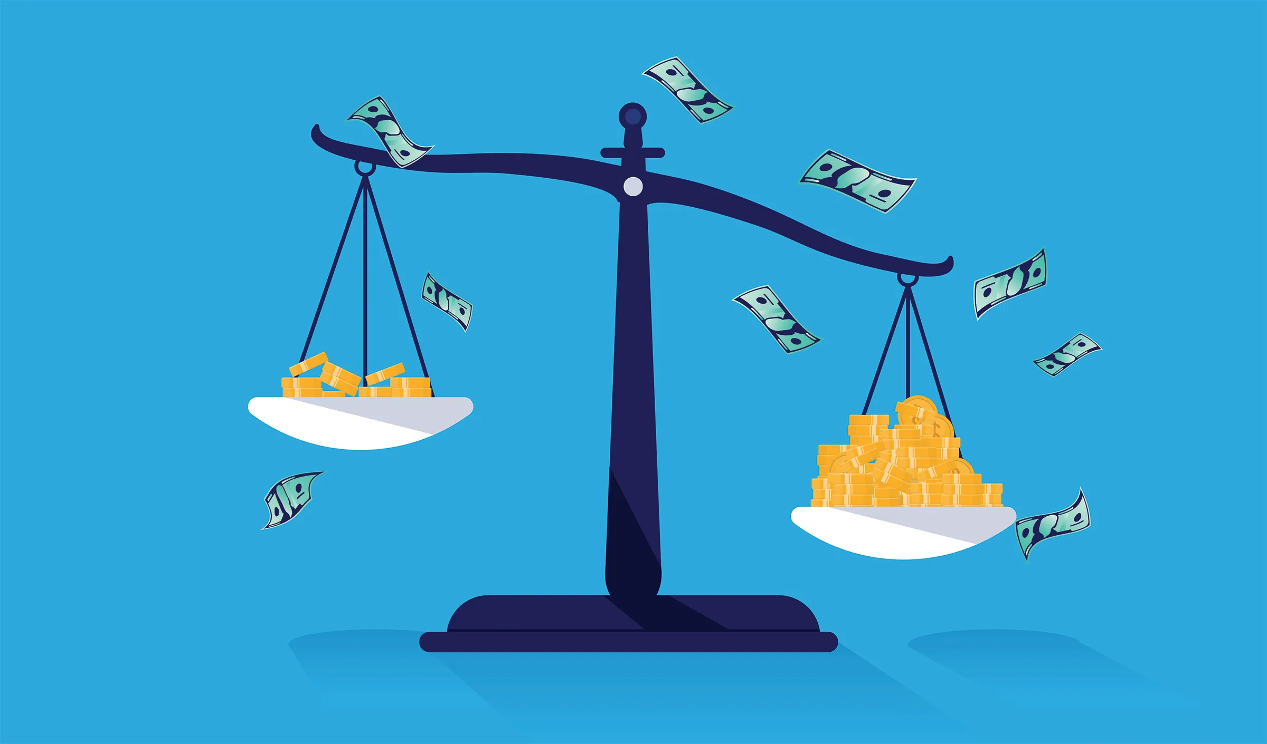
World Bank Gini %
The distribution of levels of income and consumption within households in an economy as to how it deviates from an equal distribution
The higher the Gini % the greater the inequality, such as a household or individual that receives a greater percentage of the populations income
The lower the Gini % represents that an economy has equality
By: Jennifer Mancheno

Slide 12
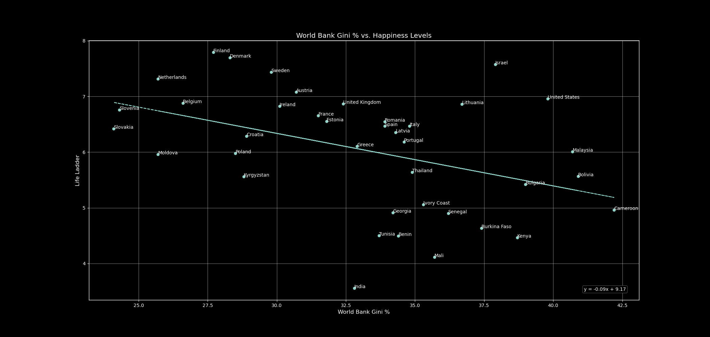

Slide 13
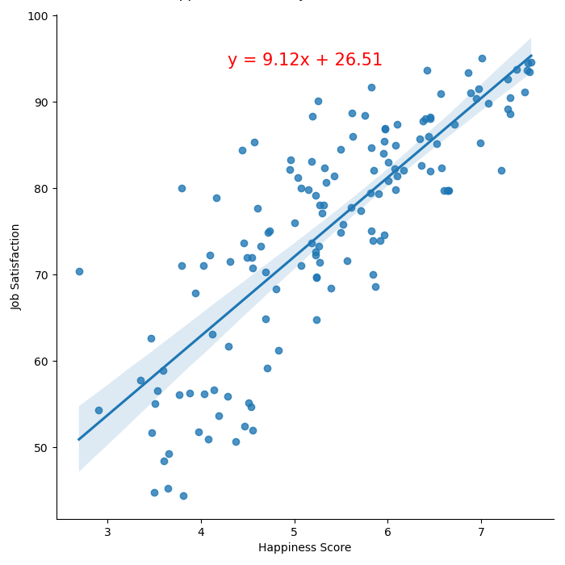
Happiness score vs job satisfaction
This analysis explores how 'Happiness Score' correlates with 'Job Satisfaction.’
The data points represent individual observations.
A positive correlation was observed, indicating that as happiness increases, job satisfaction also tends to rise.
The regression equation, y = 9.12x + 26.51, suggests that for each unit increase in happiness, job satisfaction increases by 9.12 points.
While there's a clear trend, other factors also influence job satisfaction, as seen by the spread of data points around the regression line.
Happiness is a significant predictor of job satisfaction.

Slide 14
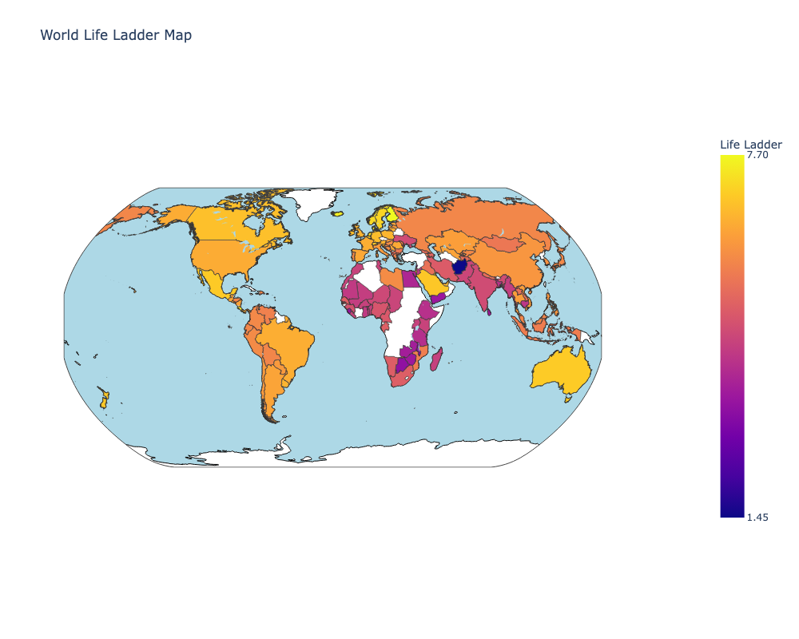
World Life Ladder Map
Lighter Colors Indicate High Happiness Levels:
North America:
The United States and Canada are shaded in light orange, reflecting high happiness levels.
Western Europe:
Most of the region, including countries like France, Germany, and the UK, also shows light orange shading.
Australia and New Zealand:
Both countries are shaded in light orange, indicating high happiness.
Northern Europe:
Nations like Norway, Sweden, Finland, and Denmark are shaded in light colors, signifying top ranks on the happiness index.
Medium Colors Indicate Moderate Happiness Levels:
South America:
Countries like Brazil and Argentina are shaded in medium orange, reflecting moderate happiness levels.
Eastern Europe & Central Asia:
This region displays a mix of medium orange shades, indicating moderate happiness.
East Asia:
Nations like China and Japan are in the medium category, signifying moderate happiness
Darker Colors Indicate Low Happiness Levels:
Africa: Sub-Saharan regions (e.g., DRC, Chad) are in dark purple.
South Asia: Afghanistan and India show dark purple/red.
Middle East: Syria and Yemen reflect low happiness.
South-East Asia: Cambodia and Myanmar also show lower indices.

Slide 15
Data Sources
https://www.oecd.org/en/about/members-partners.html
https://worldhappiness.report/
https://bakadesuyo.com/2011/06/what-five-factors-contribute-to-happiness/#:~:text=Diener%20identifies%20five%20factors%20that,people%20have%20strong%20social%20relationships

