Slide 1
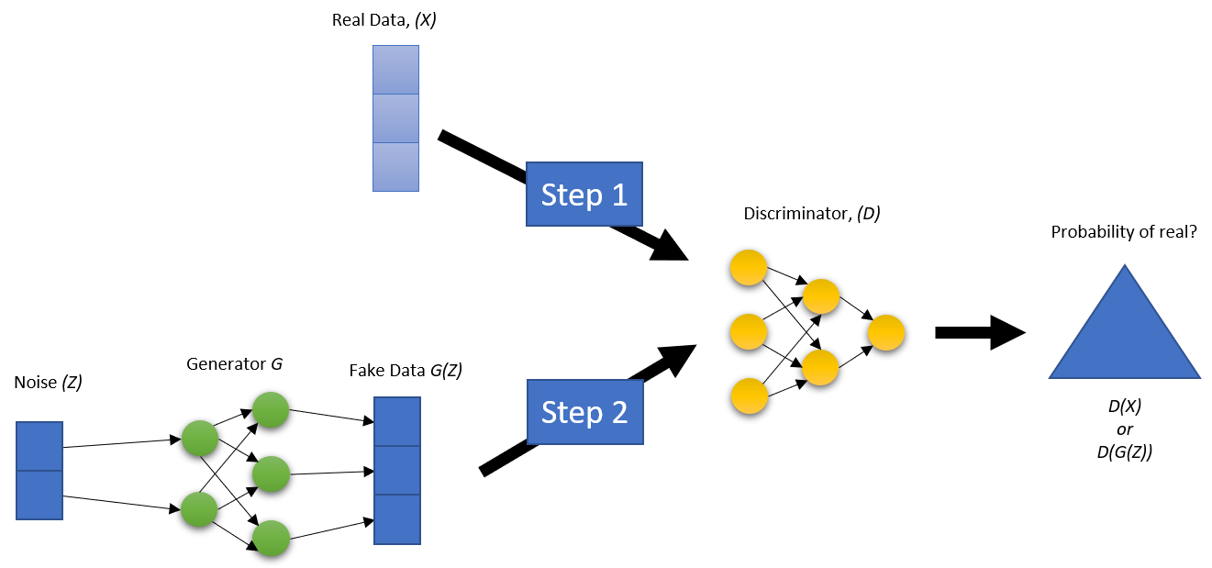
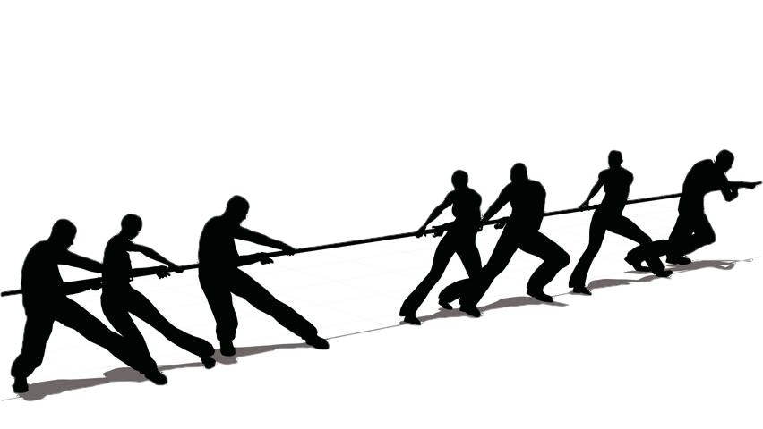
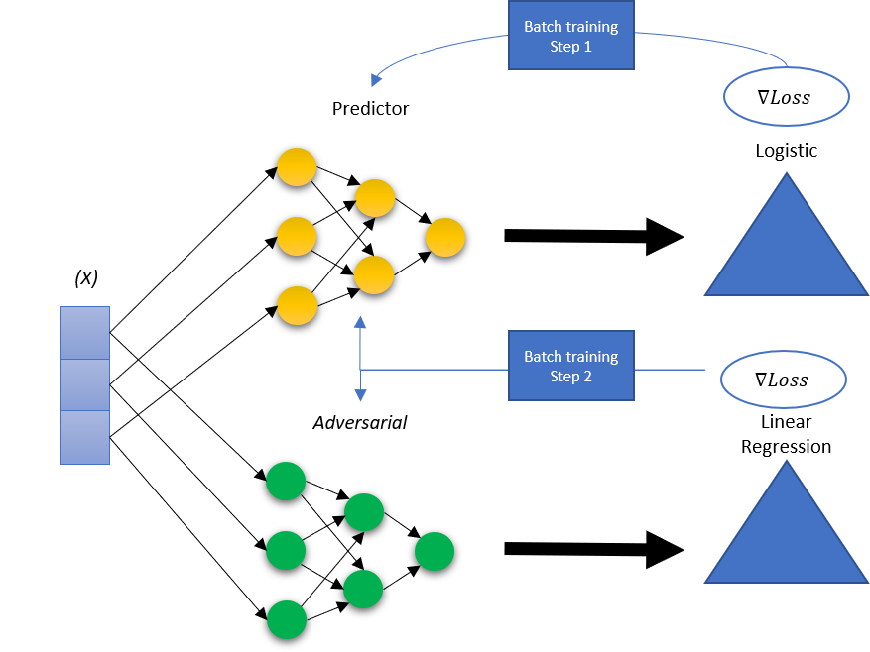
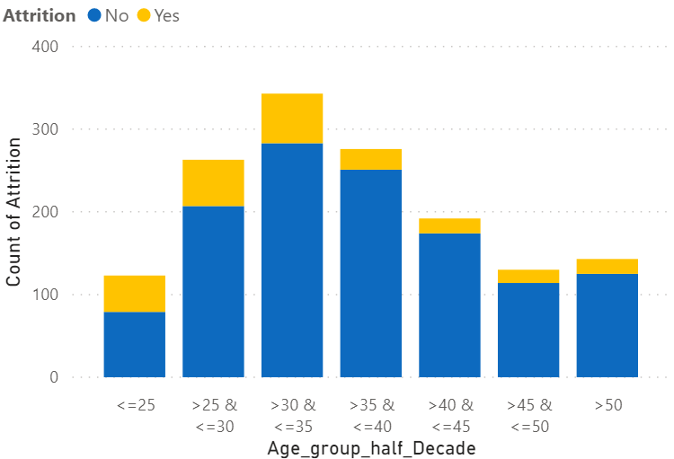

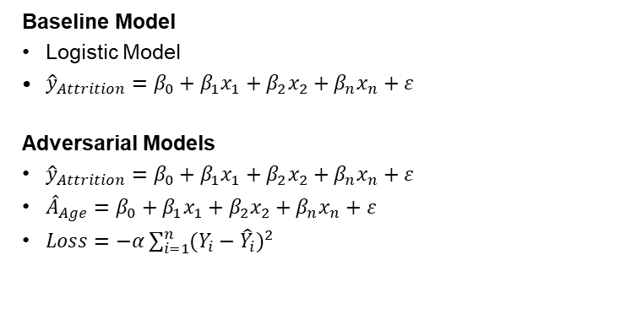
Bias in Machine Learning: An Adversarial Approach
Solange Garcia de Alford, Steven Hayden, Nicole Wittlin
Master of Science in Data Science
Southern Methodist University, Dallas, TX 75275, USA
Introduction
Model Architecture
Bias is very prevalent, occurring in ML models at pre-process, in-process, post-process stages.
Examples of ML bias are widely known – COMPAS, Amazon hiring algorithm/resume scan, Word2Vec. Most are binary: protected class vs unprotected class.
Our study focuses on eliminating bias stemming from AGE when predicting employee attrition.
Baseline Model
Logistic Model
${\hat{y}}_{Attrition}=β_{0}+{β_{1}x}_{1}+{β_{2}x}_{2}+{β_{n}x}_{n}+ε$
Adversarial Models
${\hat{y}}_{Attrition}=β_{0}+{β_{1}x}_{1}+{β_{2}x}_{2}+{β_{n}x}_{n}+ε$
${\hat{A}}_{Age}=β_{0}+{β_{1}x}_{1}+{β_{2}x}_{2}+{β_{n}x}_{n}+ε$
$Loss=−α\sum_{i=1}^{n}{{(Y_{i}−{\hat{Y}}_{i})}^{2}}$
Main Topics
Adversarial learning can be leveraged to mitigate bias and unfairness.
Competing models of GAN, where Predictor (P) tries hinder Discriminator (D) with fake data, while feedback from D tries to hinder P prediction ability.
Our study: P -- predict employee prediction; D -- predict age.
Goal: improve group fairness via demographic parity (DP) (all equally likely of positive outcome (TP + FP)).
Results
Improved DP: range Pre-GAN for all groups between 94-100%; Post-GAN range 98-100%.
Small trade-off between Accuracy and Fairness Post-GAN: accuracy decreased 2% but DP increased 6%.
Demonstrate work beyond binary classes: can work toward having more than one unprotected group.
See Results Chart
Data Overview
ACCUR | < = 25 | (25, 30] | (30, 35] | (35, 40] | (40, 45] | (45, 50] | > 50 | Overall
Pre GAN | 0.7575 | 0.84 | 0.8315 | 0.9138 | 0.9464 | 0.8696 | 0.7941 | 0.8587
Post GAN | 0.6970 | 0.8 | 0.8315 | 0.8966 | 0.8929 | 0.9130 | 0.7941 | 0.8315
Conclusions / Future Work
IBM Employee Attrition Dataset
Attrition: 84% NO / 16% YES
Age binned in 5-year ranges
More attrition <= age 35
Bias must be addressed in advance and throughout – NOT as an afterthought.
Re-run study with larger, real dataset and/or pre-processed data that balances attrition % or sampled differently.
Refine code with Early Stop, when the adversary has sufficiently mitigated bias and correlation is no longer detected in the adversarial model for Z(x), Age.
We CANNOT and MUST NOT replace the inquisitiveness, skepticism, mortal imagination and compassion that humans bring to bear on Machine Learning.
DEMO PARITY | < = 25 | (25, 30] | (30, 35] | (35, 40] | (40, 45] | (45, 50] | > 50 | Overall
Pre GAN | 0.9394 | 0.96 | 0.9438 | 0.9655 | 0.9464 | 0.9565 | 1.0 | 0.9375
Post GAN | 1.0 | 1.0 | 0.9888 | 0.9828 | 1.0 | 1.0 | 1.0 | 0.9972

