Slide 1
Reducing Age Bias in Machine Learning: An Algorithmic Approach
Adriana Solange Garcia de Alford,
Steven Hayden, and Nicole Wittlin
Amy Atwood, Ph.D,
Senior Data Scientist – T-Mobile, Capstone adviser

Slide 2
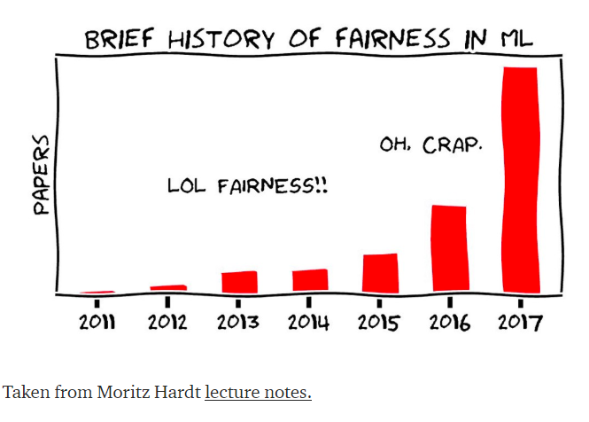
Bias in Machine Learning
Is it BIASED because it is UNFAIR?
Is it FAIR because it is UNBIASED?

Slide 3
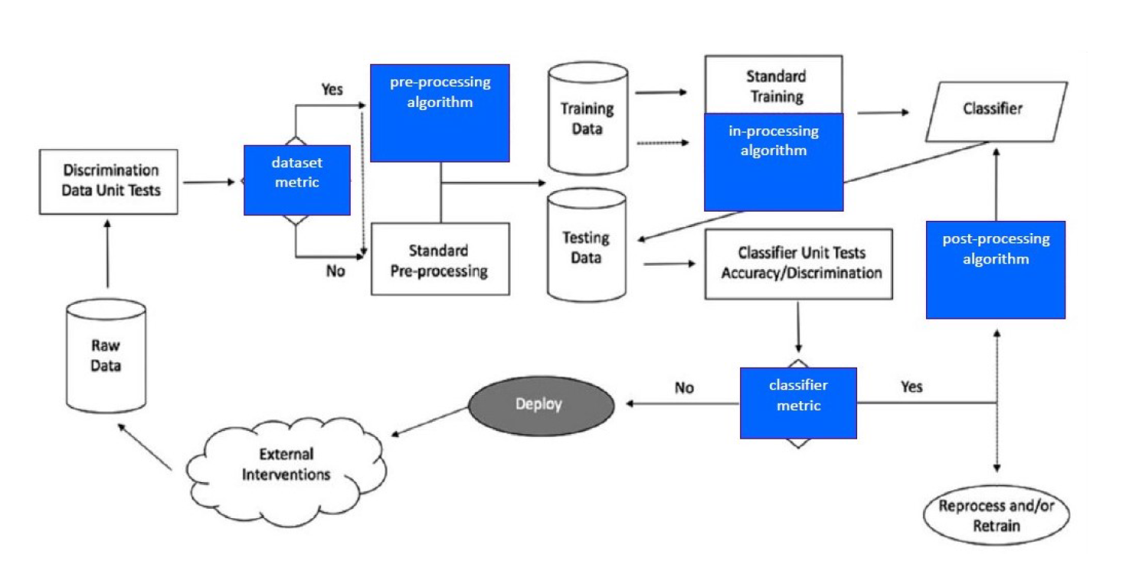
Bias in Machine Learning
PROCESS
DATA
PEOPLE
https://aif360.mybluemix.net/

Slide 4
Bias in Machine Learning
PROCESS
Intervention Points
Pre-Processing
In-Processing
Post-Processing
Classification
Regression
AI Fairness 360 Prejudice Remover
Adversarial Debiasing

Slide 5

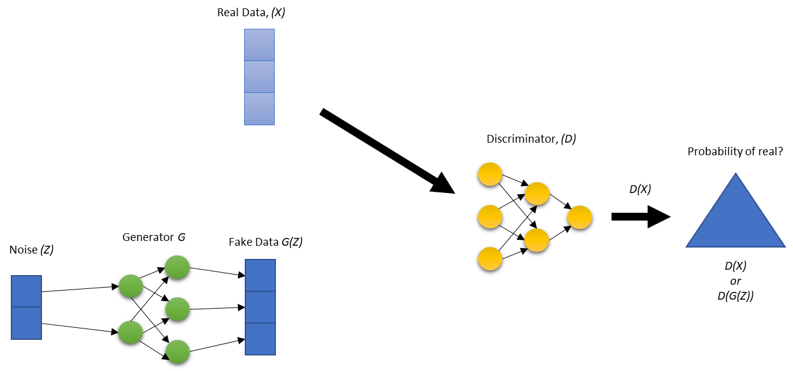
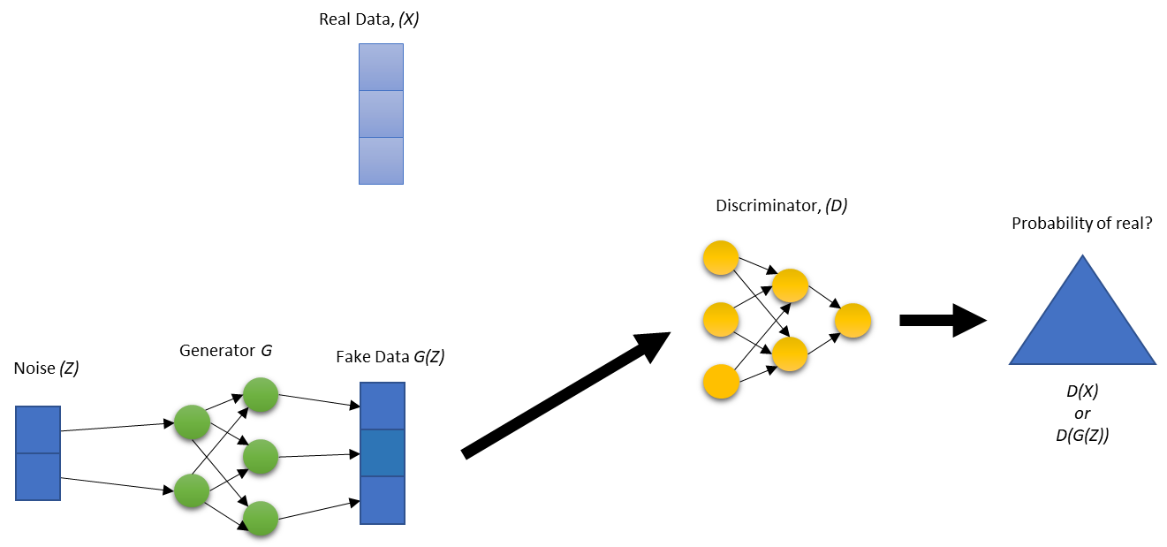
GAN Overview
https://ya-webdesign.com/imgdownload.html

Slide 6
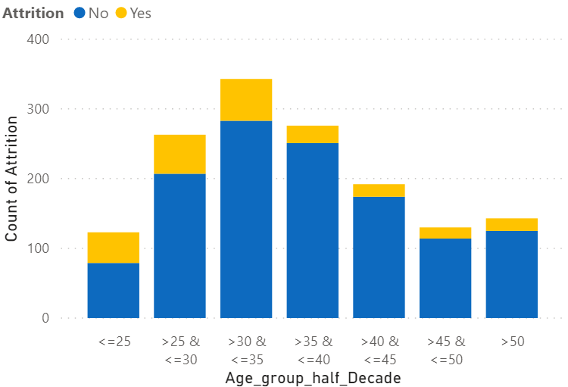
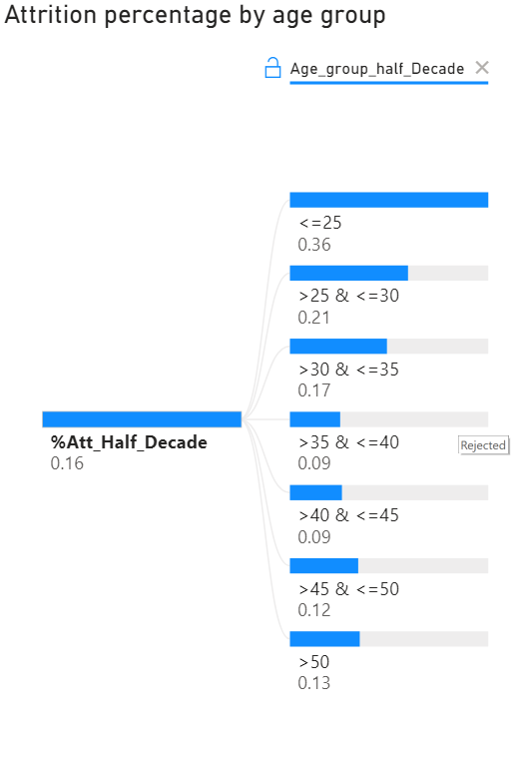
Experiment
Understanding Employee Attrition

Slide 7
Experiment
Overview Experiment
Age(Z) is protected
Age(Z) Correlated with explanatory (X) of predictor model
Goals
Good Accuracy
Demographic Parity
Both protected and unprotected classes receive a positive outcome at equal rates.
Demographic Parity = True Positives + False Positives

Slide 8
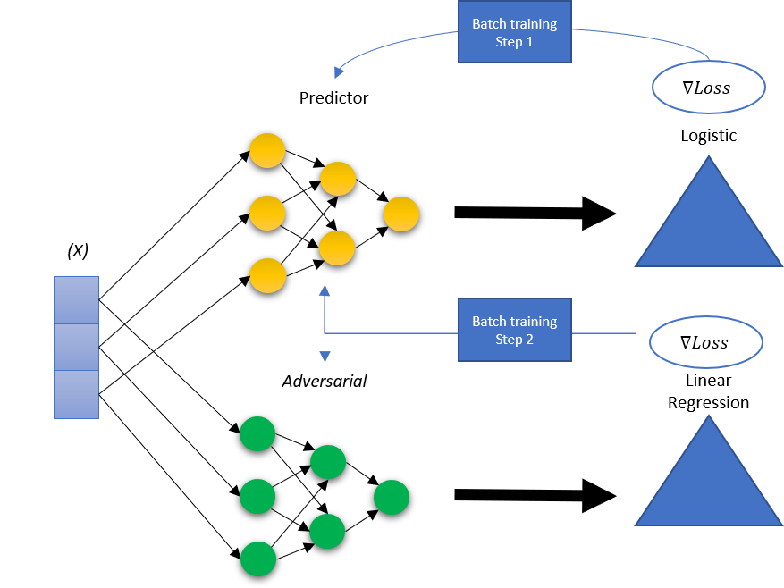
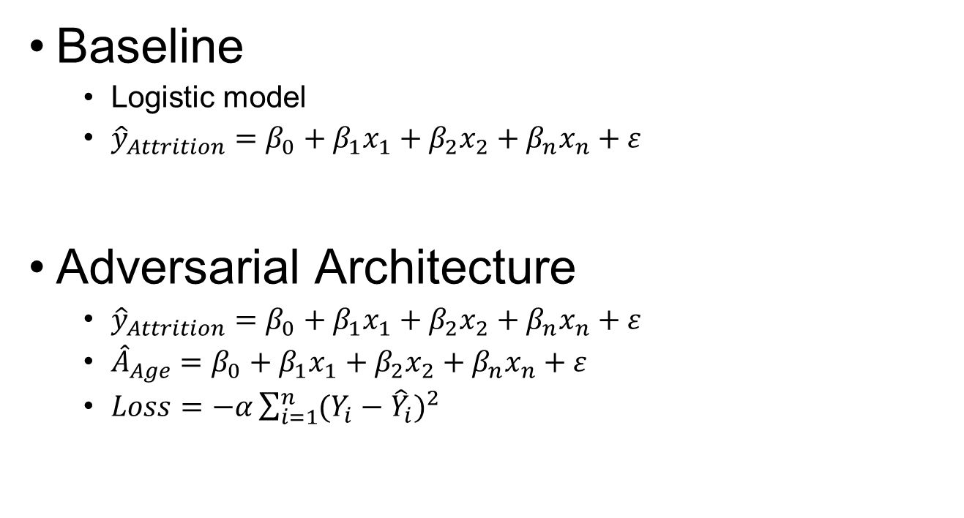
Experiment
Baseline
Logistic model
${\hat{y}}_{Attrition}=β_{0}+{β_{1}x}_{1}+{β_{2}x}_{2}+{β_{n}x}_{n}+ε$
Adversarial Architecture
${\hat{y}}_{Attrition}=β_{0}+{β_{1}x}_{1}+{β_{2}x}_{2}+{β_{n}x}_{n}+ε$
${\hat{A}}_{Age}=β_{0}+{β_{1}x}_{1}+{β_{2}x}_{2}+{β_{n}x}_{n}+ε$
$Loss=−α\sum_{i=1}^{n}{{(Y_{i}−{\hat{Y}}_{i})}^{2}}$

Slide 9
Experiment Results: Fairness
Goal: Improve group fairness based on demographic parity
Evaluated differences in accuracy and demographic parity between the baseline model and a GAN model
Calculated standard metrics to evaluate performance
Calculated several other metrics to evaluate group fairness
Metrics were calculated for 7 age groups in 5-years increments

Slide 10
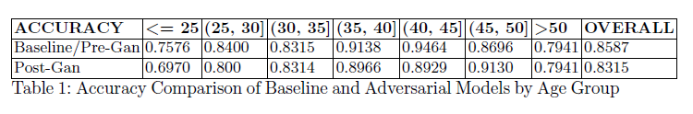
Experiment Results: Accuracy
Initial step to evaluate Accuracy of both models when predicting Attrition
Accuracy from GAN model was compared to accuracy baseline model
Accuracy in both models was expected to be similar
Accuracy from GAN was lower across all groups
Groups less than 35 and older population over 50, resulted in a lower accuracy on Attrition
Attributed this to larger number of observations in the middle age groups

Slide 11
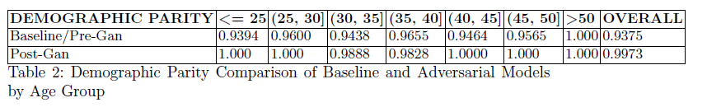
Experiment Results: Demographic Parity
Demographic Parity (DP) is achieved when:
Each group has equal likelihood to be assigned a positive outcome
Proportion of positive predictions in the subgroups is close to each other
Improved DP range across all groups:
Baseline between 94-100%; GAN range 98-100%
Small trade-off between Accuracy and Fairness GAN:
Accuracy decreased 2% but DP increased 6%.

Slide 12
Conclusions
Most adversarial debiasing work focused on protected groups such as race, sex and gender bias; we considered binned data
Achieved Demographic Parity based on results from a comparative analysis between the baseline model and the GAN model
Our focus was on Age debiasing, and how age bias can be prevented in deep learning models

Slide 13
Conclusions
Bias must be addressed in advance and throughout the ML lifecycle – NOT as an afterthought
Mitigating bias using adversarial network architecture shows promise, yet we cannot be confident that systems are unbiased and fair
We cannot and must not replace the inquisitiveness, skepticism, moral imagination, compassion, and the sensitivity to foresee consequences that humans bring to bear on machine learning.

Slide 15
