Slide 1
Reducing Age Bias in Machine Learning: An Algorithmic Approach
Adriana Solange Garcia de Alford,
Steven Hayden, and Nicole Wittlin
Amy Atwood, Ph.D,
Senior Data Scientist – T-Mobile, Capstone adviser

Slide 2
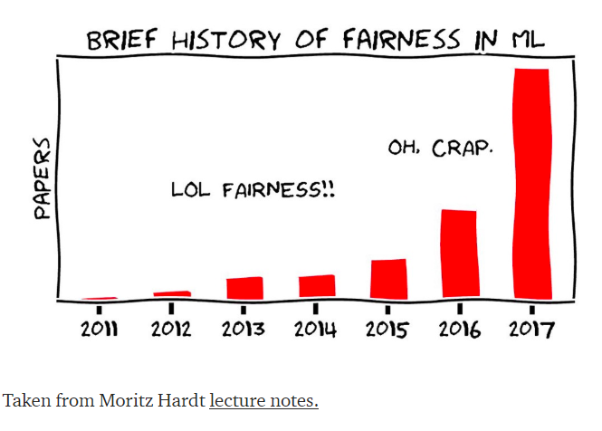
Bias in Machine Learning
Is it BIASED because it is UNFAIR?
Is it FAIR because it is UNBIASED?
Notes:
Data is driving decision-making almost everywhere, but how? What criteria are considered? What if the outcomes are biased?
As the cartoon notes, over the last few years, the machine learning community has acknowledged BOTH the prevalence and consequence of bias in ML.
For the purposes of our work – think of bias and fairness as complementary forces. Our goal is to reduce bias in the hopes of increasing fairness.

Slide 3
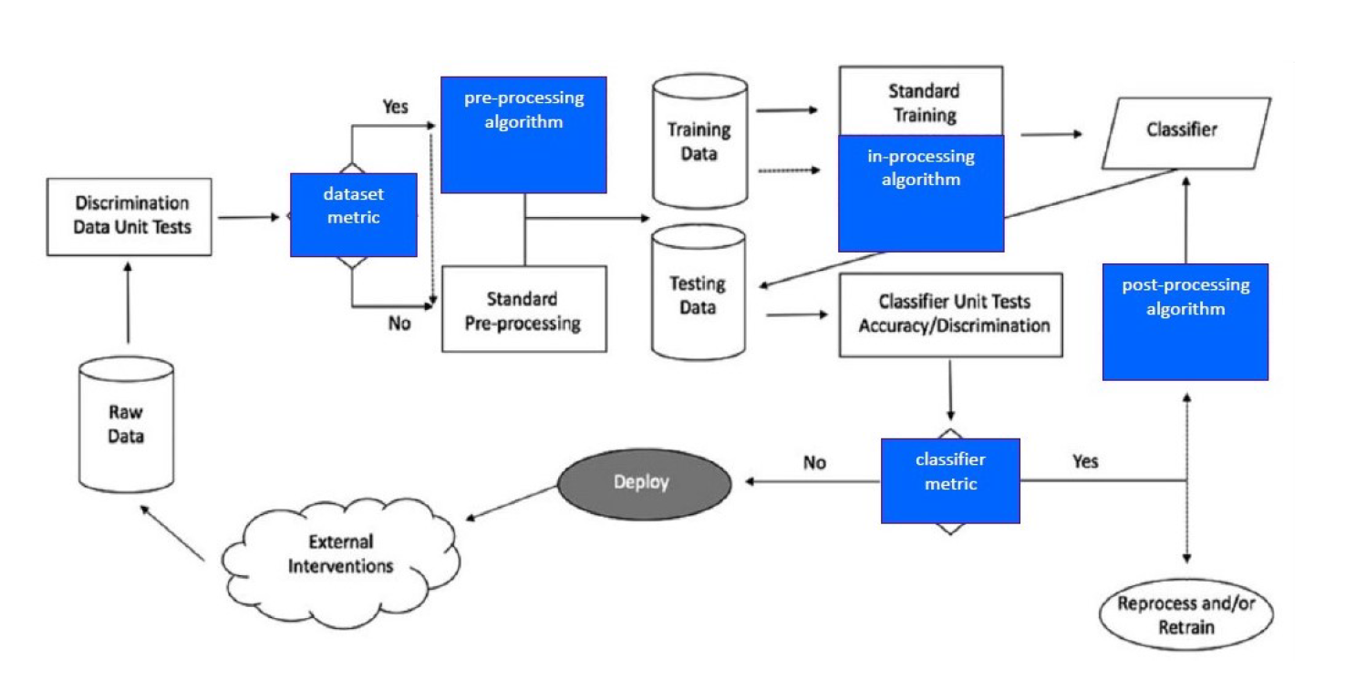
Bias in Machine Learning
PROCESS
DATA
PEOPLE
https://aif360.mybluemix.net/
Notes:
This graphic from the IBM fairness tool kit summarizes a machine learning process. Focus on the red circles I’ve added as key points where bias has impact.
Bias in Data: related to data’s origin, collection or sampling. UNFORTUNATELY, removing a protected variable or leaving it out of the model will not remove bias.
Bias in Algorithmic Process: when we select, create, and tune models.
Bias in Implementation: or the people part when implementing and using the model in the wild

Slide 4
Bias in Machine Learning
PROCESS
Intervention Points
Pre-Processing
In-Processing
Post-Processing
Classification
Regression
AI Fairness 360 Prejudice Remover
Adversarial Debiasing
Notes:
During the ALGORITHMIC PROCESS, there are 3 points to intervene to address bias:
Preprocessing, where the training data can be modified
In Processing, where bias can be addressed by changing an objective function or imposing a new constraint to the algorithm.
Or Postprocessing, where bias mitigation can be applied to the resulting predicted labels.
Of particular interest to our team is the IN PROCESS use of adversarial networks.

Slide 5
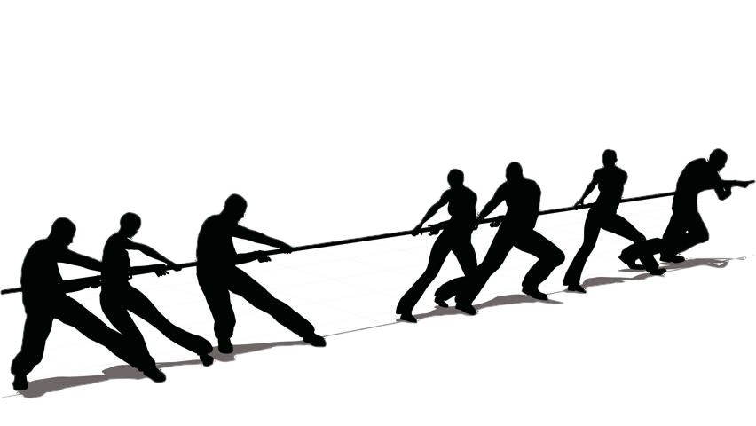
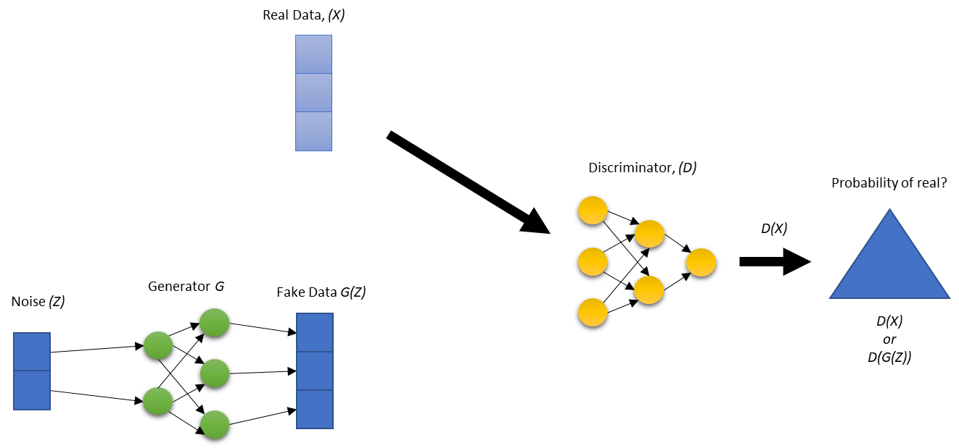
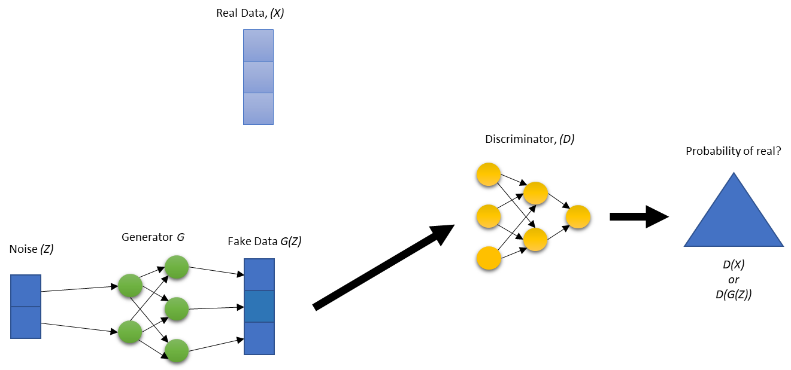
GAN Overview
https://ya-webdesign.com/imgdownload.html
Notes:
We got our inspiration from the GANS Framework
You have two algorithms competing against each other trying to minimize some loss function
In the first image you have real data passed to the discriminator (agl1) to predict if it is real or not.
In the second you have the generator taking noise and transforming it in its network to try and trick the discriminator.
Depending on what network was wrong, that is the one that will be updated.

Slide 6
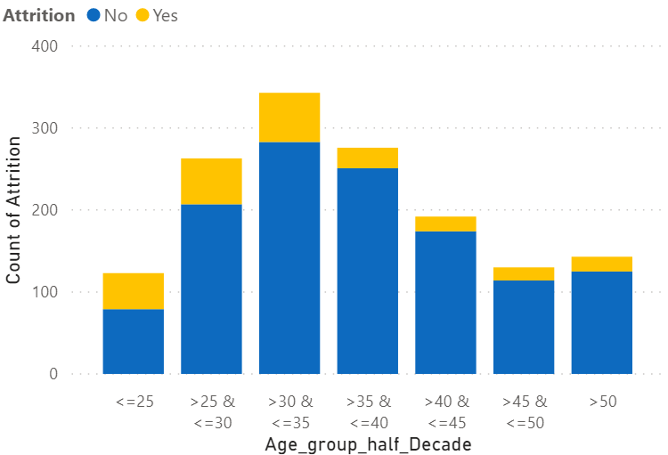
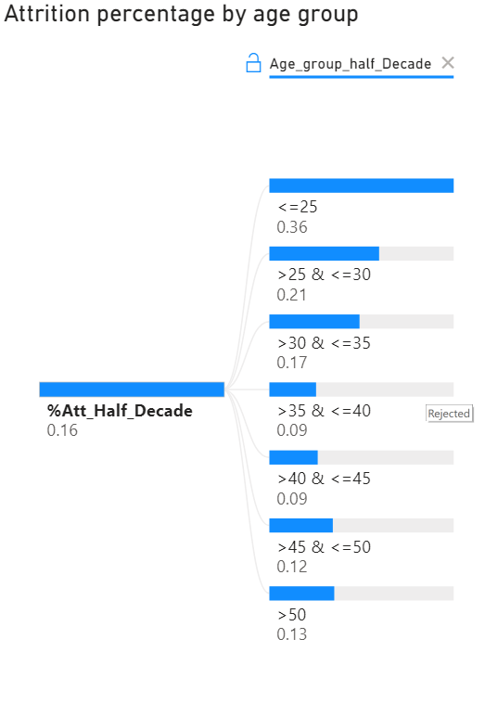
Experiment
Understanding Employee Attrition
Notes:
We used the synthetic IBM Attrition data for our experiment.
As you can see the data is unbalanced with yellow = they left.
The younger Age groups have a greater percentage of attrition.

Slide 7
Experiment
Overview Experiment
Age(Z) is protected
Age(Z) Correlated with explanatory (X) of predictor model
Goals
Good Accuracy
Demographic Parity
Both protected and unprotected classes receive a positive outcome at equal rates.
Demographic Parity = True Positives + False Positives
Notes:
Age is a protected attribute and we do not want age to influence the outcome.
Most the time the protected attributes are just dropped, but other variables could be used as a substitute or is correlated with the protected attribute.
For example, years worked at the company
Our goal is to achieve or get closer to Demographic Parity by distributing accuracy across the age groups.

Slide 8
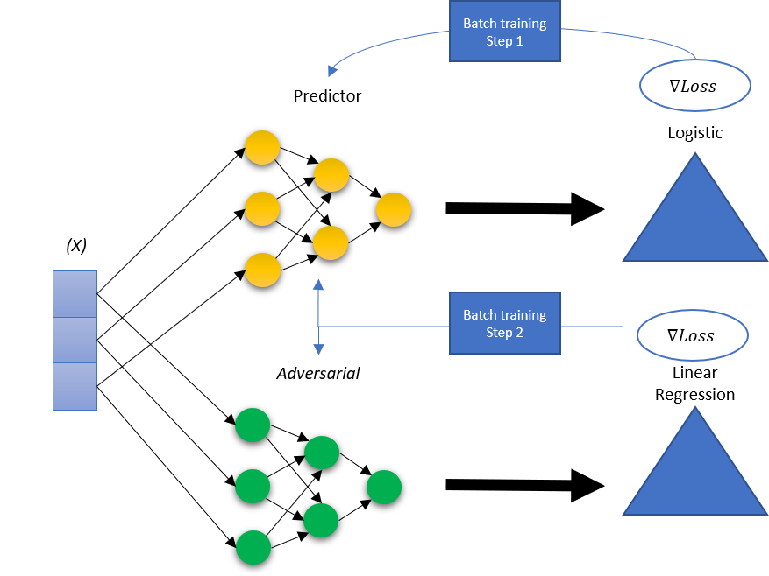
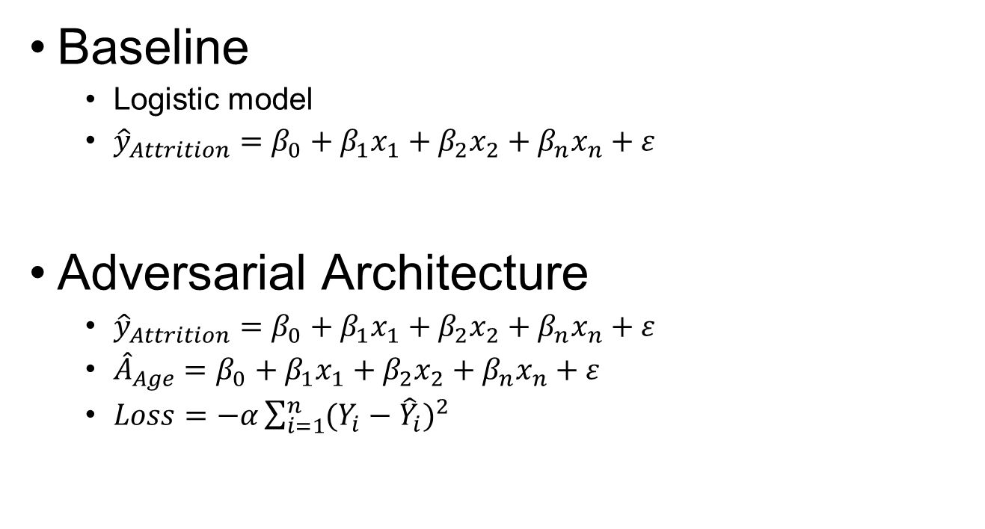
Experiment
Baseline
Logistic model
${\hat{y}}_{Attrition}=β_{0}+{β_{1}x}_{1}+{β_{2}x}_{2}+{β_{n}x}_{n}+ε$
Adversarial Architecture
${\hat{y}}_{Attrition}=β_{0}+{β_{1}x}_{1}+{β_{2}x}_{2}+{β_{n}x}_{n}+ε$
${\hat{A}}_{Age}=β_{0}+{β_{1}x}_{1}+{β_{2}x}_{2}+{β_{n}x}_{n}+ε$
$Loss=−α\sum_{i=1}^{n}{{(Y_{i}−{\hat{Y}}_{i})}^{2}}$
Notes:
We start with a baseline to see how close we are to demographic parity.
We created a simple neural net in the fashion of a logistic regression model. The idea is not to build the most accurate model but show that an adversarial can remove bias.
The adversarial framework adds in our adversarial model that tries to predict age (our protected variable).
The adversarial and the prediction models are wrapped together with a modified MSE that has a tunable parameter to dampen the gradients.
The loss is maximized because we want the model to be bad at predicting age.
The prediction algorithm is the same as in our baseline except the weights are modified from the MSE loss function (Batch training Step 2) as well as its original loss function for batch training (Step1).

Slide 9
Experiment Results: Fairness
Goal: Improve group fairness based on demographic parity
Evaluated differences in accuracy and demographic parity between the baseline model and a GAN model
Calculated standard metrics to evaluate performance
Calculated several other metrics to evaluate group fairness
Metrics were calculated for 7 age groups in 5-years increments

Slide 10
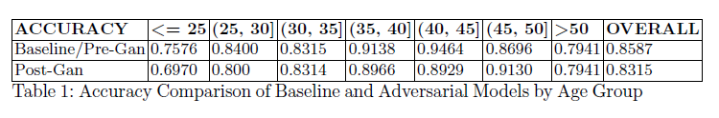
Experiment Results: Accuracy
Initial step to evaluate Accuracy of both models when predicting Attrition
Accuracy from GAN model was compared to accuracy baseline model
Accuracy in both models was expected to be similar
Accuracy from GAN was lower across all groups
Groups less than 35 and older population over 50, resulted in a lower accuracy on Attrition
Attributed this to larger number of observations in the middle age groups

Slide 11
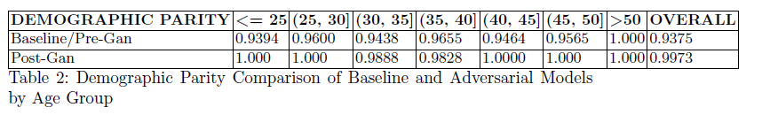
Experiment Results: Demographic Parity
Demographic Parity (DP) is achieved when:
Each group has equal likelihood to be assigned a positive outcome
Proportion of positive predictions in the subgroups is close to each other
Fairness was compared across 7 age groups
Improved DP range across all groups:
Baseline between 94-100%; Post-GAN range 98-100%
Small trade-off between Accuracy and Fairness Post-GAN:
Accuracy decreased 2% but DP increased 6%.

Slide 12
Conclusions
Achieved Demographic Parity based on results from a comparative analysis between the baseline model and the GAN model
A more balanced distribution across age groups in the data may have helped
No significant pre-processing on the data
Most adversarial debiasing work focused on protected groups such as race, sex and gender bias
Our focus was on Age debiasing, and how age bias can be prevented in deep learning models

Slide 13
Conclusions
Bias must be addressed in advance and throughout the ML lifecycle – NOT as an afterthought
Mitigating bias using adversarial network architecture shows promise, yet we cannot be confident that systems are unbiased and fair
We cannot and must not replace the inquisitiveness, skepticism, moral imagination, compassion, and the sensitivity to foresee consequences that humans bring to bear on machine learning.

Slide 15
