Slide 1

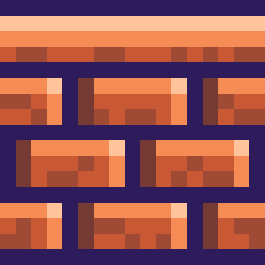







BUBBLE
BURSTER
LET’S PLAY!
SOLO - SATVIK KHETAN

Slide 2


What It Is?
A Simple Game to burst bubbles and win prize on Polkadot

Slide 3

how to play
Just Burst All the bubbles. That’s it!
Start with clicking on Play button
Send playing fee to contract
Start busting bubbles

Slide 4
ARE YOU READY?

Slide 5
Step 1
Connect your metamask and click on Play

Slide 6
Step 2
Send 1 DOT to play the game

Slide 7
Step 3
Start Busting Bubbles when Horn blows and countdown starts

Slide 8
Step 4
Claim your rewards at the end

Slide 9
how DO I WIN?
Don’t worry you won’t lose all your money (At Once :P )
Else, you will be rewarded based on the percentage of bubbles burst completely
If you burst all the bubbles. You get double

Slide 10
What NeXT?
Automatic Rewards Claim
Different Difficulty Level Different Price
Bet More! Win More!
TILL THEN JUST KEEP BURSTING!!

Slide 11
REFERENCES
HTTPS://GITHUB.COM/SKHETANNEU/BUBBLEBURSTER/TREE/MAIN

