Slide 1
RL based obstacle game (Flappy Bird)
Team members –
Satvik Khetan
Aadesh Mallya
Abhishek kumar
Professor –
Robert Platt

Slide 2
objective
To create an AI for a desktop application game inspired by a very popular game called “flappy bird”.
The AI should be able to play the game as a real human would and fly the bird avoiding the obstacles throughout the course of the game, by jumping at the correct point in time.

Slide 3
Implementation (part 1)
We used PyGame to develop the basics of the game.
It involved implementing functionalities, some of which are :
Flying the bird (Flapping its wings)
Randomly generating set of pipes with varied gaps
Moving the base to imitate that the bird is moving forward

Slide 4
Implementation (part 2)
This part involved using NEAT algorithm to teach the machine play the game.
We set up the required configurations for the algorithm such as initial weights and biases, fitness criteria, population size, etc and played around with these values finding the best fit for this game.
Later on, we set up a collection of neural networks and start the training with a group of birds (equal to the population size)
With training, we figure out the set of birds which performed well and use their networks to spawn the next generation of birds.
Doing this lead to continuously improving the quality with which these birds played the game
After few iterations, the AI was trained to play the game.

Slide 5
Results
In the initial iterations, the best bird would go through a maximum of 3-4 pipes.
With training, it reached a training level where the bird was able to go through more than 100 pipes.

Slide 6

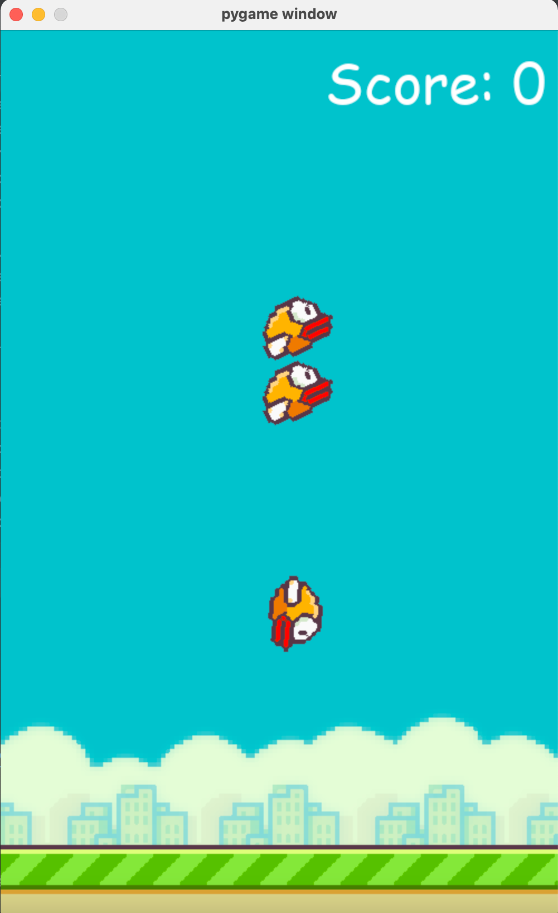
Screenshots

Slide 7
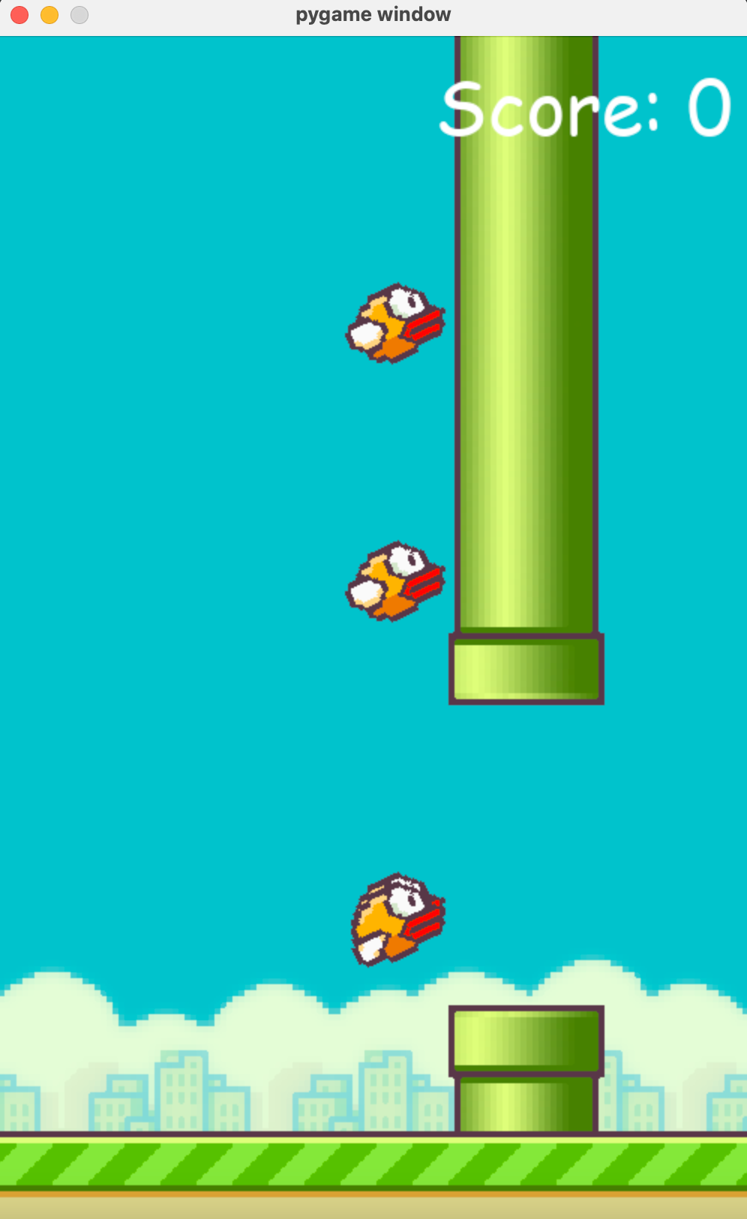
Screenshots

Slide 8
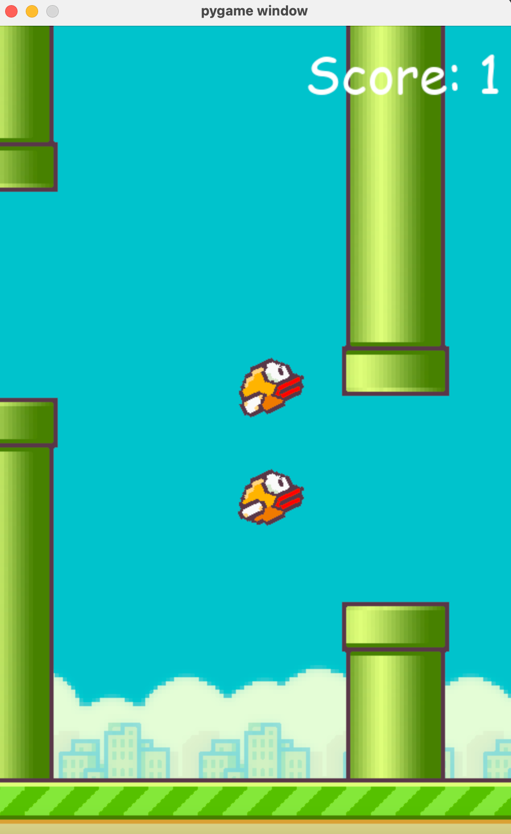
Screenshots

Slide 9
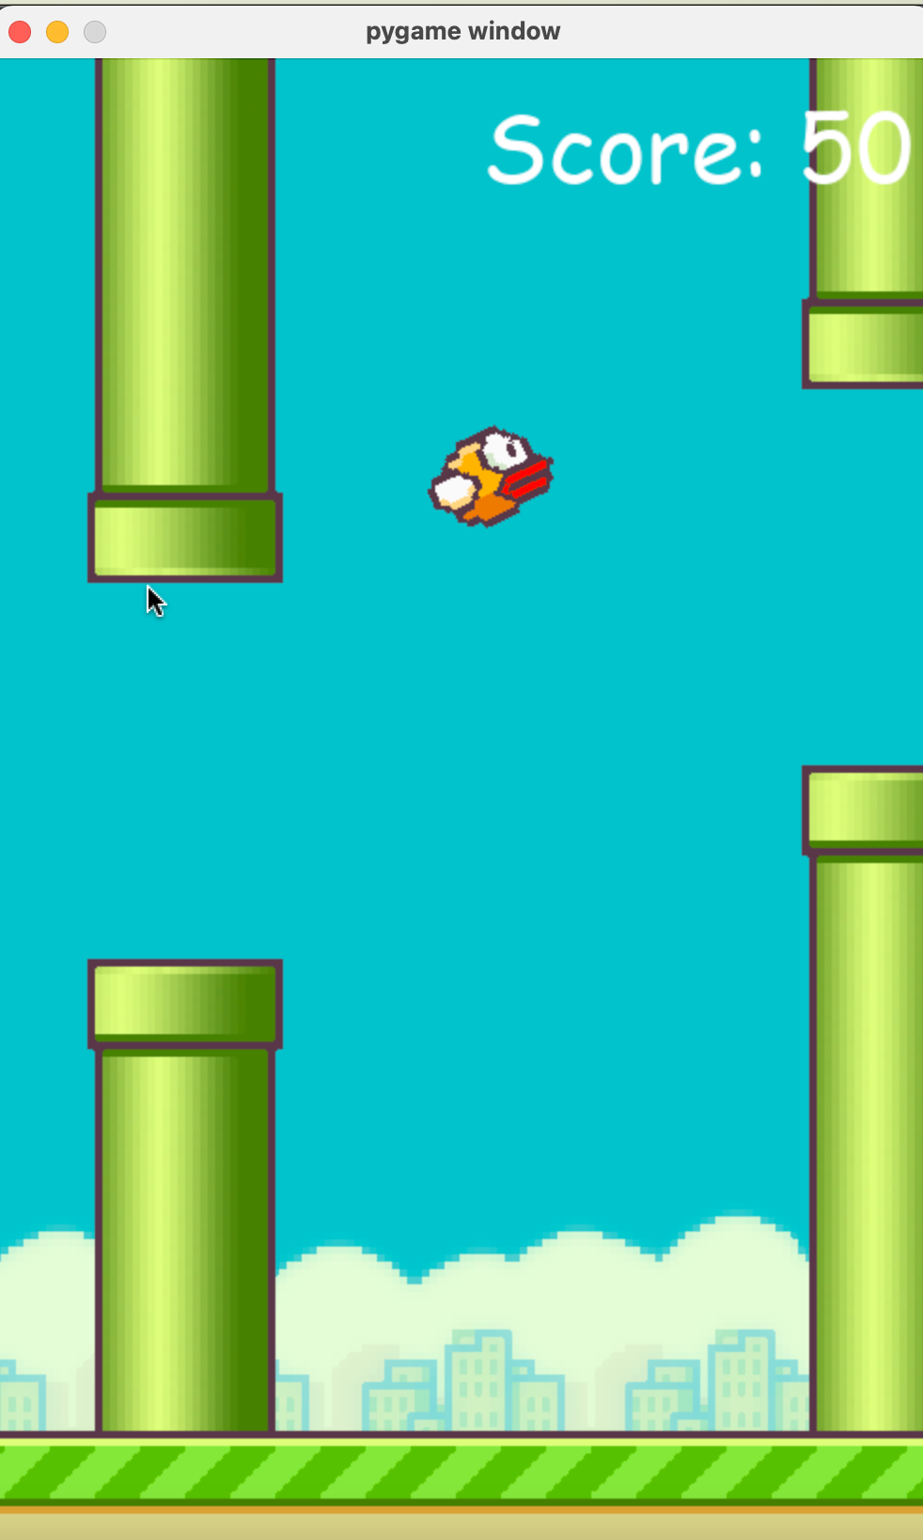
Screenshots

Slide 10
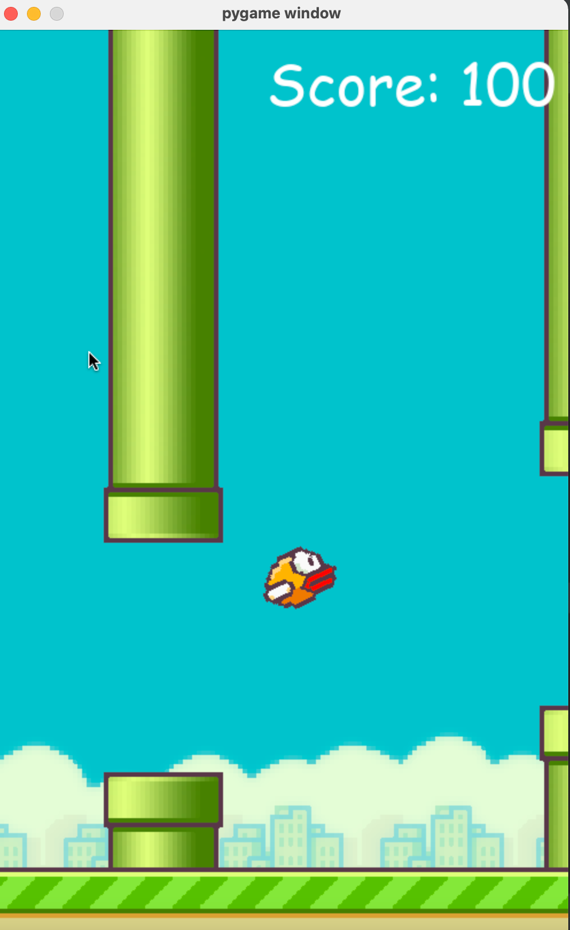
Screenshots

Slide 11
Thank you

