Slide 1
APMA S-115 Project 1 Arms Race Modeling
Suraj Khetarpal, Hongda Mi

Slide 2
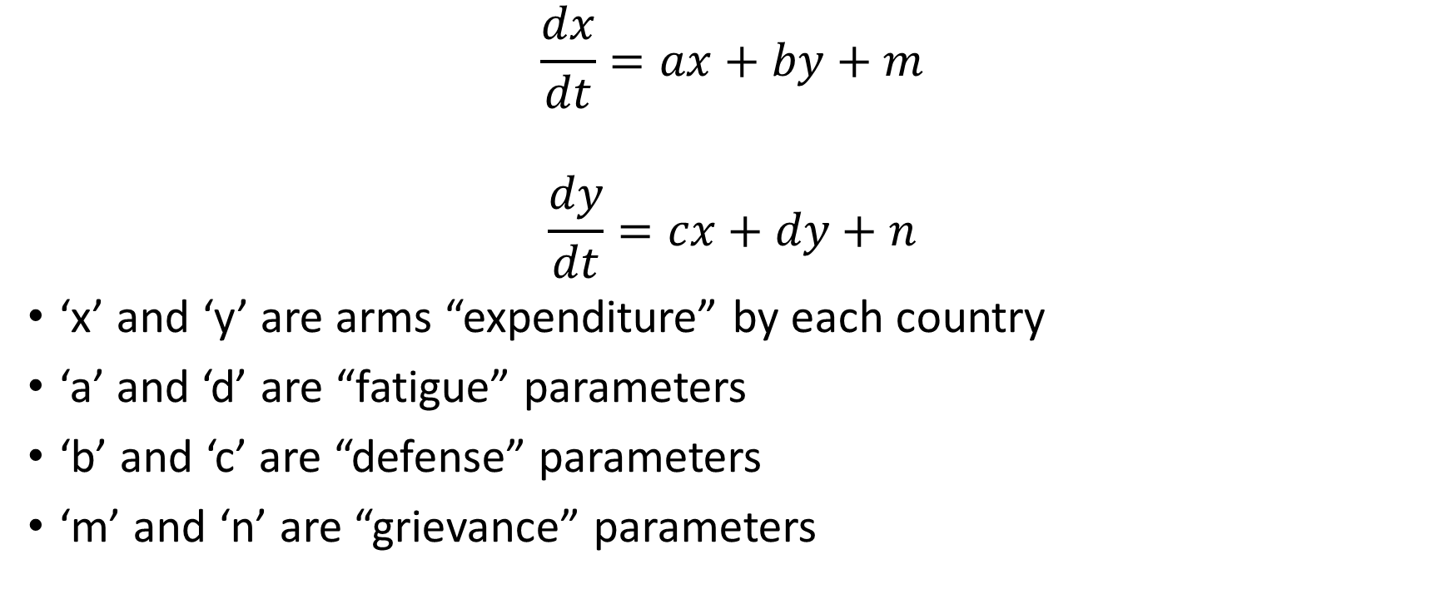
Lewis Richardson Model
$$\frac{dx}{dt}=ax+by+m$$
$$\frac{dy}{dt}=cx+dy+n$$
‘x’ and ‘y’ are arms “expenditure” by each country
‘a’ and ‘d’ are “fatigue” parameters
‘b’ and ‘c’ are “defense” parameters
‘m’ and ‘n’ are “grievance” parameters

Slide 3
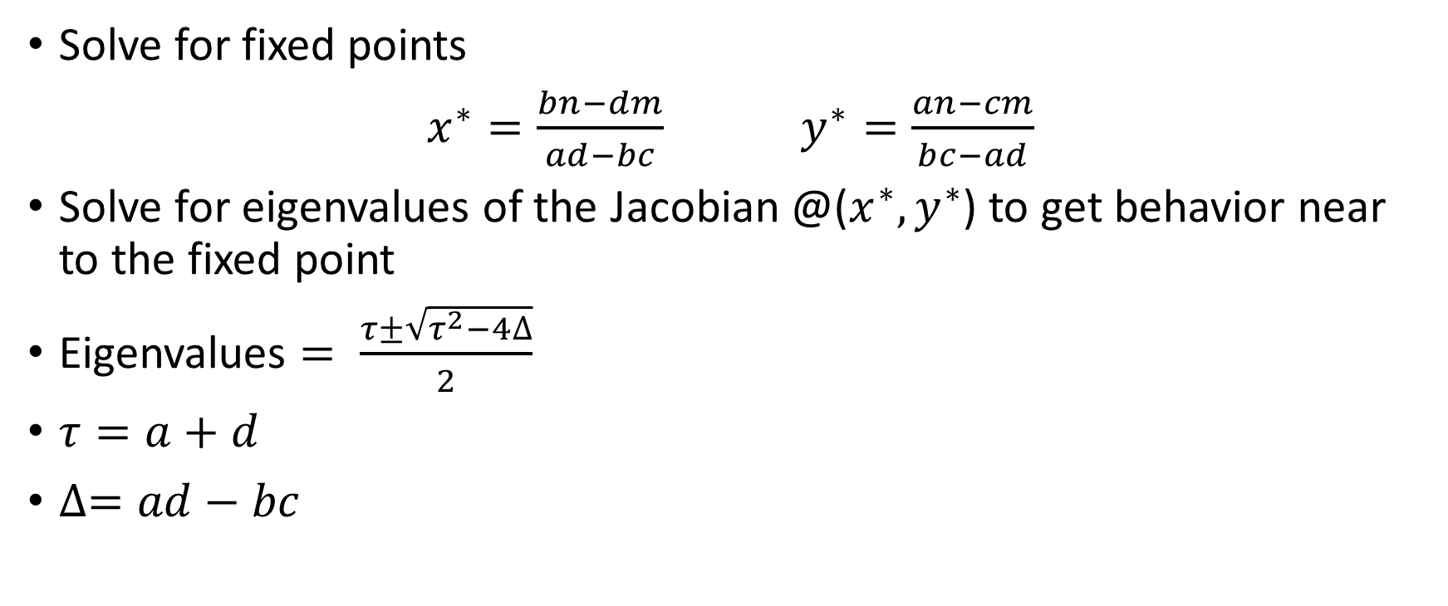
Eigen Analysis
Solve for fixed points
$x^{∗}=\frac{bn−dm}{ad−bc}$ $y^{∗}=\frac{an−cm}{bc−ad}$
Solve for eigenvalues of the Jacobian @($x^{∗},y^{∗}$) to get behavior near to the fixed point
Eigenvalues $= \frac{τ±\sqrt{τ^{2}−4∆}}{2}$
$τ=a+d$
$∆=ad−bc$

Slide 4
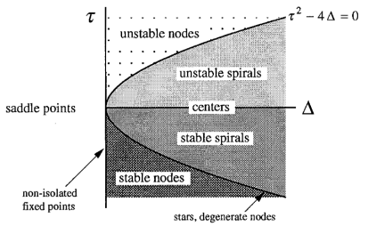
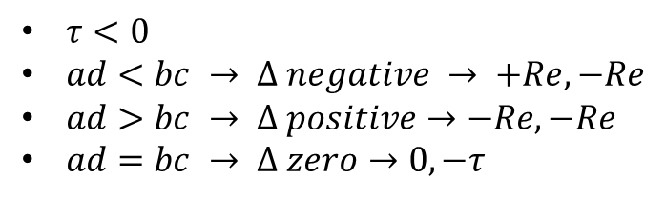
Reduced Dimensionality Parameters
$τ<0$
$ad<bc → ∆ negative → +Re, −Re$
$ad>bc → ∆ positive→−Re, −Re$
$ad=bc → ∆ zero→0, −τ$

Slide 5
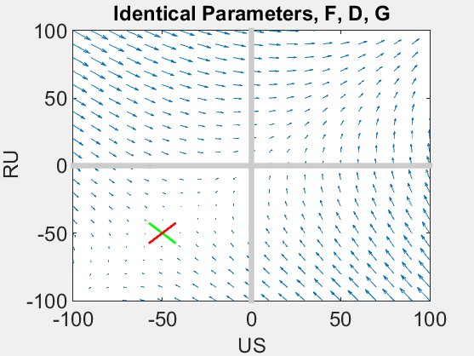

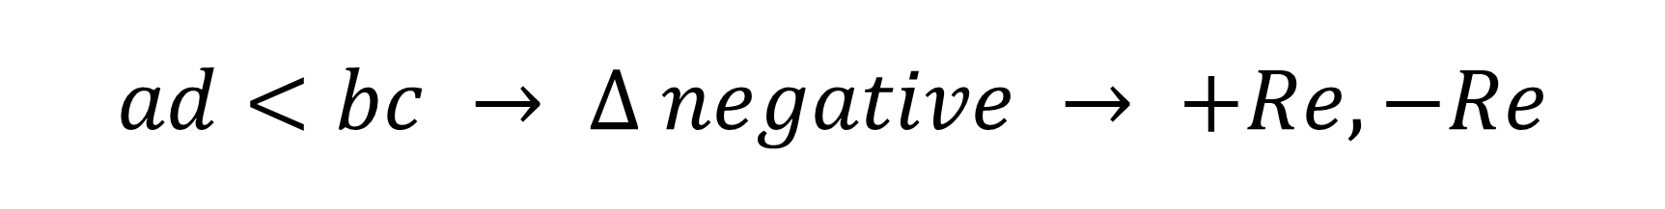
$$ad<bc → ∆ negative → +Re, −Re$$

Slide 6


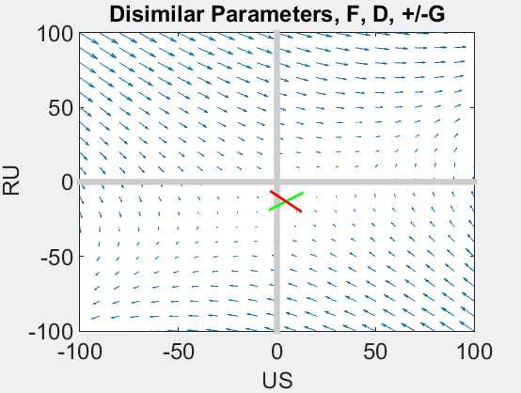
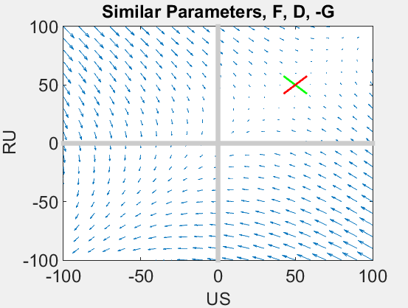
$$ad<bc → ∆ negative → +Re, −Re$$

Slide 7


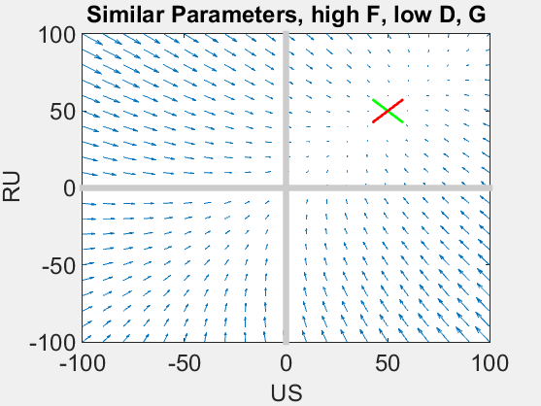
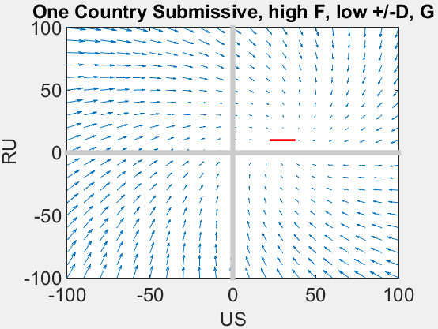
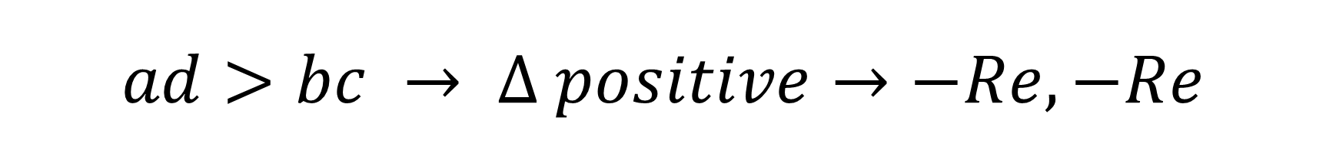
$$ad>bc → ∆ positive→−Re, −Re$$

Slide 8
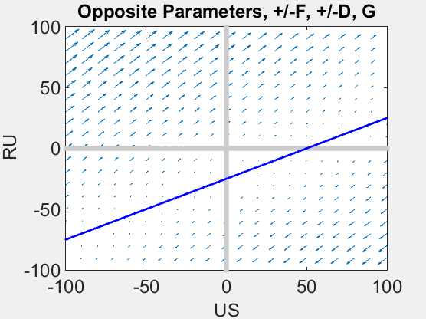


$$ad=bc → ∆ zero→0, −τ$$

Slide 9
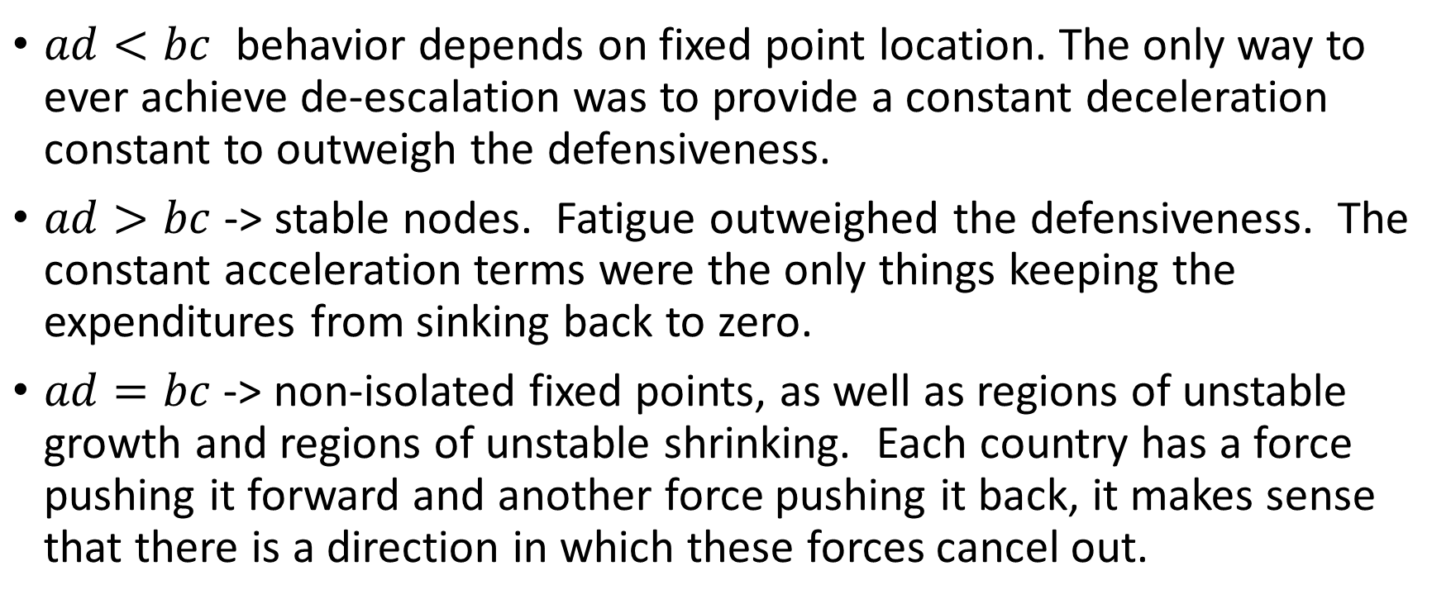
Discussion
$ad<bc$ behavior depends on fixed point location. The only way to ever achieve de-escalation was to provide a constant deceleration constant to outweigh the defensiveness.
$ad>bc$ -> stable nodes. Fatigue outweighed the defensiveness. The constant acceleration terms were the only things keeping the expenditures from sinking back to zero.
$ad=bc$ -> non-isolated fixed points, as well as regions of unstable growth and regions of unstable shrinking. Each country has a force pushing it forward and another force pushing it back, it makes sense that there is a direction in which these forces cancel out.

Slide 10
Modifications
Add a capacity term to avoid instability.
Factor in the stockpile using 2nd order equation.

