Slide 1
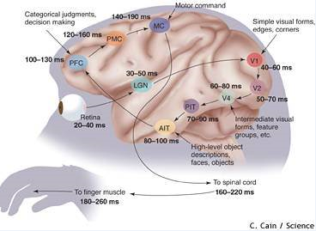
Ventral Stream
Area of
Focus =
22,770
Voxels (mm²)
Taken from http://www.nbcnews.com/id/3077497/ns/technology_and_science-science/t/rewiring-brain/

Slide 2
STIMULUS

Slide 3
STIMULUS
TIME
STIMULUS
TIME

Slide 4
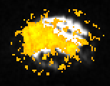
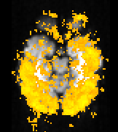
Figure X: Brain Activation with V1, PIT, and AIT overlay
View From the Right View From Above
View From the Right
View From the Right
AIT
V1
PIT
PIT
AIT
V1

Slide 5
Brain Activation from
Classifier Searchlight Test
Threshold at P-value = 0.05
View From the Right
View From Above
V1
PIT
AIT
PIT
V1
AIT

Slide 6
Brain Activation from
Classifier Searchlight Test
Threshold at P-value = 0.05
Brain Activation per Classifier Test
Threshold at P-value = 0.05
View From the Right
View From Above
View From the Right
View From Above
V1
PIT
AIT
PIT
V1
AIT
V1
PIT
AIT
PIT
V1
AIT

Slide 7
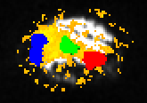
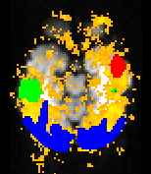
Figure X: Brain Activation with V1, PIT, and AIT overlay
View From the Right View From Above
View From the Right
View From the Right

Slide 8
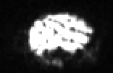
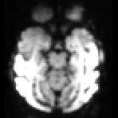
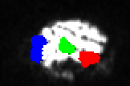
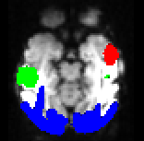
Brain at 3 Months
View From the Right
View From Above
AIT
V1
PIT
V1
PIT
AIT

Slide 9
Brain at 3 Months
View From the Right
View From Above
AIT
V1
PIT
V1
PIT
AIT

Slide 10
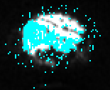
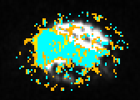
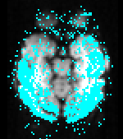
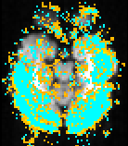
Comparison of Methodologies
Univariate T-Statistic
Multivariate Classifier
Overlay of Both
View From the Right
View From Above

Slide 11
Comparison of Methodologies
Univariate T-Statistic
Multivariate Classifier
Overlay of Both
View From the Right
View From Above

Slide 12
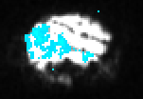
Comparison of P-values
P-value = 0.05
P-value = 0.0001
Comparison of P-values
P-value = 0.05
P-value = 0.0001

Slide 13
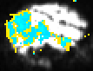
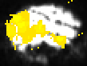
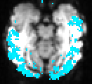
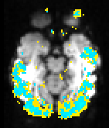
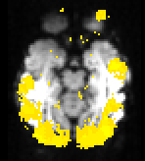
Comparison of Classifier Feature Space Size
OVERLAID
27 Dimensions
(3X3 cubic Searchlight)
View From the Right
125 Dimensions
(5X5 cubic Searchlight)
V1
PIT
AIT
OVERLAID
27 Dimensions
(3X3 cubic Searchlight)
View From Above
125 Dimensions
(5X5 cubic Searchlight)
PIT
V1
AIT

Slide 14
Comparison of Classifier Feature Space Size
OVERLAID
27 Dimensions
(3X3 cubic Searchlight)
View From the Right
125 Dimensions
(5X5 cubic Searchlight)
V1
PIT
AIT
OVERLAID
27 Dimensions
(3X3 cubic Searchlight)
View From Above
125 Dimensions
(5X5 cubic Searchlight)
PIT
V1
AIT

Slide 15
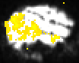



Maturing of
Visual Cortex
3
Months
3.5
Months
V1
PIT
7
Months
AIT
10.5
Months

Slide 16
Maturing of
Visual Cortex
3
Months
3.5
Months
V1
PIT
7
Months
AIT
10.5
Months

Slide 17
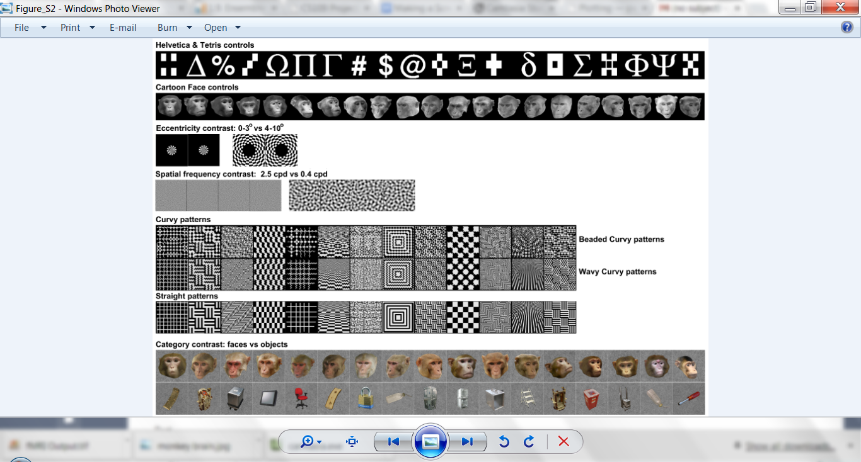
Example Experiment
Monkey named Paul shown 144 Images blocks
Images come from 4 Image Types
Brain activation measured every two seconds
One data point per voxel (cubic mm of brain*)
370,000 voxels per fMRI scan
3120 seconds of data
Voxels/scan * scans/second * seconds = 1,154,400,000 fMRI data points!
Monkey Faces
Straight Lines
Familiar Objects
Curvy Waves
* Voxels are cubic units of brain tissue with varying edge length. We chose 1mm.

Slide 18
Voxel fMRI Response to Stimulus
Response
Time
Stimulus
Start
Stimulus
End

Slide 19
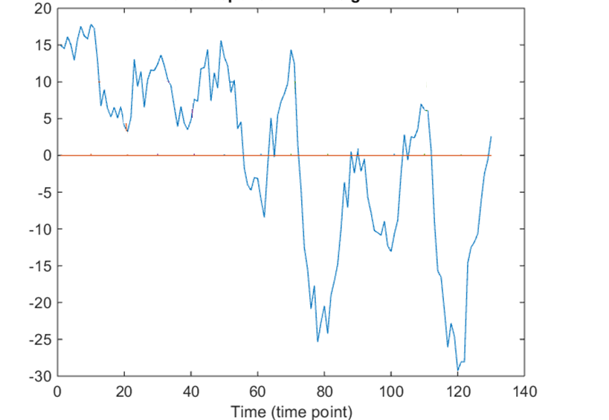
Voxel Response to Multiple Successive Visual Stimuli
Stimulus

Slide 20
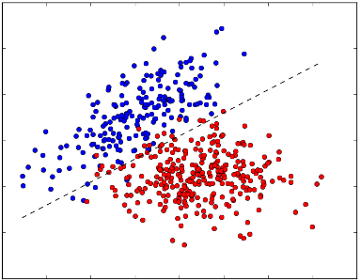
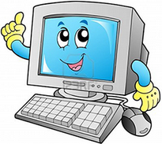
Machine Learning Classifier
TRAINING
 |  | Voxel 1 | Voxel 2 | Voxel 3 | ….
Category 1 | Image 1 | X.XX | X.XX | X.XX | X.XX | X.XX
 | Image 2 | X.XX | X.XX | X.XX | X.XX | X.XX
 | …. | X.XX | X.XX | X.XX | X.XX | X.XX
 |  | X.XX | X.XX | X.XX | X.XX | X.XX
 | Image 36 | X.XX | X.XX | X.XX | X.XX | X.XX
Category 2 | Image 1 | X.XX | X.XX | X.XX | X.XX | X.XX
 | Image 2 | X.XX | X.XX | X.XX | X.XX | X.XX
 | …. | X.XX | X.XX | X.XX | X.XX | X.XX
 |  | X.XX | X.XX | X.XX | X.XX | X.XX
 | Image 36 | X.XX | X.XX | X.XX | X.XX | X.XX
PREDICTION
Image 1
Image 2
Image 3
 | Voxel 1 | Voxel 2 | Voxel 3 | ….
Image 1 | X.XX | X.XX | X.XX | X.XX | X.XX
Image 2 | X.XX | X.XX | X.XX | X.XX | X.XX
Image 3 | X.XX | X.XX | X.XX | X.XX | X.XX

Slide 21
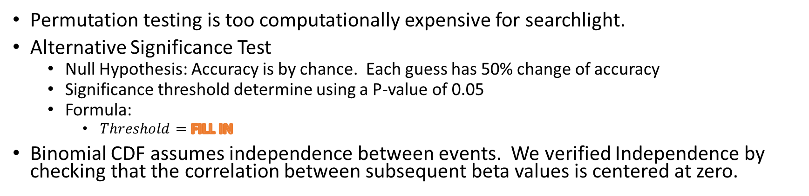
Searchlight Accuracy Significance Test
Permutation testing is too computationally expensive for searchlight.
Alternative Significance Test
Null Hypothesis: Accuracy is by chance. Each guess has 50% change of accuracy
Significance threshold determine using a P-value of 0.05
Formula:
$Threshold=$FILL IN
Binomial CDF assumes independence between events. We verified Independence by checking that the correlation between subsequent beta values is centered at zero.
Independence test image

