Slide 1
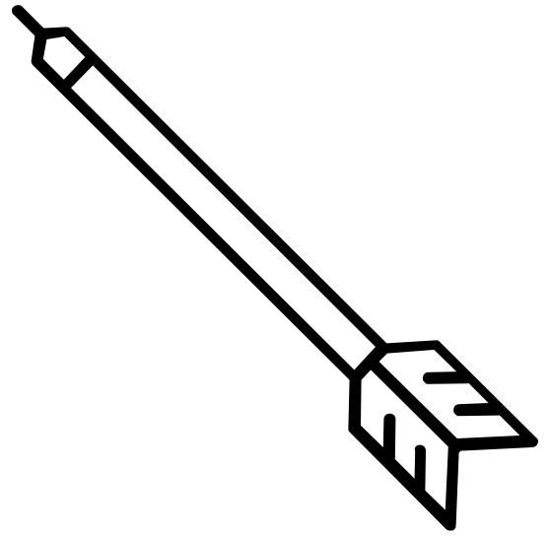
1.0
0
0.261
1.0

Slide 2
1.0
heads
tails
0
0.5
1.0

