Slide 1









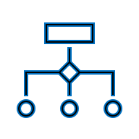



ML-9 Team Project: Stroke Prediction
Dataset
Risks & Unknowns
11 features, 5110 records:
Demographic
Residence type
Health indicators
Socioeconomic
Stroke occurrence
Techniques & Technologies
Class imbalance (limited stroke data)
Missing data, general quality
Generalizability
Model complexity
Logistic Regression
Random Forest
Neural Network (FCNN)
Parameter tuning
Regularization
Cross-validation
Outcomes
Aims
Baseline models
Neural networks
Evaluation metrics
Identify key indicators
Stroke-risk model
Targeted screening
Actionable insight
Prioritize care

