Slide 1

Smelly Pittsburgh
Analysis of Crowd-Sourced Air Quality Data in Pittsburgh
By: Bristow Richards and Sara Khoshhal

Slide 2
Introduction
Pittsburgh has some of the worst air pollution in the country, ranking 9th worst in the country for long-term particle pollution
Smell Pittsburgh: open-source community environmental reporting tool titled Smell Pittsburgh to analyze trends in air pollution and environmental justice in Pittsburgh
Users create “smell reports” that rate the severity of air quality issues on a scale of 1-5, in addition to the reporter’s geographic coordinates and any qualitative notes the user would like to submit
Notes:
Source: https://stateimpact.npr.org/pennsylvania/2021/04/21/pittsburghs-air-improving-but-still-gets-an-f-from-american-lung-association/
Source: https://smellpgh.org/data

Slide 3
Problem Statement
Are there any observable trends in the areas that report a high volume of poor odors, specifically pertaining to the demographic or geographic composition of these areas?
What areas see the most reporting, and why?

Slide 4
Findings

Slide 5
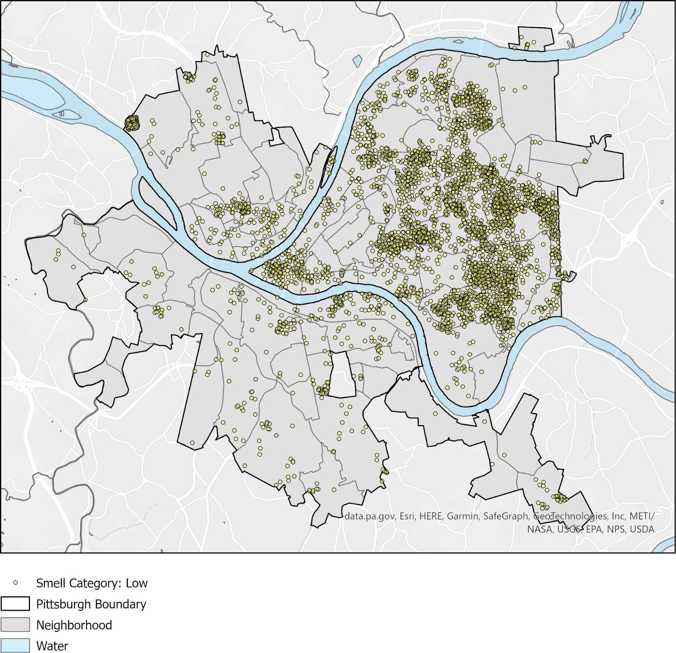
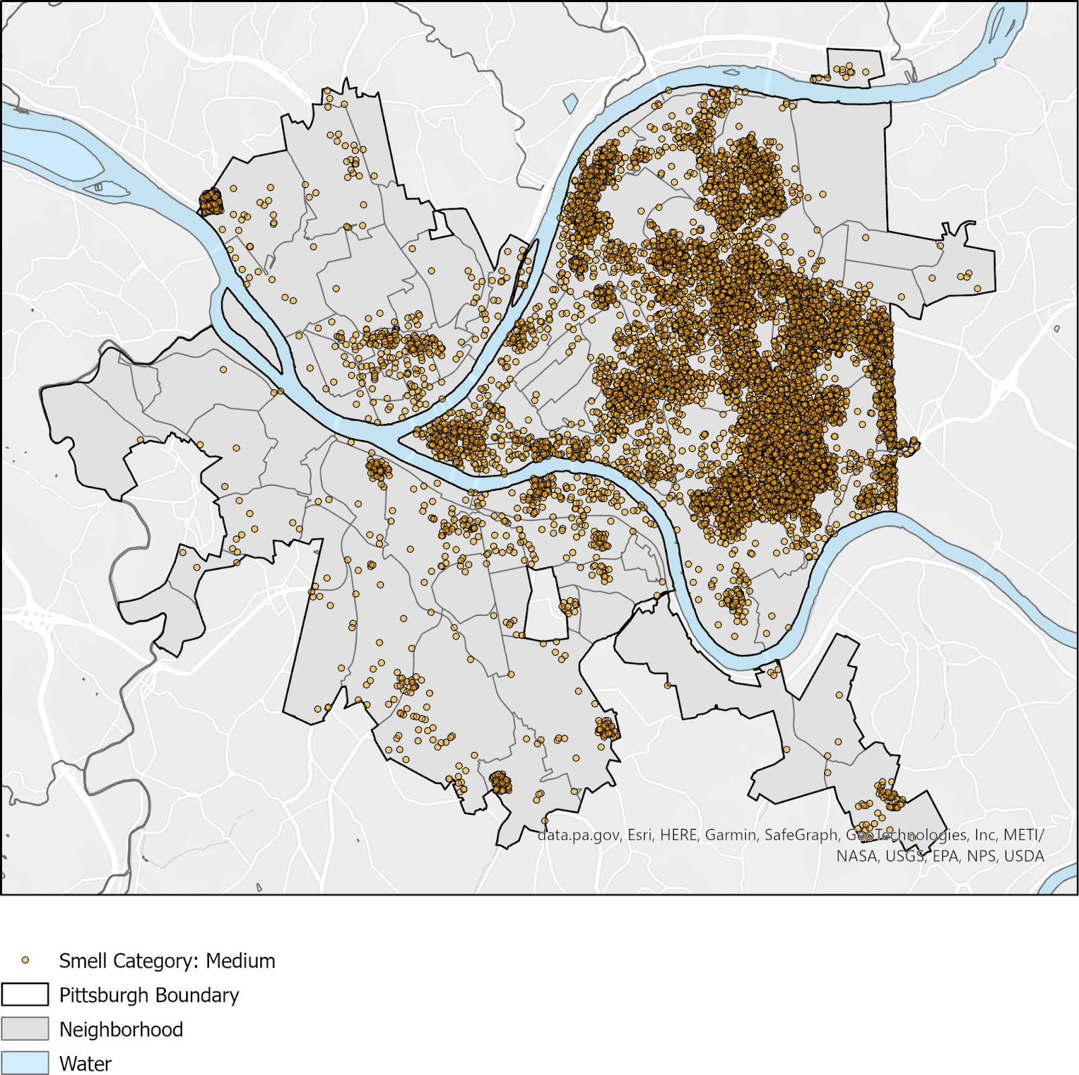
Low and Medium Smell Severities

Slide 6
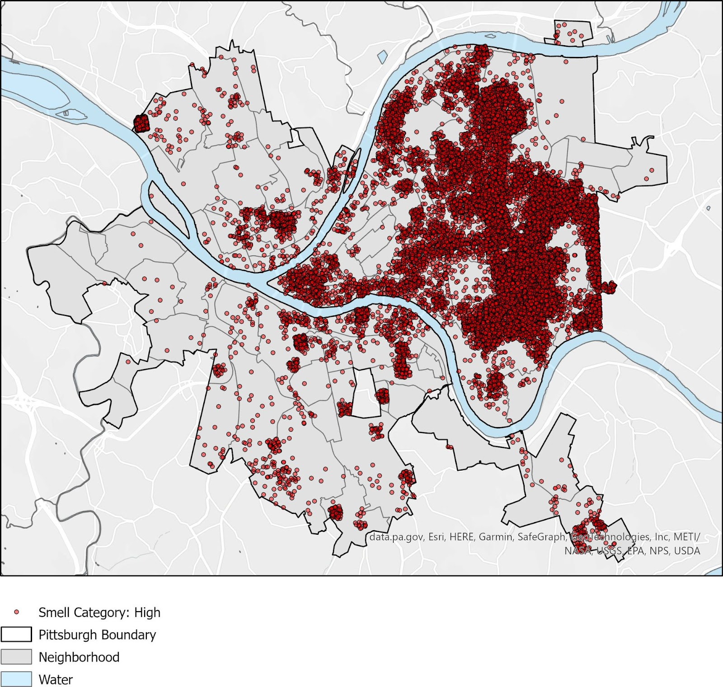
High Smell Severity

Slide 7
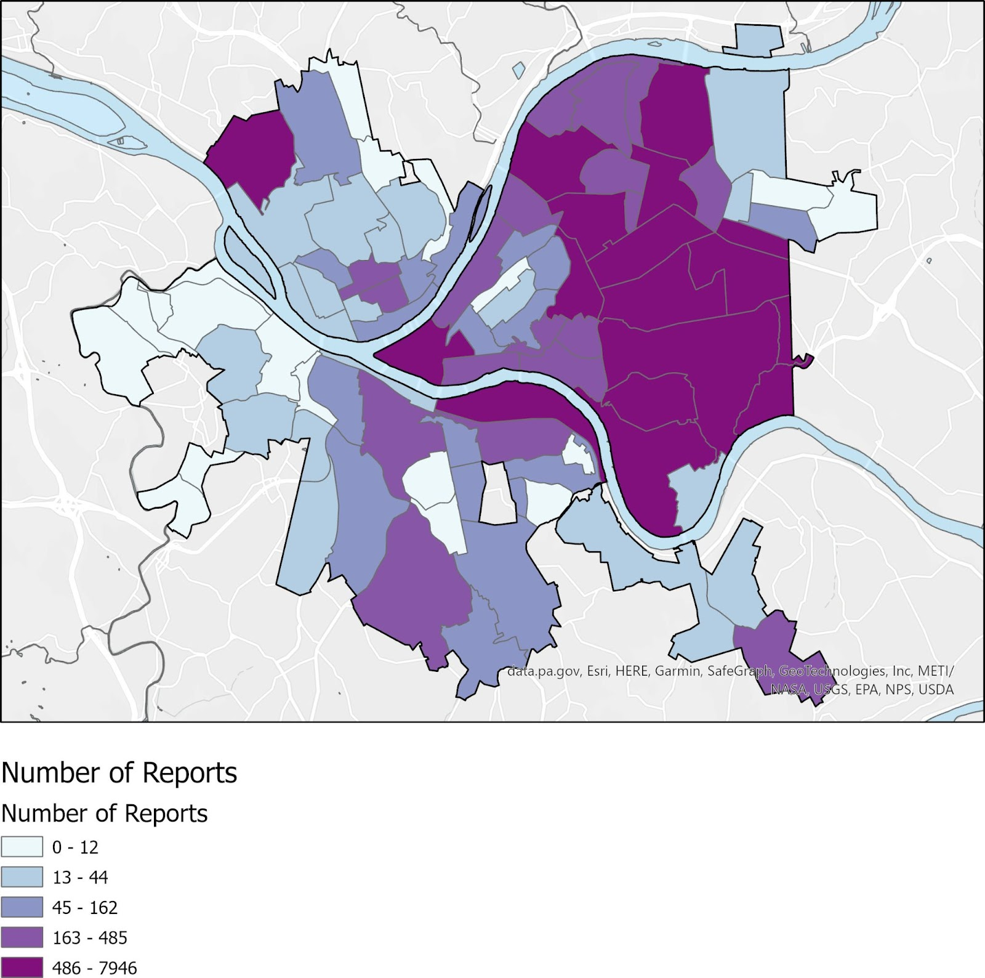
Number of Reports Per Neighborhood

Slide 8
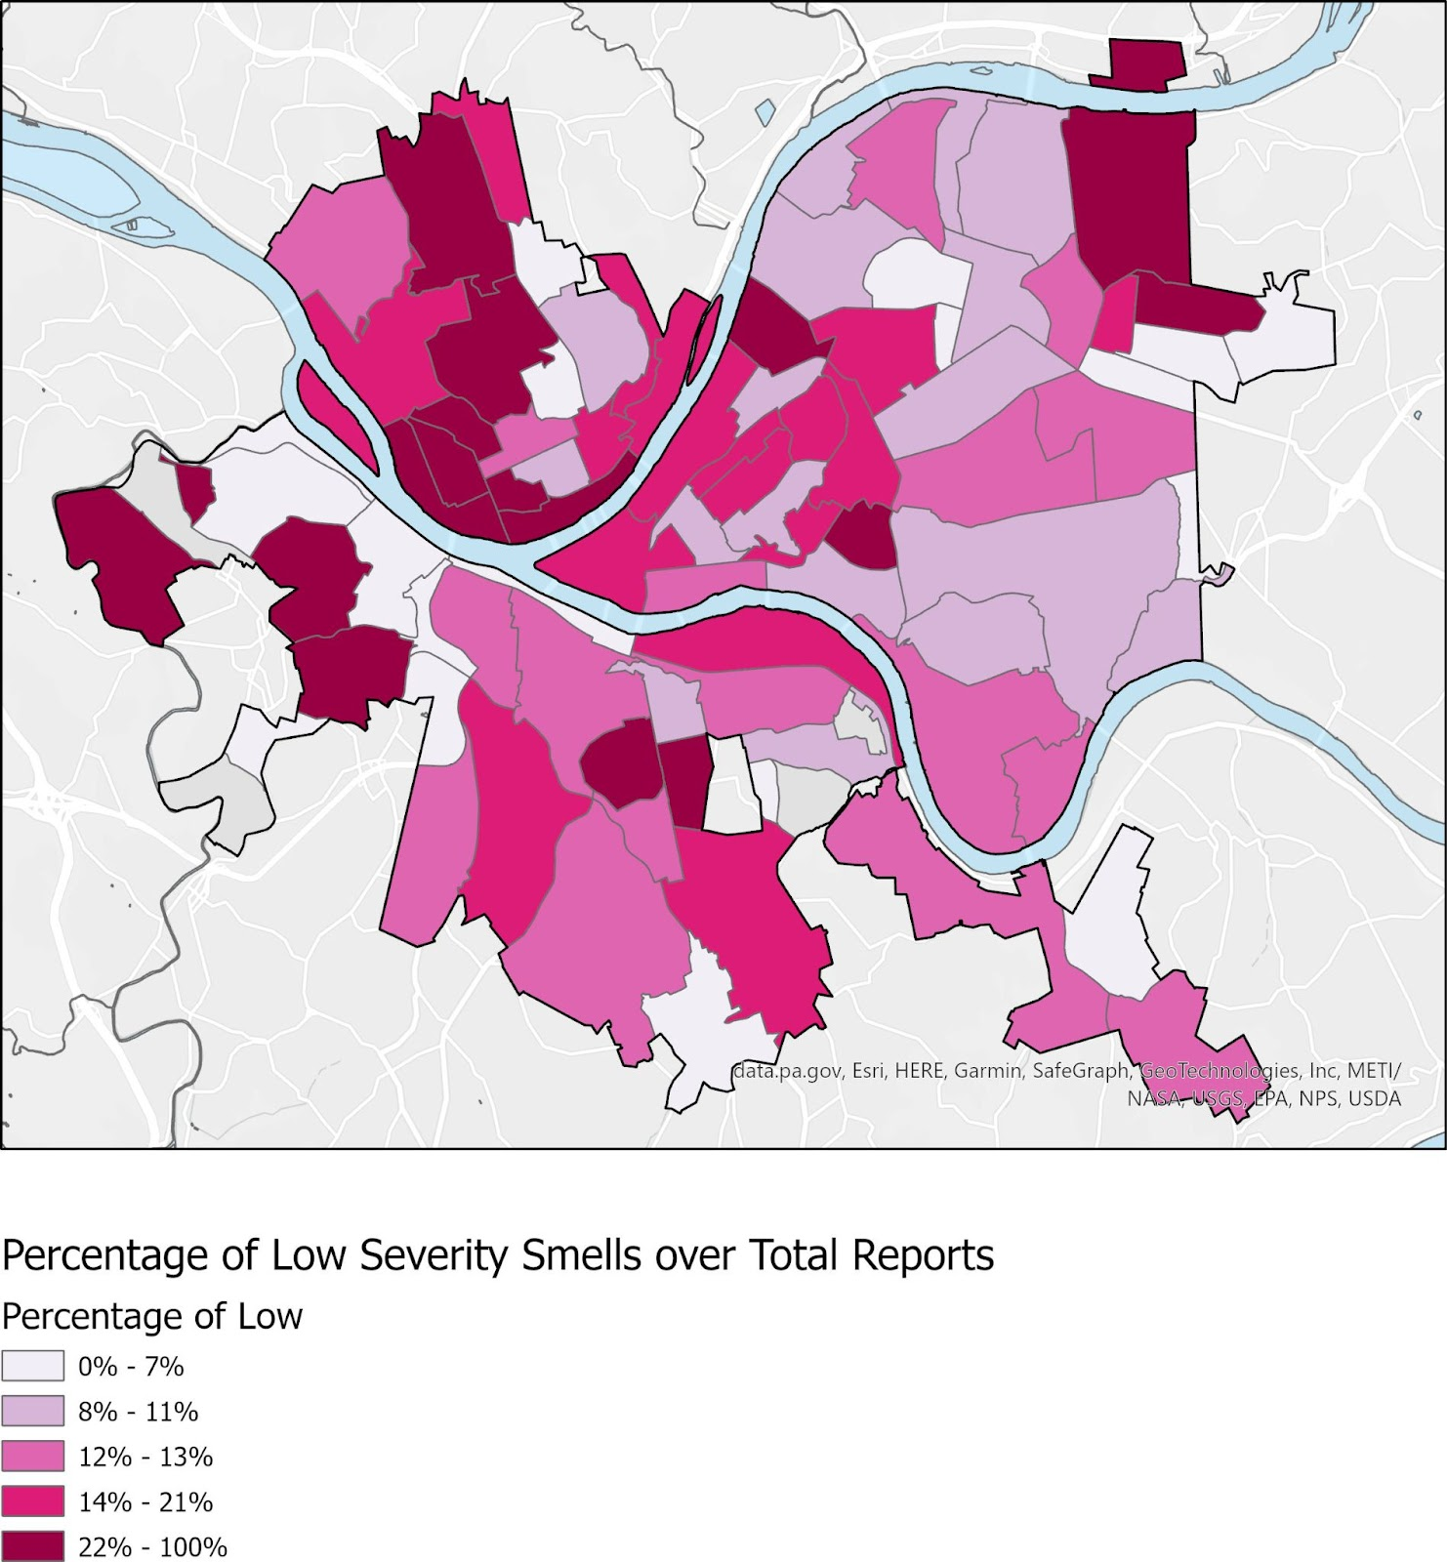
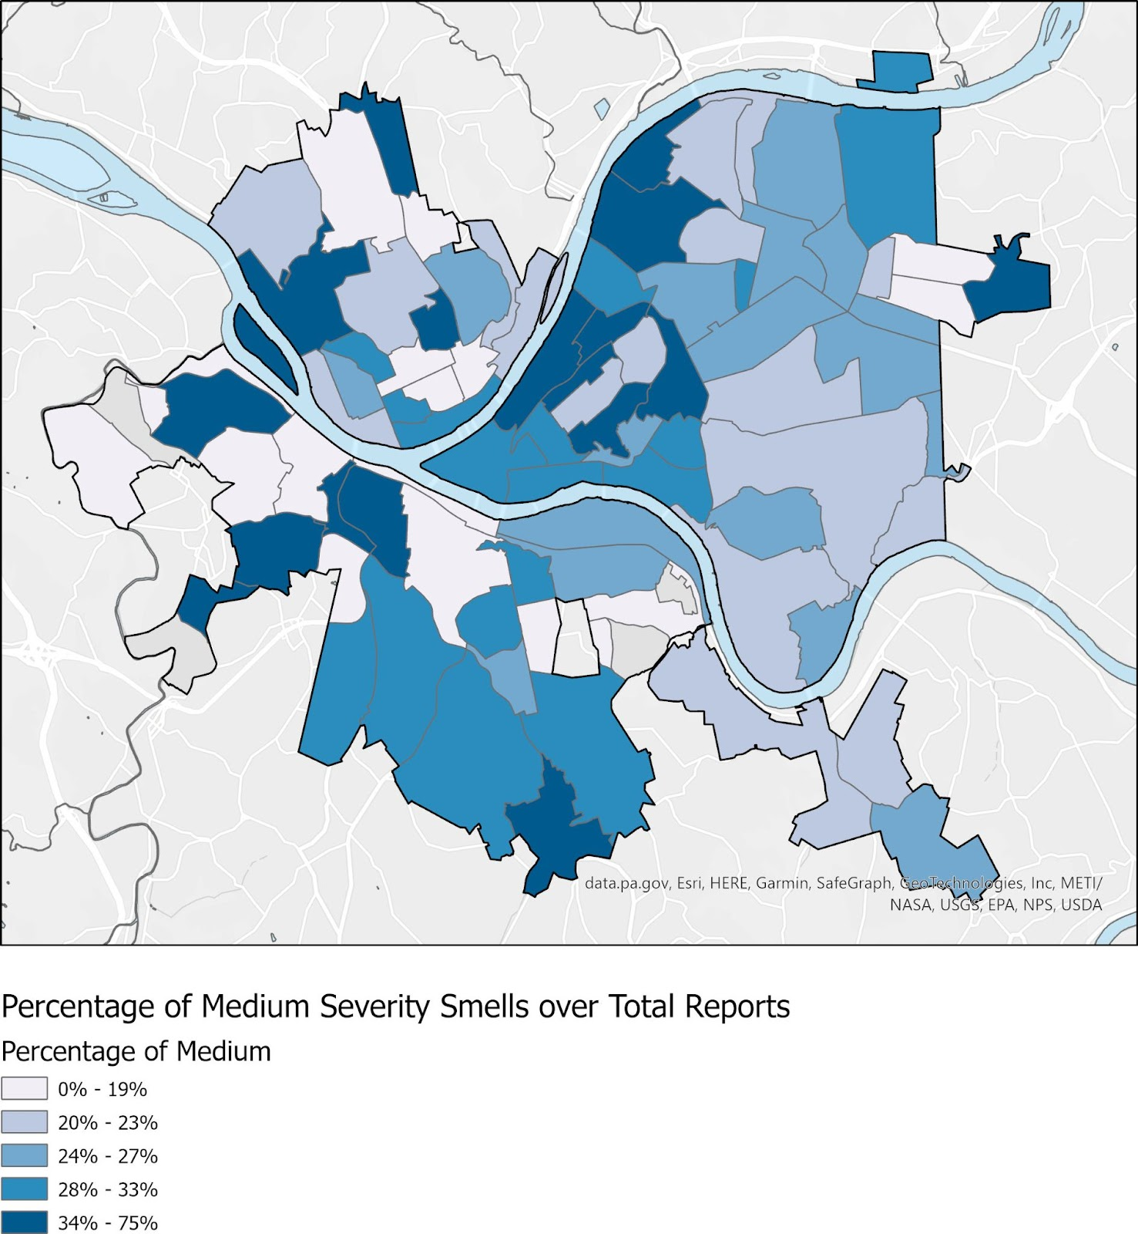
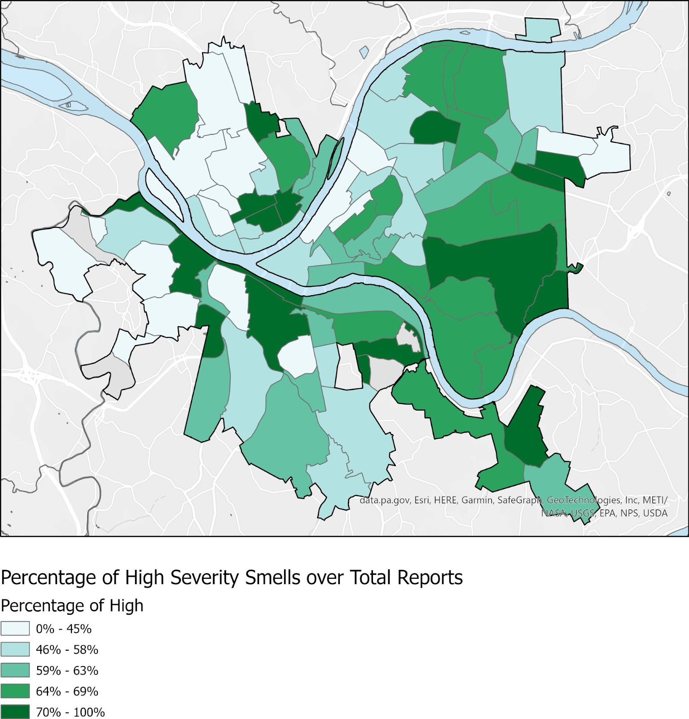
Percentage of Low, Medium, High Severity Smell Reports over Total Reports

Slide 9
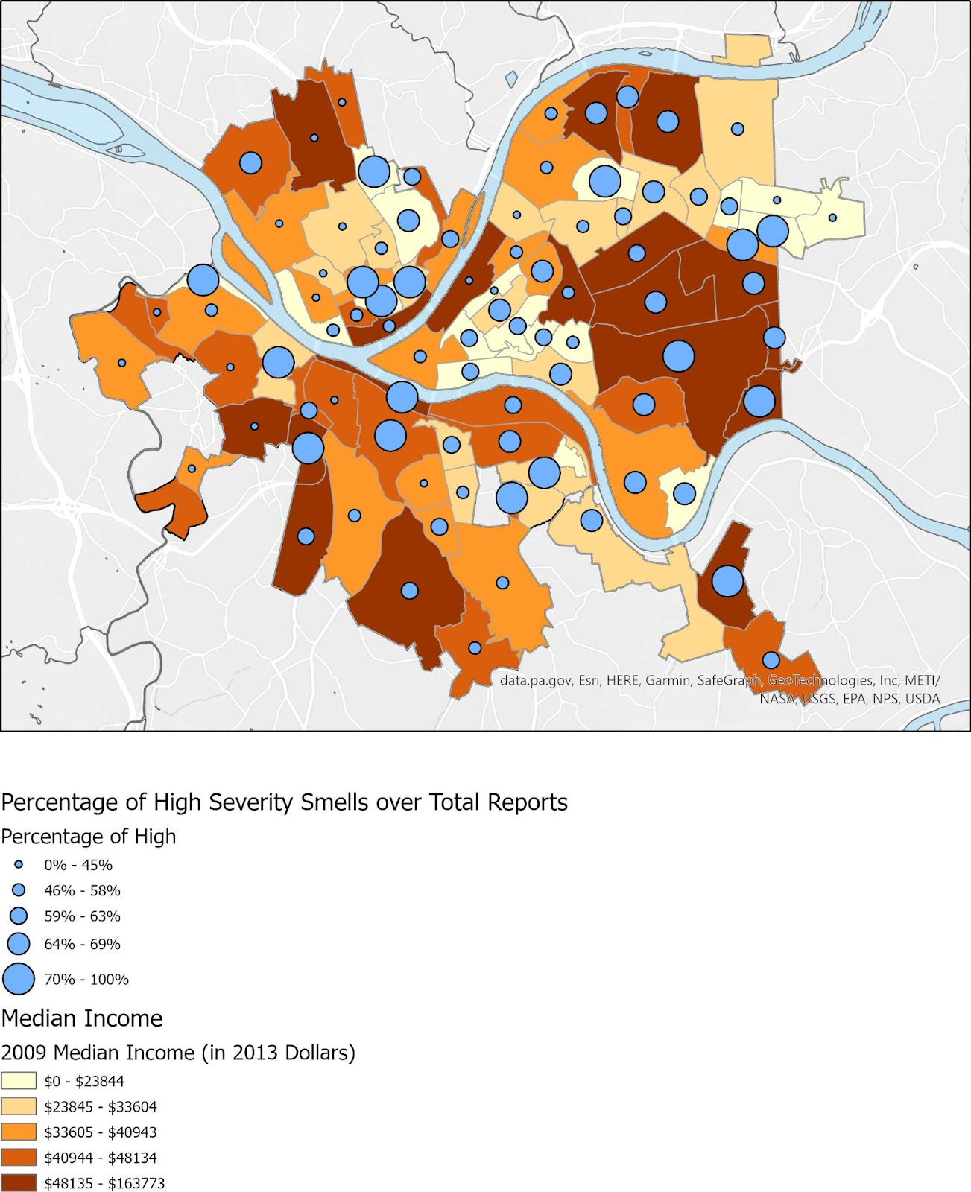
Percentage of High Severity Smells And Median Income of Neighborhood

Slide 10
Conclusions
More samples/ reporting need to be collected
Ensure minimum number of reports are collected from each neighborhood that is underrepresented
Have a threshold for minimum sample size in the future

Slide 11
Data Sources
Pittsburgh PA GIS Open Data Portal - Neighborhoods with SNAP Data: https://pghgishub-pittsburghpa.opendata.arcgis.com/datasets/pittsburghpa::neighborhoods-with-snap-data/about
Pittsburgh PA GIS Open Data Portal - City of Pittsburgh Boundary: https://pghgishub-pittsburghpa.opendata.arcgis.com/datasets/pittsburghpa::pittsburgh-city-boundary/explore?location=40.430815%2C-79.979816%2C12.25
Alleghany County GIS Open Data Source: https://openac-alcogis.opendata.arcgis.com/datasets/AlCoGIS::allegheny-county-hydrology-areas/explore?location=40.434655%2C-80.022402%2C9.65
Smell Pittsburgh Data Documentation and Direct Download:https://smellpgh.org/data

