Slide 1



World Development Indicators
Which country will develop more?
Leonardo Comandini
Viktor Snesarevskii
Andrea Schiavon
Stefano Moawad
Diana Isaeva

Slide 2
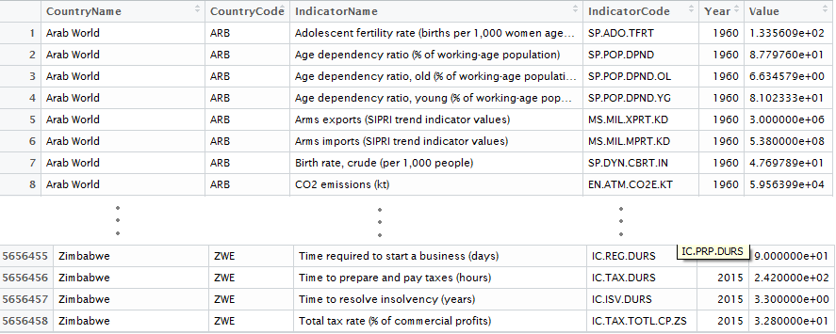


*
indicators
years
countries
*much more irregular

Slide 3
1344 indicators
select the fullest
arrange into topics
analyze the main ones
PCA
Inference

Slide 4
Ease to start a business
Agriculture
Economic indicators
Topics
Natural resources
Telecommunication
Productivity
*
Trade
* others may be added

Slide 5
dimensionality
reduction
PCA
2D representation
identification of
particular behaviours

Slide 6

Telecommunications
Population growth
Fixed telephone subs
Mobile cellular subs
Urban population growth
Internet users
2010
2000
Albania
Argentina
:
:
USA

Slide 7
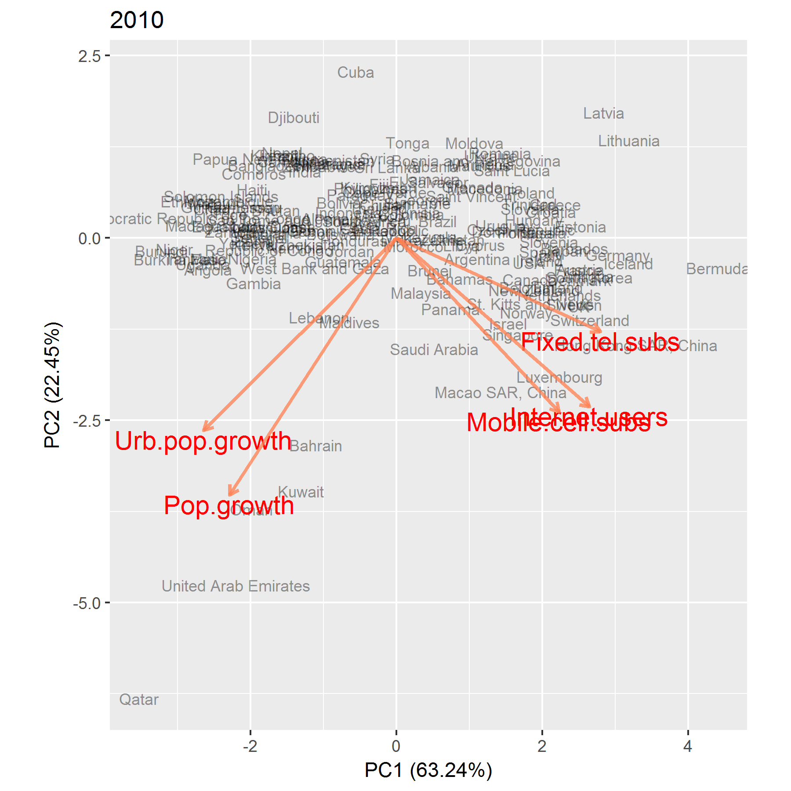
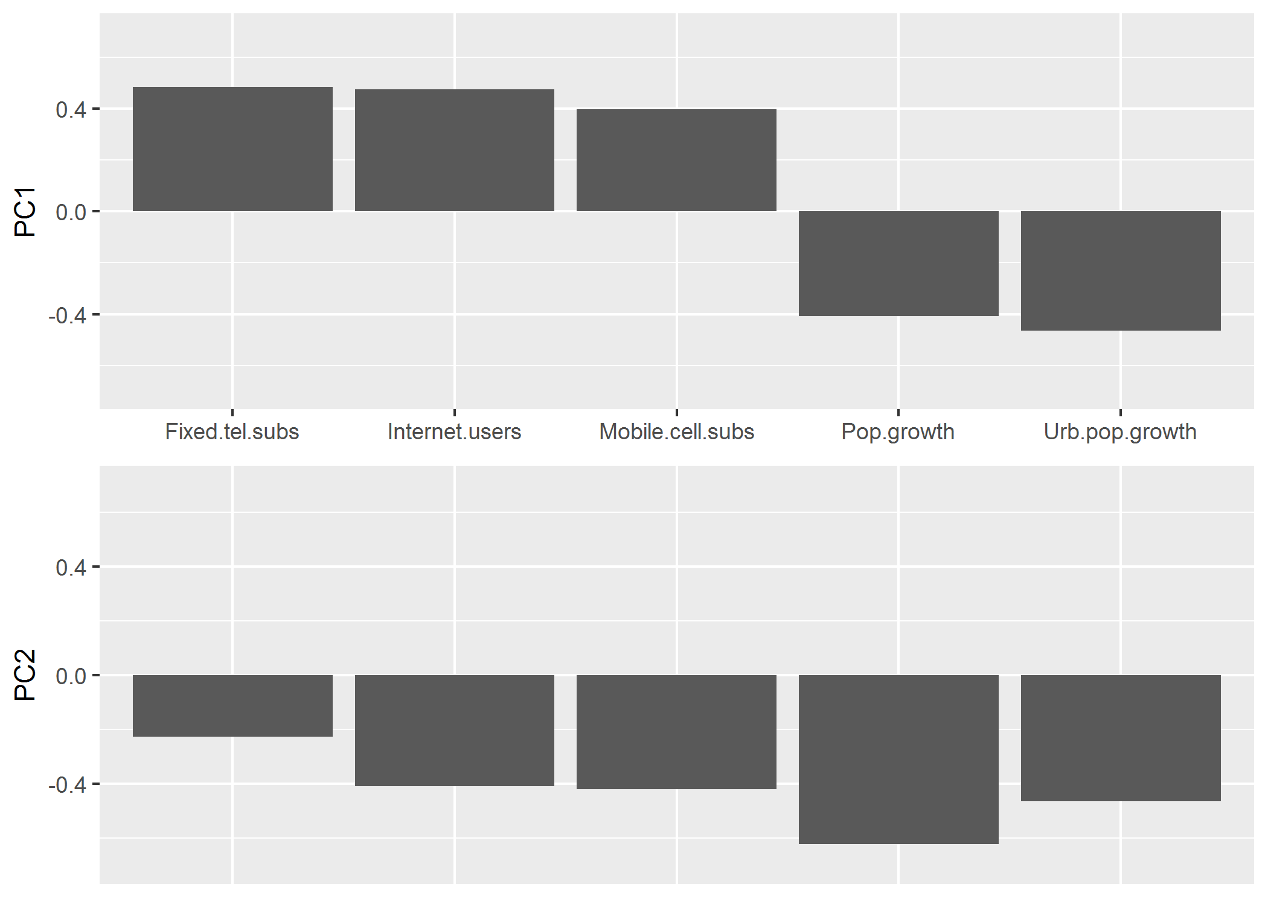
PCA for 2010

Slide 8
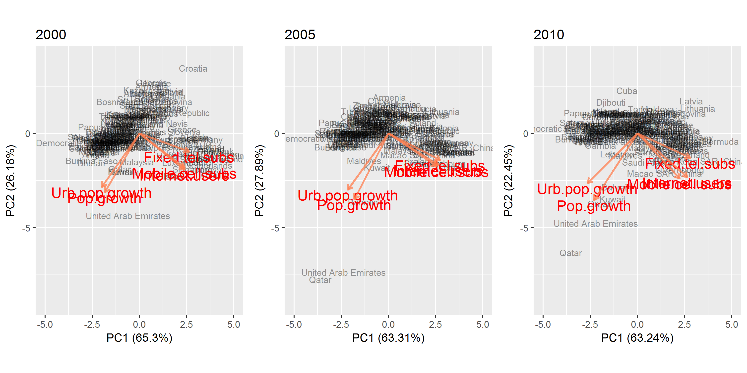
Comparing results 2000-2010

Slide 9
growth
inference
growth during
the 2008 crisis
growth vs Income,
Region, and Year

Slide 10


by growth we mean the annual
percentage variation of the GDP per
capita in local currency.
More formally,
where GDP is the Gross Domestic
Product per capita

Slide 11
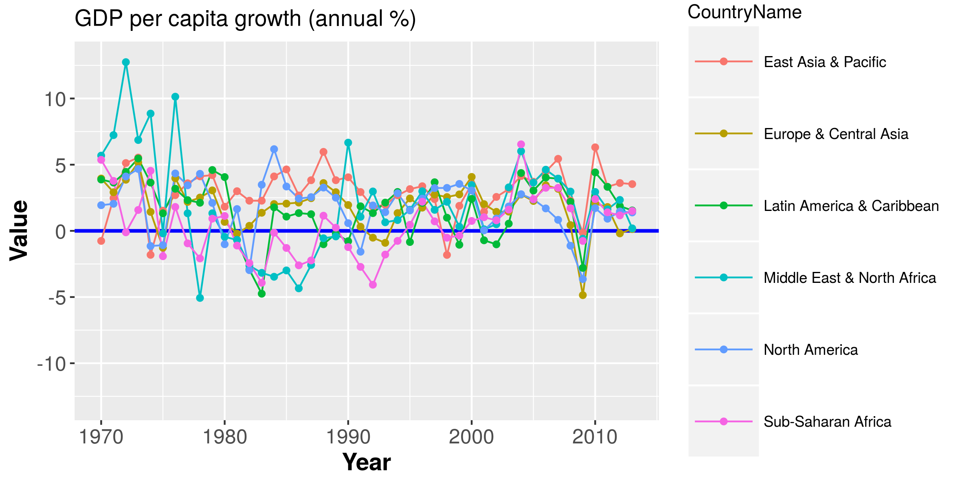
Can we say that there was no growth over this time span?
What happened in 2008/2009?

Slide 12

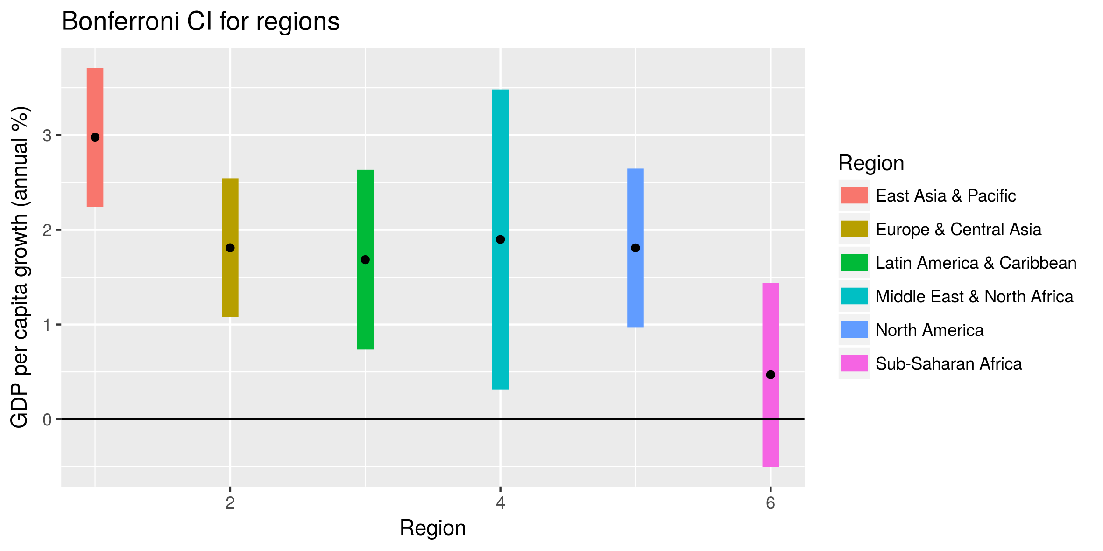
T2 test

Slide 13

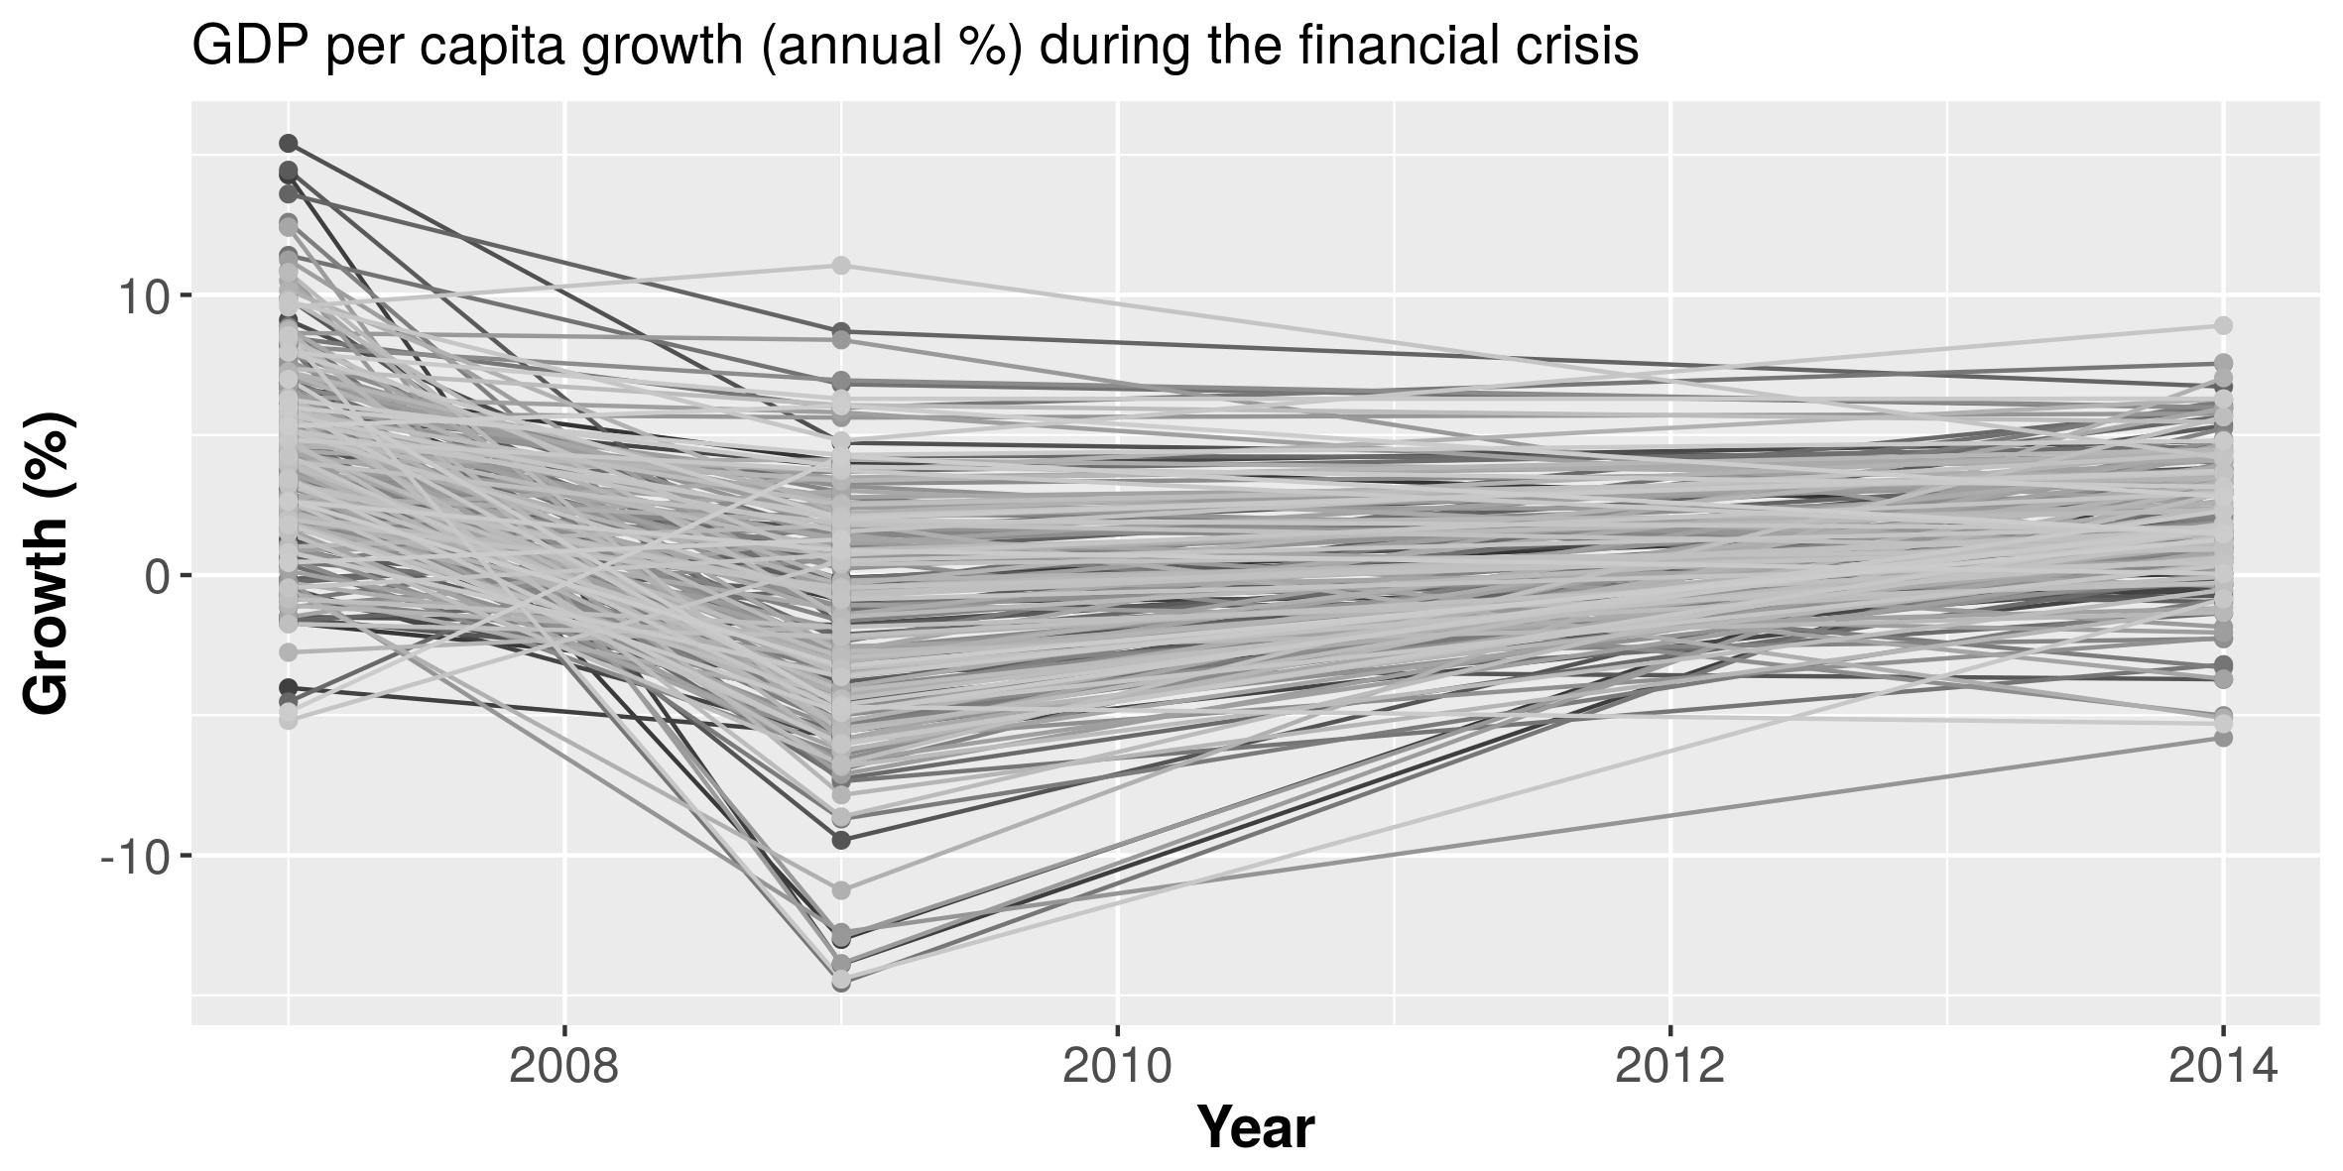
Repeated measures test

Slide 14
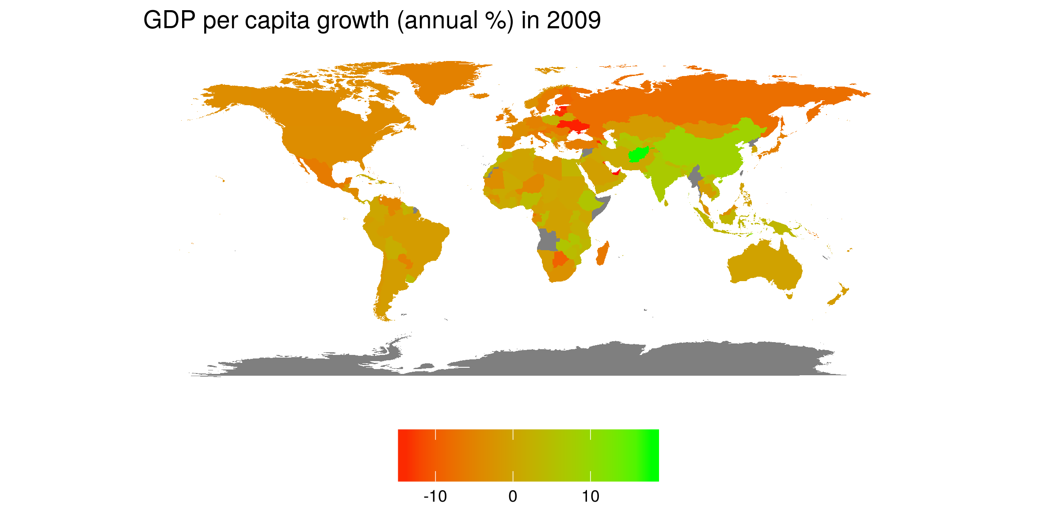
During an economic crisis does geography play a role?
Does an economic crisis strike heavier high-income
countries than low-income ones?

Slide 15
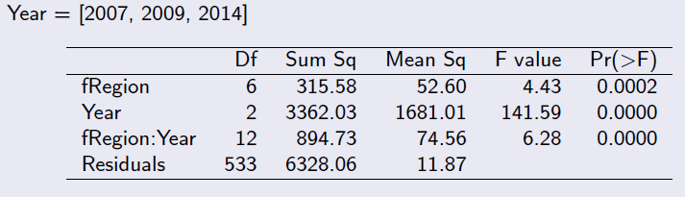
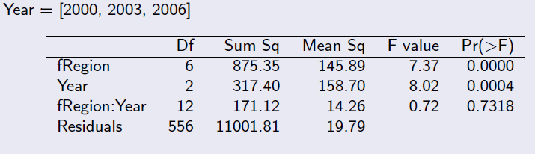
ANOVA
two-way
During crisis
No economic turmoils

Slide 16
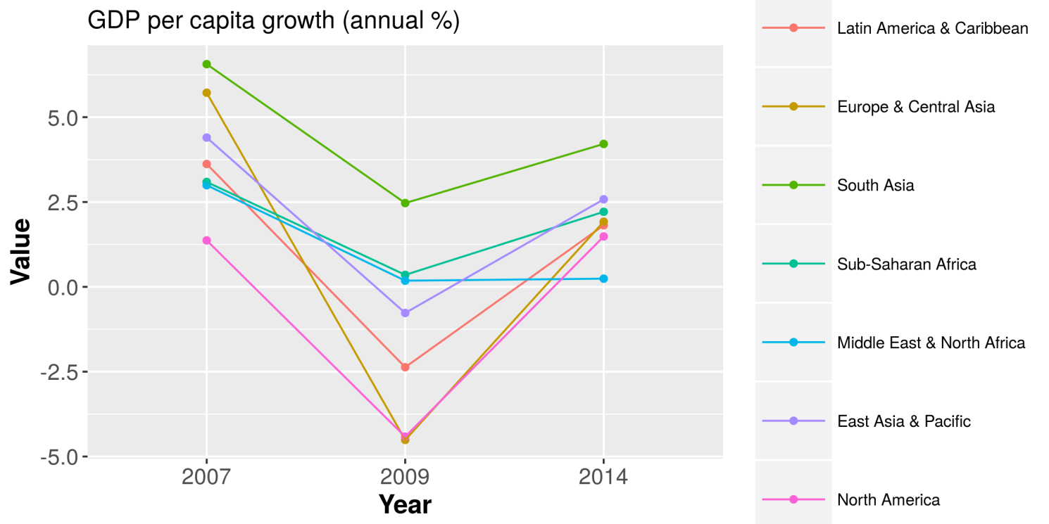
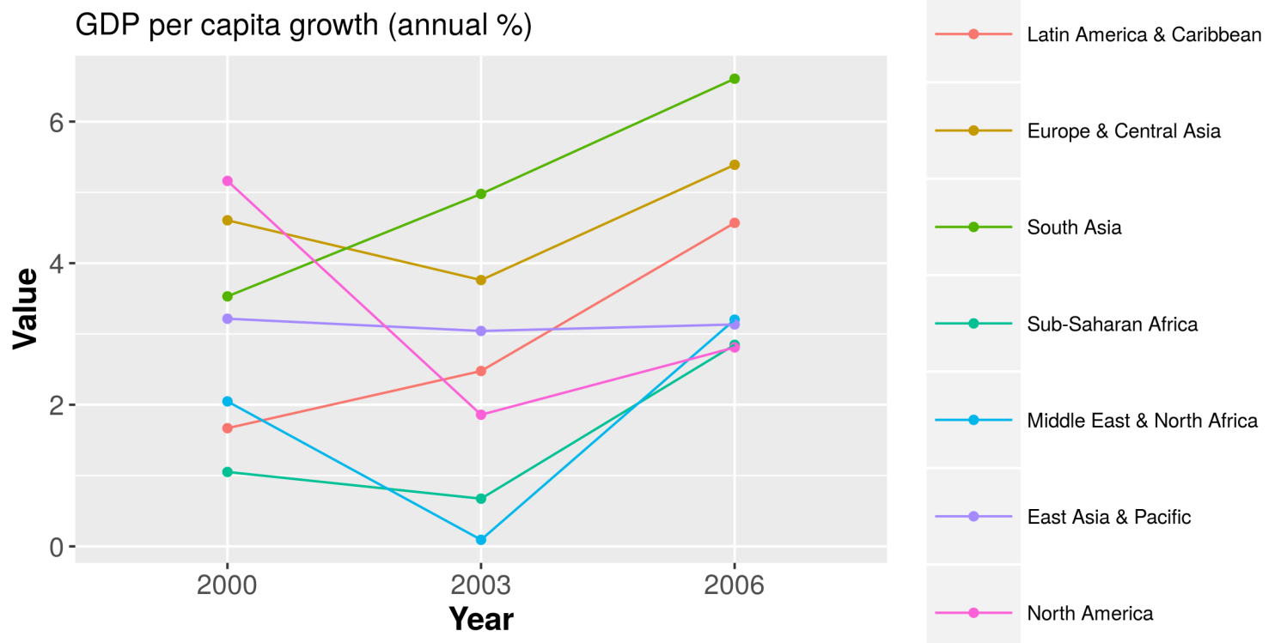
visualize the interaction

Slide 17
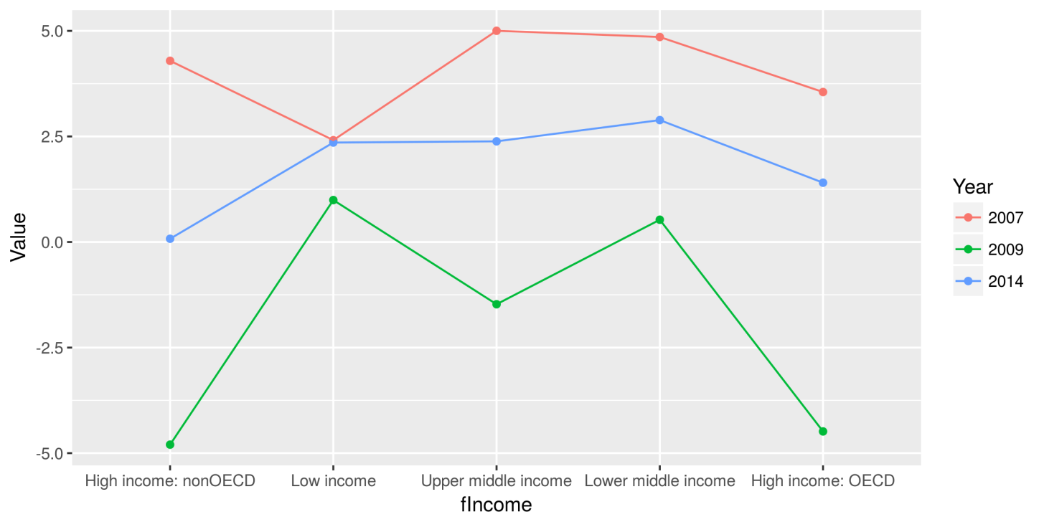
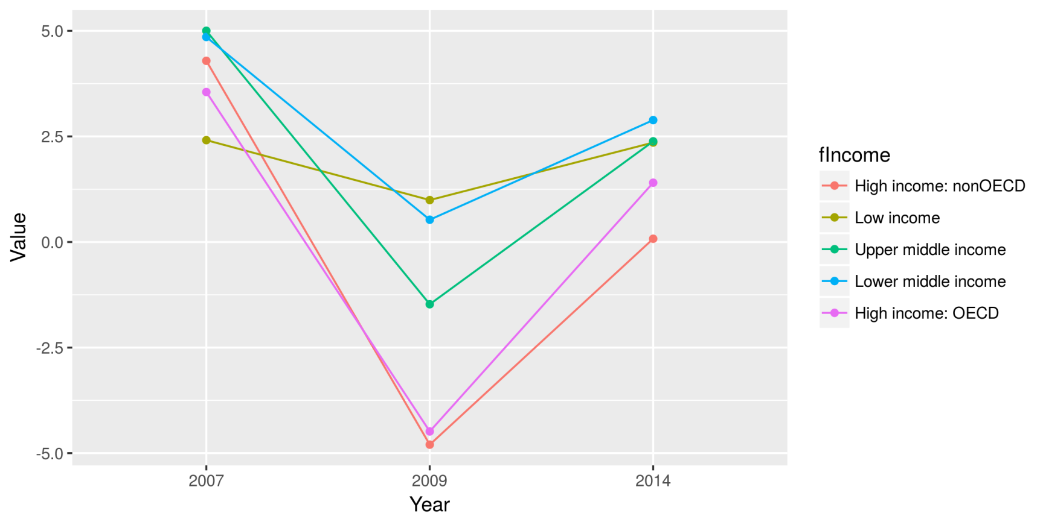
Does IncomeGroup affect Growth?

