Slide 1
Analysis of Methods for Background Execution in Modern Web Applications
Analyse von Verfahren für Hintergrundausführung in modernen Webanwendungen

Slide 2
Agenda
Introduction and motivation
JavaScript execution model
Analysis of browser behaviours
Dynamic analysis of popular web sites

Slide 3
Introduction and motivation

Slide 4








Introduction and motivation
Notes:
Web apps are a popular alternative to traditional software
Browser is used to access web apps
Apps are often left open during computing activities
Web is a lucrative target for malicious entities to gain script execution
For example by XSS, MitM attacks, Malvertising

Slide 5

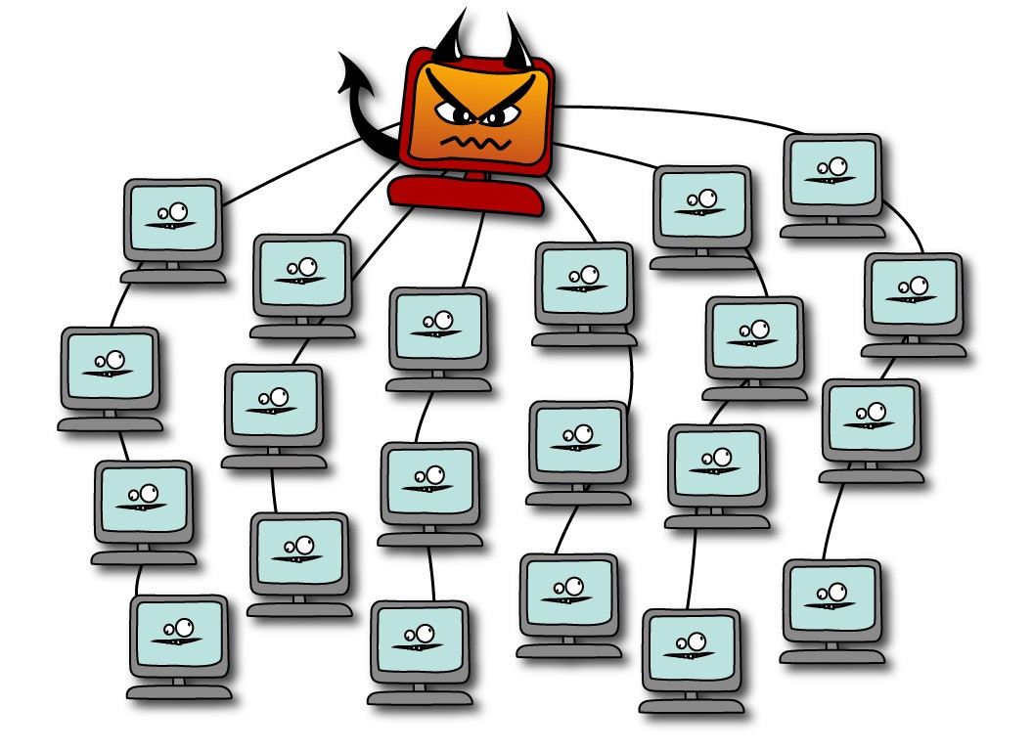
Introduction and motivation
Crypto currency miners
Browser-based botnet (Grossmann et al. 2013)
Hash cracking
DDoS
Gray computing (Yao Pan et al. 2015)
Side or covert channels
Website fingerprinting
Information leakage from other web sites (Spectre)
Image by Erin Gallagher @3r1nG
Notes:
Possible attacks if an adversary gains script exectution
Monero is a crypto currency with proof of work algorithm optimized for general purpose CPUs (High memory usage makes it improfitable for Asics or GPUs)
Miners implemented with web technologies are freely available
Web technologies can be used for a browser based botnet. Command and control server provides commands via HTTP or WebSocket connection
Grey computing uses CPU resources from visitors as alternative to cloud based computing resources for batch processing.
Side or covert channels allow adversaries to gain more information about the vicitims usage. Side channels can be used for web site fingerprinting or activity detection
Spectre attacks allow attackers to read memory of other web sites
In summary: script injection is a major attack vector

Slide 6
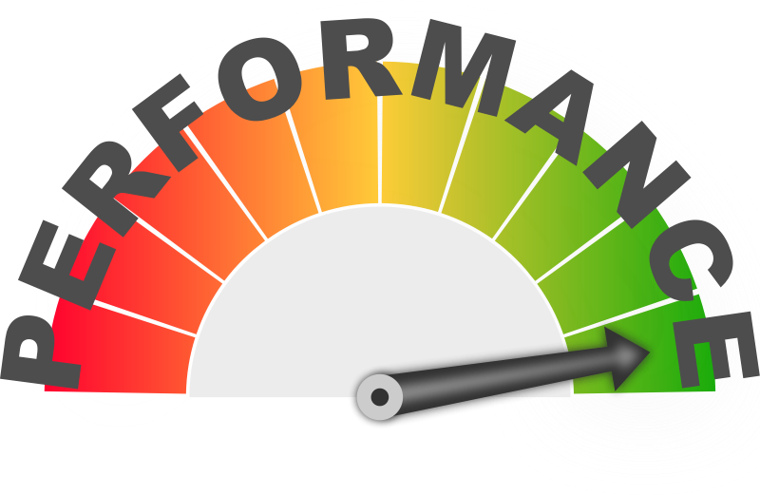
Introduction and motivation
Browsers have implemented energy conserving measures for background tabs
Do these measures prevent these attacks. If not, how can they be circumvented
Notes:
All attacks presented benefit from background execution. Crypto currency miners or gray computing are more profitable, Browser based botnets have longer control over browsers, side channels can continously monitor user activity / memory
HOWEVER, Browsers implemented throttling mechanisms for energy efficiency reasons

Slide 7
Javascript execution model

Slide 8
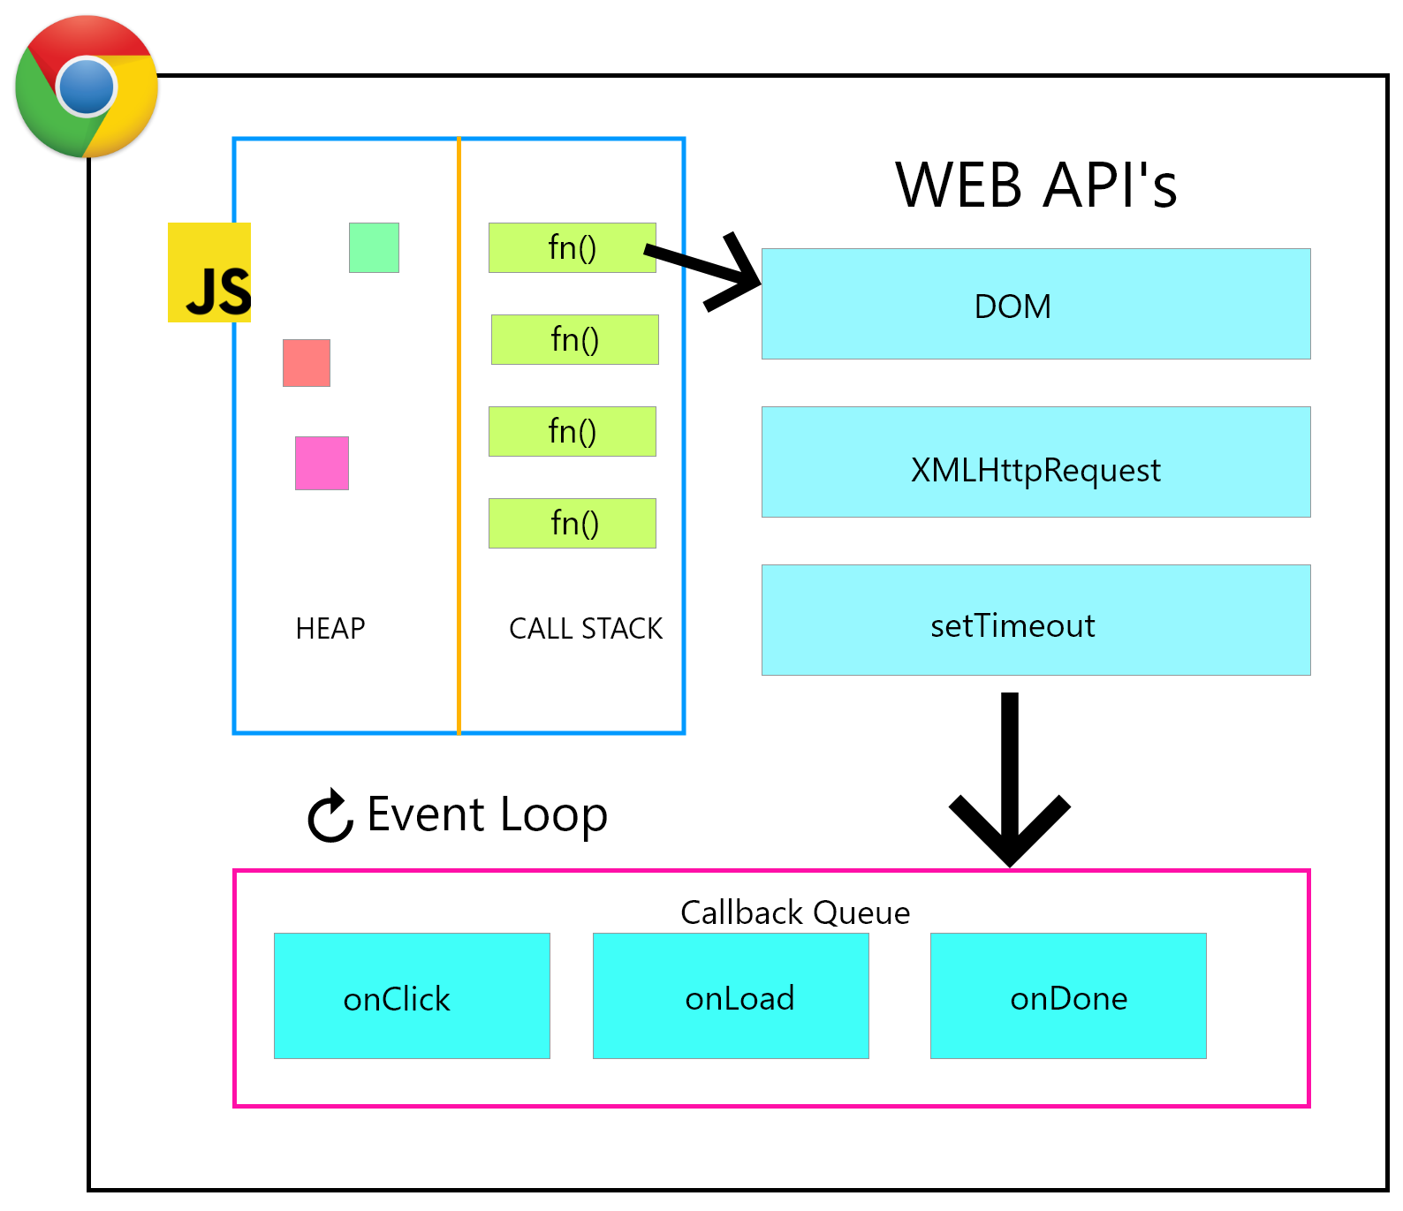
JavaScript execution model
One execution context per window and origin
Event loop executes tasks from task queue
Tasks are created in response to events
Tasks execution happens in serial
Image from freeCodeCamp
Notes:
Each window has it‘s own execution context. Execution context consist of heap memory and global object.
Each exeuction context has an event loop
Event loop executes tasks added to the task queue. Tasks can be added by registering for events (e.g. button was clicked, form was submitted) or by execution long running tasks (e.g. network request, geolocation, etc.)
Tasks are executed in a serial manner. No two tasks run at the same time.

Slide 9
Analysis of browser behaviours

Slide 10
Objectives
Which methods exist to schedule tasks programmatically
Do browser implementations throttle or limit the methods in the background
How do browser implementations differ with respect to their throttling behaviour
We consider Chrome, Firefox and Safari for desktop and Chrome for Android, Firefox for Android and Mobile Safari for mobile

Slide 11
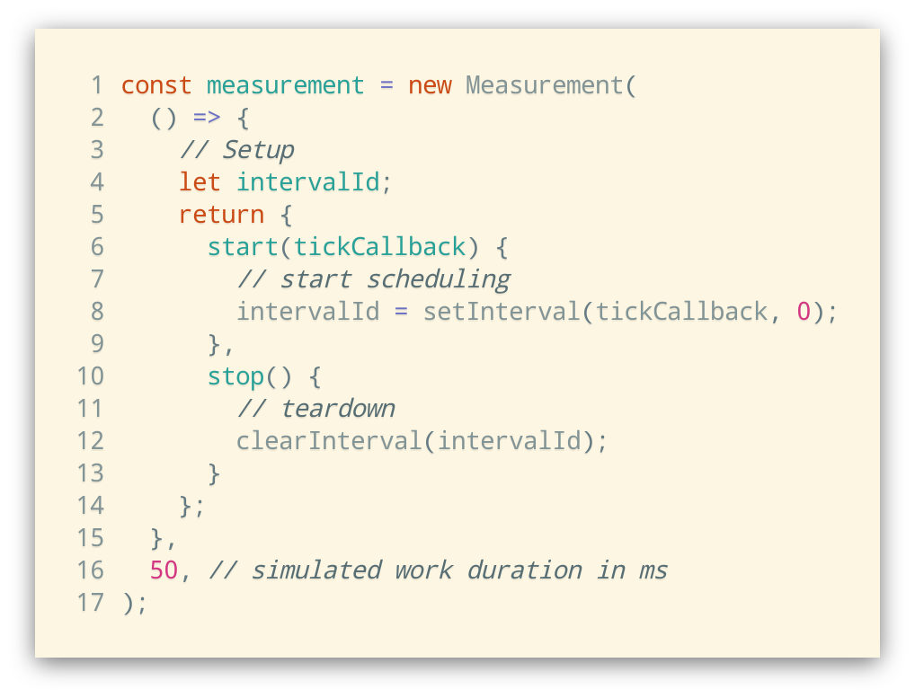
Measurement framework
Framework for measuring and comparison of scheduling methods
Simulates work load
Collects time between invocations
Calculates average CPU usage
Creates visualization and CSV export for processing

Slide 12
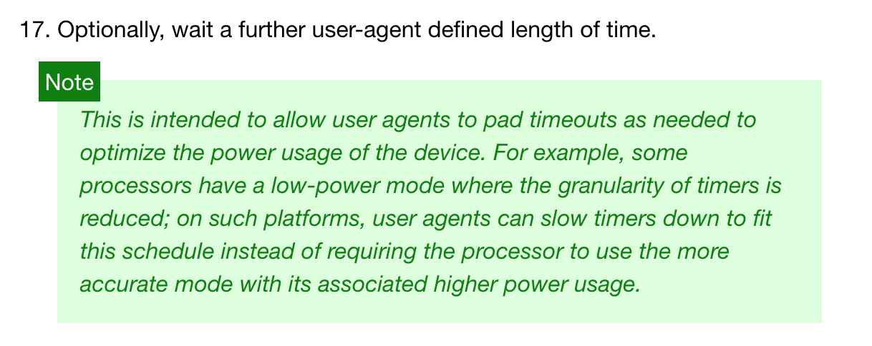
Timer tasks
window.setInterval() and window.setTimeout()
HTML5 Specification: Timers
Notes:
The most straightforward way to add tasks to the task queue programmatically via setInterval or setTimeout()
This method is throttled by all browser implementations for energy efficiency reasons
Specification defines that user agent can wait for additional time. Minumum is 4ms

Slide 13
Timer tasks
50 ms workload
1000 ms workload
Chrome and Firefox use budget-based throttling
Safari timers waiting time increases exponentially
Notes:
Chrome begins throttling after 10 seconds. After that, budget based throttling kicks in limiting to 1% of CPU time on average
Firefox waits additional second before next invocation => 50% cpu usage. After 30 seconds,

Slide 14
Timer tasks with WebSocket or AudioContext
Browsers try to keep backward-compatibility
Heuristics to determine if web page needs additional execution time
WebSocket connection is active
Used for realtime notifications or communication
AudioContext was created and is active
Audio routing graph for usage with Canvas or WebGL
Play sound in response to events
Both APIs are invisible to the web site visitor
How does throttling change when using a WebSocket or AudioContext?

Slide 15
Timer tasks with WebSocket

Slide 16
postMessage() tasks

Slide 17
Web worker timer tasks

Slide 18
Summary
Browser throttling can be circumvented
Chrome and Firefox
Safari stops after ~ 8 minutes of high energy usage

Slide 19
Dynamic analysis of popular websites

Slide 20
Preparation

Slide 21
Tracing

Slide 22
Analysis of traces

