Slide 1
Analysis of Methods for Background Execution in Modern Web Applications
Analyse von Verfahren für Hintergrundausführung in modernen Webanwendungen

Slide 2
Agenda
Introduction and motivation
JavaScript execution model
Analysis of browser behaviours
Dynamic analysis of popular web sites
Discussion

Slide 3
Introduction and motivation

Slide 4








Introduction and motivation
Notes:
Web apps are a popular alternative to traditional software
Browser is used to access web apps
Apps are often left open during computing activities
Web is a lucrative target for malicious entities to gain script execution
For example by XSS, MitM attacks, Malvertising

Slide 5

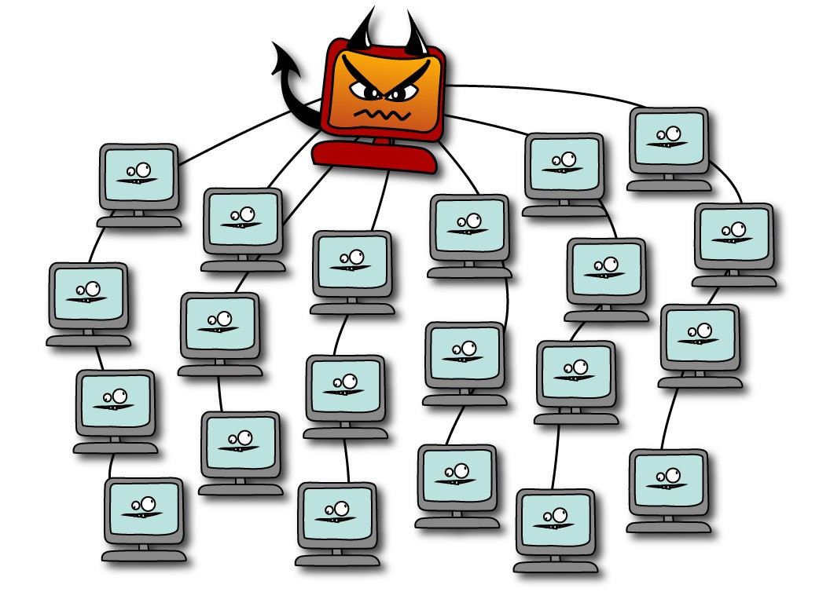
Introduction and motivation
Crypto currency miners
Browser-based botnet (Grossmann et al. 2013)
Hash cracking
DDoS
Gray computing (Yao Pan et al. 2015)
Side or covert channels
Website fingerprinting
Information leakage from other web sites (Spectre)
Image by Erin Gallagher @3r1nG
Notes:
Possible attacks if an adversary gains script exectution
Monero is a crypto currency with proof of work algorithm optimized for general purpose CPUs (High memory usage makes it improfitable for Asics or GPUs)
Miners implemented with web technologies are freely available
Web technologies can be used for a browser based botnet. Command and control server provides commands via HTTP or WebSocket connection
Grey computing uses CPU resources from visitors as alternative to cloud based computing resources for batch processing.
Side or covert channels allow adversaries to gain more information about the vicitims usage. Side channels can be used for web site fingerprinting or activity detection
Spectre attacks allow attackers to read memory of other web sites
In summary: script injection is a major attack vector

Slide 6
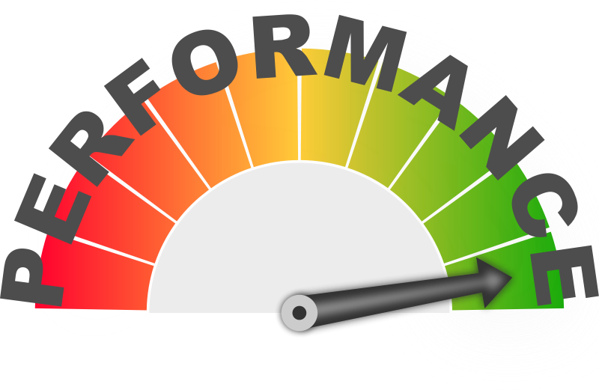
Introduction and motivation
Browsers have implemented energy conserving measures for background tabs
Do these measures prevent these attacks. If not, how can they be circumvented
Notes:
All attacks presented benefit from background execution. Crypto currency miners or gray computing are more profitable, Browser based botnets have longer control over browsers, side channels can continously monitor user activity / memory
HOWEVER, Browsers implemented throttling mechanisms for energy efficiency reasons

Slide 7
Javascript execution model

Slide 8
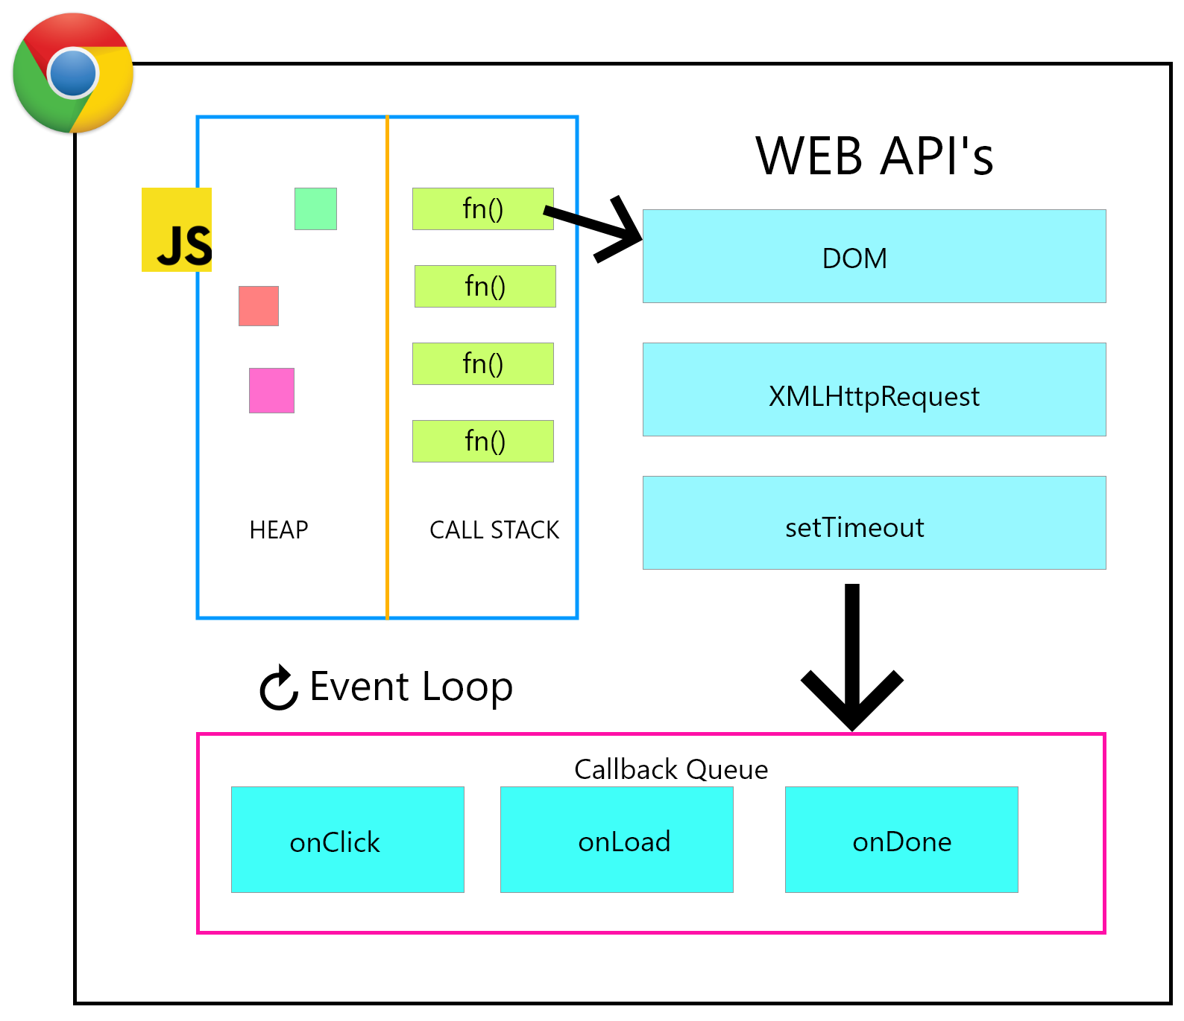
JavaScript execution model
One execution context per window and origin
Event loop executes tasks from task queue
Tasks are created in response to events
Tasks execution happens in serial
Image from freeCodeCamp
Notes:
Each window has it‘s own execution context. Execution context consist of heap memory and global object.
Each exeuction context has an event loop
Event loop executes tasks added to the task queue. Tasks can be added by registering for events (e.g. button was clicked, form was submitted) or by execution long running tasks (e.g. network request, geolocation, etc.)
Tasks are executed in a serial manner. No two tasks run at the same time.

Slide 9
Analysis of browser behaviours

Slide 10
Objectives
Which methods exist to schedule tasks programmatically
Do browser implementations throttle or limit the methods in the background
How do browser implementations differ with respect to their throttling behaviour
We consider Chrome, Firefox and Safari for desktop and Chrome for Android, Firefox for Android and Mobile Safari for mobile

Slide 11
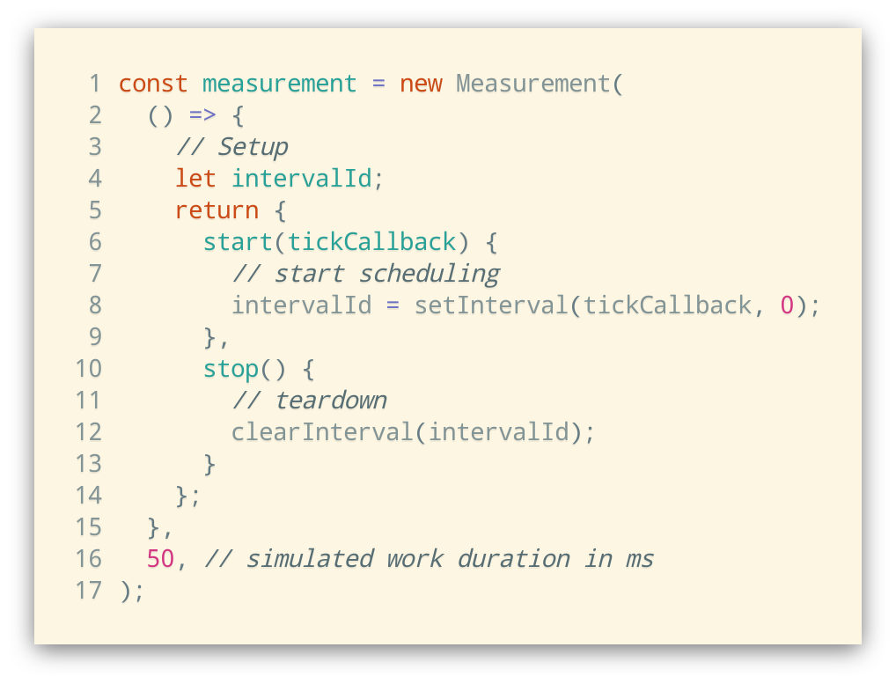
Measurement framework
Framework for measuring and comparison of scheduling methods
Simulates work load
Collects time between invocations
Calculates average CPU usage
Creates visualization and CSV export for processing

Slide 12
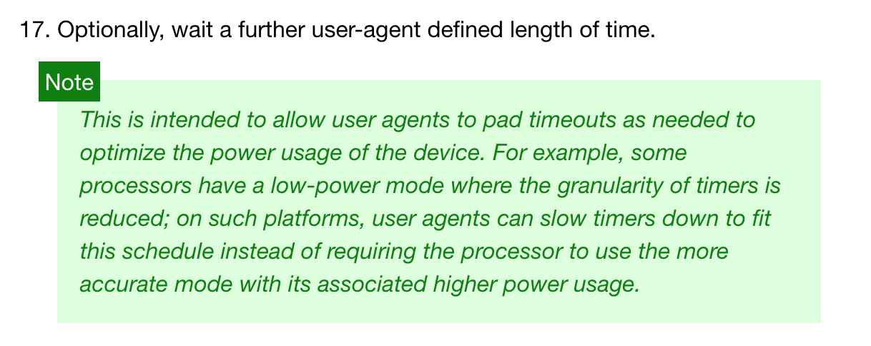
Timer tasks
window.setInterval() and window.setTimeout()
HTML5 Specification: Timers
Notes:
The most straightforward way to add tasks to the task queue programmatically via setInterval or setTimeout()
This method is throttled by all browser implementations for energy efficiency reasons
Specification defines that user agent can wait for additional time. Minumum is 4ms

Slide 13
Timer tasks
50 ms workload
1000 ms workload
Chrome and Firefox limit invocations to once a per second
Chrome and Firefox use budget-based throttling
Safari timers waiting time increases exponentially
Notes:
Chrome begins throttling after 10 seconds. After that, budget based throttling kicks in limiting to 1% of CPU time on average
Firefox waits additional second before next invocation => 50% cpu usage. After 30 seconds,

Slide 14
Timer tasks with WebSocket or AudioContext
Browsers try to keep backward-compatibility
Heuristics to determine if web page needs additional execution time
WebSocket connection is active
AudioContext was created and is active
Both APIs are invisible to the web site visitor
How does throttling change when using a WebSocket or AudioContext?
Notes:
WebSocket:
Bidirectional communication channel
Used for realtime notifications or communication
AudioContext:
Audio routing graph for usage with Canvas or WebGL
Play sound in response to events

Slide 15
Timer tasks with WebSocket
50 ms workload
1000 ms workload
Budget based throttling disabled in Chrome and Firefox
Safaris behaviour does not change

Slide 16
postMessage() tasks
postMessage() provides safe cross-origin communication
Allows communication between web site and iframe
Allows communication between web site and web worker
Can also be used to send messages to own window
Receiving a message schedules a task in task queue

Slide 17
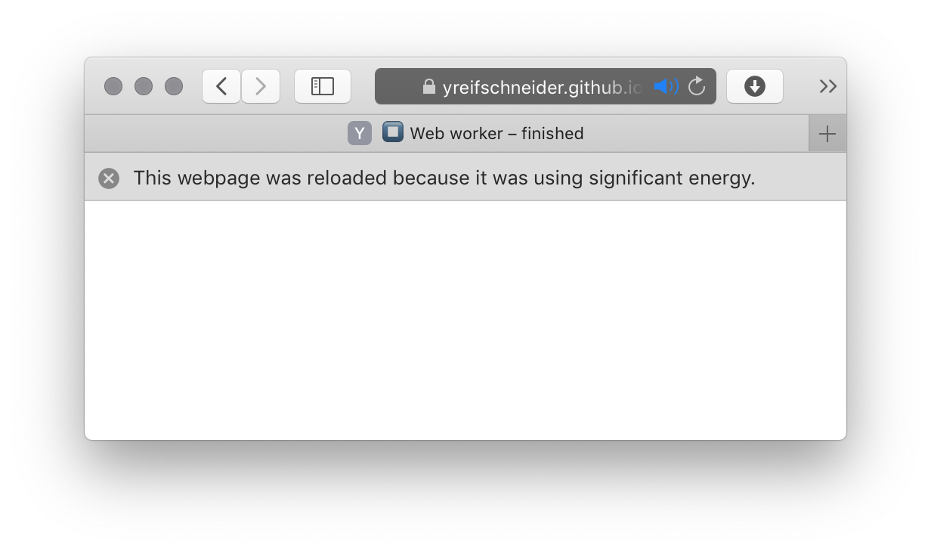
postMessage() tasks
Usage of postMessage() to create tasks allows full saturation of main thread
No throttling or limits active
Works in all browsers
Only Safari detects high energy usage and kills tab after ~8 minutes
Notes:
No graphs, because they would look boring with a straight line from left to right

Slide 18
Web worker timer tasks
Web workers spawn seperate execution context
Communication with web site via messages
Introduced to allow long running computations without blocking browser rendering
worker-timers is a drop-in replacement for setInterval() and setTimeout() implementing a scheduler in a web worker context
Notes:
Worker timers calls main thread via post message when the timer is scheduled to fire

Slide 19
Web worker timer tasks
Usage of worker-timers allows full saturation of main thread
No throttling or limits active
Works in all browsers
Only Safari detects high energy usage and kills tab after ~8 minutes
Notes:
Again, same results as for postmessage calls. Because it partly uses the same API (postmessage) But finer control when timers fire, because timers in web worker context are not throttled or otherwise limited

Slide 20
Summary
Method | Chrome | Firefox | Safari
Timer tasks | Max. 1 Hz Budget-based throttling to 1% avg. CPU usage after 10 secs | Max. 1 Hz Budget-based throttling to 1% avg. CPU usage after 30 secs Budget is clamped to [50ms, -150ms] | Starts at 1 Hz and decreases exponentially to 0.0055 Hz (3 minutes)
Timer tasks with AudioContext / WebSocket | Max. 1 Hz | Max 1 Hz | See above
postMessage() | No limits | No limits | No limits, but detects high energy usage
Web worker | See above | See above | See above

Slide 21
Summary
Mobile browsers

Slide 22
Summary
Do browser throttling measures prevent malicous CPU usage?
Browser throttling can be circumvented
Chrome and Firefox impose no limits to CPU activity
Safari stops after ~ 8 minutes of high energy usage

Slide 23
Dynamic analysis of popular websites
Notes:
With these findings, we wanted to find out if these circumvention techniques are used by popular websites
We did not try to find out, WHAT they do, but rather then IF they circumvent the browser throttling mechanisms

Slide 24
Tracing
List of ~ 1500 popular web sites
Puppeteer to remote control Chrome browser
Based on Chrome DevTools Protocol
Allows usage of internal Chrome profiling tools
Hook function calls to record WebSockets connections, postMessage() calls and Web Worker creation
Record events for web page for 15 minutes
Outputs an event trace file
Notes:
This trace file can be analysed with Chrome profiler to see what the web site is doing including a flame graph and call stack

Slide 25
Processing
How to calculate scores

Slide 26
Analysis
This is the result of our analysis

Slide 27
Discussion

Slide 28
Discussion

