Slide 1
Analysis of Methods for Background Execution in Modern Web Applications
Analyse von Verfahren für Hintergrundausführung in modernen Webanwendungen
Bachelors thesis from
Yannick Reifschneider

Slide 2
Agenda
Introduction and motivation
Background information
Analysis of browser behaviour
Dynamic analysis of popular web sites
Discussion and Conclusion

Slide 3
Introduction and motivation

Slide 4








Introduction and motivation
Notes:
The world wide web is nowadays used for much more then just static publishing
On this slide you see some example applications which run in the browser.
These are primarily made possible by the powerful scripting capabilities of modern browsers.
They allow to use JavaScript to execute code on the client in addition to performing calculations on the server
This opened the possiblity to use the browser as a platform for rich client side apps. But every web site has the same capabilites as these rich apps. And many web sites execute client side JavaScript code when they are visited.
This is a reason why the web is a lucrative target for malicious entities if they can gain script execution on a heavy traficked web site.
Somd ways to gain code execution on web site might be Cross-Site-Scripting or MitM attacks or Malvertising

Slide 5

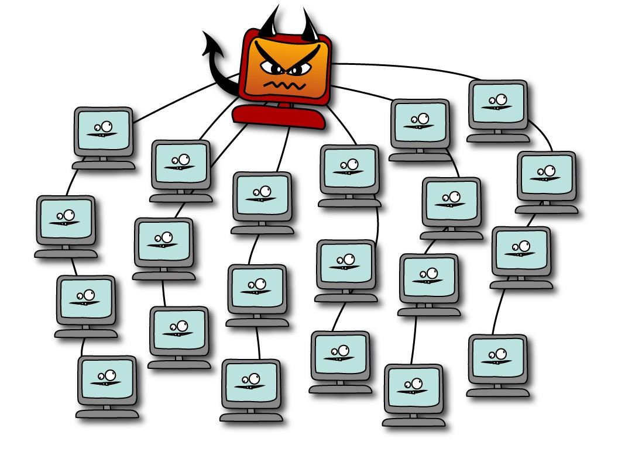
Introduction and motivation
Crypto currency miners
Browser-based botnet (Grossmann et al. 2013)
Hash cracking
DDoS
Gray computing (Yao Pan et al. 2015)
Side or covert channels
Website fingerprinting
Information leakage from other web sites (Spectre)
Image by Erin Gallagher @3r1nG
Notes:
Following are some examples of malicious activities which an adversary can perform after gaining script injection in a heavy traficked web site
Cryptocurrency Mining is the act of using computing power to earn crypto currency. Monero is a crypto currency which is suitable for browser based mining, because the computing algorithm required to earn currency is optimized for CPUs. (High memory usage makes it improfitable for Asics or GPUs) Miners, this is how the software which computes the currency is called, for Monero implemented with web technologies are freely available
The browser can become part of a botnet as described by Grossmann et al. Communication with the Command and control server is done via HTTP or WebSocket connection.
Grey computing as termed by Yao Pan et al uses CPU resources from visitors as alternative to cloud based computing resources for batch processing.
Side or covert channels allow the adversaries to gain more information about the vicitims computing activities. Side channels can be used for web site fingerprinting i.e. detect which other web sites a user is visiting in the same browser session. Spectre-like attacks allow the attacker to exfiltrade sensitive information from other web sites for example banking information.
All of these attacks benefit from a long timespan in which they can execute code

Slide 6
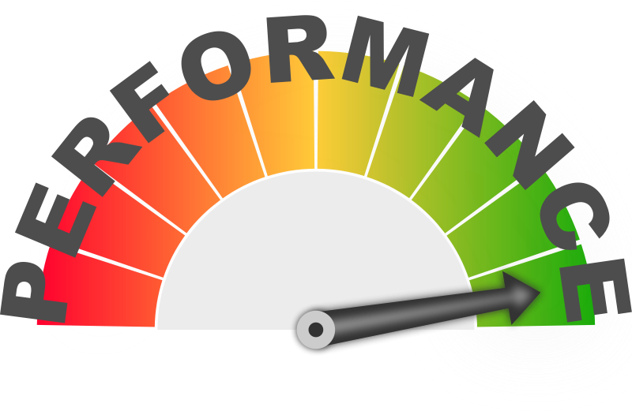
Introduction and motivation
Browsers have implemented energy conserving measures for background tabs
Do these measures prevent malicous background execution attacks? If yes, can they be circumvented?
Notes:
They would therefore also greatly benefit from background execution, whereby we define background execution as JavaScript code execution when the web site tab is not the selected browser tab. Because web site tabs are often times left open in other tabs for longer timespsns.
HOWEVER, Browsers implemented throttling mechanisms for energy efficiency reasons for background tabs.
So the question arises...

Slide 7
Background information
Notes:
To understand how scripts can execute code in JavaScript, we have to understand the JavaScript code execution model:

Slide 8
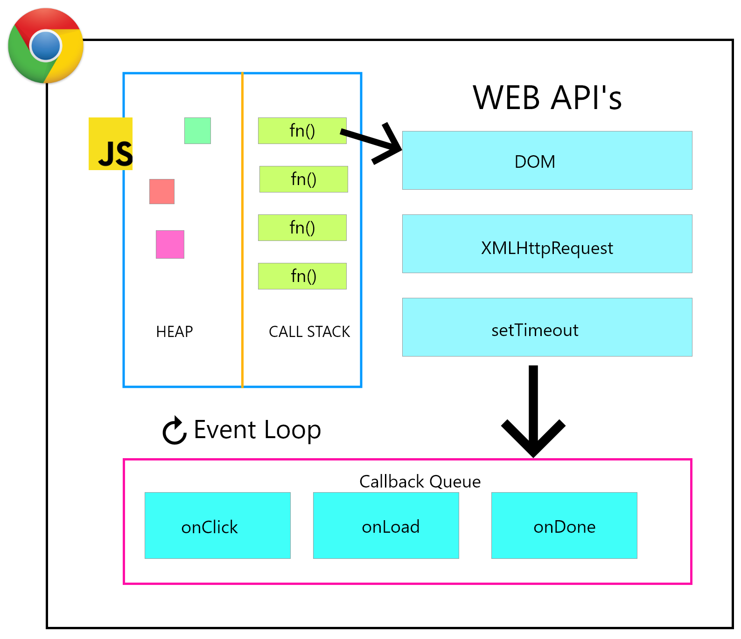
JavaScript execution model
One execution context per window and origin
Event loop executes tasks from task queue
Tasks are created in response to events
Tasks execution happens in serial order
Tasks create a frame in the call stack
Image from freeCodeCamp
Notes:
Each browser window forms an execution context. Execution context consist of heap memory and global object. Represented by the black rectangle.
Each exeuction context has an event loop represented by the purple rectangle. The event loop executes tasks added to the task queue. Tasks can be added by registering for events (e.g. button was clicked, an images was loaded, form was submitted) or from responses from asynchronous operations (e.g. network request, geolocation lookup, etc.)
Tasks are executed in a serial manner. That means, that no two tasks run at the same time. This ensures the single threaded semantic of JavaScript. When a task is executed it is removed from the tasks queue and creates a call stack frame. Every function call creates an additional call stack. When the function returns, the call stack is removed. When the call stack is empty the task execution finished.
To achieve background execution we have to find a way to allow repeated scheduling of tasks without user interaction. It is not enough to schedlune one task and run it in an endless loop, because that behaviour will block the rendering even if the web site is not visible and the browser would either warn the user that the site became unresponsive.

Slide 9
Analysis of browser behaviour

Slide 10
Research questions
Which methods exist to schedule tasks programmatically?
Are some of these methods throttled or limited by browsers to conserve energy?
How do the throttles and limits differ in in regards to the methods or between different browsers
We analysed the behaviour of the following browsers:
Chrome 76
Firefox 68
Safari 12.1.2
Chrome for Android 76
Firefox for Android 68
Mobile Safari in iOS 12.4.1

Slide 11
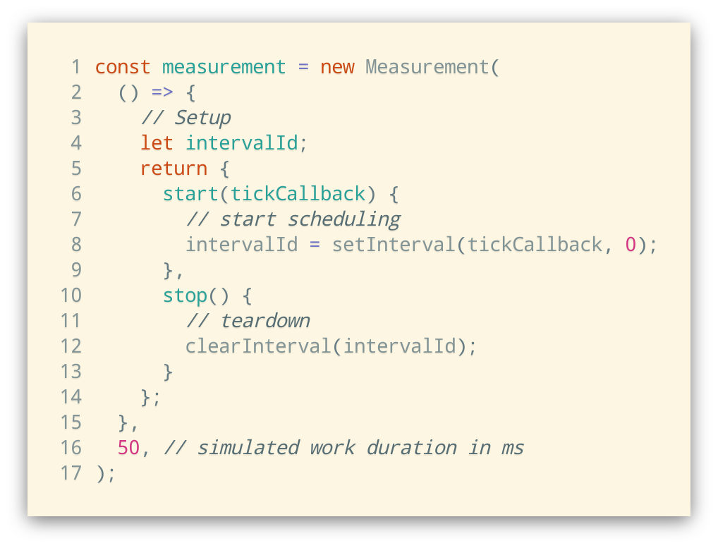
Measurement framework
Framework for measurment and comparison of scheduling methods:
simulates work load
collects time between invocations
calculates average CPU usage
creates visualization and CSV export for processing
Example use of measurement framework
Notes:
To answer the research questions we developed an extensible framework for measurement and comparison of different methods for scheduling tasks. The framework handles the following actions....
This example code demonstrates how the framework can be used for one test case.
Perform necessary setup for the method
Provide a start function which is automatically called by the framework when the browser tab is moved to the background. In this function your method should start repeatedly scheduling the tickCallback function which is provided as argument.
Provide a stop function to stop the scheduling and perform cleanup
You define the simulated working time in milliseconds as second parameter. This is the duration of the simulated workload performed by tickCallback function. This duration is variable to see if browser throttling changes to different task durations
When this code is executed in a browser, the framework starts the measurement automatically when the tab is in the background and creates a visualization of the recording when the tab is in foreground again.

Slide 12
Identified methods
Timers
Timers with open WebSocket connection
postMessage()
Web worker timers
Notes:
We identified the following methods for scheduling tasks without user interaction with different behaviour of the browsers

Slide 13
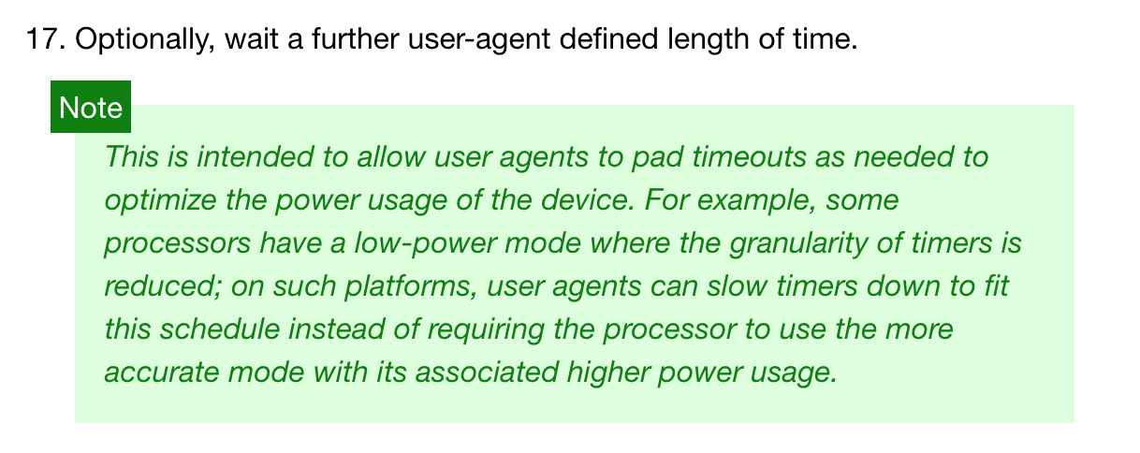
Method 1: Timers
window.setInterval() and window.setTimeout()
HTML5 Specification: Timers
Notes:
The trivial way to schedule tasks to the task queue programmatically is via setInterval or setTimeout(). They are the documented functions to do exactly that and exist solely for that reason.
However
This is an except from the specification of timers. This is a manual how to implement timers in a standard compliant way. Step 17 says that user agents are free to wait additional time for energy efficiency reasons.

Slide 14
Method 1: Timers – Results
50 ms workload
1000 ms workload
Chrome and Firefox limit invocations to once a per second
Chrome and Firefox use budget-based throttling
Safari: waiting time increases exponentially
Notes:
These graphs are the result of the measurement framework. The graph on the left shows the average CPU load over time for 50ms work duration, the graph on the right shows the same for 1000ms work duration. This is the second parameter for measurement framework.
Chrome and Firefox limit invocations of task to once per second when in the background. Peaks on the left are created because Chrome executes multiple tasks right after each other once a second before waiting the next second. Firefox waits after each single task invocation for one second. That is also show on the right side with Firefox being constantly at 50% cpu usage for the first 30 seconds.
You can see on the right graph that Chrome begins throttling after 10 seconds. Firefox begins after 30 seconds. After that, budget based throttling kicks.
What is Budget based throttling: Chrome and Firefox implemented this throttling mechanisms to limit average CPU usage of background tasks,
Each window receives a virtual time budget. The task duration is substracted from the budget. If the budget is negative. The tasks will not be executed but have to wait before the budget is positive again. The budget replenishes with a rate of 0.01seconds/second. This equals to an average of 1% of CPU usage. Firefox shows
Safari uses a different approach where each invocation has to wait longer. This waiting time increases exponentially until a maximum of 3 minutes after each task.

Slide 15
Method 2: Timers with open WebSocket
Browsers try to keep backward-compatibility
Heuristics to determine if web page needs additional execution time
WebSocket connection is active
AudioContext was created
WebSocket connection is invisible to the web site visitor
How does throttling change when using a WebSocket?
Notes:
Going to the next method which is a variation of the first method.
You might ask why a web socket connection makes a difference for the throttling behaviour of the browser.
WebSocket:
Bidirectional communication channel
Used for realtime notifications or communication. For example in a chat or messenger application.
AudioContext:
Audio routing graph for usage with Canvas or WebGL
Play sound in response to events

Slide 16
Method 2: Timers with open WebSocket – Results
50 ms workload
1000 ms workload
Budget based throttling disabled in Chrome and Firefox
Safaris behaviour does not change
Notes:
So if we open a websocket connection and then schedule an interval time, this is the result.
You might see some differences to the last graphs.
Still timers are only invoked at most once per second.

Slide 17
Method 3: postMessage()
postMessage() provides safe cross-origin communication
Allows communication between web site and iframe
Allows communication between web site and web worker
Can also be used to send messages to own window
Receiving a message schedules a task in task queue

Slide 18
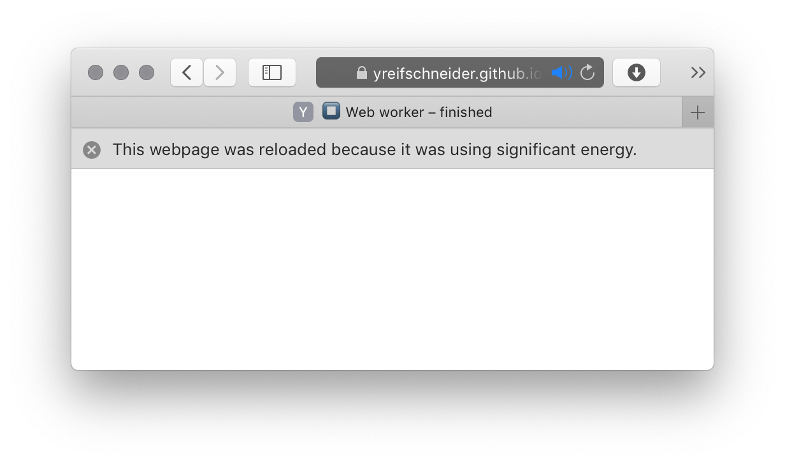
Method 3: postMessage() – Results
Usage of postMessage() to create tasks allows 100% average CPU usage
No throttling or limits active
Works in desktop browsers
Only Safari detects high energy usage and kills tab after ~8 minutes
Notes:
No graphs, because they would look boring with a straight line from left to right
100% does not mean all cores of for example a quad core CPU but only one core is used for 100%.

Slide 19
Method 4: Web worker timers
Introduced to allow long running computations without blocking browser rendering
Web workers spawn seperate execution context
Communication with web site via messages
Notes:
If you remeber, I explained that tasks are killed or stopped when they run for along time. Web workers are a solution to that. They allow tasks to run for longer times.
Execution context of web workers is not tied to the browser rendering.
They also have timers and they can communicate with the main execution context by passing messages.

Slide 20
Method 4: Web worker timers – Results
Usage of worker-timers allows full saturation of main thread
No throttling or limits active
Works in all browsers
Only Safari detects high energy usage and kills tab after ~8 minutes
Notes:
Results are the same as for postmessage tasks.
But web workers allow to use even more then one CPU core, because multiple instances of the worker could be spawned.

Slide 21
Summary for desktop browsers
Method | Chrome | Firefox | Safari
Timer | Tasks executed once per second Budget-based throttling to 1% avg. CPU usage after 10 secs | Max. 1 Hz Budget-based throttling to 1% avg. CPU usage after 30 secs Budget is clamped to [50ms, -150ms] | Starts at 1 Hz and decreases exponentially to 0.0055 Hz (3 minutes)
Timer with AudioContext / WebSocket | Tasks executed once per second | Max 1 Hz | See above
postMessage() | No limits | No limits | No limits, but detects high energy usage
Web worker | No limits | No limits | See above
Notes:
To summarize here are the results of our research in tabular form
Firefox and Chrome behave kind of similar. Chrome coalesces tasks to execute once per second. Firefox limits them to only one invocation per second. Both use a budget based throttling. Firefox budget has a minimum and maximum value.
Safari uses an expentially increasing waiting time for tasks resulting in a much faster drop in CPU usage for background pages.

Slide 22
Summary for mobile browsers
Chrome for Android stops task execution after 5 minutes
Firefox for Android has no visible change in behaviour to desktop counterpart
Mobile Safari completely suspends all tasks
Notes:
I omitted the results of the mobile browsers, because they are similar to their desktop counterparts except for the following differences.

Slide 23
Summary
Do browser throttling measures prevent malicous CPU usage?
Browser throttling can be circumvented
Chrome and Firefox impose no limits to CPU activity
Safari stops after ~ 8 minutes of high energy usage
Notes:
Coming back to our initial research question.
We found out that ....

Slide 24
Dynamic analysis of popular websites
Notes:
With these findings, we wanted to find out if these circumvention techniques are used by popular websites

Slide 25
Tracing process
Uses a list of ~ 1500 popular web sites
Uses Puppeteer to remote control Chrome instance
Allows usage of internal Chrome profiling tools
Hooks function calls to monitor WebSockets connections, postMessage() calls and Web Worker creation
Records events for web page for 15 minutes
Outputs an event trace file
Notes:
For that we developed an automated tracing process. This process consists of the following steps...
Hooking allows to detect if the web site uses a method we identified in the previous section.

Slide 26
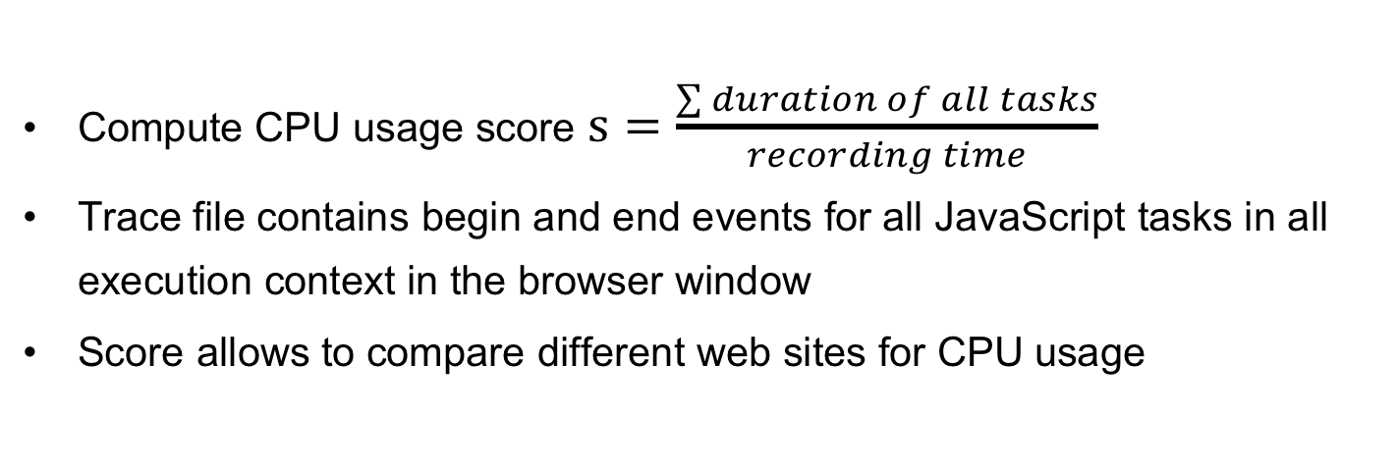
Processing
How to compare traces of different web sites?
Compare average CPU usage caused by scripting
Compute CPU usage score $s=\frac{\sum{duration of all tasks}}{recording time}$
Trace file contains begin and end events for all JavaScript tasks in all execution context in the browser window
Score allows to compare different web sites for CPU usage
Notes:
Now that we have a list of 1500 trace files. What can we do with them and how do we compare them.
Kind of similar to the research we did for analysing the methods.
We built a postprocessing pipeline which calculates the scores for each web site

Slide 27
Distribution of CPU usage score
All traces web sites
Only web sites with at least one circumvention technique
Notes:
Here we can see the distribition of the CPU usage score for all traced web sites
The majority of web sites use less then 1% avg CPU usage during the complete recording
If we only consider web sites which were monitored to use at least one method to circumvent throttling then we see this distribution.
Note that these two graphics have different Y-Axes
Most web sites with higher scores are present in the second distribution graph. This indicates that these methods are indeed responsible for removing the limitations and throttles in the browser

Slide 28
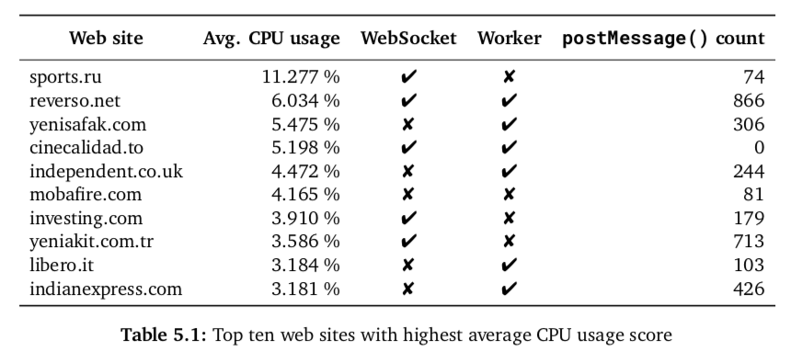
Analysis
Notes:
If we look closer to the top 10 web sites with with highest CPU activity during the recording we get this table from our processing pipeline
We can see, that all web sites use some method we identified
We have one outlier site is using much more CPU then rest.
We found no malicious web site
Heavy use of postmessage counts (for ad networks)
Ad Script injected in web site communicates with ads in iframe
Some news related web sites periodically reload to show current content. Resetting background budget limits

Slide 29
Discussion And conclusion
Notes:
So to wrap up

Slide 30
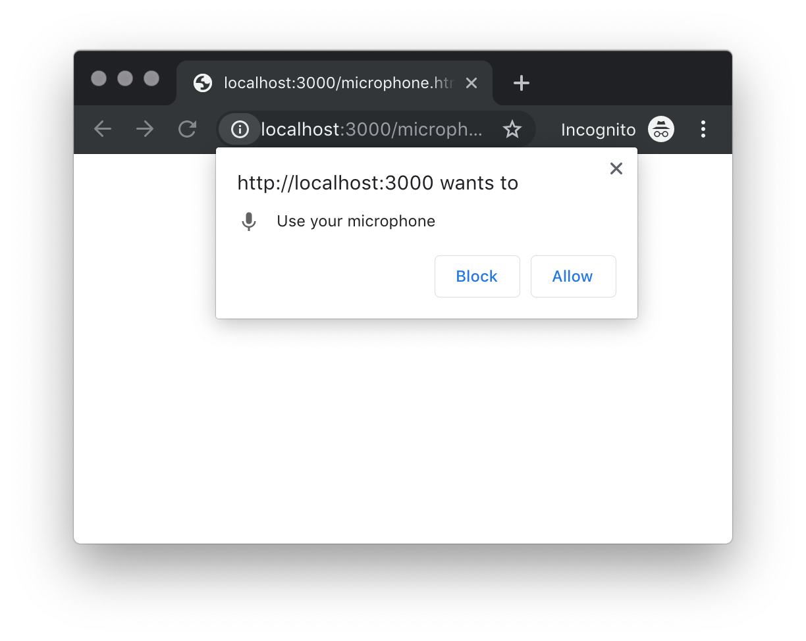
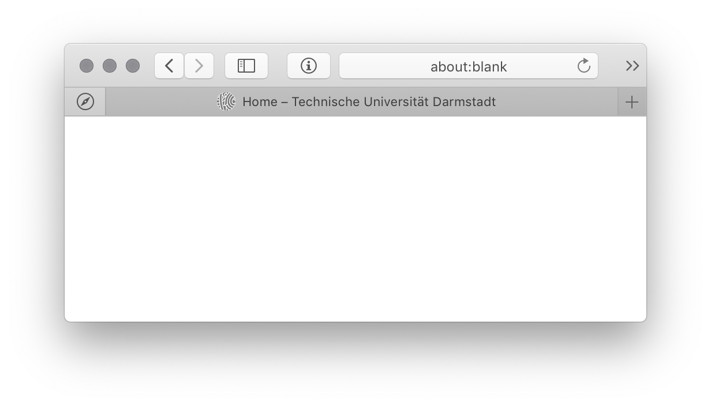
Discussion
How to prevent background execution without breaking legitimate use cases?
Proposals:
Explicit permission dialog
Give pinned tabs implicit permission
Notes:
So what are possible solutions to stop unwanted background execution while still allowing rich web apps with legitimate use cases. We advocate for suspending all background tabs completelty. To allow for legitimate use cases of background execution we propose two possible solutions:
Explicit permissions raises following questions:
Should users be asked for even more permissions. This can lead to dialog fatiguee and users blindly accepting every dialog they get shown
When should background execution permission dialog be shown. On first page load? This provides no context, why this page might need this permission. New API to request permission? Needs update to existing applications. On second or third time the user reopens the page might be a good compromise
Pinned tabs are used for web sites which behave more like traditional applications. Good contenders for a pinned tab might be Gmail or Slack were frequent access to these applications are needed during the browser session. These applications are the ones which might benefit the most from background execution. Combining this permission with pinned tabs makes sense in our opinion.

Slide 31
Conclusion
Malicious entities can abuse CPU resources from background tabs
Current browser throttling and limitations can be easily circumvented
Background tabs should be suspended completely unless given special permission
Thanks for your attention!
Notes:
To conclude the findings of our research:
...

