Slide 1
Analysis of Methods for Background Execution in Modern Web Applications
Analyse von Verfahren für Hintergrundausführung in modernen Webanwendungen
Bachelors thesis from
Yannick Reifschneider

Slide 2
Agenda
Introduction and motivation
Background information
Analysis of browser behaviour
Dynamic analysis of popular web sites
Discussion and Conclusion

Slide 3
Introduction and motivation

Slide 4








Introduction and motivation
Notes:
The world wide web is nowadays used for much more then just static publishing
On this slide you see some example applications which run in the browser.
These are primarily made possible by the powerful scripting capabilities of modern browsers.
They allow to use JavaScript to execute code on the client in addition to performing calculations on the server
This opened the possiblity to use the browser as a platform for rich client side apps. But every web site has the same capabilites as these rich apps. And many web sites execute client side JavaScript code when they are visited.
This is a reason why the web is a lucrative target for malicious entities if they can gain script execution on a heavy traficked web site.
Somd ways to gain code execution on web site might be Cross-Site-Scripting or MitM attacks or Malvertising

Slide 5

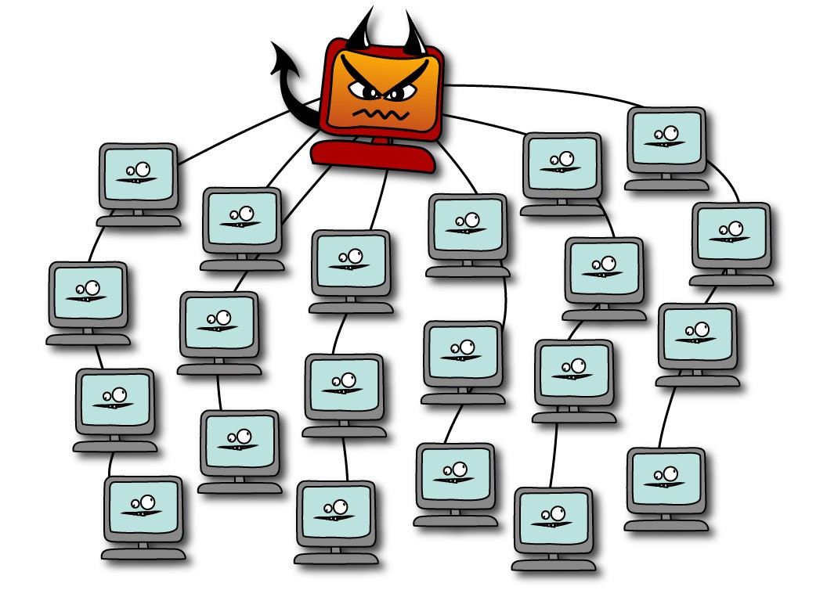
Introduction and motivation
Crypto currency miners
Browser-based botnet (Grossmann et al. 2013)
Hash cracking
DDoS
Gray computing (Yao Pan et al. 2015)
Side or covert channels
Website fingerprinting
Information leakage from other web sites (Spectre)
Image by Erin Gallagher @3r1nG
Notes:
Following are some examples of malicious activities which an adversary can perform after gaining script injection in a heavy traficked web site
Cryptocurrency Mining is the act of using computing power to earn crypto currency. Monero is a crypto currency which is suitable for browser based mining, because the computing algorithm required to earn currency is optimized for CPUs. (High memory usage makes it improfitable for Asics or GPUs) Monero Miners, this is how the software which computes the currency is called, implemented with web technologies are freely available
The browser can become part of a botnet as described by Grossmann et al. Communication with the Command and control server is done via HTTP or WebSocket connection.
Grey computing as termed by Yao Pan et al uses CPU resources from visitors as alternative to cloud based computing resources for batch processing.
Side or covert channels allow the adversaries to gain more information about the vicitims computing activities. Side channels can be used for web site fingerprinting i.e. detect which other web sites a user is visiting in the same browser session. Spectre-like attacks allow the attacker to exfiltrade sensitive information from other web sites for example banking information.
All of these attacks benefit from a long timespan in which they can execute code

Slide 6
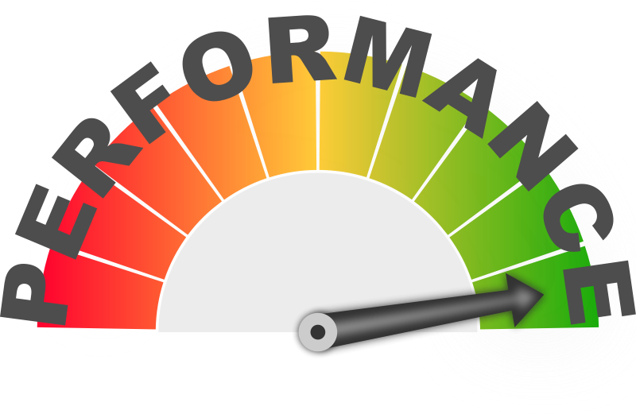
Introduction and motivation
Browsers have implemented energy conserving measures for background tabs
Do these measures prevent these attacks? If yes, how can they be circumvented?
Notes:
All attacks presented benefit from background execution. Crypto currency miners or gray computing are more profitable, Browser based botnets have longer control over browsers, side channels can continously monitor user activity / memory
HOWEVER, Browsers implemented throttling mechanisms for energy efficiency reasons

Slide 7
Background information

Slide 8
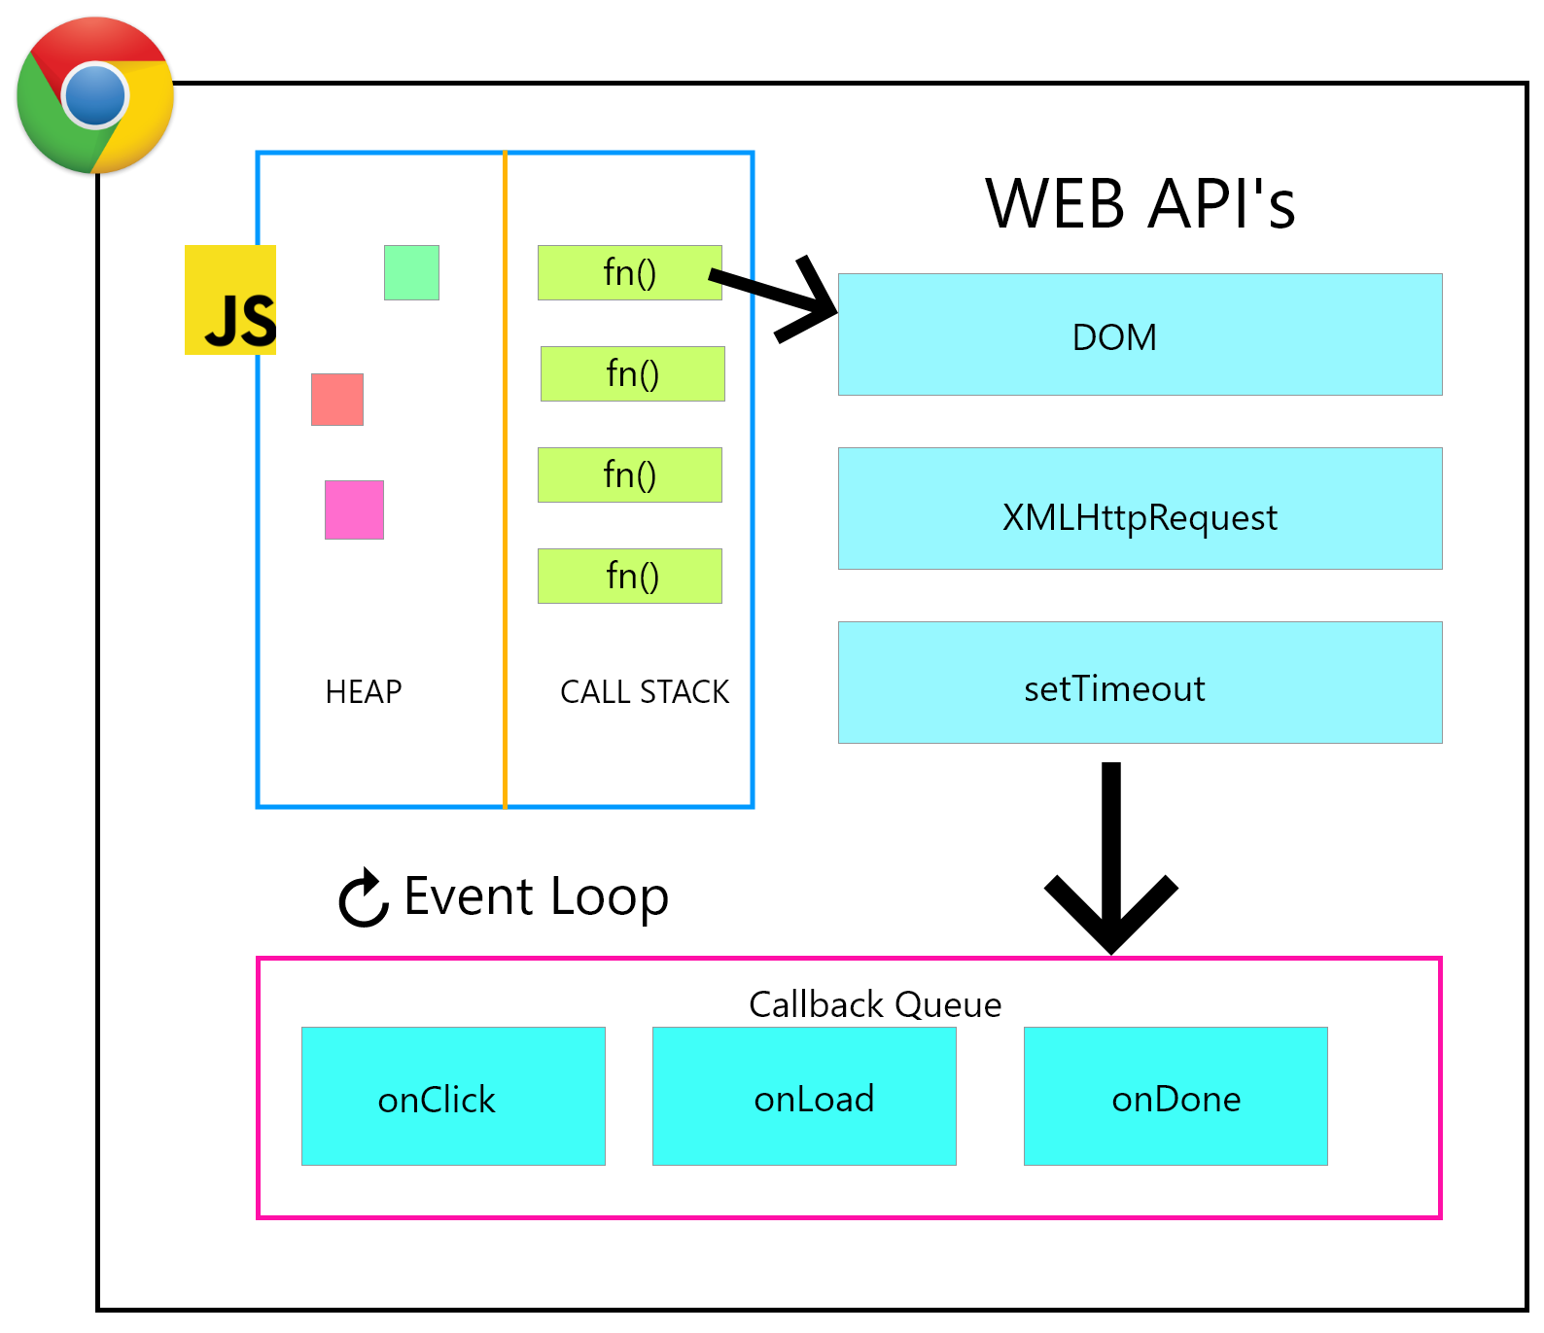
JavaScript execution model
One execution context per window and origin
Event loop executes tasks from task queue
Tasks are created in response to events
Tasks execution happens in serial order
Image from freeCodeCamp
Notes:
Each window has it‘s own execution context. Execution context consist of heap memory and global object.
Each exeuction context has an event loop
Event loop executes tasks added to the task queue. Tasks can be added by registering for events (e.g. button was clicked, form was submitted) or by execution long running tasks (e.g. network request, geolocation, etc.)
Tasks are executed in a serial manner. No two tasks run at the same time.

Slide 9
Analysis of browser behaviour

Slide 10
Research questions
Which methods exist to schedule tasks programmatically?
Do browser implementations throttle or limit the methods in the background?
How do browser implementations differ with respect to their throttling behaviour?
We consider Chrome, Firefox and Safari for desktop and Chrome for Android, Firefox for Android and Mobile Safari for mobile
Notes:
TODO: extend tested browsers

Slide 11
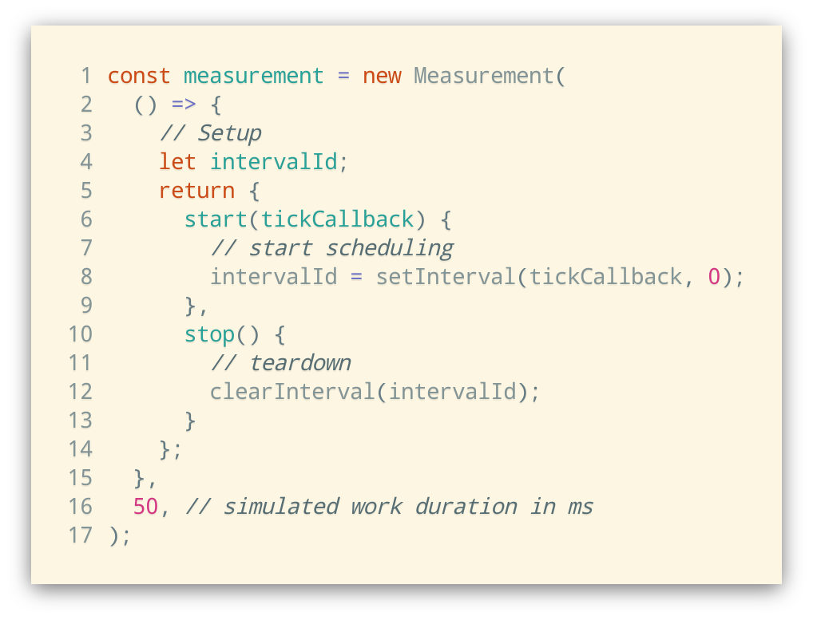
Measurement framework
Framework for measurment and comparison of scheduling methods:
simulates work load
collects time between invocations
calculates average CPU usage
creates visualization and CSV export for processing
Notes:
TODO: Add caption
Restructure code to add line breaks
It‘s an extensible framework

Slide 12
List of methods to programmatically

Slide 13
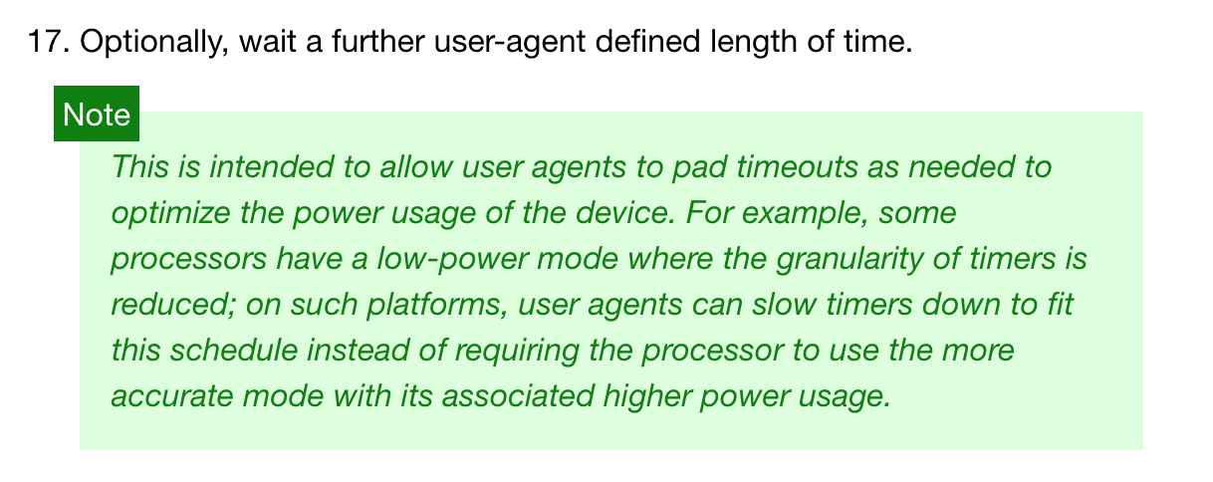
Timer tasks
window.setInterval() and window.setTimeout()
HTML5 Specification: Timers
Notes:
The most straightforward way to add tasks to the task queue programmatically via setInterval or setTimeout()
This method is throttled by all browser implementations for energy efficiency reasons
Specification defines that user agent can wait for additional time. Minumum is 4ms

Slide 14
Timer tasks
50 ms workload
1000 ms workload
Chrome and Firefox limit invocations to once a per second
Chrome and Firefox use budget-based throttling
Safari: waiting time increases exponentially
Notes:
Chrome begins throttling after 10 seconds. After that, budget based throttling kicks in limiting to 1% of CPU time on average
DESCRIBE BUDGET BASED-Throttling
Firefox waits additional second before next invocation => 50% cpu usage. After 30 seconds,

Slide 15
Timer tasks with WebSocket or AudioContext
Browsers try to keep backward-compatibility
Heuristics to determine if web page needs additional execution time
WebSocket connection is active
AudioContext was created and is active
Both APIs are invisible to the web site visitor
How does throttling change when using a WebSocket or AudioContext?
Notes:
WebSocket:
Bidirectional communication channel
Used for realtime notifications or communication
AudioContext:
Audio routing graph for usage with Canvas or WebGL
Play sound in response to events

Slide 16
Timer tasks with WebSocket
50 ms workload
1000 ms workload
Budget based throttling disabled in Chrome and Firefox
Safaris behaviour does not change

Slide 17
postMessage() tasks
postMessage() provides safe cross-origin communication
Allows communication between web site and iframe
Allows communication between web site and web worker
Can also be used to send messages to own window
Receiving a message schedules a task in task queue

Slide 18
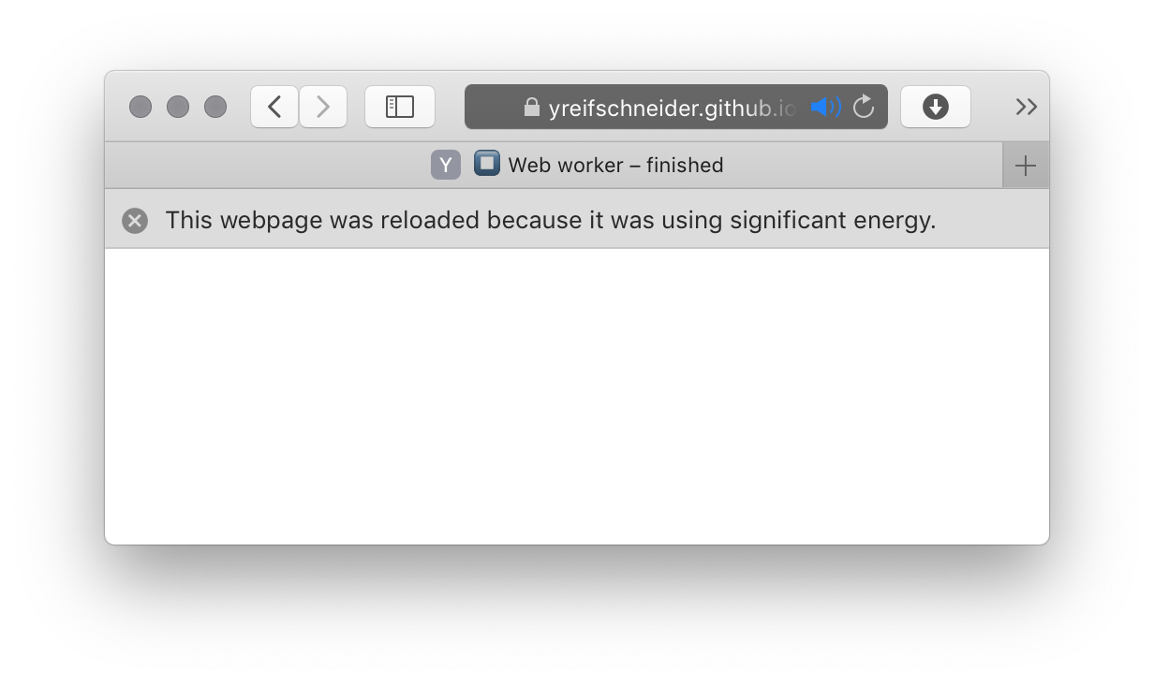
postMessage() tasks
Usage of postMessage() to create tasks allows full saturation of main thread
No throttling or limits active
Works in all browsers
Only Safari detects high energy usage and kills tab after ~8 minutes
Notes:
No graphs, because they would look boring with a straight line from left to right

Slide 19
Web worker timer tasks
Web workers spawn seperate execution context
Communication with web site via messages
Introduced to allow long running computations without blocking browser rendering
Notes:
Worker timers calls main thread via post message when the timer is scheduled to fire

Slide 20
Web worker timer tasks
Usage of worker-timers allows full saturation of main thread
No throttling or limits active
Works in all browsers
Only Safari detects high energy usage and kills tab after ~8 minutes
Notes:
Again, same results as for postmessage calls. Because it partly uses the same API (postmessage) But finer control when timers fire, because timers in web worker context are not throttled or otherwise limited
Replace full saturation with up

Slide 21
Summary for desktop browsers
Method | Chrome | Firefox | Safari
Timer | Max. 1 Hz Budget-based throttling to 1% avg. CPU usage after 10 secs | Max. 1 Hz Budget-based throttling to 1% avg. CPU usage after 30 secs Budget is clamped to [50ms, -150ms] | Starts at 1 Hz and decreases exponentially to 0.0055 Hz (3 minutes)
Timer with AudioContext / WebSocket | Max. 1 Hz | Max 1 Hz | See above
postMessage() | No limits | No limits | No limits, but detects high energy usage
Web worker | No limits | No limits | See above

Slide 22
Summary for mobile browsers
Chrome for Android limits all task execution to 5 minutes after moving to background
Mobile Safari completely suspends all tasks after moving to background
Firefox for Android had no visible change in behaviour to desktop counterpart
Notes:
TODO: shorten sentences

Slide 23
Summary
Do browser throttling measures prevent malicous CPU usage?
Browser throttling can be circumvented
Chrome and Firefox impose no limits to CPU activity
Safari stops after ~ 8 minutes of high energy usage
Notes:
Integrate mobile browsers results here

Slide 24
Dynamic analysis of popular websites
Notes:
With these findings, we wanted to find out if these circumvention techniques are used by popular websites
We did not try to find out, WHAT they do, but rather then IF they circumvent the browser throttling mechanisms

Slide 25
Tracing process
Use list of ~ 1500 popular web sites
Use Puppeteer to remote control Chrome browser
Allows usage of internal Chrome profiling tools
Hook function calls to monitor WebSockets connections, postMessage() calls and Web Worker creation
Record events for web page for 15 minutes
Output an event trace file
Notes:
This trace file can be analysed with Chrome profiler to see what the web site is doing including a flame graph and call stack

Slide 26
Processing
How to compare traces of different web sites?
Compare average CPU usage during recording
Trace file contains duration for JavaScript tasks in all execution context
Sum of duration of all tasks divided by recording time
For complete recording time
Only when web socket was opened
Only for web worker context
Score allows to compare different web sites for CPU usage
Notes:
Restucture, question => answer
TODO: Add pseude formular

Slide 27
Distribution of CPU usage score
All traces web sites
Only web sites with at least one circumvention technique
Notes:
Most of the web sites with higher scores are shown in second distribution as well indicating that these methods are indeed responsible for higher CPU activity

Slide 28
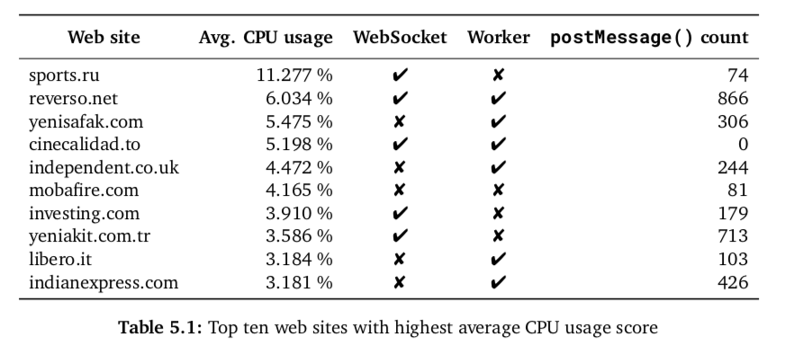
Analysis
Notes:
All web sites use some method we described
One site is using much more CPU then rest
We found no malicious web site
Heavy use of postmessage counts (for ad networks)
Ad Script injected in web site communicates with ads in iframe
Some news related web sites periodically reload to show current content. Resetting background budget limits

Slide 29
Conclusion and Discussion

Slide 31
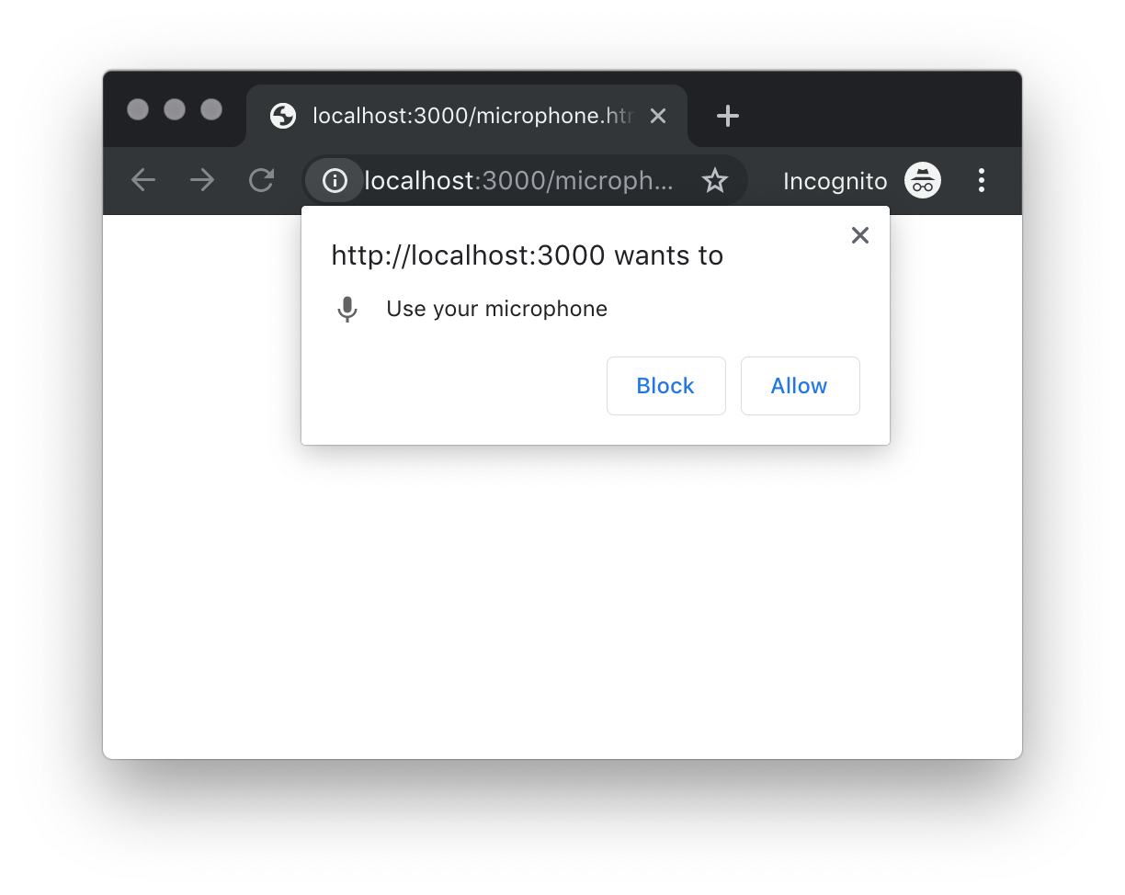
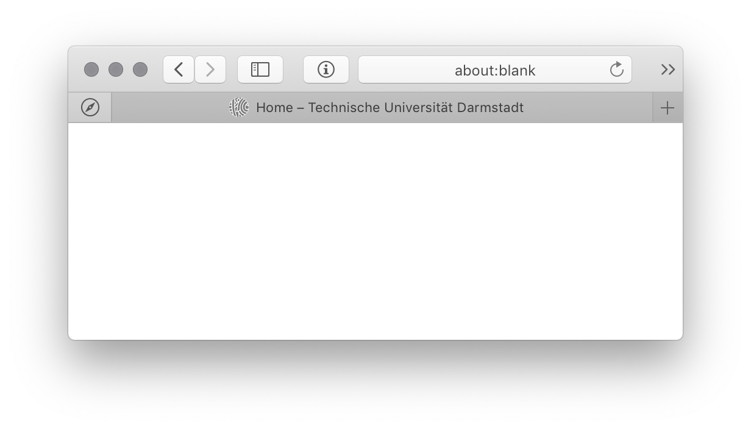
Discussion
How to prevent background execution without breaking legitimate use cases?
Proposals:
Explicit permission dialog
Pinned-Tab feature
Notes:
Explicit permissions raises following questions:
Should users be asked for even more permissions. This can lead to dialog fatiguee and users blindly accepting every dialog they get shown
When should background execution permission dialog be shown. On first page load? This provides no context, why this page might need background execution. New API to request permission? Needs update to existing applications. On second or third time the user reopens the page might be a good compromise
Pinned tabs are used for web sites which are used like applications. Good contenders might be for example Gmail or Slack which are open the whole time. These applications are the ones which might benefit the most from background execution. Combining this permission with pinned tabs might make sense.

Slide 32
Thanks for your Attention

