Slide 1
Analysis of Methods for Background Execution in Modern Web Applications
Analyse von Verfahren für Hintergrundausführung in modernen Webanwendungen

Slide 2
Agenda
Introduction and motivation
JavaScript execution model
Analysis of browser behaviours
Dynamic analysis of popular web sites

Slide 3
Introduction and motivation

Slide 4








Introduction and motivation
Notes:
Web apps are a popular alternative to traditional software
Browser is used to access web apps
Apps are often left open during computing activities
Web is a lucrative target for malicious entities to gain script execution
For example by XSS, MitM attacks, Malvertising

Slide 5

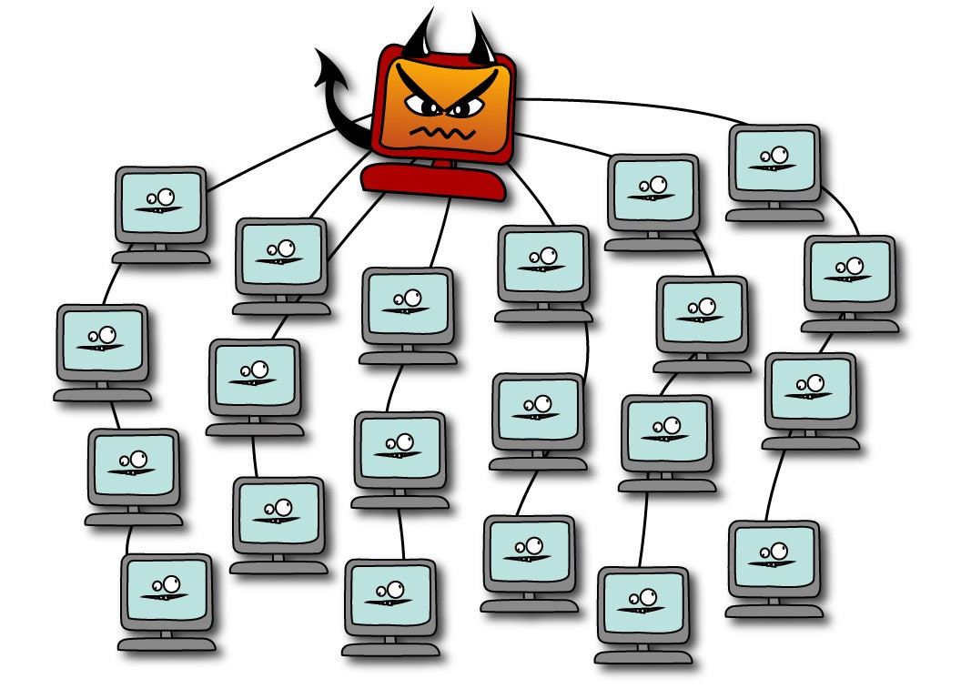
Introduction and motivation
Crypto currency miners
Browser-based botnet (Grossmann et al. 2013)
Hash cracking
DDoS
Gray computing (Yao Pan et al. 2015)
Side or covert channels
Website fingerprinting
Information leakage from other web sites (Spectre)
Image by Erin Gallagher @3r1nG
Notes:
Possible attacks if an adversary gains script exectution
Monero is a crypto currency with proof of work algorithm optimized for general purpose CPUs (High memory usage makes it improfitable for Asics or GPUs)
Miners implemented with web technologies are freely available
Web technologies can be used for a browser based botnet. Command and control server provides commands via HTTP or WebSocket connection
Grey computing uses CPU resources from visitors as alternative to cloud based computing resources for batch processing.
Side or covert channels allow adversaries to gain more information about the vicitims usage. Side channels can be used for web site fingerprinting or activity detection
Spectre attacks allow attackers to read memory of other web sites
In summary: script injection is a major attack vector

Slide 6

Introduction and motivation
Browsers have implemented energy conserving measures for background tabs
Do these measures prevent these attacks. If not, how can they be circumvented
Notes:
All attacks presented benefit from background execution. Crypto currency miners or gray computing are more profitable, Browser based botnets have longer control over browsers, side channels can continously monitor user activity / memory
HOWEVER, Browsers implemented throttling mechanisms for energy efficiency reasons

Slide 7
Javascript execution model

Slide 8
Event queue
Tasks
Single threaded

