Slide 1


Big Data Analytics SOEN 691 Dr. Tristan Glatard Winter 2020 Team ID 12 NBA Playoff Prediction
Ying Rao
Elie Dosh
Project Repo
https://github.com/skierwing/soen691_project_ed_yr.git

Slide 2
Outline
Part 1 | Part 2 | Part 3 | Part 4
Introduction | Machine learning libraries | Observation | Conclusion
Data preparation and analysis | Technical Details |  | Questions

Slide 3
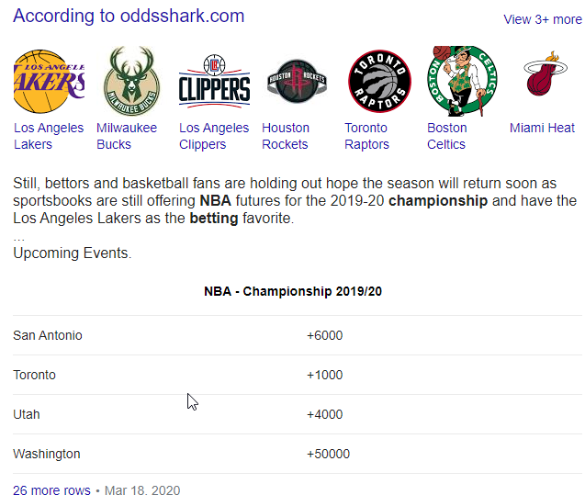
Introduction
The goal of the project is to predict if an NBA Team will make it to the playoff or NOT

Slide 4
Data preparation and analysis

Slide 5
Data preparation and analysis
Manually gather data from basketball-reference.com
Between Seasons 1980-2018
Analyzing the data:
Number of teams changed over the years 23, 27,29 and lately 30
Seasons 1980-1983 12 Teams 1984-2018 16 Teams to playoff
Each team plays different number of minutes in total
Used the Minutes Played field as common denominator for all Classifiers
Using Spark framework and the Dataframe Library to generate the dataset
Points_Per_minute | 3Points_Per_minute | 2Points_Per_minute | FThrow_Per_minute
Rebound_Per_minute | Assists_Per_minute | Steals_Per_minute | Blocks_Per_minute
TurnOvers_Per_minute
Playoff

Slide 6
Machine Learning Libraries
Technical Details

Slide 7
Machine Learning Libraries
Small Dataset
1074 records & 9 Classifiers
Decision to use Gaussian Naïve Bayes & SVM supervised learning models
Implemented “scikit-learn” library (Sklearn)
Used K-fold technique for training and testing

Slide 8
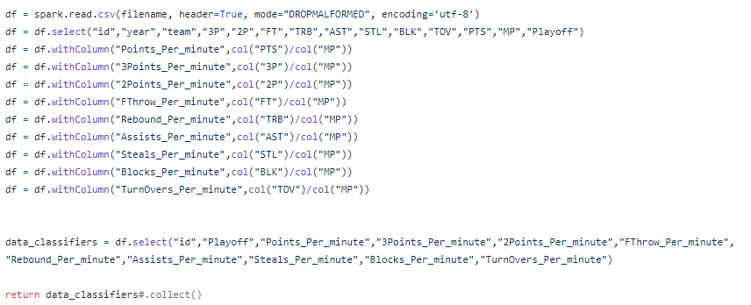
Technical Details
Data loading and pre-processing: Spark dataframe

Slide 9

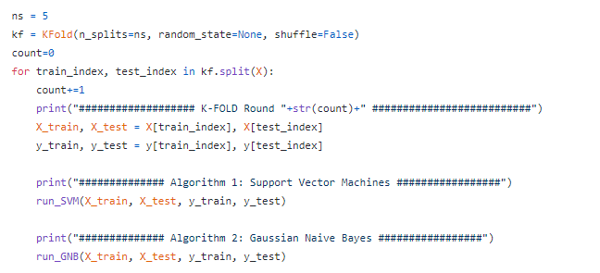
Technical Details
Split Data using K-fold: sklearn.model_selection
K-fold is a good cross-validation method that tackles overfitting or underfitting

Slide 10
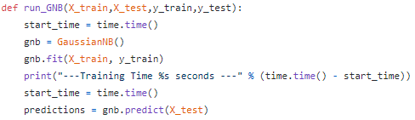
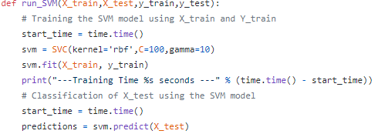
Technical Details
Data modeling and classification: scikit-learn
library: sklearn.naive_bayes GaussianNB and sklearn.svm SVC

Slide 11
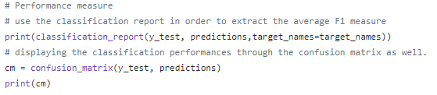
Technical Details
Performance evaluation: F1 score, confusion matrix
library: sklearn.metrics classification_report and sklearn.metrics confusion_matrix

Slide 12
Observation

Slide 13
Observation
Base on our chosen dataset and classifiers
Naïve Bayes Classifier was quicker during execution
SVM Classifier is better at predicting the Playoff
Average Precision : [SVM=0.734] > [GNB=0.694]
Average Recall : [SVM=0.704] > [GNB=0.622]
Average F1-Score : [SVM=0.698] > [GNB=0.574]
Results Explained

Slide 14
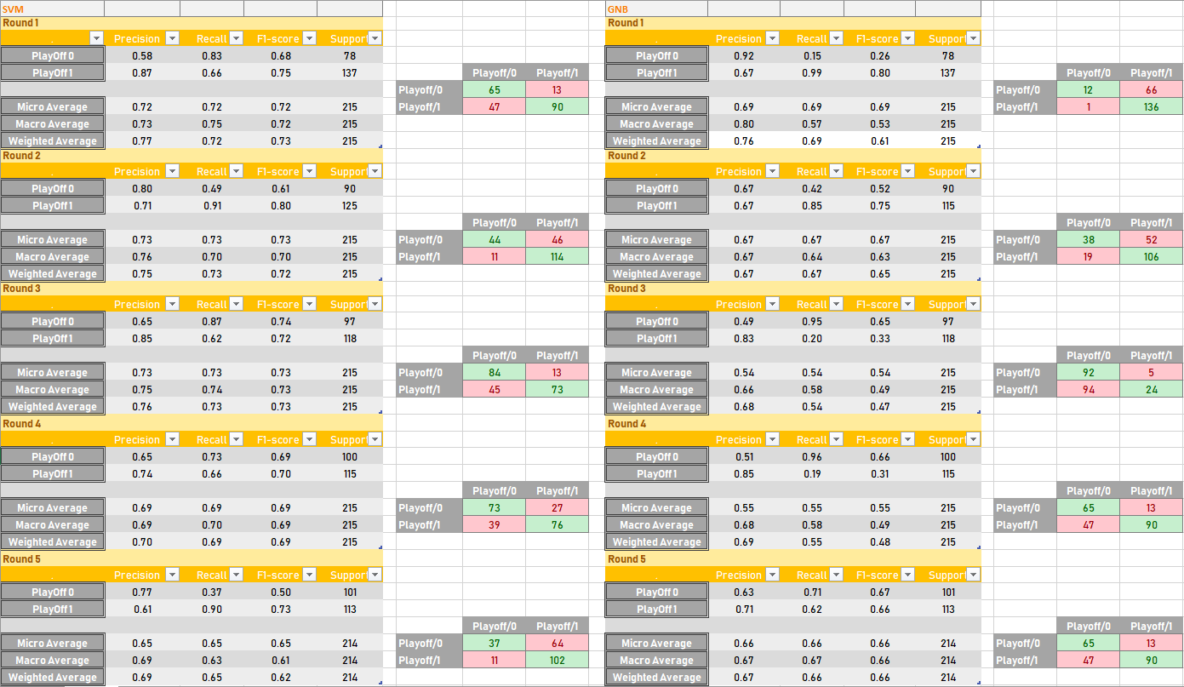
Results
Explained

Slide 15

Conclusion

Slide 16
Conclusion
Given our dataset
Gaussian Naïve Bayes performed the worst
SVM Decent for playoffs prediction [~70%]

Slide 17

Thank You

Slide 18
Questions?

Slide 19
References
Google
https://www.basketball-reference.com/leagues/
https://scikit-learn.org/stable/
https://muthu.co/understanding-the-classification-report-in-sklearn/
https://scikit-learn.org/stable/modules/generated/sklearn.metrics.precision_recall_fscore_support.html
https://scikit-learn.org/stable/modules/generated/sklearn.model_selection.KFold.html

